Slide 1
Strategies for Increasing Cultural Communication Competence
Anne F. Mattina, PhD Professor & Chair of Communication Stonehill College

Slide 2
Agenda
10:30 Introductions & Ice-breaker
10:45 Transactional Model of Communication
11:00 Co-Cultures
11:15 Hofstede’s Cultural Dimensions
11:30 Cultural Communication Competence
Self-monitoring scale
11:50 Small Group Case Study
Closing

Slide 3



The Transactional Nature of Communication
Roles/Rules
Roles/Rules
Roles/Rules
Context
Verbal & Non-verbal
Messages
Noise in the channel
Person B
field of experience
Person A
field of experience
Continual messaging

Slide 4


Co-Cultures
Dominant culture is a culture within society whose attitudes, values, beliefs, and customs reflect the majority lifestyle.
Co-cultures are groups of people living within a dominant culture who are clearly different from the dominant culture.

Slide 5

Hofstede’s Cultural Dimensions
Power Distance: the extent to which the less powerful members of organizations and institution accept and expect that power is distributed unequally
https://www.hofstede-insights.com/

Slide 6
Hofstede’s Cultural Dimensions
Uncertainty Avoidance
is not the same as risk avoidance; it deals with a society's tolerance for ambiguity.
It indicates to what extent a culture programs its members to feel either uncomfortable or comfortable in unstructured situations.

Slide 7
Hofstede’s Cultural Dimensions
Individualism vs. Collectivism
Collectivism is the degree to which people in a society are integrated into groups.
On the individualist side we find cultures in which the ties between individuals are loose: everyone is expected to look after him/herself
On the collectivist side we find cultures in which people from birth onwards are integrated into strong, cohesive in-groups, often extended families) that continue protecting them in exchange for unquestioning loyalty, and oppose other ingroups.

Slide 8
Hofstede’s Cultural Dimensions
Masculinity – Femininity
The women in feminine countries have the same modest, caring values as the men; in the masculine countries they are somewhat assertive and competitive, but not as much as the men, so that these countries show a gap between men's values and women's values. In masculine cultures there is often a taboo around this dimension (Hofstede et al., 1998).
The assertive pole has been called 'masculine' and the modest, caring pole 'feminine'.

Slide 9
Hofstede’s Cultural Dimensions
Long-Term vs. Short-Term Orientation
Values of a long-term orientation were perseverance, thrift, ordering relationships by status, and having a sense of shame;
values related to short term orientation were reciprocating social obligations, respect for tradition, protecting one's 'face', and personal steadiness and stability

Slide 10
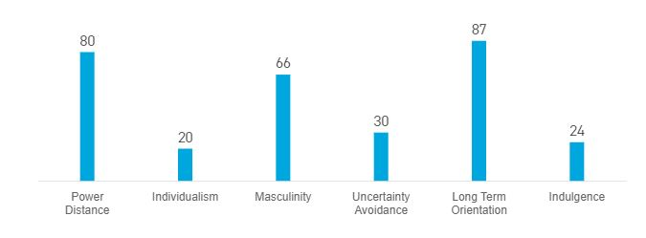
Country Comparison
China

Slide 11
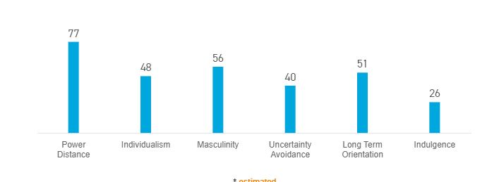
Country Comparison
India

Slide 12
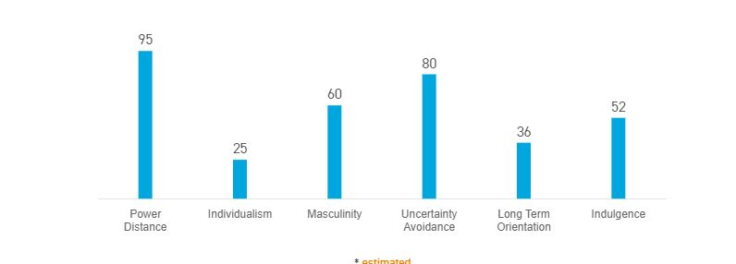
Country Comparison
Saudi Arabia

Slide 13
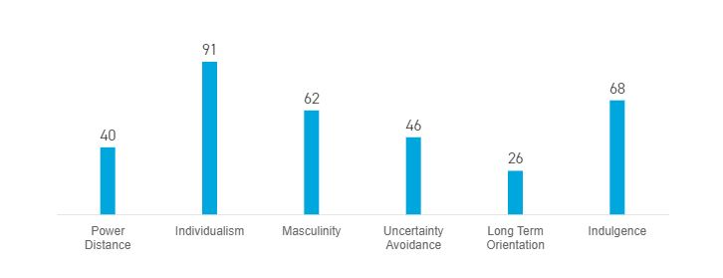
Country Comparison
United States

Slide 14

Characteristics of Cultural Communication Competence
Flexibility
Cognitive complexity
Empathy
Self-monitoring
Commitment

Slide 15
Flexibility
Increase active listening
Recognize Context
Recognize Cultural Differences
Constant Change

Slide 16

Cognitive Complexity
The state or quality of a thought process that involves numerous constructs, with many interrelationships among them.
Such processing is often experienced as difficult or effortful
                APA Dictionary of Psychology

Slide 17
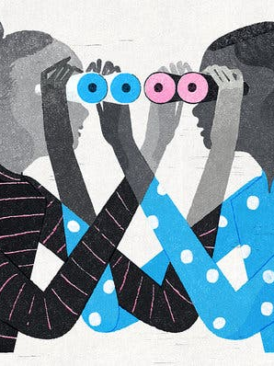
Empathy
Cognitive empathy the ability to understand how someone else feels and to work out what they might be thinking
Emotional empathy or Affective empathy refers to the ability to share another person's emotions
Compassionate empathy Compassionate empathy is when you take feelings to actions
Daniel Goleman & Paul Ekman

Slide 18

Self-Monitoring
A personality trait reflecting an ability to modify one’s behavior in response to situational pressures, opportunities, and norms.
High self-monitors are typically more apt to conform their behavior to the demands of the situation
How self-monitors tend to behave in accord with their internal feelings.

Slide 19
Commitment
Continuous Learning
Take advantage of every opportunity to experience other co-cultures & cultures

Slide 20
Case Study
“Telling Students Not to Speak Chinese”
As chair of the biostatistics department, in the aftermath of these events, what is your plan for dealing with the faculty in your department?
As a group, determine a set of action items based on short-term and long-term goals. Be prepared to share these with the larger group.

