Slide 1
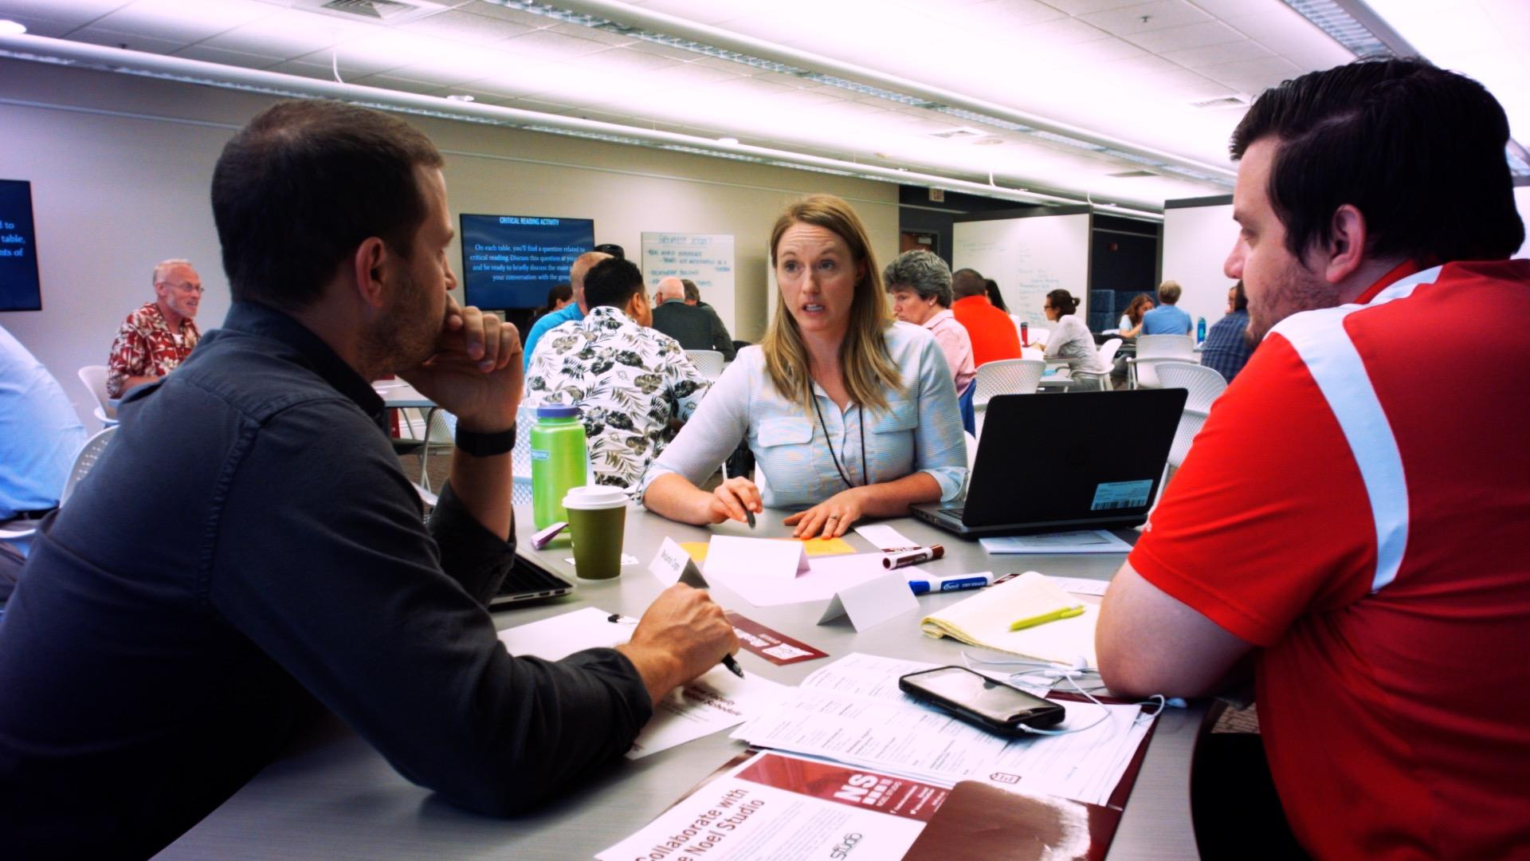
Administrative Best Practices for
Engaging Millennial Faculty
Academic Chairpersons Conference . Savannah, GA
7 February 2020
Shanti Bruce, Nova Southeastern University
Russell Carpenter, Eastern Kentucky University
Kevin Dvorak, Nova Southeastern University
Michael G. Strawser, University of Central Florida
Notes:
Rusty (and each panelist introduces)

Slide 2
Administrative Best Practices for
Engaging Millennial Faculty
Overview
Panel Introductions
Generational Differences
The New Professoriate
Think-Pair-Share
Panel Questions
Notes:
Rusty

Slide 3
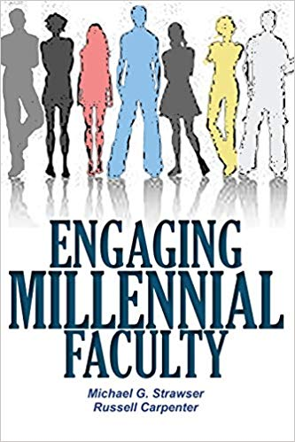
Rationale:
Realized concerns about generational disconnects
Explored the implications of millennial faculty
Goals:
Expand the conversation about millennial faculty engagement
Welcome more conversation about best practices for engaging millennial faculty
Notes:
Rusty

Slide 4
This session will discuss how millennial faculty may
change the higher education system;
adapt their own internal wiring to fit higher education; and
relate to faculty/staff of other generations.
Notes:
Rusty---transitions to Michael to talk about generational differences broadly

Slide 5
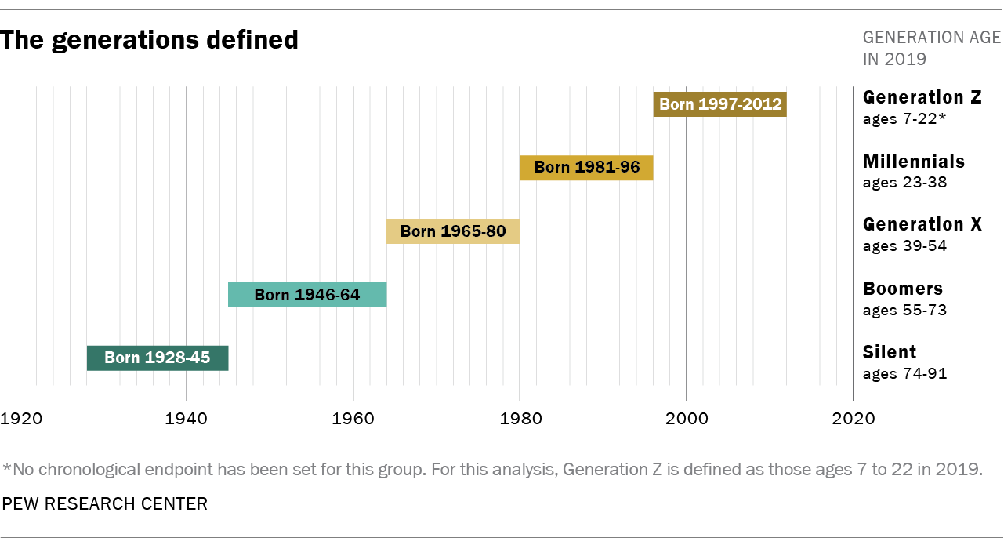
Notes:
Michael

Slide 6
Baby Boomers: Born 1946-1964
Workaholics | Materialistic
The “American Dream” | Greedy
Ambitious | Anti-Establishment
Big Spenders | Loyal To Children
Work / Life Imbalance | Strong Work Ethic
Competitive | Live To Work
Career Loyalists | Responsible
Hard To Trust Young Workers | Flat Organizational Hierarchy
Notes:
Michael

Slide 7
Generation X: Born 1965-1980
Balance | Highly Educated
Independent | Angry
Informal | Confident
Global Thinkers | Pragmatic
Self-Reliant | Results Oriented
Skeptical | Responsible
Cynical | Ignore Leadership
Lack Organizational Loyalty | Latch-key Kids
Notes:
Michael

Slide 8
Millennials: Born 1981-1996
Achievement | Optimistic
Perfectionists | Idealism
Civic Minded | Teams / Collaboration
Tolerant | Diversity / Inclusion
Confident | Entitled
Social | Self-Absorbed
Tech-Savvy | Open to New Ideas
Instant Gratification | Value Individuality
“Spiritual”
Notes:
Michael---transition into small group discussion

Slide 9
What initial questions do you have about engaging millennial faculty?
Notes:
Michael----transition into new professoriate (break into small groups (3-4) to discuss this question.

Slide 10
The New Professoriate
Increased Expectations (Research; Teaching; Service)
Technology Use
Teaching and Learning Strategy
Community Engagement and Institutional Service
Working in Diverse Groups
Student Mental Health/Advising
Communicate to Various Audiences
Notes:
Michael - first 4; Rusty - last 3

Slide 11
Generational Perspective - Millennial Faculty
Expect immediate feedback, communication, and acknowledgement
Appreciate collaborative work
Focus on values-driven systems
Use of technology in daily lives (and work)
Notes:
Immediate feedback - Shanti
Collaborative work - Kevin

Slide 12
Group Conversation
Notes:
Michael [michael, watch time, etc.] a) change the higher education system; b) adapt their own internal wiring to fit higher education; and c) relate to faculty/staff of other generations.
Participants will also address issues related to new faculty engagement and professional development, expectations of communication, and responses to campus sexual harassment.

Slide 13
Administrative Best Practices for Engaging Millennial Faculty
Establish productive and meaningful processes and practices for formal and informal feedback
Design systems for acknowledging success (awards, etc.)
Integrate technology into department workflows
Provide structures that acknowledge and value collaboratively developed work (publications, presentations, research, committees, etc.)
Notes:
Link to role of the chair/etc.; practical recommendations, call to action, Rusty

