Slide 1
New Chairs Boot Camp
2020 Academic Chairperson’s Conference
Margaret Thomas-Evans, PhD
Chera LaForge, PhD
INDIANA UNIVERSITY EAST

Slide 2
2016 UCEA Study
As Reported in Inside HigherEd
Topline Findings:
Average chair tenure is 4 years.
67% received no formal training.

Slide 3
What did long-serving chairs wish they had known?
ACC 2020
Department management
Strategic enrollment management

Slide 4
Department Management

Slide 5
Overview of Topics
ACC 2020
Daily Operations
Keeping Records
Running Effective Meetings
Handling Complaints
Budget
Textbook Orders
Hiring and Onboarding
Annual Reviews

Slide 6
Daily Operations
ACC 2020
Email
  Advisors – HSS and across campus
  Students – course permissions and information
Listserv
  Full time
  Part time
Accessing Student Records
Office Hours
  Students and faculty
  Busiest after meetings on Thursday
  Open door
Meetings
  Chairs with Dean – bi-weekly
  Dean – monthly – one on one
  Chairs with Associate Dean – monthly - professional development
Working with Admin Assistant(s)

Slide 7
Keeping Records
ACC 2020
Box Account – Department
  Folders: Agendas & Minutes, Strategic Plan, Course Schedules & Rotations, Self-Study/Review, Policies (Standards, Research)
Website
  Update Faculty
  Current Events
  Student Spotlight
  Faculty Spotlight
  Programs
  Courses

Slide 8
Running Effective Meetings
ACC 2020
Schedule room (plan ahead – space is hard to find)
Provide dates/times and location to faculty
Agenda
  Send out call for items a few days ahead
  Send out agenda by previous day
  Start with Chair’s updates (items that come from Chairs & Dean meetings)
Talk
  Give everyone in department a chance to speak – tougher in a large boisterous department!
  Moderate conversation to allow quieter faculty to speak and prevent dominate voices from taking over
  Keep to your agenda
Assign
  Minutes taker (rotate among faculty)
  Send minutes to Chair
  Edit and distribute (file in Box account)

Slide 9
Handling Complaints
ACC 2020
Faculty
  Listen
  Investigate (other side)
  Bring together to talk (if possible)
  Resolution
Students
  Ask if student talked to instructor –
    No - ask why and encourage this step
    Yes – what happened?
  Contact faculty member
  Meet with parties separately or together
  Resolution

Slide 10
Budget
ACC 2020
PD/Travel
  Keep track (chart or spreadsheet – Admin keeps one too)
  Save emails
Strategic Investments
  Ask for department input
  Discuss and vote
  Submit to Dean
Discretionary
  Scheduled events
  Department needs

Slide 11
Textbook Orders
ACC 2020
Orders for adjunct faculty (or ask coordinator as applicable)
Full time faculty – ask them to forward confirmation of order to you
Associate Dean will ask you to follow up on orders (missing/errors/desk copies)
Late add sections and cancellations
Issues with print, e-text, and no text.

Slide 12
Hiring and Onboarding
ACC 2020
Full-Time
  Meet all interview candidates and interact with them
  Assist committee as needed
  Check on hiring paperwork
  Send email welcome
  Inform of events/meetings and dates (Retreats, Senate, HSS, Department, etc.)
  Faculty mentor
  Office/phone/email
  Textbooks
  CAs/TAs
  Add to department listserv/Box/Canvas
Part-Time
  Job ads and committee
  Conduct Interviews
  Initiate hiring paperwork
  Inform of events such as adjunct faculty fall meeting
  Textbooks
  CAs/TAs
  Add to listserv (if applicable)

Slide 13
Annual Reviews
ACC 2020
Time consuming – schedule your February carefully! (Academic Chairs Conference!)
3 to 10 people depending on department
Online portal
  Reviewer access
  Run Reports
Template
  Course Evaluations section in Teaching
  Assessment section in Teaching
Draft – send out prior to 1:1 meeting
Meeting – Discuss review, finalize, sign

Slide 14
Enrollment Management

Slide 15
Overview of Topics
ACC 2020
Course Rotation
Schedule Building
Responding to High/Low Enrolled Courses
IUOCC Considerations
Fielding Questions from the Advising Office
Student Data and Advising Records with Demo

Slide 16
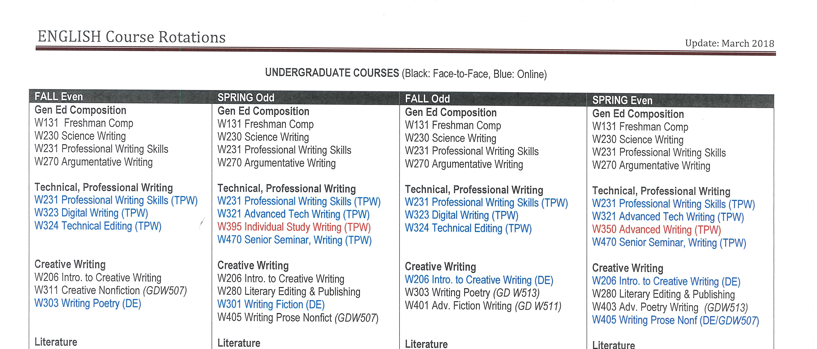
Course Rotations
ACC 2020

Slide 17
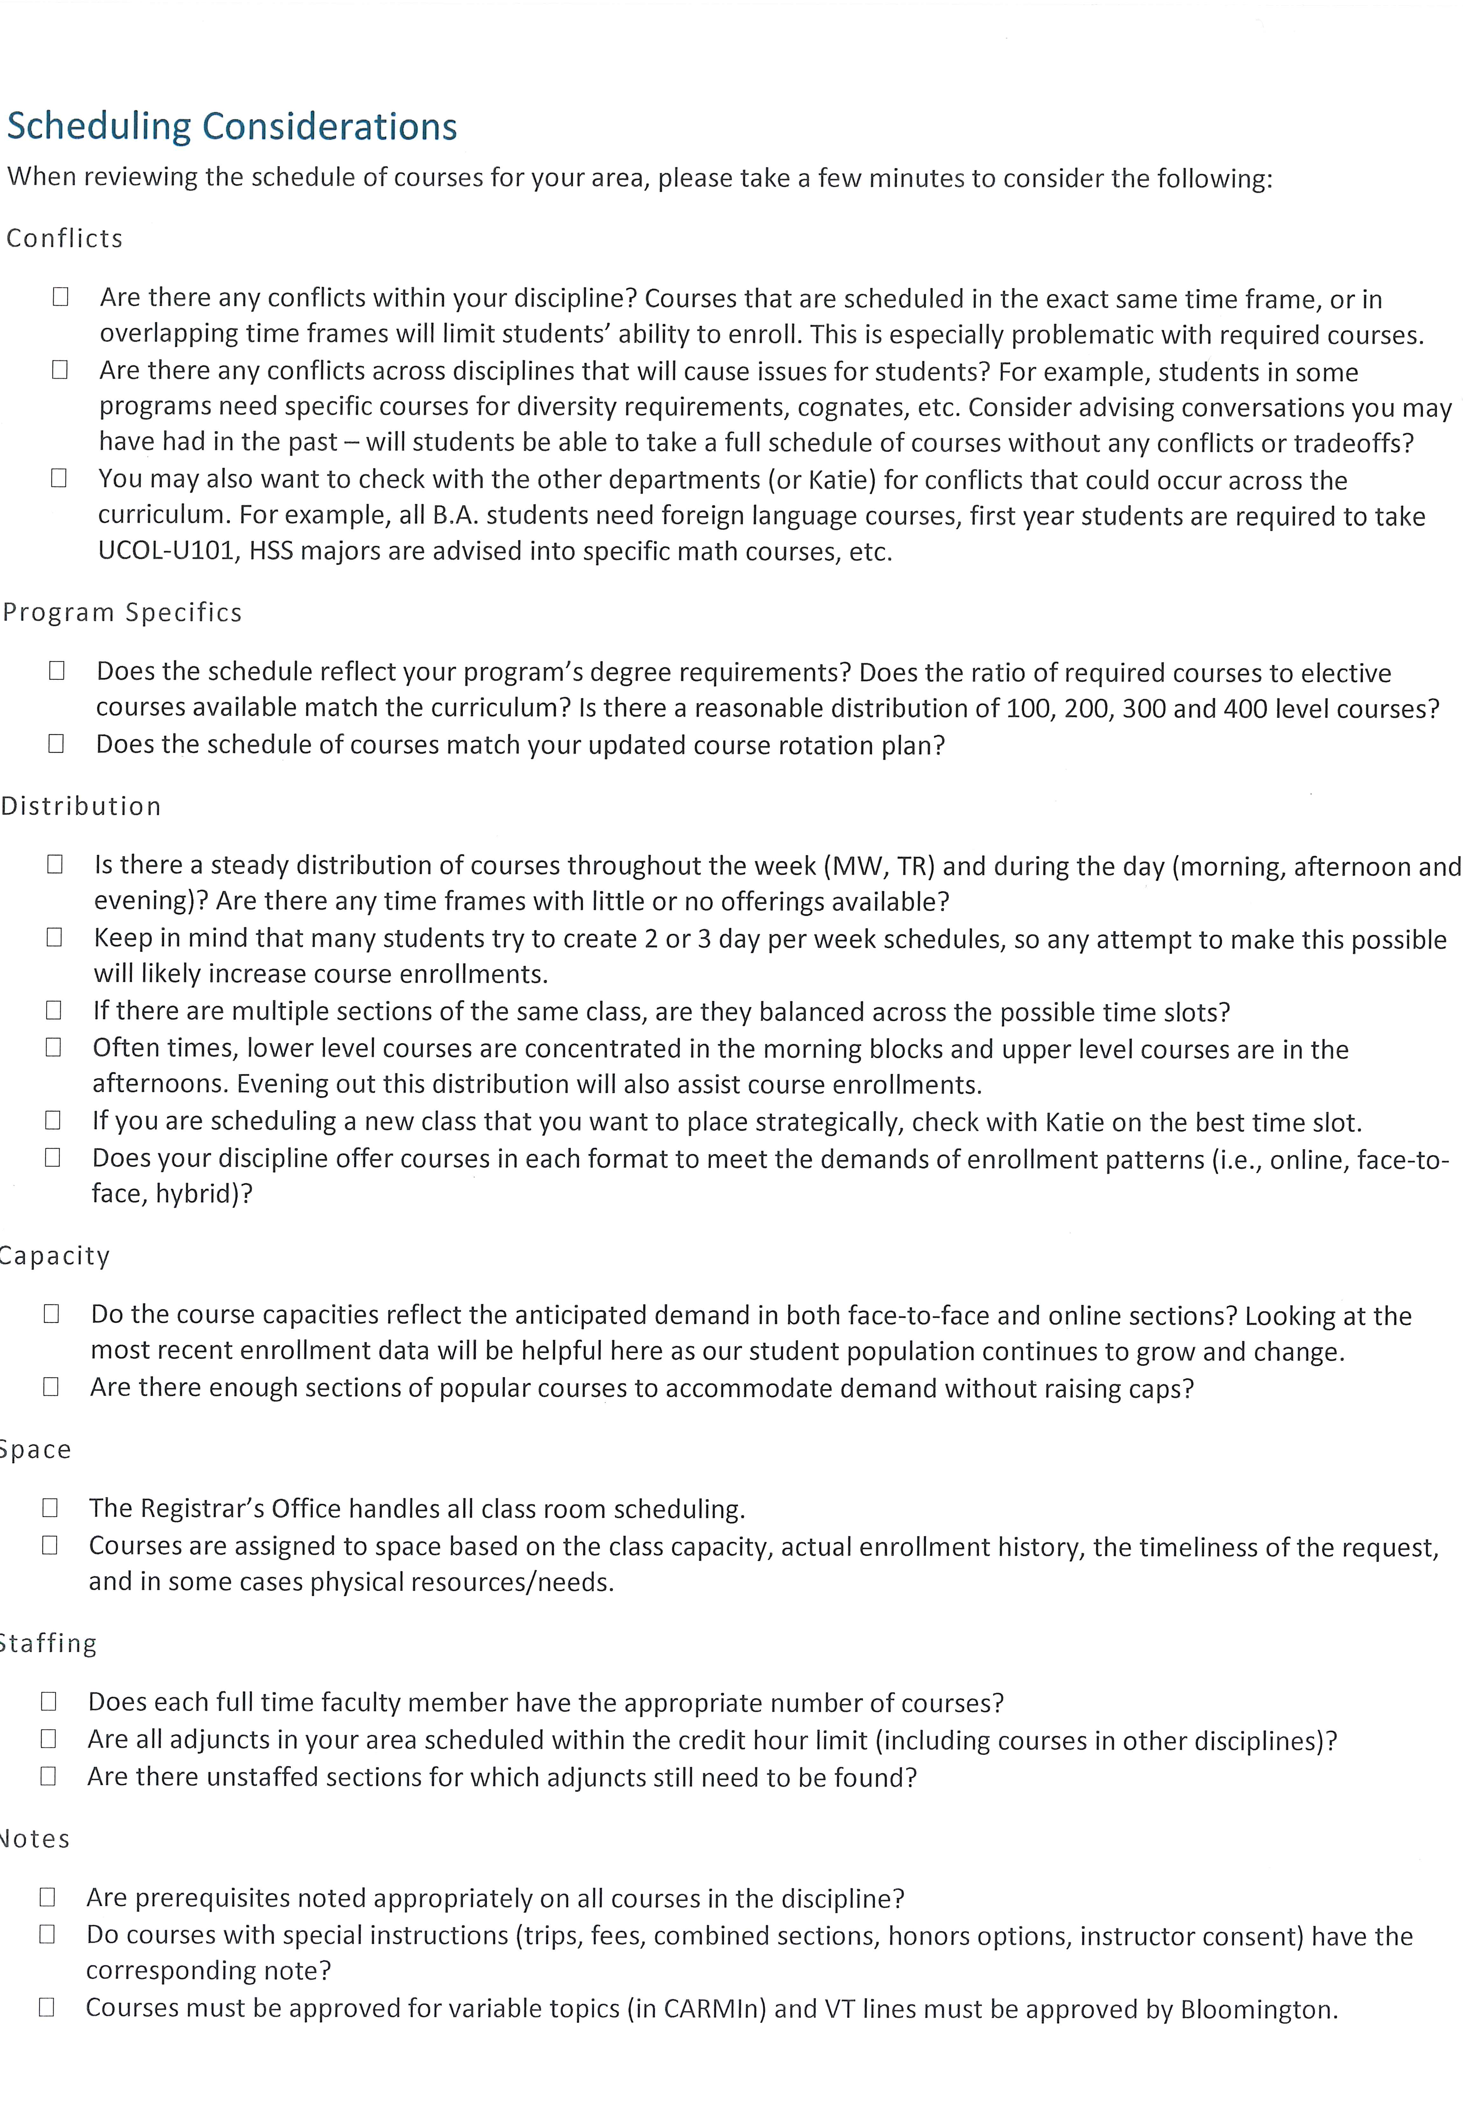
Schedule Building
Conflicts
Program Specifics
Distribution
Capacity
Space
Staffing
Notes

Slide 18
Advising Records
ACC 2020
Common Uses
Enrollment Numbers
Pending Grades
Messaging
Academic Performance
Program Trends
Dynamic Saved Lists

Slide 19
Feedback and Suggestions

Slide 20
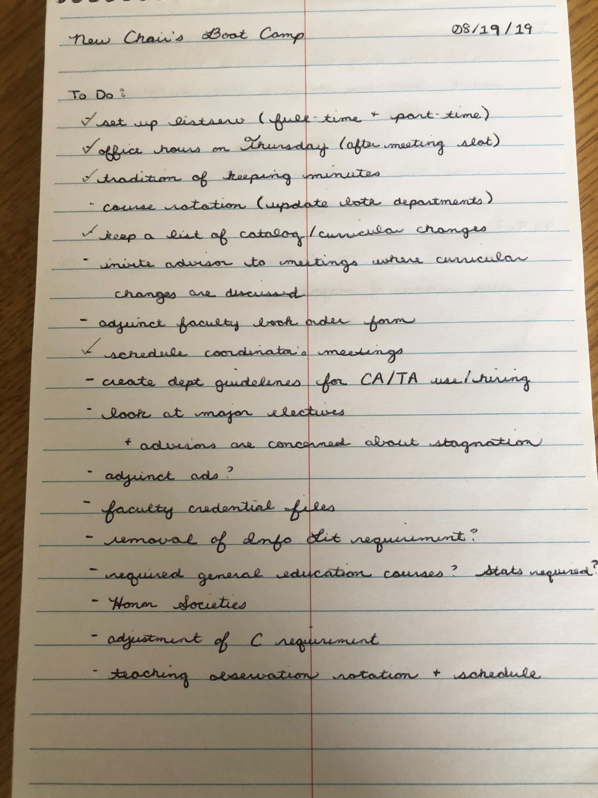
Feedback from New Chairs
Most valuable topics:
  Advising Records Demo
  Schedule Building
  Daily Operations
  Handling Complaints

Slide 21
Further Suggestions
ACC 2020
Designate a point person to schedule rooms, order foods, develop the agenda.
Offer lots of time for Q&As and scenarios. Listen to questions asked and use those questions for follow-up training.
  Dead Chairs
  Readings/Book
Make a chairs’ retreat the norm, but move from development over training if there is low/no turnover.

Slide 22
Questions?
Chera LaForge – Chair of Criminal Justice & Political Science
Margaret Thomas Evans – Associate Dean, School of Humanities & Social Sciences (former Chair of English)

