Slide 1

Managing Course Consistency Across Multi-Campus, Multi-Modal systems
Academic Chair Person Annual Conference
Thursday, February 6, 2020

Slide 2
Welcome
Stephen Pyle, Johnson & Wales University
  Associate Professor,
  20 Years in Academic Administration
  Multi-Campus; Multi-State Institution
David Line, Eastern Washington University
  Assistant Professor, Program Director
  Quality Matters Program Evaluator
  Multi-Campus Regional State Institution
Notes:
Stephen – Private, No Tenure, No Union
Dave-Public Regional, Tenure, Union
Concepts
Resources
Practices
Experiences

Slide 3

Session Focus
Standardization between
Academic Units
Modalities
Calibration of
Grades
Evaluations
Notes:
Academic Units - Campuses/Colleges/Schools/Programs/Degrees/Courses/Sections of Courses
Modalities (Online – On-campus)
Grades
Between courses
Within courses (Between instructors, between semesters)
Evaluation
Of similar content in the same course
Of assessment methods
Hour expectations
We will introduce
Concepts
Resources
Practices
Experiences

Slide 4


Definitions
Standardization – making things the same based on an agreed upon metric
Calibration – comparison of measurement values with a standard
Both have been around since education was standardized
Notes:
Example – Standardized course syllabus or learning management format
Calibration – course hours

Slide 5
Why Standardize
Accreditation
Federal Regulations
Professional expectations
Transfer students (credits)
Transfer of credits from one institution to another is built on the presumption of calibration between institutions
Calibrate for credit consistency between programs
Notes:
While calibration process provides a metric on individual courses but most importantly metric on curriculum and where information appears – so we don’t repeat things beyond our plan. Also catch courses that have morphed over the years in terms of content but faculty teaching the courses have not morphed with it. Great was to be everyone back into alignment.

Slide 6
Resources
Learning Management System
Blackboard
Canvas
Task Stream
Curriculum Calibrations Worksheet
Rice University
American Public University System
Institution Generated
People
Instructors
Subject Matter Experts
Instructional Designers
Administration

Slide 7
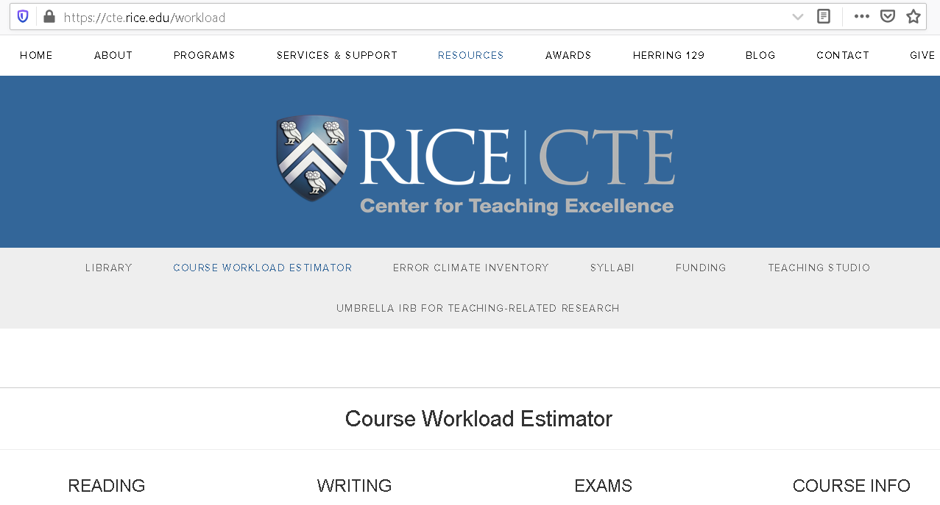
Rice University Course Workload Estimator
Readings
Writing
Exams
Other Assignments
Notes:
Rice Credit Calculator – important tool being used by A&S that we adopted for use across system to identify credit hours by course and establish a base line for comparison
Created Out-of-Class hours by assignment type form (based on teaching methods most often used by college – included “other” category to capture unique methods not commonly used) to compare teaching types by faculty and campus. Also helped to ensure we were meeting minimum number of course credit hours.
https://cte.rice.edu/workload

Slide 8
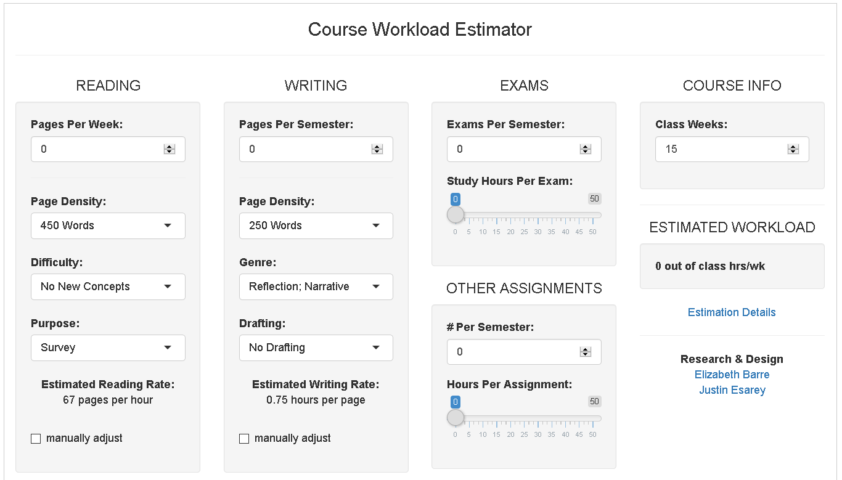

Slide 9
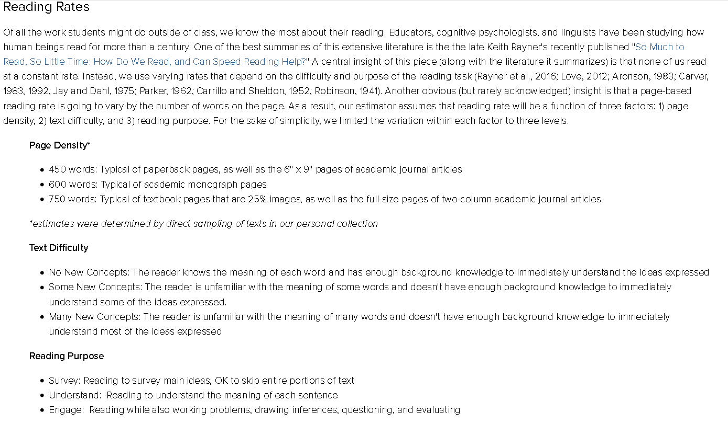

Slide 10
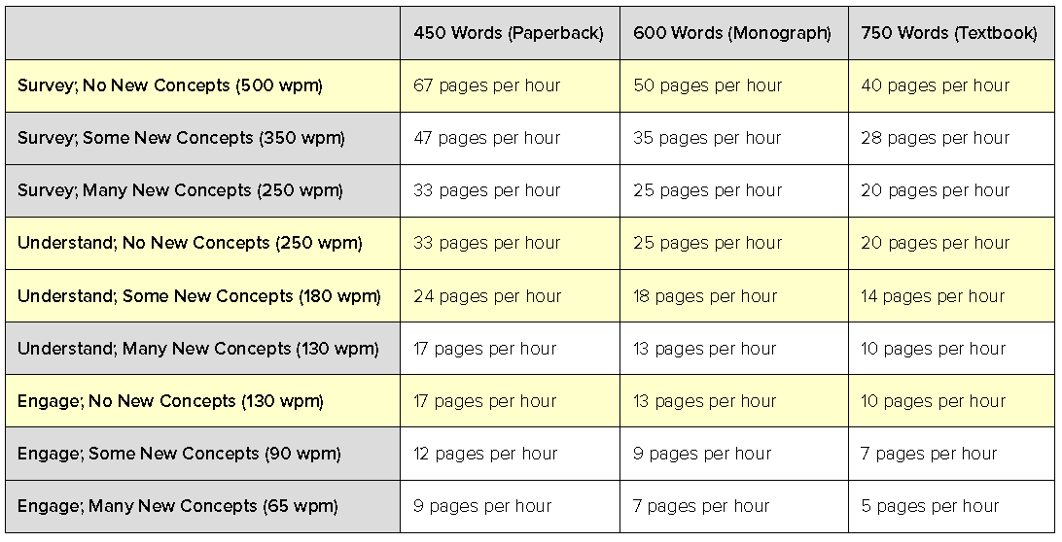
Reading

Slide 11
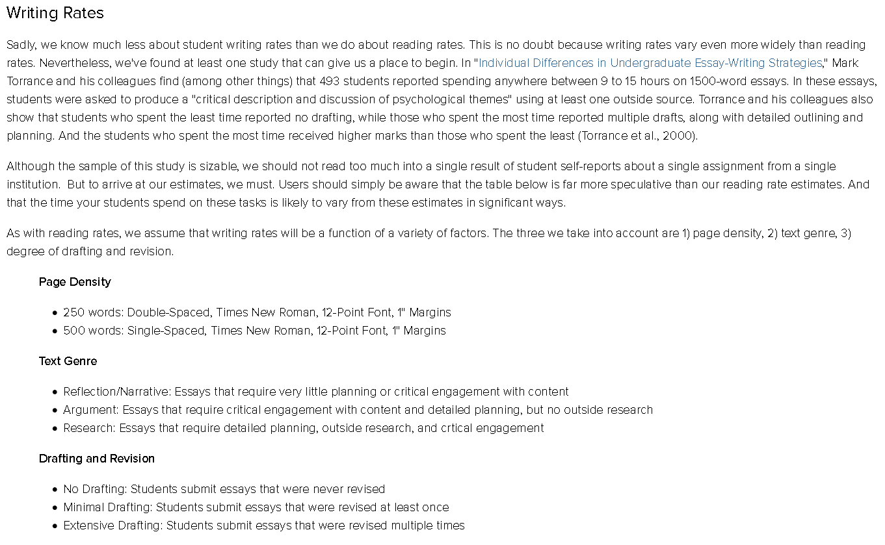

Slide 12
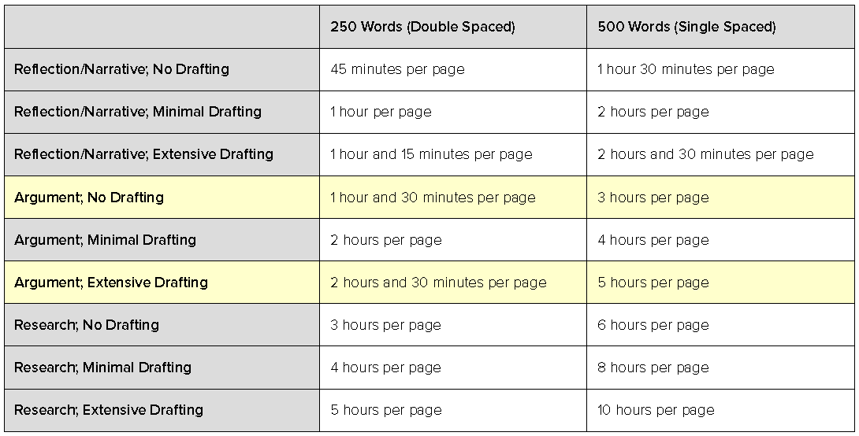
Writing

Slide 13
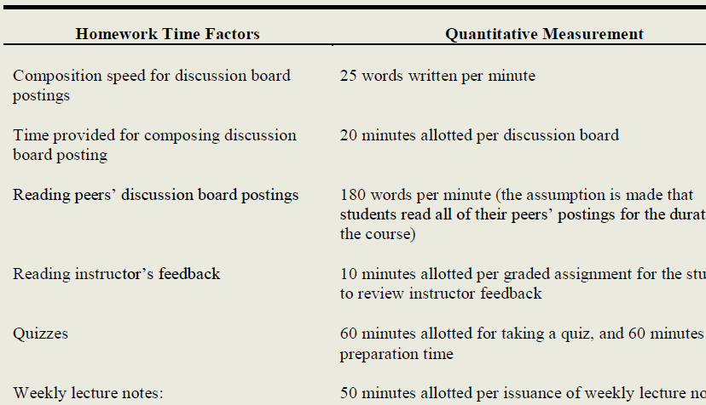
American Public University System
APUS Online Learning Contact Hour Calculator
  Build calculations of Carnegie Units into an Online Specific Tool
  Developed for Undergraduate and Graduate Levels
Powell, Stephens-Helm, Layne, & Ice DOI: 10.5929/2012.2.2.7

Slide 14
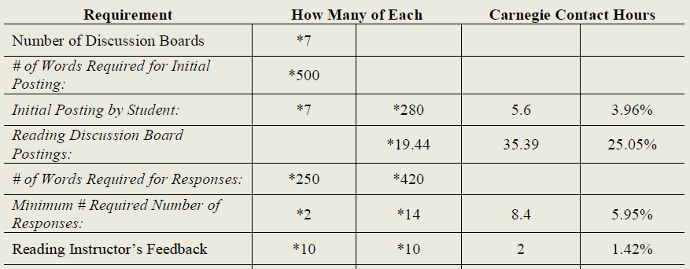
APUS Contact Time Calculator

Slide 15
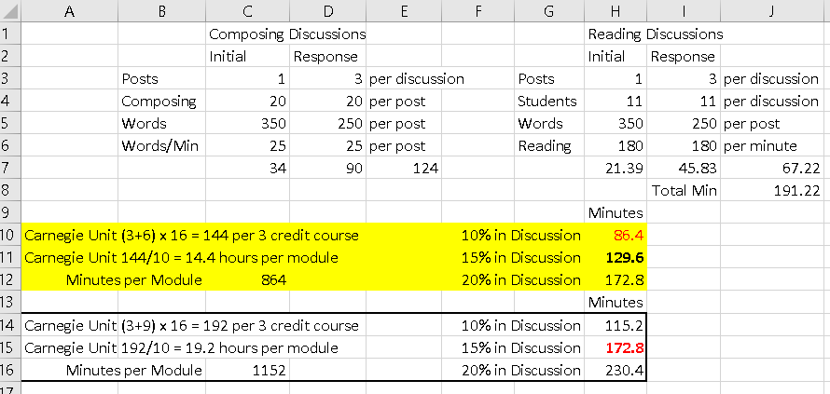
Line Discussion Calculator

Slide 16
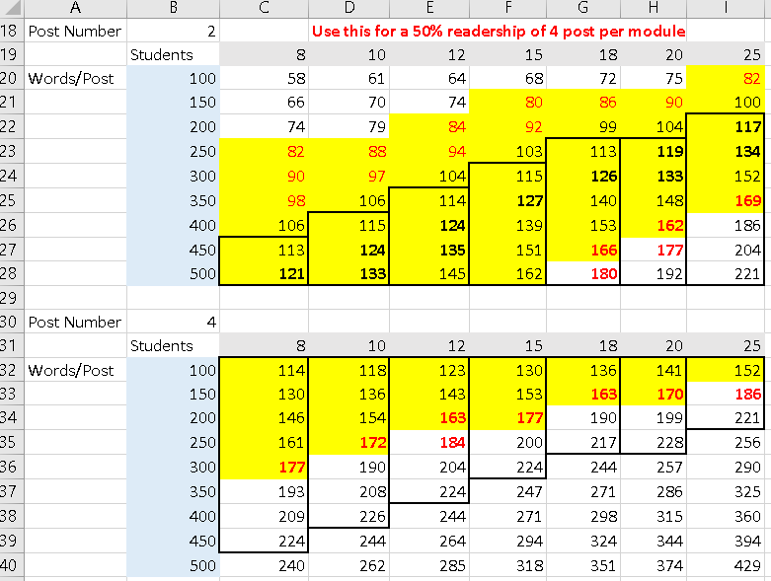
Line Discussion Calculator

Slide 17
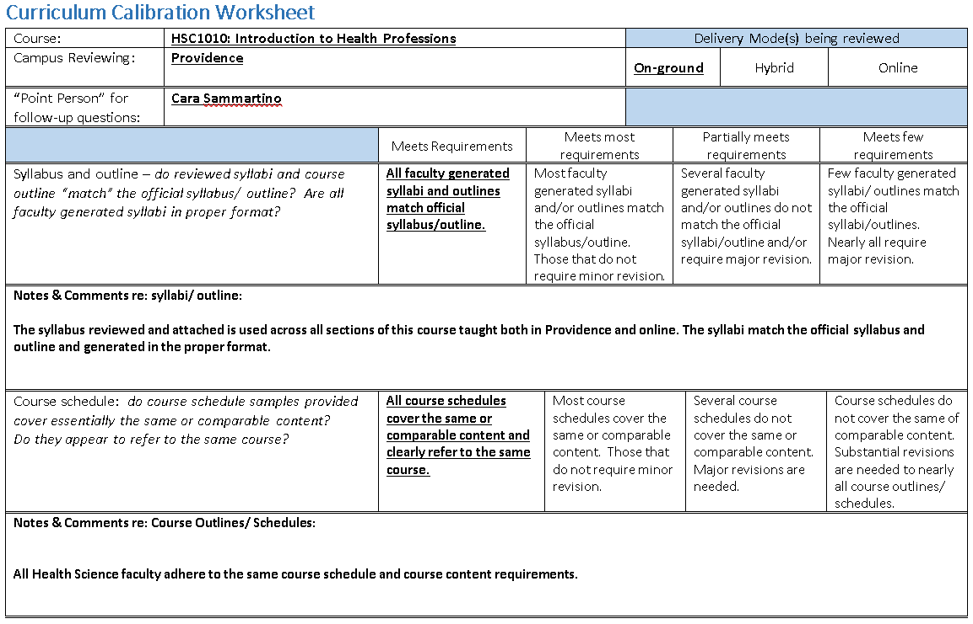
Johnson & Wales, Calibration Worksheet

Slide 18
Standardization to Calibration
Credits | Hours In Class | HoursOut of Class | Total Hours
1 | 15 | 30 | 45
Notes:
Transition from Standardization to Calibration:
So we have discussed the basics of establishing Standardization – now let’s talk calibration
In a perfect world, once you create the standard all should be fine… but we know, like a piano going out of tune over time due to use, temperature change, movement, we need to adjust things periodically.
Education is no different. As we make curriculum changes, add/lose staff, develop new locations, adapt to regional differences, change leadership, things can get morph

Slide 19
Why Calibrate
Accreditation
To make degrees, courses, or content equivalent regardless of
  delivery method,
  campus location,
Evaluation
Meet governing requirements
Notes:
Why did JWU embark on system wide calibration process?
Preparation for 10 year accreditation visit
Accreditation (NECHE) standards stress two issues
“All students – All Modalities – All Campuses”
No matter where or how or who (population) – students must experience “equivalent” – Learning and expectations for the students are consistent across all delivery methods (on-ground, on-campus, hybrid or campus locations)
Federal Credit Hour Requirement – meeting federal guidelines to ensure credit hours are awarded appropriately (4.5 credits = minimum of 132 hours “engaged” in material)
Again, across all sections of a given course, regardless of student, modality or campus location, courses be “equitable” (not identical) in terms of course work.
Ensure courses are being delivered in a similar manner and with similar level of rigor and amount work expected from students
Clinical hours

Slide 20

Why this work is necessary? (NEASC)
All Students – All Locations --- All Modalities
  Is it the same course for all?
The Federal Credit Hour Requirement
  The hours
  Ensuring “equitability”
Site Visit Expectations
  “trust but verify”
Notes:
In October, a group of us from the Provost’s Office attended a NEASC Self-Study workshop in preparation for the 2018 Re Accreditation visit. There were a few consistent matras we heard….
The first “All students – All Locations – All Modalities: this was stressed over and over again. That regardless of where or how or population – that students experience “equivalent” curriculum – this is an issue of “consistency”
In this era where students may be completing their work face to face, hybrid, online and on multiple campuses schools need to ensure that the learning and expectations for the students are consistent, even if the delivery method is different.
We also heard over and over about the Federal Credit Hour requirement – which you received a handout explaining. Here is where we meet compliance… This is the “federal government” seeking to ensure that their “investment” is sound… that when students enroll (and spend federal dollars to pay tuition!) that they will have the opportunity to learn by engaging with the curriculum…. Or put more simply? Ensuring when that credits are awarded appropriately…. If we award a student 4.5 quarter credit hours for successfully completing a course, that they spent a minimum 132 hours “engaged” with the material…
We need to determine if – across all sections – regardless of modality or location or population that there are EQUITABLE expectations for students in terms of course work will require at least 132 hours over 11 weeks….
Simply put – we don’t have easy sections and hard sections…
Please keep in mind that EQUITABLE does not mean STANDARD! Five papers over the course of the term may be equivalent to someone else’s major individual project…. At that would be fine… but if I only give t/f quizzes and require no project or papers – there would be questions about whether or not the courses were “equivalent”….
During the Site Visit we expect there to be an ask for syllabi and course schedules from across the campuses, including online. At they will be comparing to see if the expectations for students are “equitable” – and this determination will be based on their professional judgement…
And before I go any further – let me address the myth of the 20% rule (…and it is a myth!) – there is NO license to change the syllabus/outline by any percentage. We have to deliver what the course says. If you want to make a change, it MUST go through the formal curriculum process….and I mention this because in some cases, as depts look at the course description, objectives, outlines – there may be new awareness that revisions are needed….
Your work using the NEASC template will stay at the Unit/ School level --- but issues uncovered will need to be address within units and across campuses. The template includes a rubric for rating how “aligned” the course materials frosm various instructors are – remember we are not seeking to SOLVE today, only DOCUMENT – and there is nothing to be gained from “sweeping things under the carpet”…. In fact that may really hurt us.
As you consider the work required of students – remember to also consider HOW the student complete that work… if there is a major course project that “everyone” has their students complete, that may seem “equitable… but DIG DEEPER… if I assign the projects to groups of 5 – and you have students complete the same project individually that is not “equitable” – and yes, there could be other course requirements that provide balance… but we need to be certain they are in place.
You work today is likely to lead to robust conversations – and learning about what your peers do… that may challenge your frame of references… quote shared “If learning doesn't make you uncomfortable, you're probably not doing it right.”….
Ultimately, this is all about teaching… and our pursuit of excellence…and in support of this I was asked to share

Slide 21
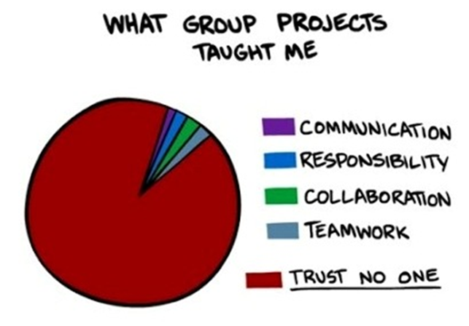
Excellence in Teaching & Learning
Sequential assignments and culminating projects
Authentic problems and questions
Thinking as well as knowing
Strategic use of group work, student presentations and class-based “experiential learning”
Purposeful & intentional assessment
Notes:
Sequential Assignments – allow students “grow” into the project and helps faculty assess where they are…
Group projects -- Group work included because part of the required learning? IF merely for convenience – then need to rethink… ? Student fatigue issue… Individual Accountability
Experiential – Tradeshow example 2 to 1 for “traditional” – 3 to 1 for experiential…and longer hours.
Presentations – what is the rest of the class REALLY learning? Can you have these recorded? What is the quality? Why do they need to present in class?
Authentic – relevancy, purposefulness, staying current, thought-provoking
Teaching strategies/ activities focuses on building knowledge as well challenging student to THINK – makes sense of --- within frame of reference (not all T/F – MC assessments)
Class to class and course to course. The era of the “Sage on the Stage” is the over… as the only means . Variety in assessment as well – and using the results of assessment to inform professional practices WITHIN the class.

Slide 22
Standardization, Calibration & Academic Freedom
Oversite
Empowerment
Notes:
Define Academic Freedom
Empowerment of faculty but oversite by Provost office/Deans/Chairs to keep process moving forward and meet timelines
Establish parameters such as Course Learning Objectives

Slide 23

Required or modifiable
Determine what is required and what can be modified
  Time Expectations
  Program Learning Outcomes
  Course Learning Objectives
  Content
  Assessment Methods
  Delivery Methods
Notes:
Start bigger picture of calibration and move to tools/procedure/steps to accomplish calibration
Include accreditation standard examples (on-ground, on-line) to demonstrate/argue need for calibration efforts
Link calibration with continual improvement and outcomes
Limitations based on our experience, institution type, culture (union vs. non-union)
Discussed private vs. public (union vs. non-union) – rapid vs. slow change impacting calibration efforts. Frameworks we have to work within when accomplishing this process.
Start with specifics (sections, courses, programs, etc)
Identified key courses to begin process (we started with major course and most common electives, developed a form to guide information gathering and developed universal procedure, created spread sheet indicating course number, campus at which course is offered and date by which to complete the work.

Slide 24

Process
Top down
Middle built
Bottom up
Notes:
Top down management to establish framework for work completion but then bottom up faculty driven to accomplish work

Slide 25
Where to Start
Selection of contributors
Administration
Designers
Faculty
Instructors
Students
Collaboration methods
Survey
Meetings
Asynchronously
Notes:
Cross campus faculty teams were identified based on faculty most often taught course to be calibrated.
Have to figure out how to manage input from campus or program that uses adjuncts to teach the course.
Individual faculty calibrate personal course to credit hour requirement and complete out-of-class hours by assignment type.
Upload to common course area by campus in Ulean. Course lead faculty member identified (used PVD as had most bandwidth. Couse Lead called conference call and led meeting via phone/video to review all 4 campus courses. Identify were problems exist on common worksheet. Lead coordinated next steps through curriculum committee process.
Students, instructors, staff, administration, professionals, stakeholders

Slide 26
Courses to Start With
Start with Core courses
Pick courses which Are easily modified
Notes:
Start with major courses first then electives (80/20 rule)
Centralized management of data for easy loading, access and reporting
Establish data file naming conventions for organization
Create centralized and shared training cycle to set expectations and address questions at college and campus levels. “Prepare, align, execute”
Establish and publish key terms, worksheets, procedures and role expectations to all stakeholders
Establish defined timelines but provide flexibility to complete work
Determine champions across system to implement, track and complete reporting goals
Develop plan to address curricular issues that are discovered during process. Address after calibration process

Slide 27
Experiences
J&W
Inter-campus calibration exercise
EWU
Grading calibration exercise
Notes:
J&W
Important outcome for NECHE (JWU accrediting body) – course work must be equivalent across all campuses and all modalities. As JWU is so complex this is an important thing for us to look it and NECHE has stressed it something they will look at too. JWU Scope and Scale makes this difficult but very necessary
Also an important tool for Outcomes importance – we want to make sure our “planned curriculum is lived curriculum”
Two key reason to calibrate: 1)Metric on how it is going 2) engages all faculty (she thinks this one of the best aspects of doing calibration – in gets every faculty member involved and makes them think beyond the individual into a collective)
In addition to NECHE, JWU COB and COHM desired to pursue IACBE – another reason to drive this need for calibration.

Slide 28
Detailed Process
Establish team
Select standards
Definition of a credit
Calibration methods
Review process
Individual
Team
Timeline
Documentation
Notes:
Process: (completed over a 3 week period)
Cross campus course teams established and team lead appointed
Team members completed credit hour analysis individually for assigned course(s) and results loaded to taskstream with assignment/project examples for team discussion (show example)
Team members review all work submitted
Team members hold conference call(s) to review work and complete course calibration worksheet. Future curriculum issues are noted. Results posted to taskstream. (show example)
Courses determined to be out of compliance are addressed by Department Chairs for further analysis.

Slide 29
Conclusions
Develop a calibration audit – ensures that instruction evolved with course
Helps to ensure courses are reviewed in a measurable way.
Helps you to build a culture of continuous improvement – not just a compliance task
Helps us to keep our promise to students
Helping students achieve program outcomes – quality measure for us – highly aligned
Stress the point – we are not auditing you but part of making our program stronger – not about outing people but rededicated people
Notes:
Start bigger picture of calibration and move to tools/procedure/steps to accomplish calibration
Include accreditation standard examples (on-ground, on-line) to demonstrate/argue need for calibration efforts
Link calibration with continual improvement and outcomes
Limitations based on our experience, institution type, culture (union vs. non-union)
Discussed private vs. public (union vs. non-union) – rapid vs. slow change impacting calibration efforts. Frameworks we have to work within when accomplishing this process.
Start with specifics (sections, courses, programs, etc)
Identified key courses to begin process (we started with major course and most common electives, developed a form to guide information gathering and developed universal procedure, created spread sheet indicating course number, campus at which course is offered and date by which to complete the work.
Jenn, as outcome person, feels the calibration process drives conversation and shows accountability by faculty – it should not be about catching those doing it differently/wrong but that we are all working together on our pedagogy – not just about me – peer pressure to do things right so those outside of expectations may change courses to come into the fold.

Slide 30

Final Thoughts
Thank you in advance for energy and enthusiasm
Enjoy the chance to share professional practices
Don’t spend time trying to reach agreement
Authentically record what is learned – (Candor)
Reflect and consider
And remember --- it’s not bad --- It’s all good!
Notes:
Don’t get bogged down….
CANDOR is critical…. Which is something we heard a NEASC
One of things I have come to appreciate is how helpful the accreditation process is – because it is focused on improvement… if all is “perfect” – that is suspicious…
Engage in authentic conversations about --
Curriculum Alignment
Course Expectations
Teaching “best practices”
Why ARE we doing it this way?
We are NOT seeking to –
Debate which approach is best
Create “cookie-cutter” curriculum
Mandate how to instruct
Write fiction…

Slide 31
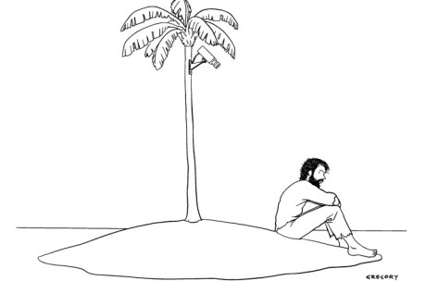
NO course is an island…
Notes:
Students enroll at JWU to earn a degree in a program that is deliver through a curriculum
To keep our “promises” made through program and UNIVERSITY outcomes…. We need to be sure that our curriculum is an integrated whole -- We have to ensure we “deliver’ what we promise..
As a faculty member, I have to know not only what I am supposed to be teaching in my course but also how it contributes to the overall curriculum (as a stepping stone toward the next course…) … I have an obligation to provide learning opportunities that are in concert with what the course outlines specifics…
As you work in your course teams, its likely that in some cases we will find that the intended curriculum (what is in the official syllabus/ outline) is not the same as the “lived curriculum” (what is actually being taught) – and that will lead to some very necessary conversations… This is known as Syllabus “drift” – and it is something that we need to work against… What is the in the outline must be taught
Likewise – if its not in the outline, it may not be appropriate to deliver as part of the course, especially if it is covered else where in the curriculum (planned vs. habit-based redundancies…)
And let’s be clear… these are not an issues of Academic Freedom… Academic Freedom refers to DELIVERY not to content…. If the course I am assigned to teach is intended to teach students about topic A, I can deliver that content tap-dancing on the desk if I wish – that is with the parameters of my Academic Freedom. I can express my opinion about the content, as can students. I can determine the type assignments and assessments I want to use (more about this later)…
BUT What I can’t do is decided that I don’t want to teach topic A and instead cover topic Z instead…. That is NOT academic freedom. . Academic freedom never means “everything goes… “
The faculty as a corporate body determine the content of the curriculum within the framework of accreditation and other parameters… and faculty teaching within a program are expected to provide learning experiences for students that allow them to engage with the content in purposeful and intentional ways
Like OA, the work we do today is something we should want to do, even if outside forces didn’t compel us to do this work, -- because it makes us better, the curriculum stronger and supports student learning.
But there are outside forces… so let’s talk about what they are focus on – 3 main areas Consistency, Compliance and Content

