Slide 1


From Surviving to Thriving:
Top Tips to Help Newer Chairs
Dr. Ethan Krase
Chair of English
Winona State University
Dr. Gian Pagnucci
Chair of English
Indiana University of Pennsylvania
2020 Academic Chairpersons Conference
Savannah, GA
Feb. 7, 2020

Slide 2
Department Chair – most difficult job in higher education?
e
Very little formal training
Steep learning curve
Volume and complexity of issues
Finite time and energy
Isolation from colleagues
Place in between faculty and upper administration
High and low stakes mixed together
Limited resources
Highly contextualized

Slide 3
On a piece of note paper…
What is one key question or issue you are wondering how to address?

Slide 4
Gian Pagnucci
Indiana University of Pennsylvania
English Department chair for 10 years
Midsize university: 10,000 students
Chairs elected for 3-year term (no maximum)
Unionized faculty
Responsible for schedule, evaluation, day-to-day operation, curriculum, student problems, resource management, budgets
Fun Fact:
        Avid comic book collector
        Still playing Pokémon Go (even though it’s no longer cool)

Slide 5
Ethan Krase
Winona State University
English Department chair for 9 years
Midsize university: 7,500 students
Chairs elected for 3-year term (maximum of 3 terms)
Unionized faculty
Responsible for schedule, evaluation, day-to-day operation, curriculum, student problems, resource management, budgets
Fun Facts:
      Group fitness instructor on the side
      Compulsive fisherman

Slide 6
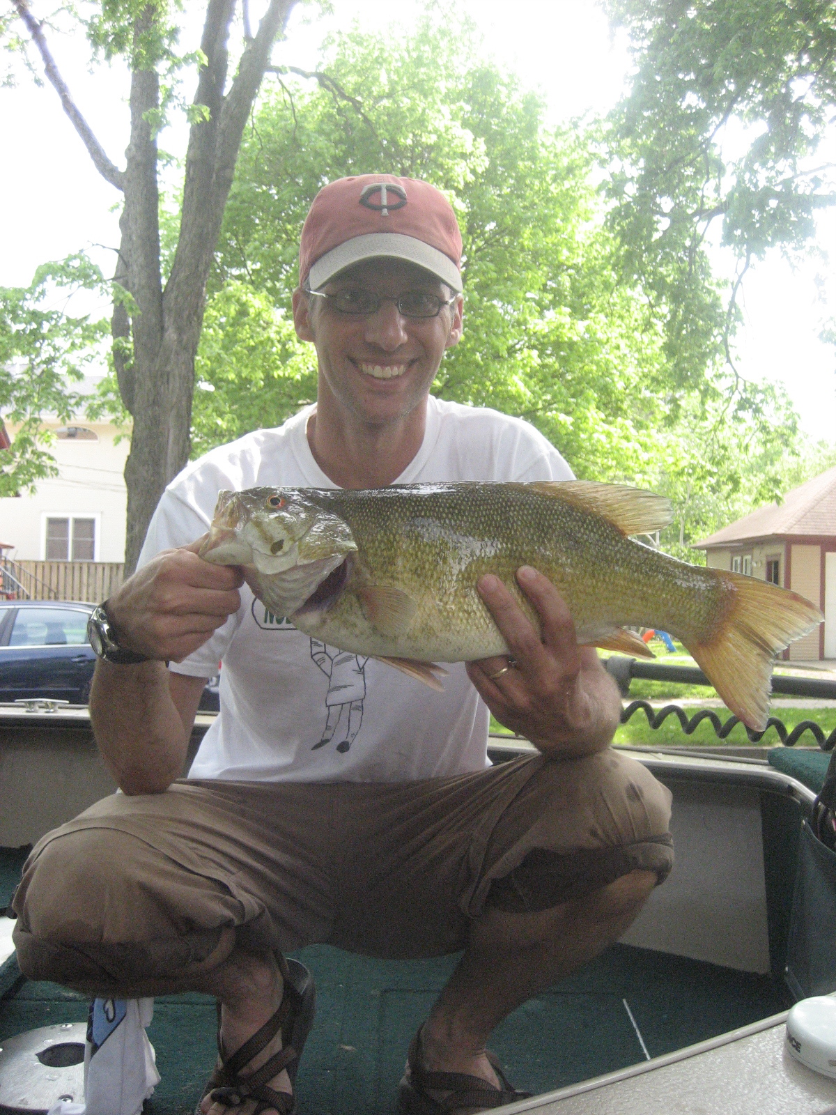
Happy chairperson with smallmouth bass

Slide 7
Note:
Unfortunately, we do not have a slide of Gian playing Pokémon Go.
Ethan feels bad about that and will try to address this in future presentations.

Slide 8
Session Objectives
g
Review strategies for helping newer chairs be more effective in eight key areas:
      Responding to complaints
      Constructing schedules
      Managing email
      Working with the dean
      Handling difficult colleagues
      Promoting departmental harmony
      Managing time effectively
      Maintaining mental health

Slide 9
Session Description
e
Focus on practical strategies
Tap into shared knowledge
Allow time for discussion
Create space for connection
Address universal questions
Motivate purposeful reflection

Slide 10
Schedule
e
      Introduction
      Responding to complaints
      Constructing schedules
      Managing email
      Working with the dean
      Small group discussion #1
      15-minute break
      Handling difficult colleagues
      Promoting departmental harmony
      Managing time effectively
      Maintaining mental health
      Small group discussion #2
      Concluding discussion

Slide 11

If you remember just one thing from this presentation…
2020 Administrative Professionals' Day
Wednesday, April 22
Always occurs on the Wednesday of the last full week in April.

Slide 12
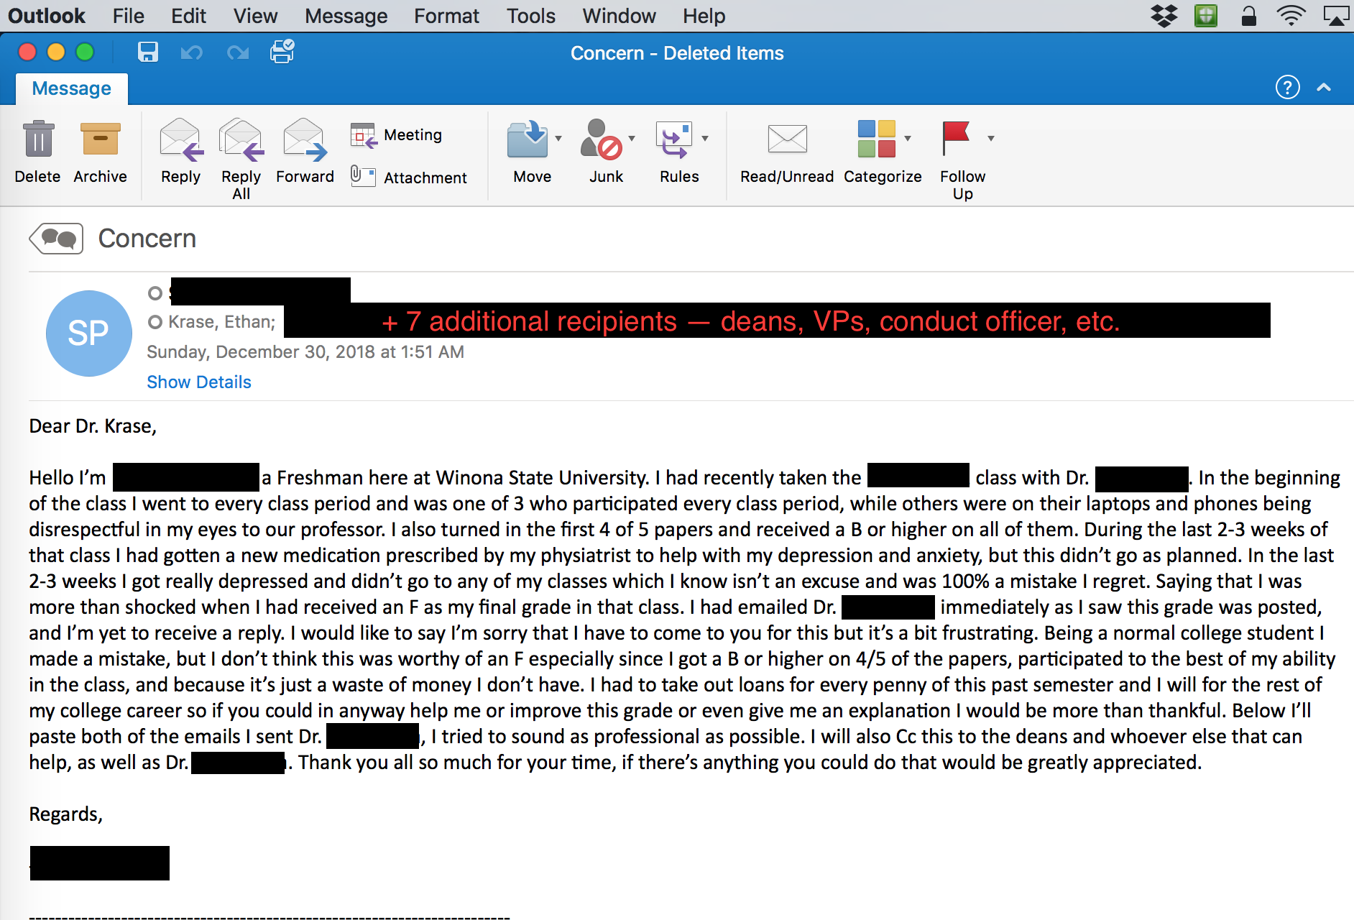
1. Responding to Complaints
g e

Slide 13
1. Responding to Complaints
g
Always take notes and use them as you respond
Listen reflectively – “What I hear you saying…”
Ask “What would you like to see happen here?”
Tell the person what you need (more time, continued patience, others’ input, etc.)
Keep your focus on the greater good

Slide 14
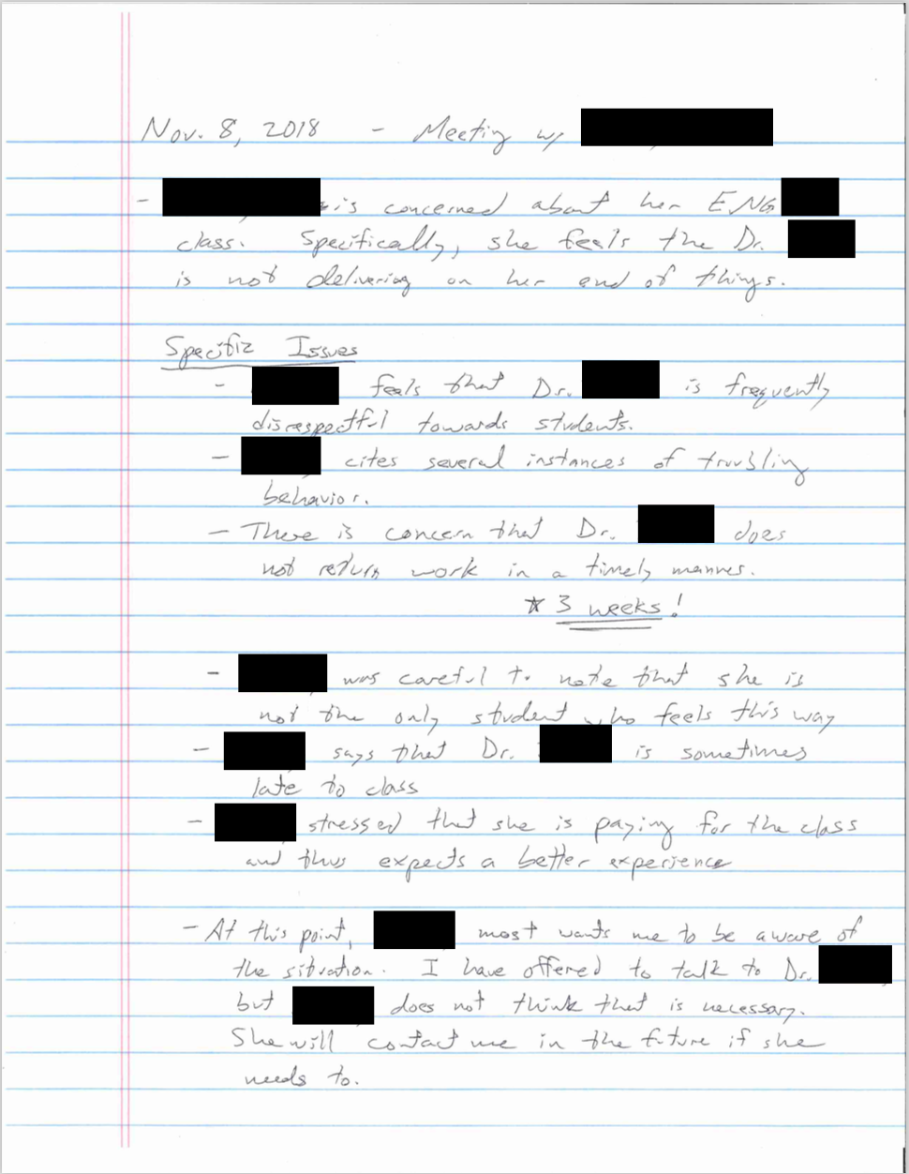
Handwritten notes for complaint meeting

Slide 15
2. Constructing Schedules
e
Obtain a written indication of faculty preferences (courses, times, etc.)

Slide 16
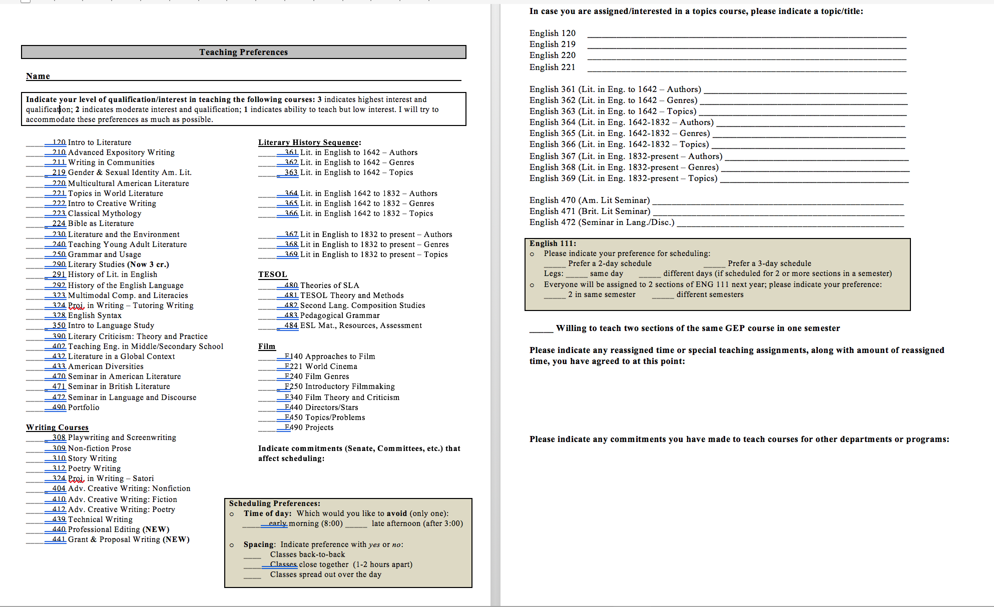
Faculty course preference sheet

Slide 17
2. Constructing Schedules
e
Obtain a written indication of faculty preferences (courses, times, etc.)
Use past teaching assignments to create a record of course rotations

Slide 18
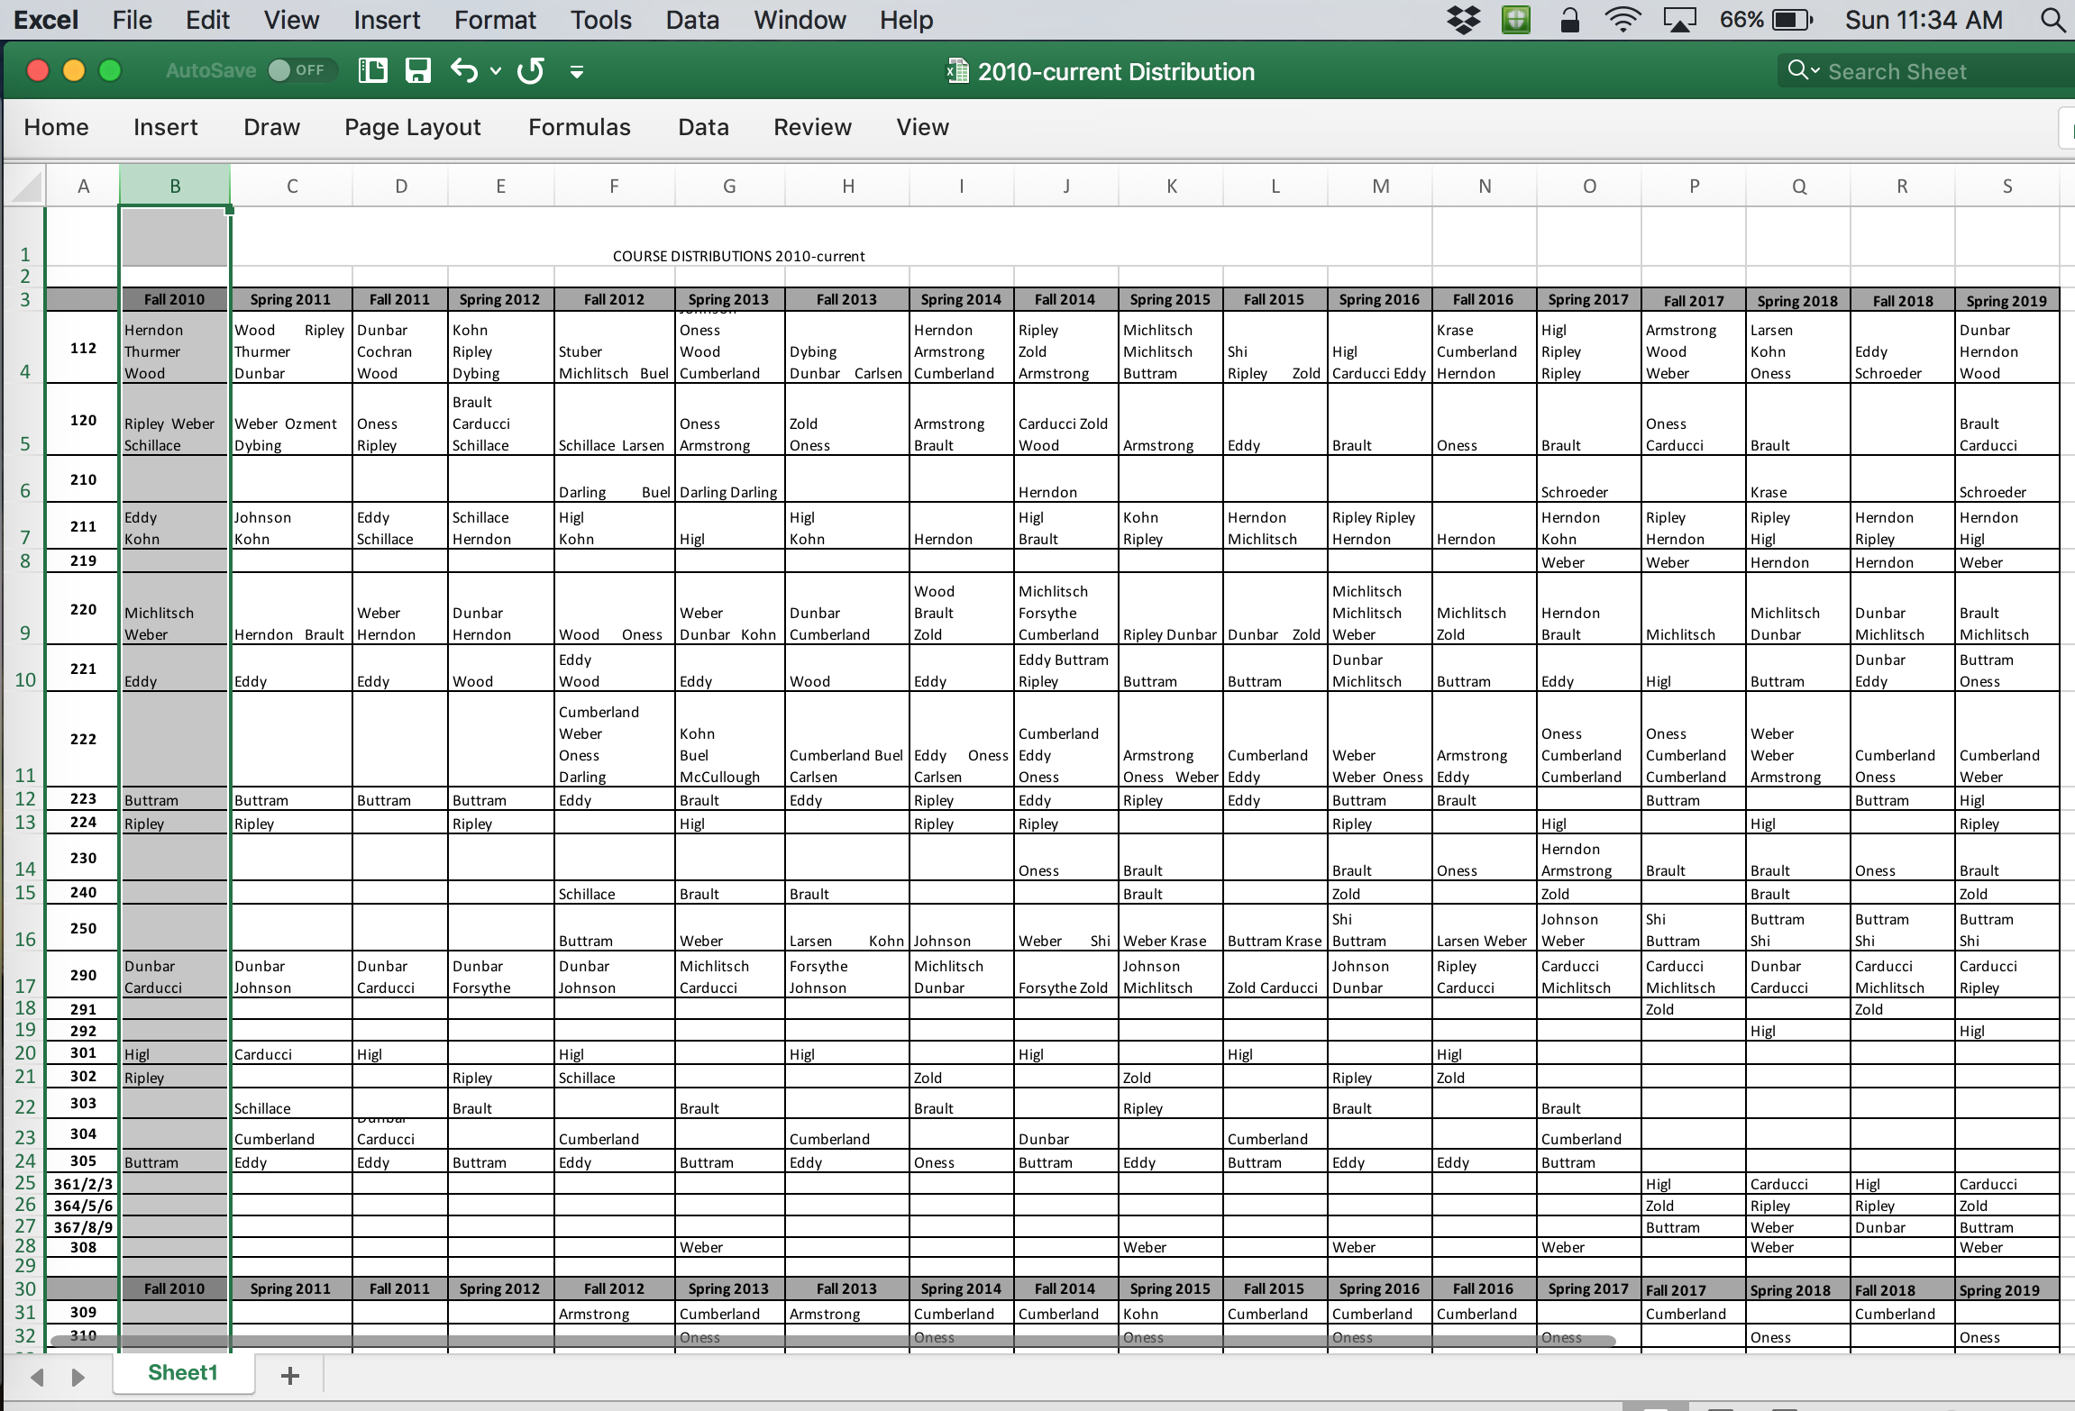
Tracking faculty course assignments

Slide 19
2. Constructing Schedules
e
Obtain a written indication of faculty preferences (courses, times, etc.)
Use past teaching assignments to create a record of course rotations
Spread responsibility
Create a common meeting time for committees
Track key information
  Enrollment data
  Faculty preferences
  Committee assignments
Be fair

Slide 20
3. Managing Email
g
Turn off email alerts
Only check email at the start and end of the day
Set a timer – 30 minutes
Limit replies to 5 lines or less

Slide 21
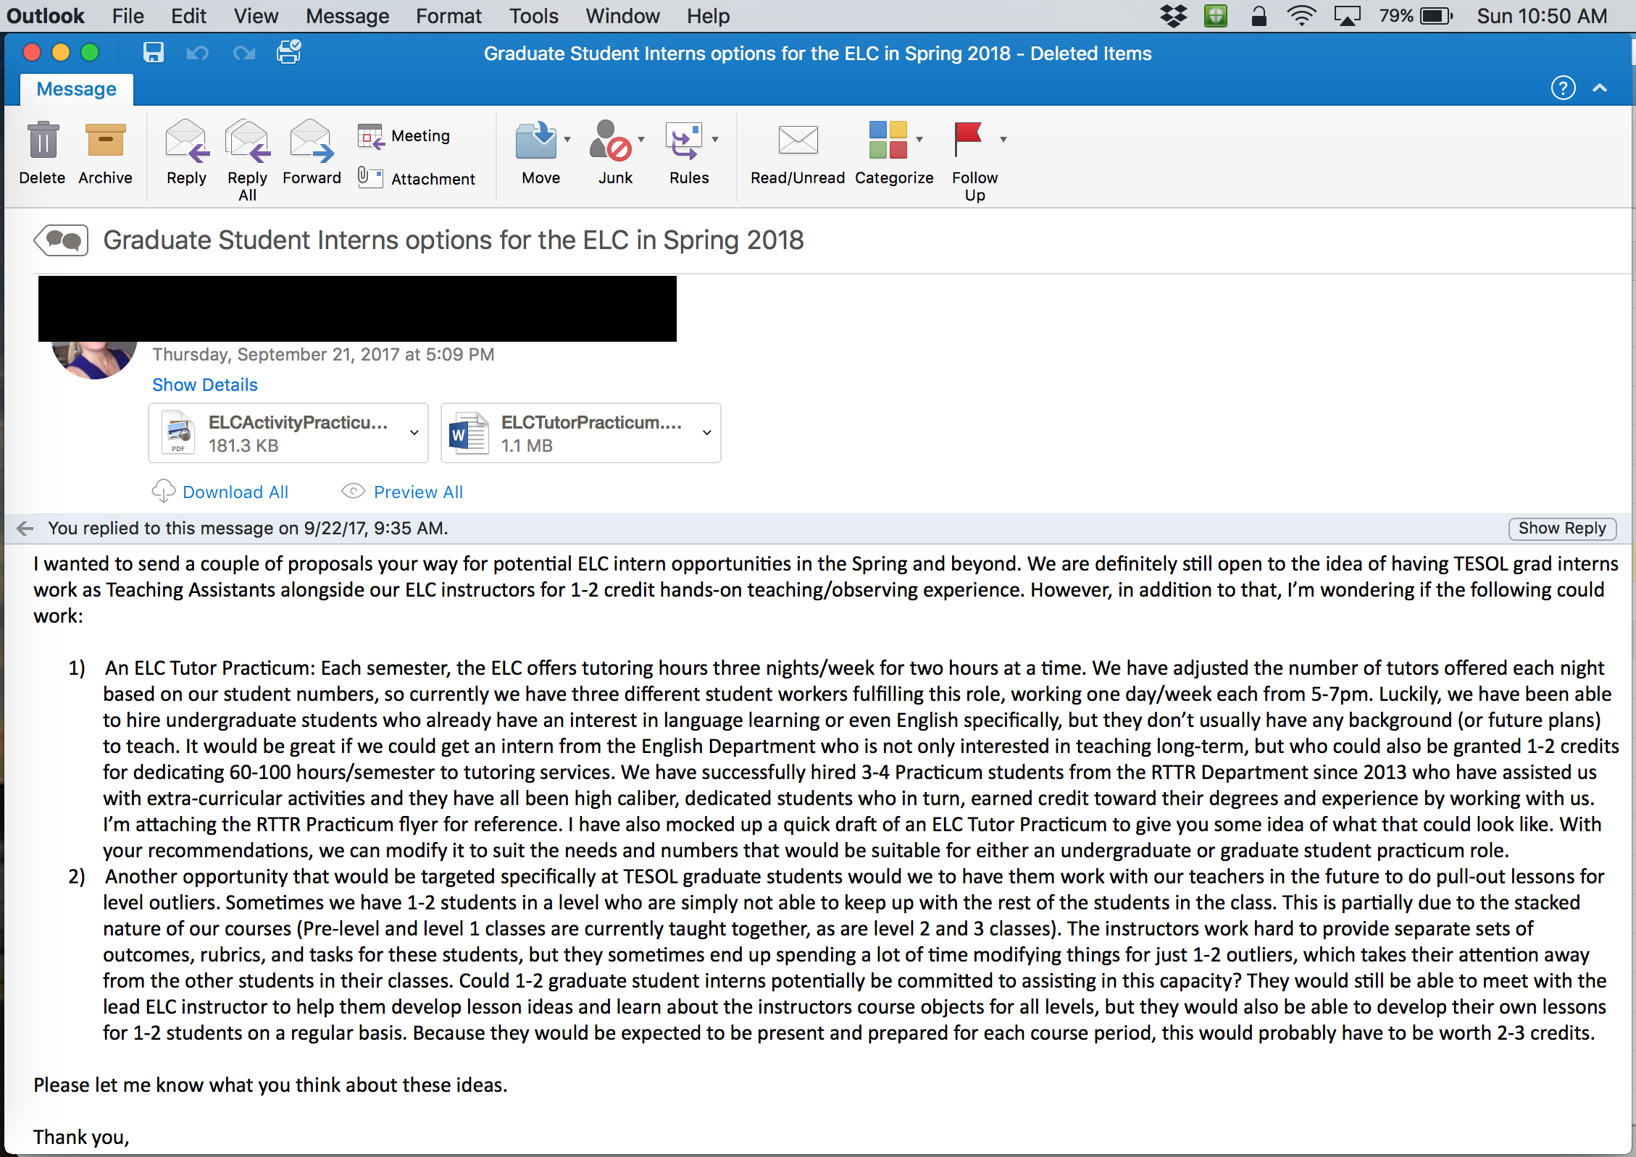
Five lines or less?
e

Slide 22
3. Managing Email
g
Turn off email alerts
Only check email at the start and end of the day
Set a timer – 30 minutes
Limit replies to 5 lines or less
Create email templates for commonly sent messages

Slide 23
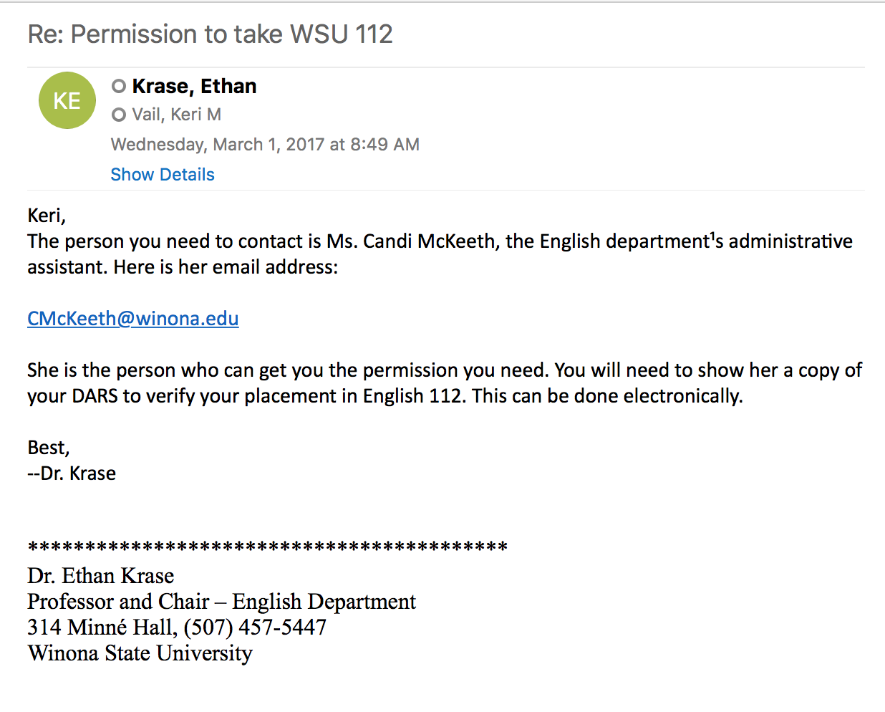
Sample email template
e

Slide 24
3. Managing Email
g
Turn off email alerts
Only check email at the start and end of the day
Set a timer – 30 minutes
Limit replies to 5 lines or less
Create email templates for commonly sent messages
Remember inbox is not a to-do list
Construct a simple filing system
Options: Reply or Forward or File or Wait or Delete

Slide 25
4. Working with the Dean
e
Take time to learn the dean’s pressures
Understand that trust has to go both ways
Invite the dean – to a meeting, to an event, etc.
Pick your battles
Bring a written list/agenda to meetings:
        Good news to share
        Your greatest need at the moment
        Other items in order of importance

Slide 26
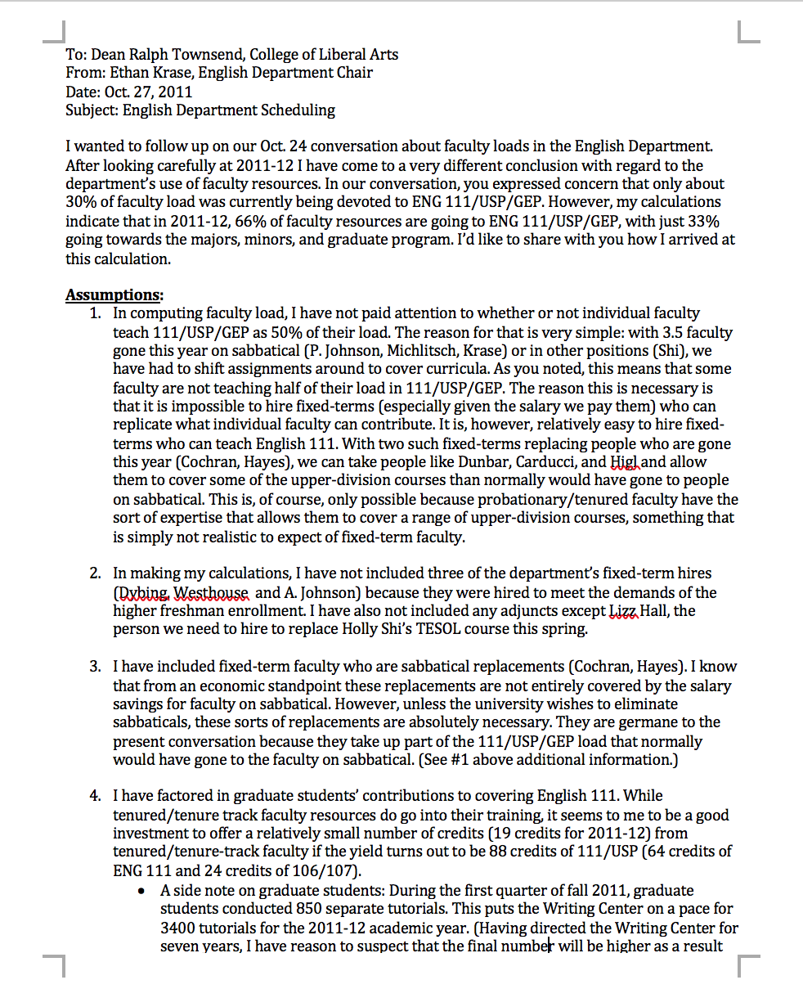
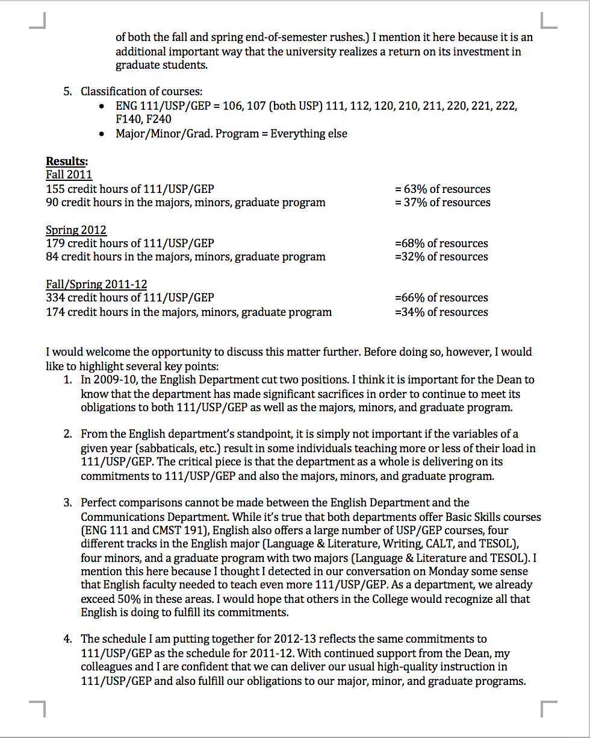
Nightmare memo for the dean…

Slide 27
Small group discussion #1
Reflect on the four strategies covered so far:
Responding to complaints
Constructing schedules
Managing email
Working with the dean
Discuss briefly your experiences with these issues, sharing ideas and practical strategies.

Slide 28
Session evaluations
Reminder to please fill out session evaluations

Slide 29
Session Break – 30 minutes
Grab a cup of coffee or a snack as you continue your conversation. We will reconvene at 11:00.

Slide 30
5. Handling Difficult Colleagues
g

Slide 31

What we wish for…

Slide 32

What we often get.

Slide 33
When difficult colleagues attack...
I just want to play devil’s advocate here….
I’m not doing this for me, I’m concerned about others.
We tried that a long time ago and it didn’t work.
After all these years, I don’t think I should have to ______.
I don’t know why you won’t go to bat on this. You don’t get it.
Why does so-and-so get to…?
Apparently, I’m the only one who…
That’s not in the contract.
[GLARING]
[LOUD SIGHING]
[SHOUTING]

Slide 34
5. Handling Difficult Colleagues
g
Understand that very few people act poorly on purpose
Stay calm
Calm down some more.
Learn the issues that set off difficult colleagues
Explain what you need to be helpful – Be specific and assertive
Find a way to value difficult faculty
Work towards closure

Slide 35
6. Promoting Departmental Harmony
e
Apologize for situations and circumstances
Send thank you notes
Recognize achievements
Record key details you hear from colleagues (trips, milestones, events, etc.)
  Enlist administrative assistant
MBWA – Manage By Walking Around

Slide 36
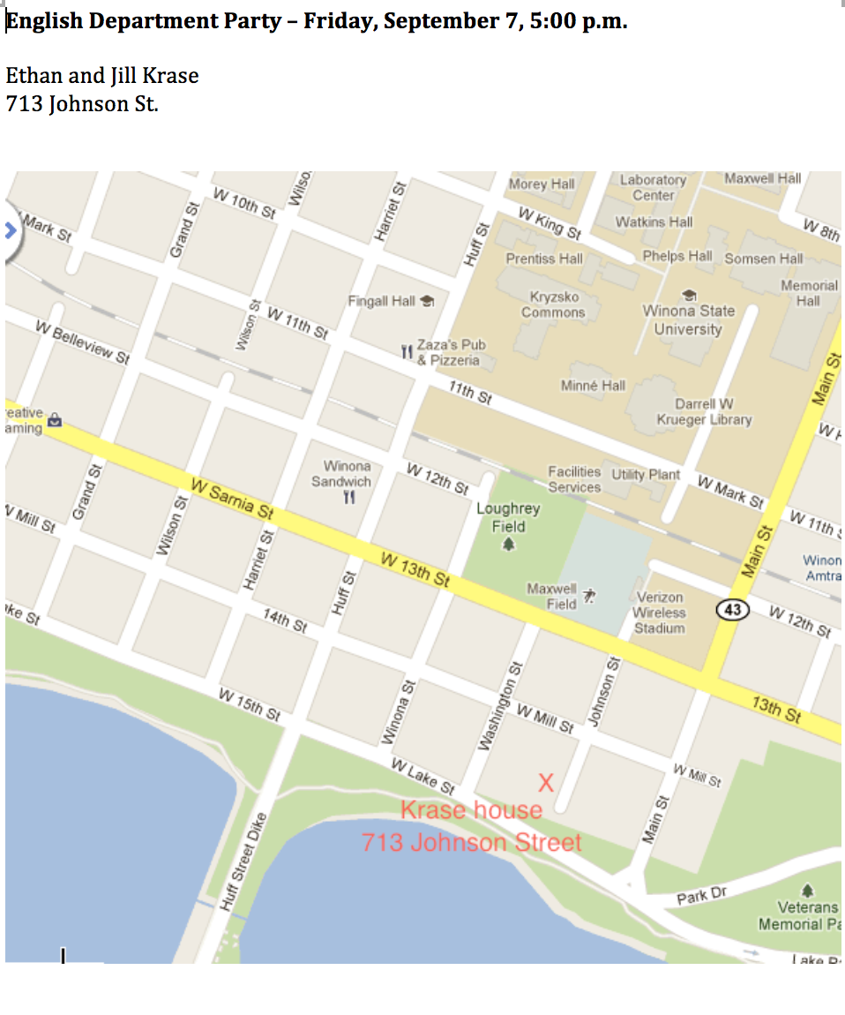
Remember the value of mandatory fun…

Slide 37
7. Managing Time Effectively
g
Set no more than three goals for each day
Enlist administrative assistant as resource
Practice effective email strategies
Two-minute drill
Periodic review of department goals/priorities
Block time for individual goals

Slide 38
8. Maintaining Mental Health
e
Remember the chair is a role
Work towards the mission
Stay out of the weeds (as much as possible)
Have a chair confidant

Slide 39
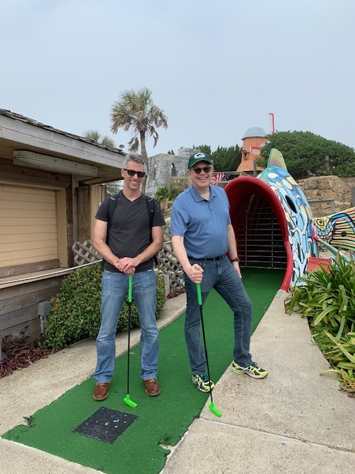
Confiding over a competitive round of (mini) golf…

Slide 40
8. Maintaining Mental Health
e
Remember the chair is a role
Work towards the mission
Stay out of the weeds (as much as possible)
Have a chair confidant
Exercise
Walk away at the end of the day

Slide 41
Small group discussion #2
Reflect on the last four strategies covered:
Handling difficult colleagues
Promoting departmental harmony
Managing time effectively
Maintaining mental health
Discuss briefly your experiences with these issues, sharing ideas and practical strategies.

Slide 42
Concluding discussion
Questions from either of your small group discussions
Additional thoughts, strategies, or issues

Slide 43
Session evaluations
Reminder to please fill out session evaluations

Slide 44
The good reasons to be chair…
Help a student in crisis
Recognize excellence in a faculty member
Reward staff for a job well done
Move the department forward on a key issue
Solve a persistent problem

Slide 45
More Help for Academic Departments
Email us for scheduling information:
  Ethan Krase, Ph.D.
    ekrase@winona.edu
  Gian Pagnucci, Ph.D.
    pagnucci@iup.edu

