Slide 1

University Academic Assembly
UAA

Slide 2
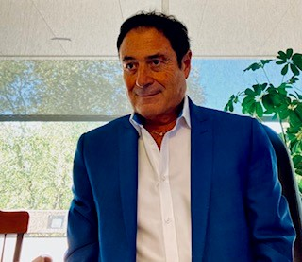
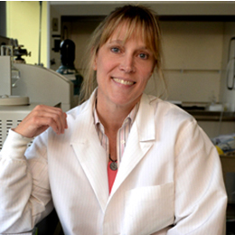
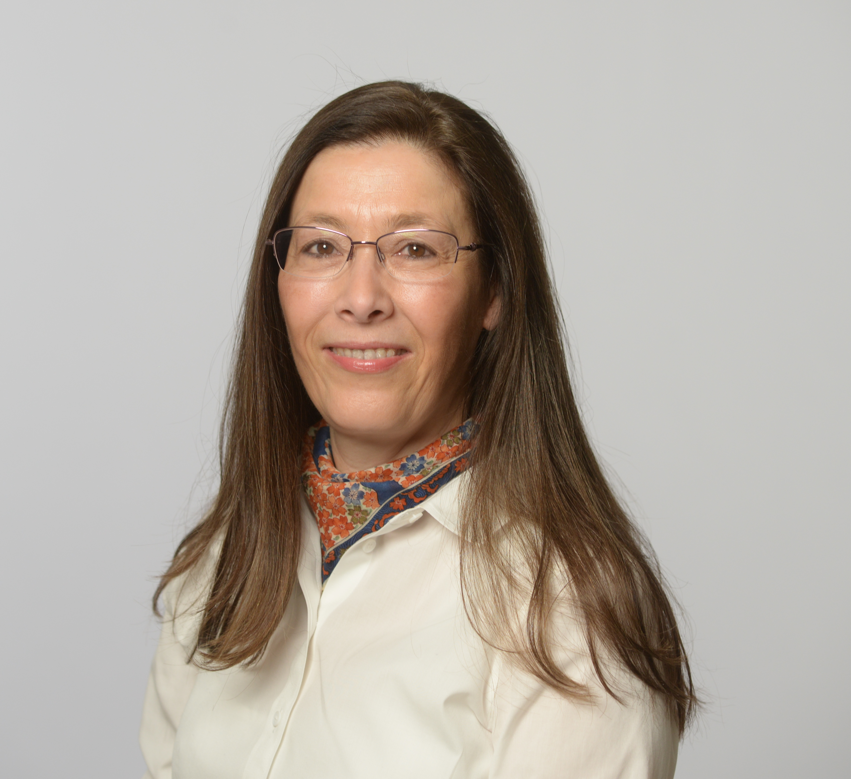
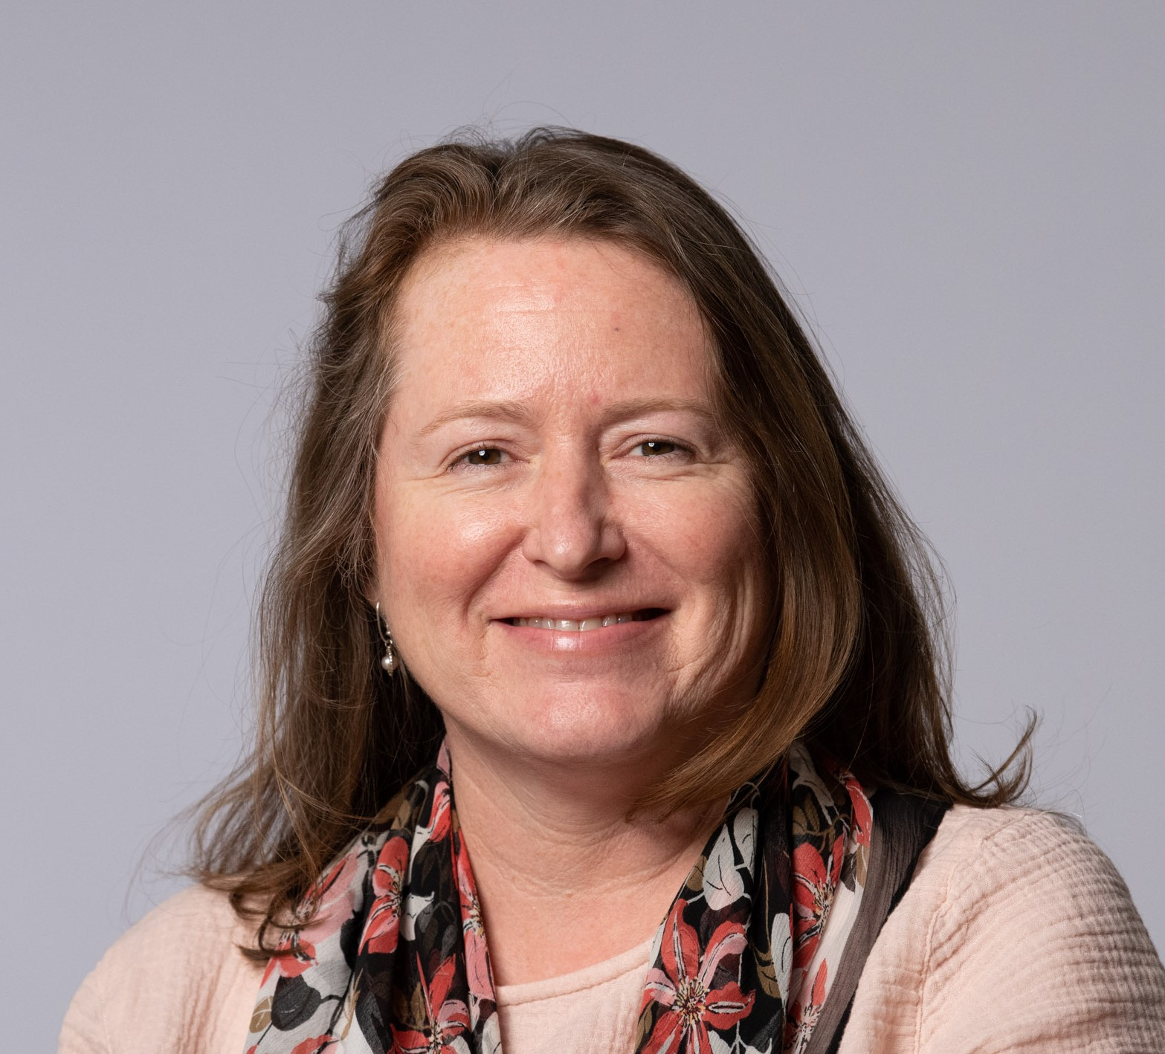
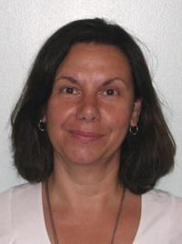
2021-2022 Officers
Domenick Pinto
UAA President (WCBT)
Barbara Pierce
UAA Vice-President
(CAS)
María Lizano-DiMare
UAA Past-President
(FCOE)
Bronwyn Cross-Denny
UAA Parliamentarian
(CHP)
Linda Morrow
UAA Recorder
(DHCN)

Slide 3
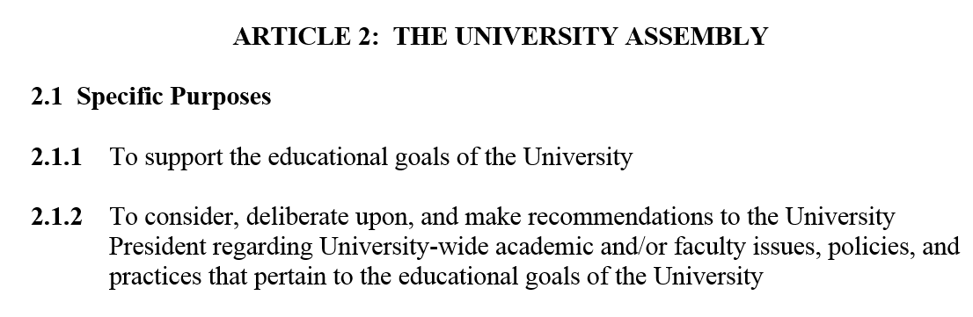
Role of the UAA
(Source – UAA Bylaws)

Slide 4
Key Governance Principles
Involvement and engagement of faculty and senior academic administrators in decisions central to the academic life and educational goals of the University.
Creation of an inclusive environment where full-time faculty, adjunct faculty, full-time staff with teaching responsibilities and senior academic administrators can engage and discuss University-wide academic issues in a meaningful and transparent way.
Development of a culture of mutual respect and effective communication between faculty and senior academic administrators.
Notes:
- Decision-making should take place at the lowest feasible level. Where issues are determined to affect a single department or college, decision-making authority (or compelling influence) is assigned at the department or college level.

Slide 5
Representation of five Colleges
College of Arts & Sciences
CAS
Jack Welch College of Business & Technology
WCBT
College of Health Professions
CHP
Isabelle Farrington College of Education
IFCE
Dr. Susan L. Davis, RN, & Richard J. Henley College of Nursing
CN
Notes:
Decision-making should take place at the lowest feasible level. Where issues are determined to affect a single department or college, decision-making authority (or compelling influence) is assigned at the department or college level.
between faculty and senior academic administrators.
between faculty and senior academic administrators.
between faculty and senior academic administrators.

Slide 6
Organization
University Academic Assembly (UAA)
Council of the University Academic Assembly (UAA Council)
Standing Committees
  Academic Affairs
  Benefits & Compensation
  Budget & Strategic Planning
  Faculty Affairs
  Rules
UAA Ad Hoc Committees
UAA Adjunct Council

Slide 7
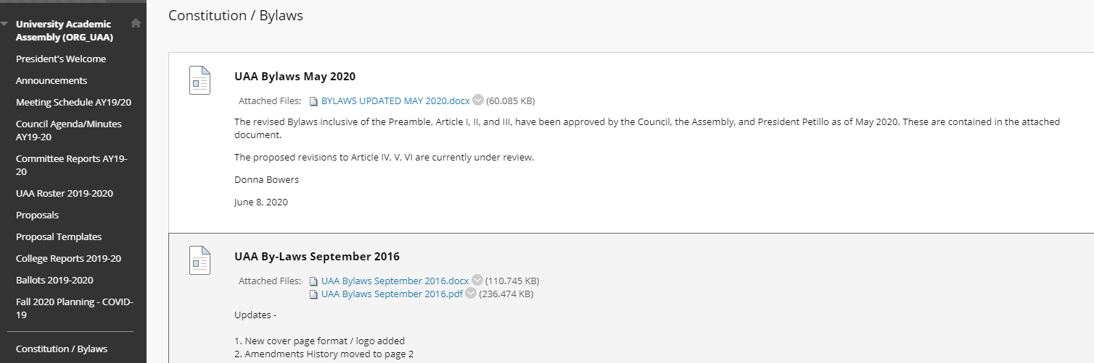
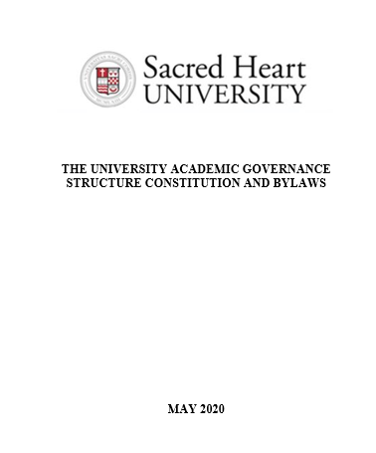
UAA Bylaws

Slide 8

UAA & Faculty Expectations
Know the UAA Officers
Identify your College UAA Council representatives
Pay attention to UAA reports provided
within your College
Read UAA communications
Become familiar with UAA Bylaws and
UAA Blackboard organization
Engage with your College UAA Council representatives

Slide 9
Submit Proposals – Your Privilege
Any member of the UAA (“all full-time University employees with faculty appointment”) can issue a proposal or charge the UAA / a specific standing committee AT ANY TIME.
Your proposal should contain the following four items:
  - Name(s) of originator(s) of proposal / Date
  - Statement of the proposal (or “charge” so to speak)
  - Rationale for the proposal
  - Data / background information

Slide 10

Vote on Proposals

Slide 11
UAA Communication Protocol
Contact your College UAA Council Representatives
Present your concerns / recommendations during
UAA Assembly Meetings
Contact the UAA President or other UAA Officers
Do not email UAA related issues/concerns/comments directly to the Provost or University President

Slide 12
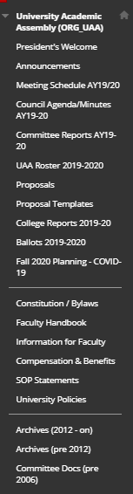
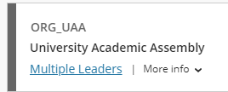
Resources for New Faculty
Full Time Faculty Handbook SACRED HEART UNIVERSITY Fairfield, Connecticut Revised, Approved by the Board of Trustees on May 13, 2019. URL: https://www.sacredheart.edu/media/shu-media/human-resources/Faculty_Handbook_May_2019_v3.pdf
The University Academic Governance Structure Constitution and by-laws-→MySHU, Blackboard, Organizations,
→

Slide 13
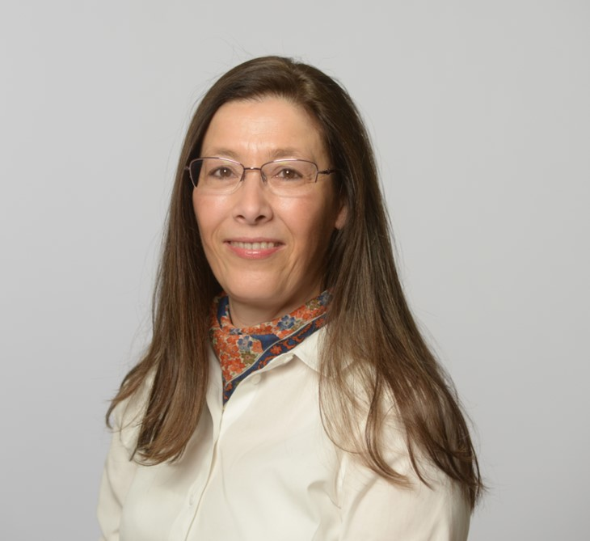
Contact Information
Barbara Pierce
UAA Vice-President
pierceb@sacredheart.edu
Linda Morrow
UAA Recorder
morrowl@sacredheart.edu
Domenick Pinto
UAA President pintod@sacredheart.edu
María Lizano-DiMare
UAA Past-President
lizanom@sacredheart.edu
Bronwyn Cross-Denny
UAA Parliamentarian
Cross-dennyb@sacredheart.edu

