Slide 1
Moving the faculty diversity needle: A view from the trenches
Amanda R. Bozack
Darryl L. Corey
Radford University

Slide 2
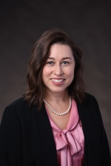
Amanda Bozack
Director of the School of Teacher Education and Leadership since 2016.
Notes:
Amanda R. Bozack is Associate Professor and Director of the School of Teacher Education and Leadership at Radford University (RU) in Virginia. She has been a part of eleven searches in her four years at Radford, none of which have resulted in a minority hire. She recently served as a member of the University Hiring Procedures Committee and as a member of the Diversity and Equity Action Committee’s faculty recruitment and retention work group. Prior to RU, she served as the Chair of the Education Department at the University of New Haven (UNH), where, as part of her equity work she served as an advisory board member for the Institute for Social Justice (UNH). She has written and presented on issues of gender equity in teacher education and is co-PI on a $13.8 million US Department of Education grant that provides specialized education training to underserved teachers in rural Appalachia.

Slide 3
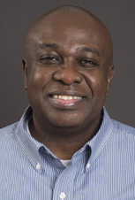
Darryl Corey
Program Coordinator of the Online MS and Certificate Programs in Math Education
Notes:
Darryl L. Corey is Associate Professor and Program Coordinator of the Online Masters and Certificate Programs in Mathematics Education at Radford University (RU) in Virginia. He currently serves as co-Chair of the university’s Diversity Equity and Action Committee and Chair of the Equity, Accessibility, and Cultural Humility Subcommittee in the School of Teacher Education and Leadership. In his career he has served on eight faculty search committees resulting in only one minority hire. His research and educational interests include online/distance mathematics education, mathematics teachers’ professional development, and culturally responsive mathematics teaching. Darryl has been awarded over $1.1 in external funding, including state, national, and international grants and contracts.

Slide 4
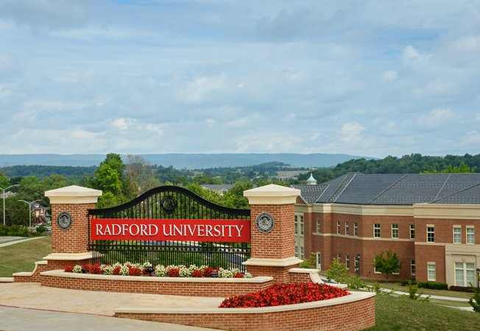
Our academic home
Notes:
Amanda- Rural, regional, public, master’s comprehensive with a few doc programs. Our enrollment hovers around 10,000 students, many of whom are first generation college students. In the Commonwealth, we are widely known for our Education and Nursing programs.
Out of the 35 faculty in our School, we have 3 BIPOC faculty members, two of whom are also international faculty members.
Darryl- what he’s noticed sitting on search committees here on campus.

Slide 5
Uncomfortable truths about our university and higher education
Higher education lacks ethnoracial diversity
Homogeneity in faculty limits the student experience
Increasingly diverse student bodies notice the lack of faculty diversity when describing their experiences at an institution
Faculty hiring practices perpetuate homogeneity through an engrained belief in the absolute right to exclude people (CRT).
Ethnoracial diversity can only occur when white faculty members recognize the exclusionary tactics utilized and take conscious actions to counter those tactics.
Notes:
Amanda-What Darryl noticed on our campus, is not limited to our campus.
Amanda will cover the first two bullets and Darryl will do the 3 other ones.
In 2016, among full-time professors, 55 percent were White males and 27 percent were White females. Hispanic and Black faculty rates have stagnated at 3-6 percent for decades
Such homogeneity restricts students’ exposure to a variety of “perspectives, experiences, knowledge and methodology,” and limits scholarly cross-pollination.
Turner, C. S. (2015). Lessons from the field: Cultivating nurturing environments in higher education. The Review of Higher Education, 38(3), 333-358.
research has demonstrated that ethnoracial diversity is associated with positive outcomes for students.
Park, J.J. & Denson, N. (2009). Attitudes and advocacy: Understanding faculty views on racial/ethnic diversity. Journal of Higher Education, 80(44), 415-438.
Critical Race Theory’s (CRT) construct of Whiteness as property and its identifying characteristic of the absolute right to exclude people, we posit that the belief in the right to exclusion is both deeply engrained and often unconsciously executed within the academy, starting with faculty search and hiring processes. Ladson-Billings, G. & Tate, W.F. (1995). Toward a critical race theory of education. Teachers College Record, 97(1), 47-68.
Harris, C. I. (1993). Whiteness as property. Harvard Law Review 106(8), 1707-1791.

Slide 6
A tale of 11 searches
(2016-2020)
We had searches in foundations, secondary math, special education, and educational leadership.
We hired 3 men, 7 women. All White.
We had 1 failed search. Black man, offer declined.
Notes:
Amanda-state the facts. The majority of our faculty have not seemed concerned with this.

Slide 7
Things we hear faculty say
“No one who’s _____will come here because we’re not in a big city.”
“No one from those racial backgrounds apply.”
“There just aren’t many BIOPC people in the field with doctoral degrees.”
Notes:
Darryl’s slide (modify as you like)
What other things do we hear faculty say to explain the racial disparity in hiring?
This sort of justifying the way the ad was written, where it was promoted, and what’s highlighted as important--rather than asking what role we’ve played in this trend.

Slide 8
But we’re trying to change the culture…
Revised the university faculty hiring guidelines with a greater focus on diverse recruitment
Attended a regional conference on strategies for hiring diverse faculty
Took roles on university committees recommending changes in DEI practices
Led workshops for university faculty and staff; provided articles for search committees
Staffed search committees with faculty who support diversity efforts
Modified search requirements and campus visit agendas
Notes:
Amanda does a quick overview of the slide & Darryl talks more about DEAC

Slide 9
And yet…
We still have a long way to go.
Notes:
Amanda.

Slide 10
Reflections on what this means
The power to exclude is strong
  Will 4 new searches yield the same results?
What counts as diversity in your departments?
What are the consequences of hiring a “good fit” candidate?
What effective practices are your colleges using to move toward diversity-focused faculty hiring?
Notes:
Amanda does the first bullet and Darryl leads the reflection questions.

Slide 11
References
U.S. Department of Education, National Center for Education Statistics (2019). https://nces.ed.gov/fastfacts/display.asp?id=61
Turner, C. S. (2015). Lessons from the field: Cultivating nurturing environments in higher education. The Review of Higher Education, 38(3), 333-358.
Park, J.J. & Denson, N. (2009). Attitudes and advocacy: Understanding faculty views on racial/ethnic diversity. Journal of Higher Education, 80(44), 415-438.
Heilig, J.V., Flores, I.W., Souza, A.E.B., Barry, J.C., Monroy, S.B. (2019). Considering the ethnoracial and gender diversity of faculty in United States college and university intellectual communities. The Hispanic Journal of Law and Policy, 2019(1) 1-31.
Smith, D.G., Turner, C.S.V., & Osei-Kofi, N. (2004). Interrupting the usual: Successful strategies for hiring diverse faculty. Journal of Higher Education, 75, 133-156.
Ladson-Billings, G. & Tate, W.F. (1995). Toward a critical race theory of education. Teachers College Record, 97(1), 47-68.
Harris, C. I. (1993). Whiteness as property. Harvard Law Review 106(8), 1707-1791.
Dodo Seriki, V.D., Brown, C.T., Fasching-Varner, K.J. (2015). The permanence of racism in teacher education. National Society for the Study of Education, 114(2), 75-102.

