Slide 1
Navigating the Realm of Faculty Evaluation
Sonal Dekhane, Patrice Bell, Neelam Khan
Academic chairpersons conference
February 10, 2022

Slide 2
Agenda
Institutional background
Evaluation framework
Essential skills for evaluators
Managing a team of evaluators
Challenges
Successes

Slide 3
Institutional Background
Young public, liberal arts institution, launched in 2006
Offering baccalaureate degrees
  11,000 students, 60+ programs of study
Open access, Minority serving institution, Hispanic serving institution
Some unique characteristics
  Flat structure that has evolved as the institution grew
  Faculty have rank, but no tenure
  Comprehensive evaluation each year, vital to faculty advancement and retention
School of Science and Technology (SST)
  Largest school in the college, 7 disciplines
  ~4300 students, >200 full-time faculty, 40 part-time faculty

Slide 4
Evaluation Evolution Timeline
Dean, Associate Deans
Dean, Associate Deans, Assistant Deans
Chair of Faculty + Secondary evaluators
2007 - 2012
2013 - 2017
2018 - Present

Slide 5
Evaluation Framework
Six (6) Major Milestones in an Academic Year
August
Evaluee drafts and submits goals for the year on Faculty Evaluation Support Form (FESF).
September
Meet with evaluees and discuss FESF
Observe teaching (every 2 years)
October
Evaluator documents initial notes on FESF
Distributes a copy to faculty
April
May
June
Evaluee submits:
1) annual portfolio
2) updated goals on FESF
Meet with evaluees and discuss year in review
Evaluator documents final notes on FESF
Complete FT evaluation report
Solicit feedback/review from faculty on FT evaluation report.
Submit final evaluation report to Dean with supporting documents (FESF, teaching observation, annual portfolio)

Slide 6
Faculty Weights of the Four Domains
Domain | Example Distribution | Minimum Allowed | Maximum Allowed
Teaching | 45 | 45 | 60
Student Engagement | 15 | 15 | 30
Scholarship and Creative Activities | 15 | 10 | 30
Service | 25 | 10 | 30
GGC is primarily a teaching institution.
Domain weights are present in the Annual Portfolio.
Faculty and evaluators agree on this final distribution in the May meeting.

Slide 7
Sample Excerpts from the Faculty Evaluation Support Form
Professional Development Goals for the Academic Year. (August)
(List one or two goals you intend to work toward in each of the academic domains – Teaching, Scholarly and Creative Activities, Service and Student Engagement.)
* Annual Portfolio provides detailed documentation of all domains.
List Your Significant Contributions for the Academic Year. (May)
(This should be a bulletized list of major progress made toward the professional development goals set in your initial meeting with your rater for each academic domain. You should expand on those entries in your portfolio.)

Slide 8
Essential Skills for Evaluators
Communication (Oral and Written)
Unbiased Intake of Situations
Critical Thinking
  Problem Solving - “Think on your feet”
  Conflict Management - Fair, constructive solutions
Accountability for Professional Development
Mentoring
Record keeping

Slide 9
Team Work to Evaluate Large Disciplines
  Chair of Faculty – ultimate responsibility
  One evaluator per 10 faculty
  Communicate priorities, philosophy and expectations
  Consistent guidelines and standard tools
    Rubrics, spreadsheets
  Regular meetings to ensure all questions are answered, all steps in the framework followed
  Regular meetings also help discuss issues and tweak process and guidelines as needed
  One evaluator (CoF) for small disciplines
Notes:
Assoc and Full profs, evaluate faculty with lower ranks

Slide 10
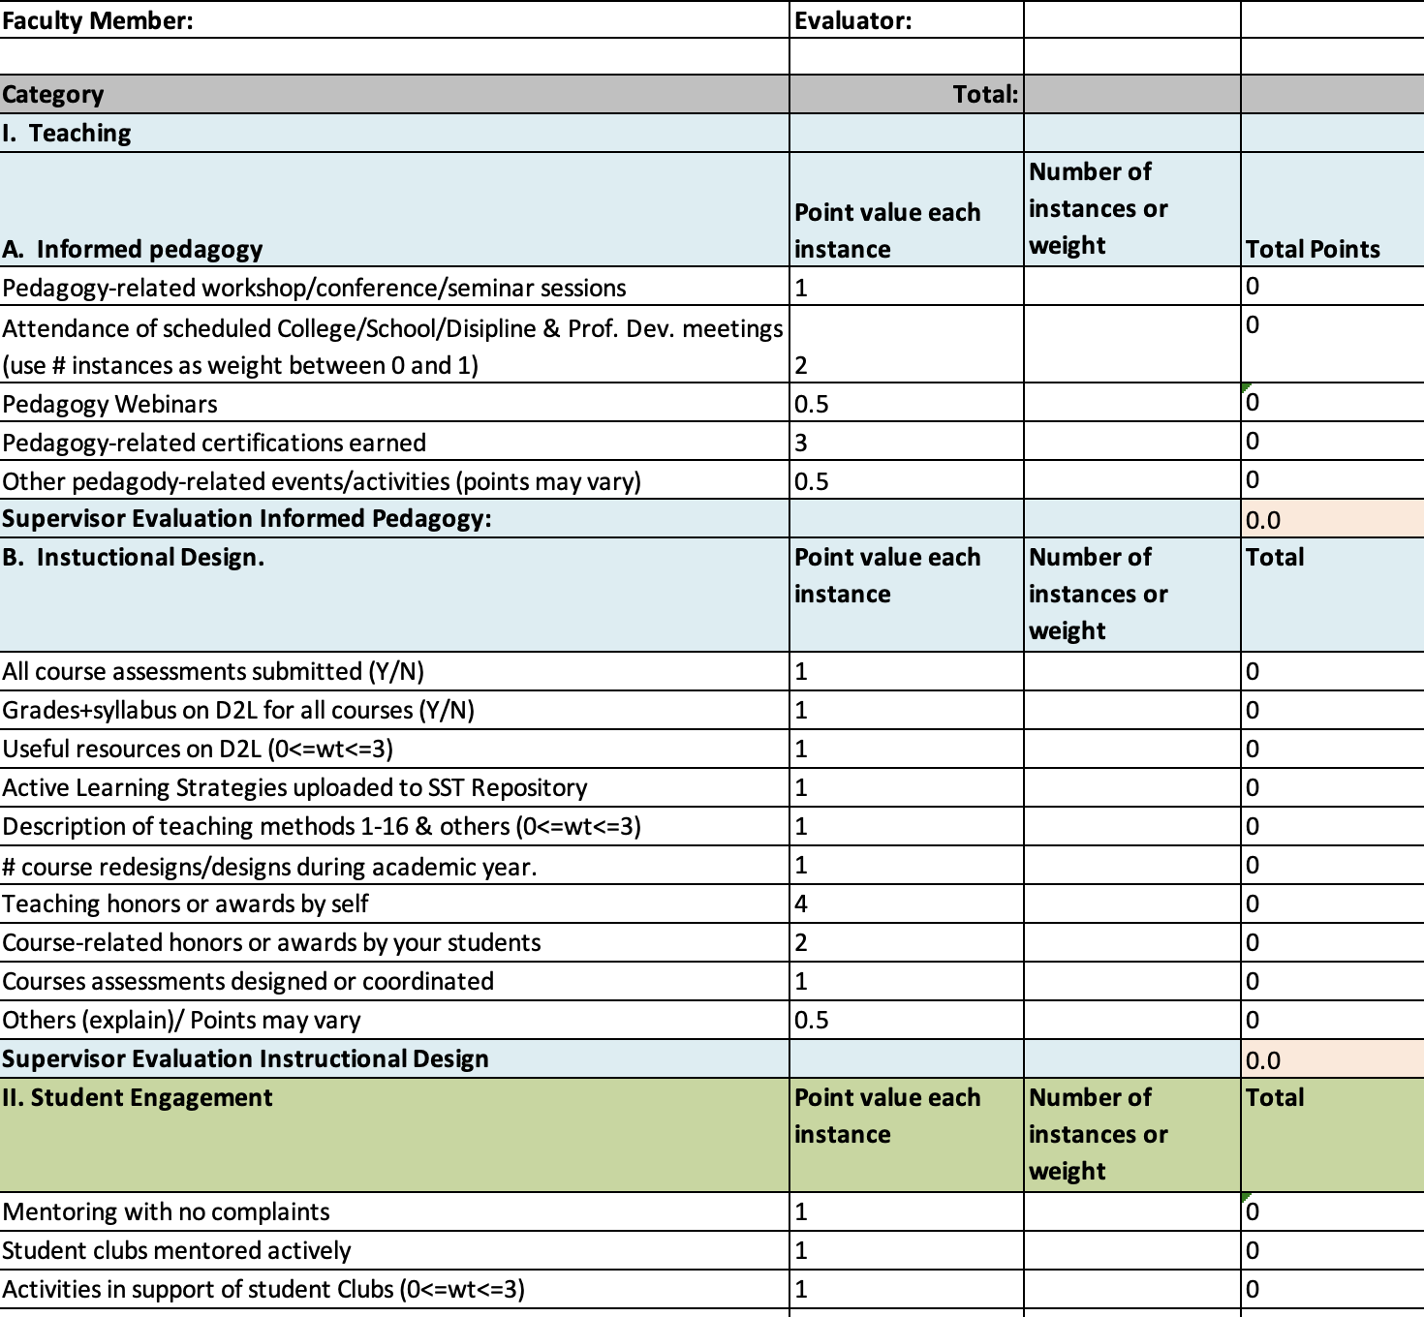
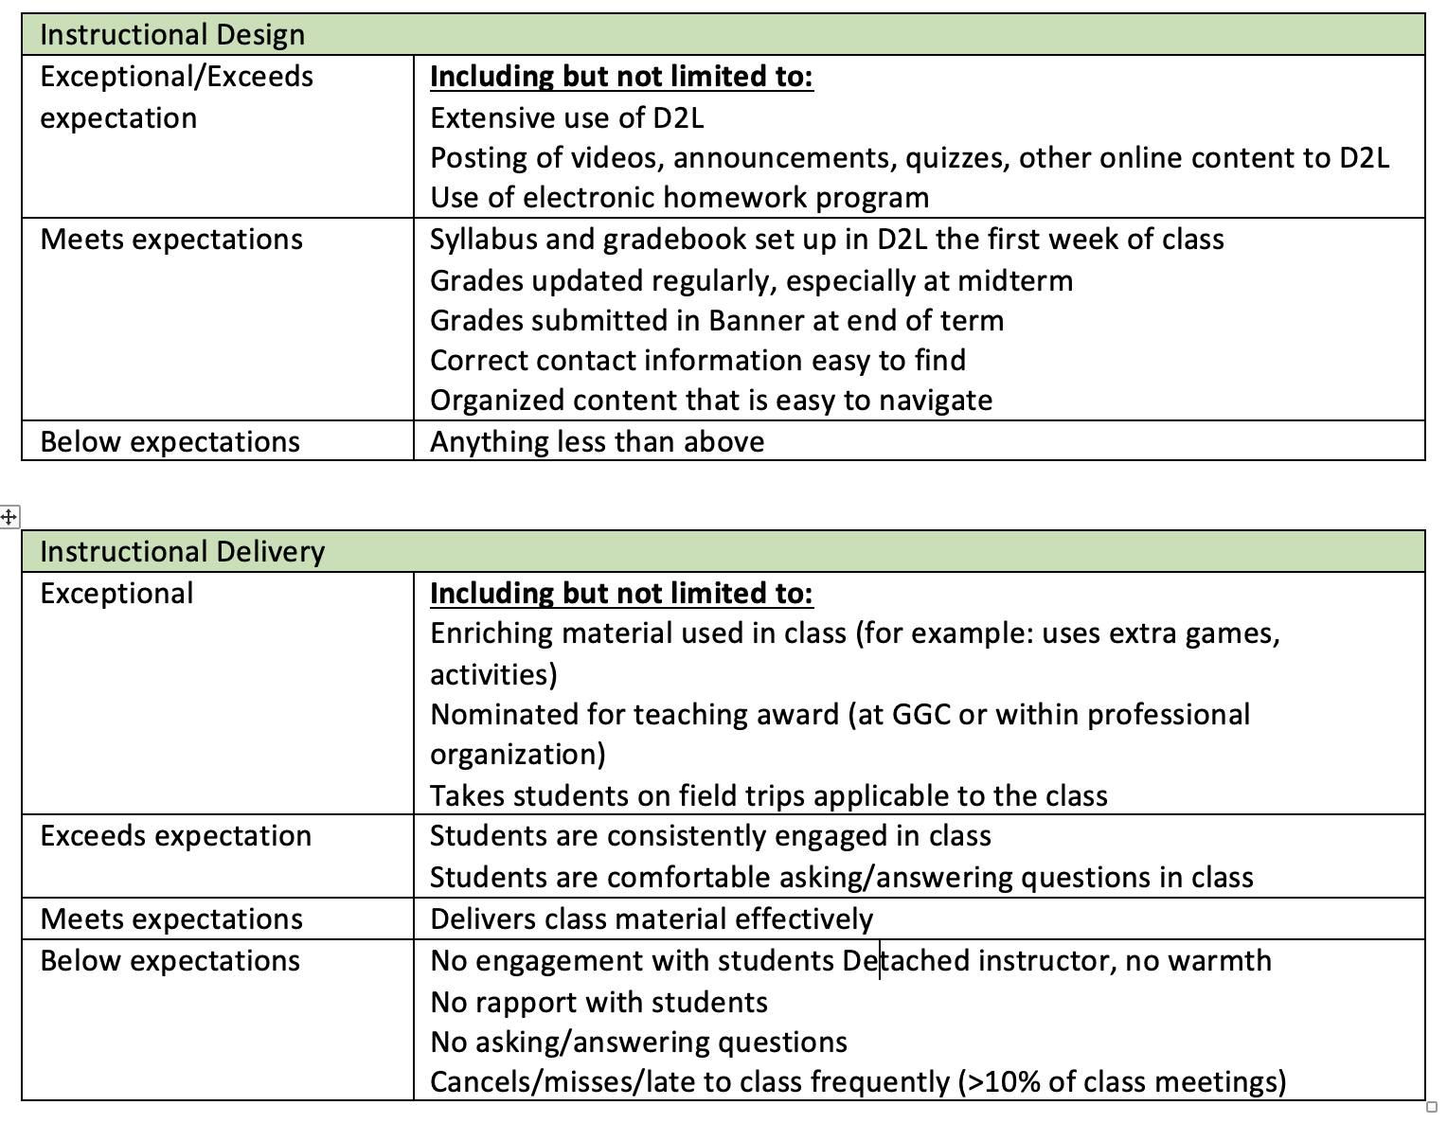
Sample Tools

Slide 11
Challenges
Lack of productivity
Sustained pattern of complaints
Lack of collegiality
Conflict management

Slide 12
Successes
Effective Evaluation Strategies
To create a professional growth mindset, chairs meet with the faculty to discuss their professional development goals for the academic year that they listed in FESF.
Chairs are role models for faculty. They lead by example that is reflected through their own annual portfolio.
Chairs share their own annual portfolio, and rubric with faculty to give an example of how to report each category, and additionally how each category will be evaluated.
Faculty know what is expected of them to meet expectations, exceed expectations, below expectation.

Slide 13
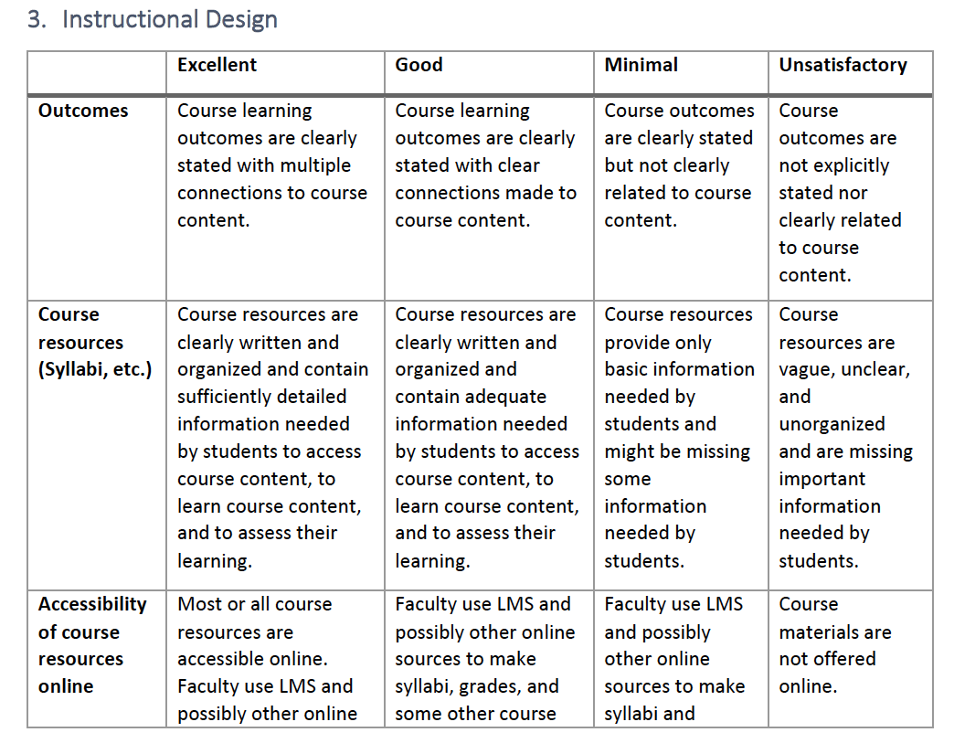
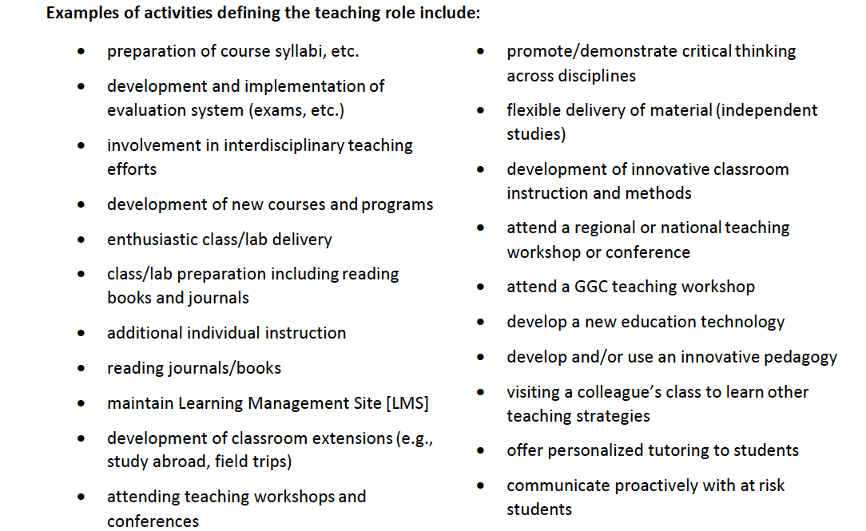
Successes
Rubric-Example-Teaching
Example of Activities-Teaching

Slide 14
Successes
Strategies that worked during the annual meeting.
    Review faculty's portfolio before the meeting.
    Asking faculty about how they felt about their performance in all the academic areas of evaluation, so they could self-reflect.
    Giving them an opportunity to speak about what worked and what didn’t.
    Faculty are praised if they performed well, and their efforts are appreciated.
    If any of the domain needs improvement, they are given an opportunity to express how they can improve it.
    Link evaluation to promotion and career development opportunities.
Faculty are informed verbally during the meeting, if any of the academic domain needs improvement, and suggestions/ constructive feedback is provided. They are told that they will receive what is being discussed in the written form as well to avoid any surprises for them.
The written evaluation form is shared with the faculty member for them to sign, which indicates that the faculty has seen the form.

Slide 15
Successes
The success of our evaluation method is reflected through the number of promotions from assistant to associate and associate to professor position
 | # of Faculty Promoted | # of Faculty Promoted
Year | Assistant Professor to Associate Professor | Associate Professor to Professor | Success rate for all promotions
2017 | 15 | 1 | 84%
2018 | 15 | 7 | 91%
2019 | 10 | 7 | 100%
2020 | 8 | 2 | 71%
2021 | 17 | 10 | 93%
Average (AY17-21) |  |  | 88%

Slide 16
Summary
Established GGC faculty evaluation system is successful.
  Helps cultivate a professional growth mindset
  Aids with retention and advancement
  Accountability of four domains as reviewed by evaluator
Collaboration of evaluator team and Chair of Faculty has proven to be a manageable model—one evaluator per ten faculty for larger disciplines.
  Essential skills for evaluator
  Consistent evaluation and mentoring
  Standard tools (rubrics, spreadsheets) per discipline with common domains
Periodic review of our challenges, successes and best practices drive our continual assessment and improvement of our evaluation process.

Slide 17
Questions?

Slide 18

Example Scenario: Student Complaint with Professor
Student Complaint Communication
Separate Intake Statements & Evidence
  Student Intake statement
  Faculty Intake statement
Evaluate the situation
  Is there clear evidence of (by either party):
    Miscommunication
    Course policy violation (syllabus)
    Grade Discrepancy
    Other School policy violation
  Is there sufficient evidence to make a decision?
Weigh the evidence. Do you need a fourth party?
Communicate the solution. What would benefit both parties?

