Slide 1

Evaluating Faculty in the Cloud: Leveraging what Online offers in Evaluating Courses and Instructors
Academic Chairperson's Conference
Virtual
February 4th, 2021
David Line, Eastern Washington University
Stephen Pyle, Johnson & Wales University

Slide 2
Welcome/Introductions
Stephen Pyle, Johnson & Wales University
College of Online Education, College of Business Academic Director
20 Years as an On-Campus Academic Chair
25 Years as a Full-time On-Campus Faculty
Non-Union Private Institution
David Line, Eastern Washington University
Master of Public Health, Program Director
12 Years as a Full-time Online Instructor
Quality Matters Master Course Reviewer
Unionized Public Institution
spyle@jwu.edu
dline@ewu.edu
Notes:
(out frames of reference)

Slide 3

Introduction to the Presentation
Examine available tools and resources available to chairs to support evaluation of on campus and remote faculty
  Learning Management Systems (LMS)
  Techniques
Capture the benefits of digital systems for on-campus evaluations
  Blend the benefits of both formats to strengthen evaluation systems

Slide 4

Statement of Need/Opportunity
Current situation, COVID Response
  Forced shift in Spring 2020
    Missed faculty evaluation in Spring 2020
    Need to reinstate for 2020-2021 Academic Year
Current opportunity
  Delivery of courses in 2021-2022 academic year is evolving
    Transition future evaluation methods to take advantage of online delivery
Online evaluations provide a myriad of additional evaluation opportunities
  Greater access to course content
  Greater access to course delivery
This presentation will focus on using digital information to enhance both traditional and online instructor evaluation.
Notes:
1.5 million faculty moved from on-campus to online in Spring 2020 terms
Inside Higher Ed (2020, April 24). The Great (Forced) Shift to Remote Learning: a Survey of
Instructors and Campus Leaders​​​​​​​ [Webinar]. Retrieved from https://clicktime.symantec.com/3BUptVmJ43v64XdHd2yU3f17Vc?u=https%3A%2F%2Fevent.on24.com%2Fwcc%2Fr%2F2284011%2F83FCC1EADB0A4255DD68A65282E2DA09%3Fmode%3Dlogin%26email%3Dspyle%40jwu.edu

Slide 5

What are your Experiences of Faculty Evaluations in Spring 2020 & 2020-2021 A.Y.
In Spring 2020
  Did you shift from on-campus to online?
  Were you evaluated by students?
  Were you evaluated by peers?
  What happened to your year end summary?
In Academic Year 2020-2021
  Are you still primarily online?
  Will your faculty be evaluated by students and peers?

Slide 6

Problem Statement: On-Campus evaluations lack the ability to evaluate Remote Delivery
Inability to evaluate faculty in person
On-campus and online evaluation criteria are different
Online evaluations are often developed from on-campus evaluations
On-campus chairs often are out of their comfort zones
  Especially those who have limited previous remote teaching experience (i.e.: Senior faculty, Deans, Provosts, and Presidents)

Slide 7
What is the status of your institution?
Did you have an online specific evaluation before Spring 2020?
Have you developed an evaluation specific to remote delivery?
Are you using an on-campus evaluation for remote delivery?

Slide 8
Learning Management System
Do you use LMS data in course evaluations?
Do you have access to courses taught by instructors in an LMS?
Who does the LMS evaluation?

Slide 9
Typical Components
Used to Evaluate Faculty
Peer and/or Chair Evaluation
Student Course-Instruction Evaluation
Midterm and End of Course
Data-Content Evaluation
LMS and/or Syllabus
Summary Evaluation
Instructor vs Program
Program vs Institution
Classroom Observation

Slide 10
Resources Available to Chairs
On Campus Delivery
Digital Delivery
Peer/Chair Evaluation
  Single Observation in a Class
  Check Sheet/Guide
Data-Content Evaluation
  Syllabus
Student Evaluation
  Quantitative & Qualitative
Peer/Chair Evaluation
  Learning Management System
    Analytics
    Direct Observation
  Check Sheet/Guide
  Process
Data-Content Evaluation
  Learning Management System
Student Evaluation
  Quantitative & Qualitative

Slide 11
Differences in Access to Data
On Campus Delivery
Digital Delivery
Direct access to course:
  Syllabus
In class observation once a term/year
  Performance anxiety/stress component
  Students are aware of observation
Observation must be planned
  Spontaneous or announced
Direct access to course:
  Syllabus
  Lecture materials/videos
  Course messages (announcements, module introductions, emails, Q&A, etc)
  Discussion posts
  Assignment feedback
Potential for ongoing evaluation
  Analytics

Slide 12
Differences in Process
Traditional Format
Digital Format
Traditionally done by being invited into a class or showing up unannounced
  Syllabus is commonly sent prior to reviewing the class
  Course content may or may not be provided in advance, or upon arrival, to the class
  Acceptable level of information based on the nature of the case study evaluation
Online is done by reviewer entering the course
  Quantity of information available is extensive
    i.e.: When does the instructor log-in
    i.e.: When are informal evaluations of the course progression done?
  Opportunity to have instructor provide a targeted course introduction to the reviewer
    This can double as an instructor course self-evaluation

Slide 13
Differences in Peer/Chair Evaluations
On Campus Delivery
Digital Delivery
Anecdotal and single case
Emphasis on Subjective Evaluation
Cohort Study
Emphasis on Objective Evaluation
Peer/Chair Evaluations typically draw from a standard set of questions and assessments of:
Syllabus
Delivery
Content
Demonstrated Expertise
Engagement

Slide 14

Evaluating Digital Delivery: Best Practices

Slide 15
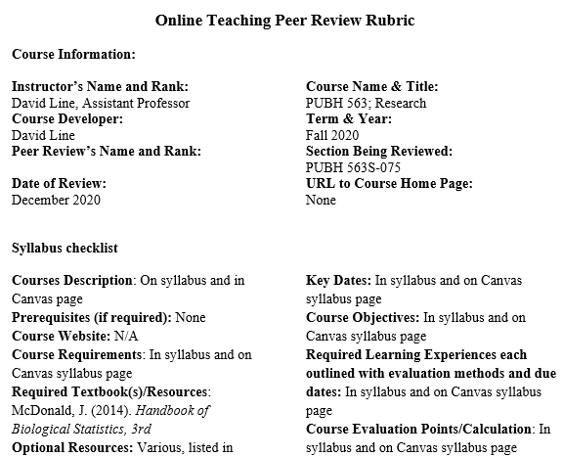
Pre-evaluation for Digital Evaluation
Instructor provides a targeted introduction to course
  This can double as an instructor course self-evaluation
Every question should either have
  an answer provided or
  a process to find the answer
Reviewer systematically reviews course
Saves reviewer time and effort
  Digital and on-campus take same amount of time
Increases instructor’s awareness of expectations

Slide 16
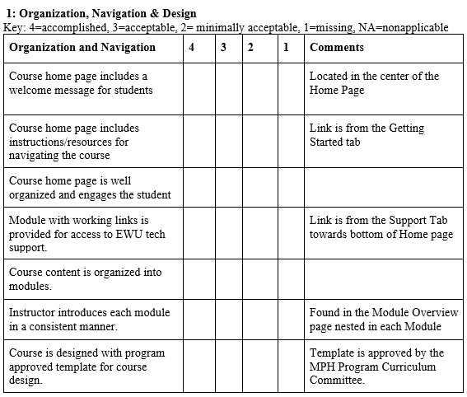
Pre-evaluation for Digital Evaluations
Completed by Instructor
  Pre-evaluation takes about 1 hour to complete
Expectation of identifying course components is placed on the instructor
Benefits
  Reduces the potential of the reviewer to miss components
  Encourages instructor to highlight components
Reviewer examines the identified components for credibility

Slide 17
Learning Management System Data Generation
Timing - Pre-term, Beginning of term, Middle of term, End of term, After term
Access to course – Institutional access, Invitation by instructor, Quick Enroll options in LMS
Level of access – Course shell (proxy course), instructor introduced materials, all materials including student generated materials, graded materials, grade book, analytics
Assessment features (tools) – Course content, analytic tools
Analytics – University generated; reviewer accessed
Review response timing – within days, weeks, term, on-going

Slide 18
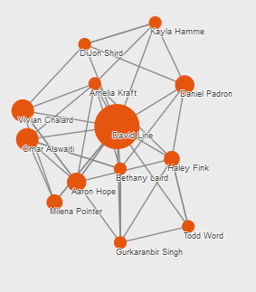
Presenting the Findings
Formats
  Formal Evaluations
  Dashboards
Audiences
  Instructor
  Students
  Administration
  Promotion Committee

Slide 19
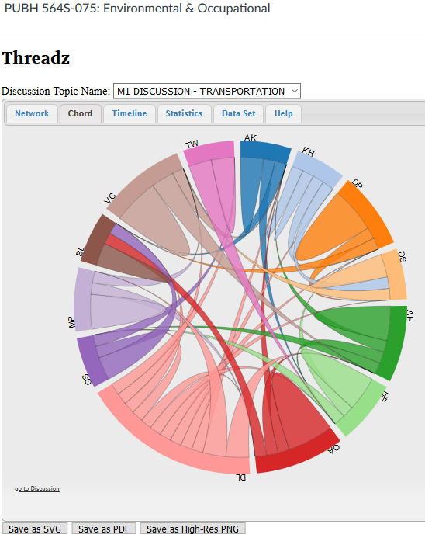
Use of Results
Instructor Review
  Promote
  Renew
  Release
Trend lines
Program Review

Slide 20
Effectiveness
How well does the process give you information that you can use?
How adaptable is the evaluation process?
How well does your process function?

Slide 21
Ethics
Data gathering
Transparency
Information security
Reporting
Who gathers & What is gathered
Who is aware Data is Gathered
Who has access to data Gathered
Who Sees results

Slide 22
Conclusion
Traditional methods should not limit current opportunities
Online methods can be incorporated into traditional formats

Slide 23

Thank You

