Slide 1

Effective Shared Governance:
Creating Boundaries
or Alignment?
Steven C. Bahls, Augustana College

Slide 2

Lessons from Arctic Canada:
When in quick-sand,
keep moving.

Slide 3

Lessons from Arctic Canada:
2. Too much focus on a mere annoyance can cause you to lose sight of the big threats.

Slide 4

Photo by Larry Fisher, Quad-City Times, Oct. 3, 1995

Slide 5
Each group views Shared Governance differently:
Faculty
Board members
Administrators

Slide 6
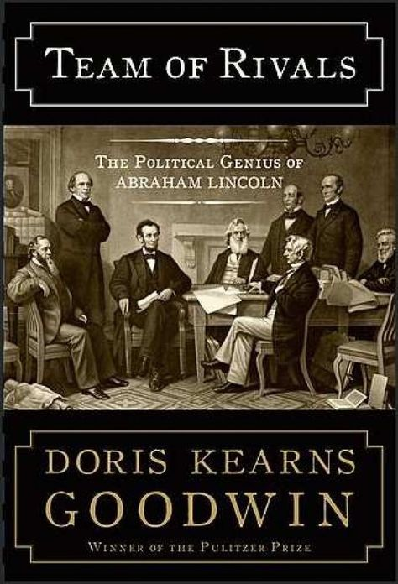
Cover of Doris Kearns Goodwin’s Team of Rivals
(featuring Francis B. Carpenter’s “First Reading of the Emancipation Proclamation Before the Cabinet”)

Slide 7
An effective Team of Rivals can:
Lead to consequential boards
Empower faculty governance
Enhance legitimacy for administrative leadership
Create alignment

Slide 8
Evolving challenges in Shared Governance:
Increase in non-tenured faculty
Multiple campuses
Pace of change
Collective bargaining agreements

Slide 9
Four views:
Equal Rights
Consultation
Rules of Engagement
Shared Responsibility

Slide 10
At College of Saint Mary ~
Current State:
33% Consultation
19% Boundaries

Slide 11
At College of Saint Mary ~
Desired State:
49% - A system to align priorities

Slide 12
At College of Saint Mary ~
Perception Gaps:
Definition of Shared Governance
Level of advocacy for S.G.
Level of transparency
“Good faith” in discussions
Clarity of Faculty Handbook

Slide 13
Shared Governance as…
Equal rights to governance

Slide 14
Shared Governance as…
Obligation to consult

Slide 15
Shared Governance as…
Rigid rules of engagement

Slide 16
Shared Governance as…Frost?
My apple trees will never get across
And eat the cones under his pines, I tell him.
He only says, “Good fences make good
neighbors”…
“Why do they make good neighbors? Isn’t it
Where there are cows?”
But here there are no cows.
-Robert Frost, Mending Wall

Slide 17
Shared Governance as…
Open communication that aligns priorities & creates a culture of shared responsibility

Slide 18
To align priorities:
Nurture culture of transparency
Commit to joint consideration of
difficult issues
Agree on shared set of metrics for success
Craft checks & balances to maintain mission focus

Slide 19
Barriers:
Attitudinal
Structural
Behavioral

Slide 20
Attitudinal Barriers:
Myths corrode trust

Slide 21
Five myths about trustees:
‘Suits’ practicing Drive-by management.
Care more for the website’s landing page than the content of the catalog.
Prefer bragging rights to lasting outcomes.
Bean counters who lack vision.
Motivated by Good Ol’ Days that weren’t really that good.

Slide 22
Five myths about administrators:
Only care about the bottom line.
Puppets of the board.
Self-promoting hucksters of higher ed.
The best administrators are order-takers for my constituency.
Essentially, a necessary evil.

Slide 23
Five myths about faculty:
Kittens would be easier to manage.
Want to be asked, but don’t care to respond.
Best to find the path of least resistance.
Professional contrarians who reward their best with tenure.
They just can’t take ‘Yes’ for an answer.

Slide 24
Structural Barriers:
Excessive decentralization
Prone to ‘Grumbler’s Veto’
No implementation matrix

Slide 25
Behavioral Barriers:
Conflict avoidance
Lack of respect
Impatience
Divide and conquer attitudes

Slide 26
Six Best practices:
1. Actively engage board members, administrators, and faculty leaders in a serious discussion of what shared governance is (and isn’t)

Slide 27
Six Best practices:
2. Periodically assess the state of shared governance and develop an action plan to improve it

Slide 28
Six Best practices:
3. Expressly support strong faculty governance of the academic program

Slide 29
Six Best practices:
4. Maintain a steadfast commitment to three-way transparency and frequent communication

Slide 30
Six Best practices:
5. Insist on mutual accountability and outcomes measures

Slide 31
Six Best practices:
6. Develop deliberate ways to increase social capital between board members and members of the faculty

Slide 32
What roles should students play in Shared Governance?

Slide 33
Thanks!
Steven C. Bahls, Augustana College
stevenbahls@augustana.edu

