Slide 1

Avoiding Yet Another Search:
Programs That Support a Diverse Faculty
Christy Crutsinger, Vice Provost for Academic Affairs
Michael McPherson, Associate Vice Provost for Faculty
Notes:
Mike
Christy

Slide 2
Purpose
Identify strategies to help your department or institution retain a diverse faculty.
Notes:
Christy

Slide 3

Hiring a diverse faculty
is _________________ because ____________________________.
Notes:
Christy

Slide 4
Retaining a diverse faculty is _________________________ because ___________________.
Notes:
Christy

Slide 5
The Value of Diversity.
Diversity fosters creativity
Diverse learning environments make students more marketable (and better citizens)
Faculty diversity helps institution recruit and retain students
Notes:
Christy

Slide 6
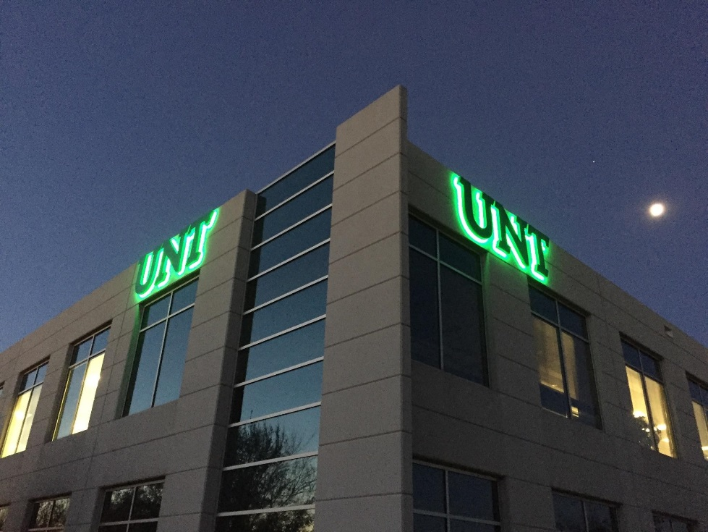

How Diverse is UNT’s Faculty?
Notes:
Christy

Slide 7
Racial Diversity in Higher Education (2014)
SOURCE: National Center for Education Statistics
Notes:
Mike

Slide 8
Gender Diversity in Higher Education (2014)
SOURCE: National Center for Education Statistics
Notes:
Mike

Slide 9
Why do faculty leave?
Alignment with research and teaching interests
Increase salary
Isolation
Workload
More prestigious institution
Personal reasons
Bullies
Work life balance
DEPARTMENT CHAIR
Notes:
Mike

Slide 10
Quit Lit
To be seen and heard after years of feeling ignored, devalued and dismissed
To be a role model for others
To publicly explain their choice to leave
To provide their own critical analysis of the state of the academy on the way out the door
Notes:
Mike

Slide 11
How healthy is your department?
Pre-Awareness
Intention Inclusion
Culture of Inclusion
Diversity Awareness
Transition State
Achieving a Culture of Inclusion. A Self-Assessment Tool (2006).
UCLA Office for Faculty Diversity
Notes:
Christy

Slide 12
Retention Efforts @ UNT
Notes:
Mike

Slide 13
Benchmarking
COACHE survey
Climate survey
Exit surveys
Notes:
Christy

Slide 14
Faculty Mentoring Program
One-on-One Mentoring
Cross Disciplinary Mentoring Teams
Mentoring Grant Program
Find a mentor. Be a mentor
Notes:
Mike

Slide 15
Faculty Affinity Groups
LaColectiva
Black Faculty Network
Asian Faculty Network
LGBT Faculty Network
Women’s Faculty Network
Notes:
Mike

Slide 16
New Faculty Initiatives
Conference Support
Mini Development Leaves
Notes:
Mike

Slide 17

Advocates
Allies
NSF -ADVANCE Plan D
Notes:
Christy

Slide 18

ADVOCATE. A male colleague who has a strong voice in the department and is willing to train others to address gender equity issues.
Notes:
Mike

Slide 19
ALLY. A male faculty member whom the advocate trains as a proponent of gender equity.
Notes:
Mike

Slide 20


Webinars
Monday Motivators
Private Forum
Multi-Week Courses
Career Center
Notes:
Mike

Slide 21
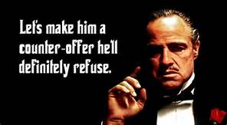
Counteroffers
Notes:
Christy

Slide 22
Preparing for a Counteroffer
Don’t be caught off guard
Have clear guidelines/procedures in place (and know what they are)
Give your dean a heads up
Notes:
Christy

Slide 23
What are your great ideas?
Notes:
Christy

Slide 24
Hot Spots
Let’s hear from our faculty hot spots. In your group, take a few minutes to reflect on the situation.
Why would this faculty member say this?
How does this make YOU feel?
What can you do to improve their experiences?
Notes:
Christy

Slide 25
Thank You! christyc@unt.edu
Michael.mcpherson@unt.edu
Please don’t forget to complete your survey, either on the Guidebook app or using the paper forms in the back of the room!
Notes:
Christy

