Slide 1

Musings & Reflections from First-Year Department Chairs: An Extension of the NCA
Dr. Mark Urtel
Indiana University-Purdue University Indianapolis
Dr. Sandra Jowers-Barber
University of the District of Columbia Community College
Dr. Stacey Smith
Fort Hays State University

Slide 2


Introduction/Background
2016 New Chair Alliance
Networking
Shared experiences

Slide 3

The Good!
Program Review
Accreditation
0 credit hour course development
Gen Ed course approvals
Course unification
Minors / Certifications
Dr. Mark Urtel
Indiana University-Purdue University Indianapolis

Slide 4
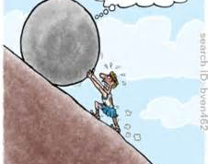
The Bad!
Audits / Reports
Course scheduling
Facility Coordination
Some data collection
Dr. Mark Urtel
Indiana University-Purdue University Indianapolis

Slide 5
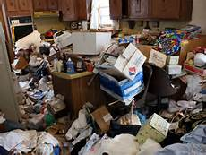
The Ugly!
Complaints / conflicts among or
between students, faculty, and staff
The politics of it all
Merit pay
Dr. Mark Urtel
Indiana University-Purdue University Indianapolis

Slide 6
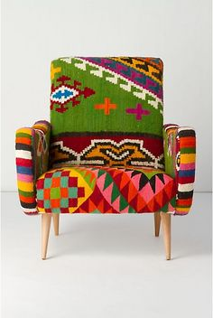
The Good!
Really wanting to be chair
    My leadership style:
    Servant Leadership or no leadership at al
    Know the expertise you bring to the position
    Improve the student experience
    Remember, it is not “your” department
Dr. Sandra Jowers-Barber
University of the District of Columbia Community College

Slide 7

The Bad!
Taking a long vacant chair
    Dealing with faculty who wanted to be chair
    Fostering unity and moving forward
    Steering divided support for curriculum change
    Accepting the fact that “the union says you are not one of us”
Dr. Sandra Jowers-Barber
University of the District of Columbia Community College

Slide 8

The Ugly!
Leading during challenging times
    Surviving public (unpleasant) leadership changes.
    (Re)assuring and (re)engaging faculty who want to
    move forward.
    Learning when and how to cut dead weight.
    Understanding you are the chair for All of the faculty.
Dr. Sandra Jowers-Barber
University of the District of Columbia Community College

Slide 9
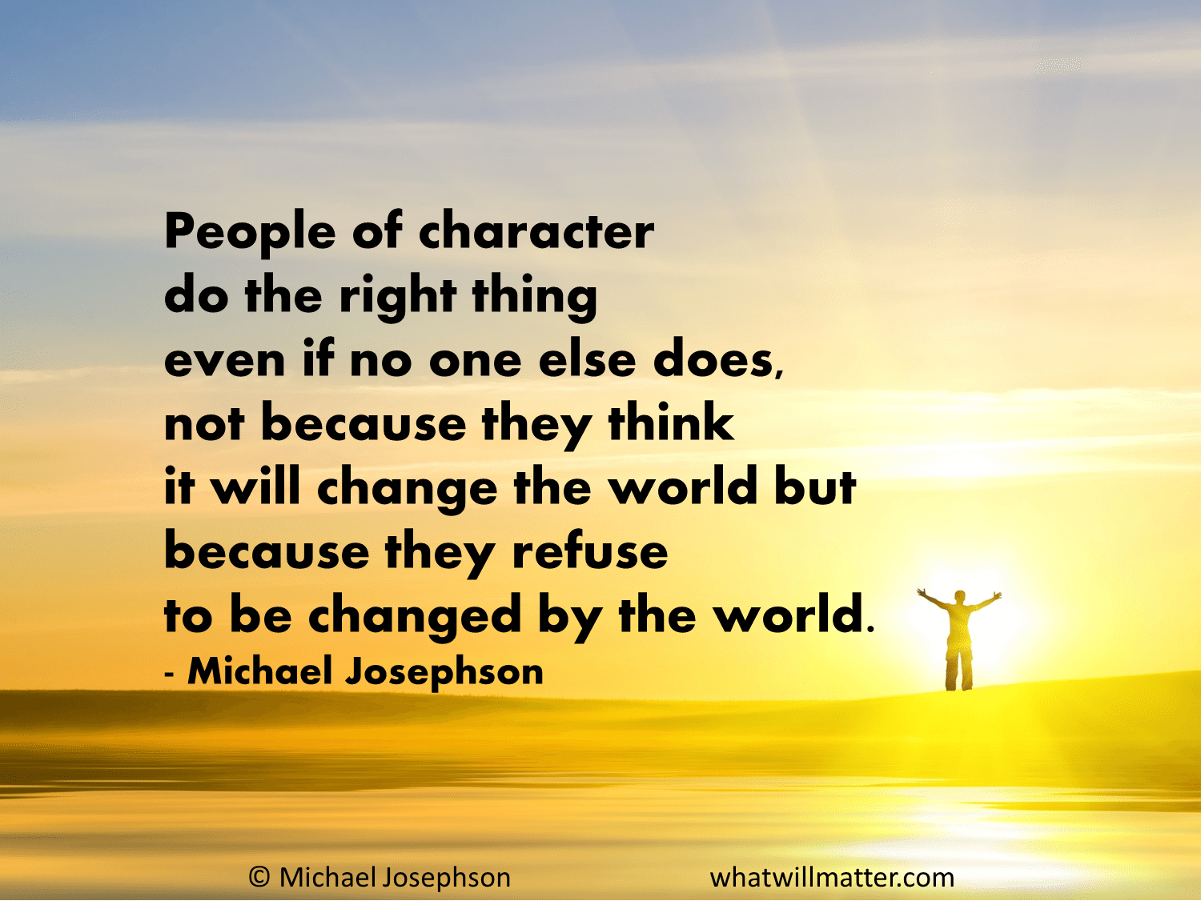
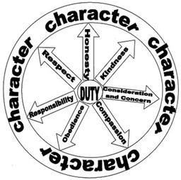
The Good!
Character
  Know thyself
  Do not lead with an ego
  Open communication
  Emotional intelligence
  Be kind and polite
Dr. Stacey Smith
Fort Hays State University

Slide 10

The Bad!
Processes
  Develop strategic plan
  Communication strategy
  Use scheduling to reward when budgets limited
  Meetings
  Accreditation
Dr. Stacey Smith
Fort Hays State University

Slide 11
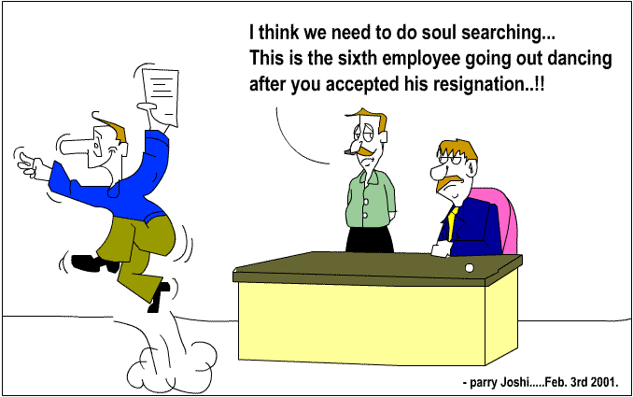
The Ugly!
Culture
  College culture seeping into department
  Conversations
  Team building
  Focus on micro culture
  Sharing information
  Engaging critics in non-threatening ways
  Opportunity! New department, new beginnings
Dr. Stacey Smith
Fort Hays State University

Slide 12

Contact Information
Dr. Mark Urtel, Chair
Department of Kinesiology
IUPUI
Indianapolis, IN
317.278.2015
murtel1@iupui.edu
Dr. Stacey Smith, Chair
Department of Applied Business Studies
Fort Hays State University
Hays, KS
785.628.4696
slgsmith@fhsu.edu
Dr. Sandra Jowers-Barber, Chair
Humanities Division
University of the District of Columbia Community College
Washington, D.C.
202.274.5797
sjowers@udc.edu

