Slide 1
New tools for new roles in Outcomes assessment and improvement
Dr. Jackie Kress
Georgian Court University
Jkress@Georgian.edu
February 9, 2017

Slide 2
This session…
Introduction and brief background
Five tools, when to use them, examples from practice
  Affinity Diagrams
  Dot Voting
  Poka-Yoke
  Policy Audit
  0-credit Administrative Courses
Additional information, directions, & examples in handout.

Slide 3

Department Leaders
Experienced and Successful Faculty
Temporary
Taking-a-Turn
Service

Slide 4
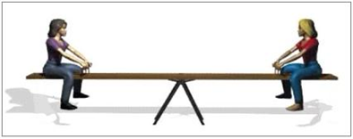
Keep things steady
Faculty RTP
Budget
Course Schedules
Represent Department/Program
Consult and Manage
Scholar

Slide 5
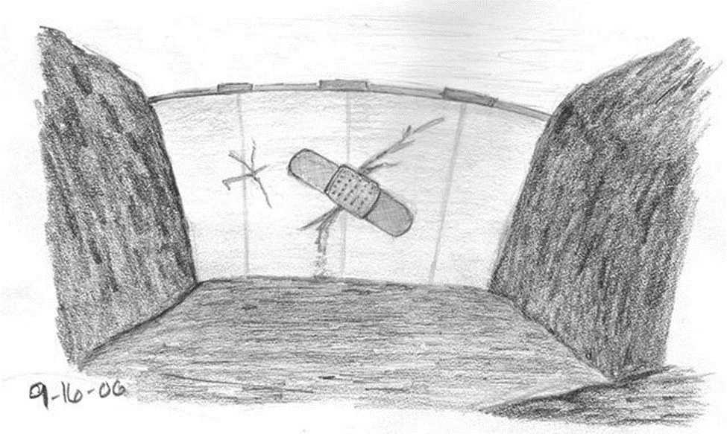
Minor ups & downs
Short-Term Issues
One-Offs
Trouble-Shooting
Student Concerns
Faculty Concerns
New Initiative

Slide 6

More and more expectations
Cost-Cutting
Retention
Reputation Building
Graduation Rate
Rankings
Outcomes Assessment
Evidence-Based Improvement
Student-Centeredness

Slide 7
Change is constant And Difficult
General aversion to change
Tradition of autonomy and academic freedom
Expected privileges of rank and tenure
Committee structures
Campus culture
Short densely-packed cycles (two 15-week semesters)
Resistance to external mandates and pressure
Workload and scheduling issues

Slide 8

Keep your balance by
Using Your Faculty Skills
Asking Questions
Collecting & Analyzing Data
Experimenting
Teaching – Presenting/Publishing
Adding New Practices

Slide 9
Five tools to use
Simple, transparent, data-based, & functional
  Affinity Diagrams
  Dot Voting
  Poka-Yoke
  Policy Audit
  0-credit Administrative Courses

Slide 10
Affinity Diagrams (aka kj method)
Use instead of brainstorming
Traditional brainstorming – often only 8-10 ideas generated (<1 per person)
most aggressive/highest ranking voice dominates
chaining of ideas creates vectors and limits alternate directions of ideation
no indication of strength of idea – once on the board, not repeated
contributions “edited” as they are being captured
not supportive of the soft-spoken, detail-thinker, 30,000ft perspective, or worry-wart
Affinity Diagrams
Gives every voice equal respect and opportunity to impact group
Controls for power and rank effects – outcomes speak for the group, not individuals
Accommodates and captures “outliers” and naysayers
Generates and organizes large amounts of information in brief period
Also can be used in classes – assess prior knowledge, review a topic, identify issues…

Slide 11
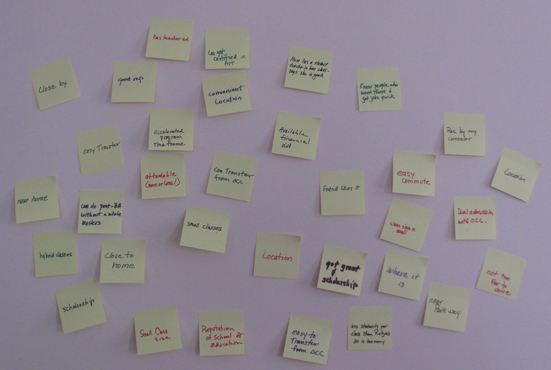
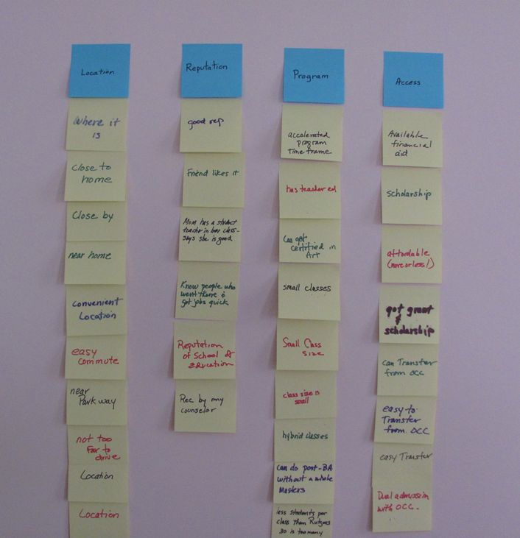
why did you choose gcu? 33R/6P
Notes:
Give participants 3-4 minutes to respond to question by writing one idea (word or phrase) on post-its.
All randomly put post-its on board/wall
SILENTLY group moves post-its so ideas are placed with others they have affinity for (related)
Continue moving post-its until everyone is satisfied that they are “where they belong”
Leader reads grouping, participants offer title or category heading for each
The post-its in each category are counted and the number added to the header
The results are captured and distributed

Slide 12
Affinity outcomes – syllabus design
26 faculty in the School of Health Professions - 6 minutes – 158 responses!
What are the components of an excellent syllabus?
Course and Faculty Information 33
About the Course 12
Calendar Information/Schedule 18
Course Outcomes/Learning Expectations 32
Policies 14
Grading 14
Assignments 22
Books & Reference Materials 13

Slide 13
Dot voting
Use to prioritize, guide choices, or select action items
Traditional balloting
    Binary – either you win or you loose
    Forces choice and suggests one option has everyone’s support
    No second option, if first one doesn’t work out
    No information about perspectives on most options
Dot Voting (Vegas Voting)
Works well for showing preferences/opinions
Limits long or charged statements of opinion
Visual information simplifies interpretation of results
Different formats – different advantages
GYR – Yes! Maybe? No! GGYYRR – strength of response GGGG – this one

Slide 14
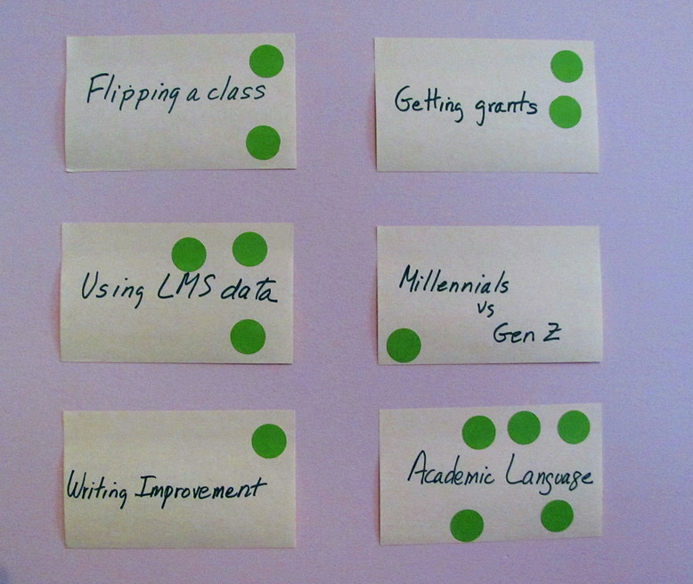
Professional Development options Prioritized 14p
Six ideas proposed
14 faculty
Discussion open-ended with no clear decision
At end of meeting:
“Here are the ideas we’ve been discussing. Put your dot on the your top choice. We’ll use the outcome as our priority list.”

Slide 15
Poka-yoke
Japanese term meaning mistake-proofing from yokeru (avoid) and poka (mistakes).
Goal: Design the environment to make it difficult to make a mistake.
Used to decrease errors on forms and in all major processes.
Old: SS#___________ Phone __________ Credit card _____________
_ _ _-_ _- _ _ _ _ _ _ _-_ _ _-_ _ _ _ _ _ _ _ - _ _ _ _ - _ _ _ _ -_ _ _ _
Poka-yoke uses visual or other signals to make a mistake stand out so it can be corrected before moving on.
You experience poka-yoke on websites that
will not “continue” until missing information is provided
checks your email address by having you input it twice
checks birthdates to error of providing current year birthday

Slide 16

Policy Audit
Admissions
Retention
Program Progression
Grades
Graduation

Slide 17
Audit of graduation applications
232 applicants for August graduation
186 applicants approved, 46 not approved (20%)
Checklist used to review individual folders
Students were notified of problems via form letter
Anger, stress, frenzied activity, no joy
Most “Not Approved” because
Comprehensive exams - No documentation of passing
Matriculation Gaps – No record of leaves of absence or maintenance of matriculation for stop-outs
Students were considered “ineligible” but neither policy was backed by a good implementation process.

Slide 18
0-credit administrative “courses”
An administrative control mechanism that results in transcript notations showing students met a specific program requirement.
Use 0-credit courses
  To register for and get grade for comprehensive exams
  To document passing external professional examinations such as Praxis II
  To document continuous matriculation in a program start to completion
  To document embedded internship/practica
  To show recital, exhibition, service learning, other embedded component
  To document end-of-program portfolio review

Slide 19
0-credit courses & graduation audit
Established a master’s and doctoral comprehension course for each program (PES 0010, PES 0012, PES 0020, PES 0022, PES 0030, PES 0032)
  Creates class list for administrative use (orientation, eligibility review, proctoring, scheduling)
  Provides mechanism for inputting grade and showing it on transcript
Established a Maintenance of Matriculation course for each department (PES 0005, EDU 0005)
  Students register for a leave of absence if within allowed time
Two years later, no graduation application was rejected because of missing comprehensive exam results or for “mat gaps”!

Slide 20


Slide 21

Dr. Jackie Kress
jkress@Georgian.edu or jkress101@gmail.com

