Slide 1
Developing and Supporting the Diversity of Chairperson Roles
Interactive Session
34th Academic Chairpersons Conference
New Orleans, LA
February 9, 2017
Jean Pawl, Richard Griner, Deborah Richardson, and Beth NeSmith
Augusta University, Augusta, Georgia
Notes:
Introduce our team (Deb)
3 department chairs: 2 from CON on HS campus; 1 from Dept of Bio in CSM on Summerville campus
Director for Faculty Development in Office of Faculty Development and Teaching Excellence -- who was charged with developing the program we’re talking about today.

Slide 2
Objectives:
Describe the Chair Professional Development program at Augusta University.
Highlight the challenges and outcomes of the program.
Demonstrate a typical exercise used by the program to develop Chairpersons.
Invite participants to consider how a similar program does or could operate in your institutions.
Notes:
Deb does this slide

Slide 3
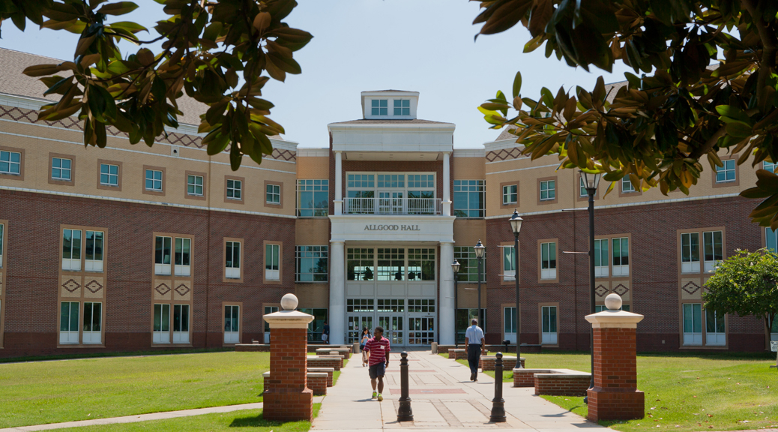
Augusta University
Consolidation of regional comprehensive and health sciences university
~ 8000 students
  Undergraduate and professional
~1600 faculty members
Notes:
Deb does this slide

Slide 4

OFDTE
Office of Faculty Development and Teaching Excellence
Mission
...to provide, support, and communicate opportunities for professional development for faculty as educators, as scholars, and as administrators;
to recognize and reward accomplishments and achievements;
to enhance collegiality, collaboration, and a sense of community among all Augusta University faculty.
Notes:
Deb does this slide

Slide 5
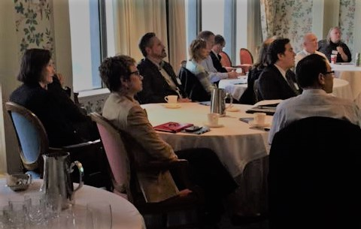
Chair Professional Development Program: What is it?
Monthly meetings
Annual Chair Orientation and Update
Resources
Leadership Development?
Notes:
Deb does this one

Slide 6
Chair Professional Development: Why?
Request from Provost to Director for Faculty Development
Communication from higher administration to chairs
Opportunity for networking among chairs from different campuses
Notes:
Deb does this one

Slide 7
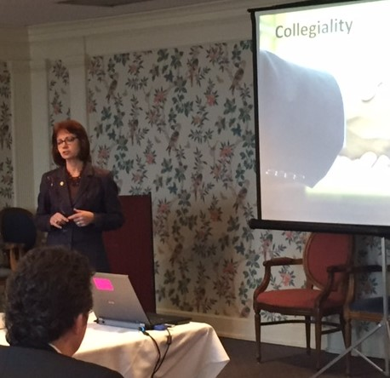
Chair Professional Development: How?
AVP for Academic Affairs partner
Advisory group: Chairs from both campuses
Suggestions from Provost and VPAFA
Suggestions from Chairs
Notes:
Deb does this one

Slide 8
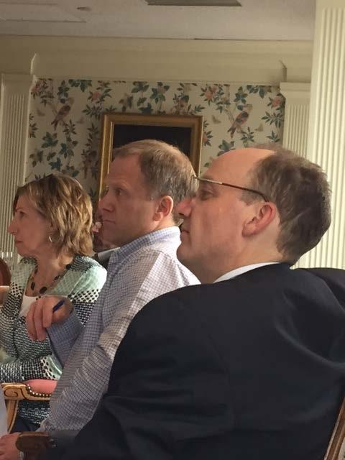
For example...
Information
  Advising Review
  Campus Communication
  Education Mission Strategic Plan
  Introduction to CyberSecurity Program
  Quality Enhancement Plan
Challenges
  Dealing with Challenging Faculty
  Effective Faculty Mentoring
  Effective Performance Reviews
  Recruiting and Hiring New Faculty
  Making Decisions with Data
  Managing Difficult Conversations
  Time Management
Notes:
Deb does this one

Slide 9

What do chairs want?
We ask frequently…
Preference for interactive sessions
Notes:
Deb does this one

Slide 10
Exercise 1: Diversity of the group
Name of your department?
Record the range at your table for each of the following:
Number of years as chair
Number of faculty in your department
Number of departments in your college
Number of majors enrolled in your department
Number of different undergraduate/graduate academic programs in your department
Number of support staff members in your department
Notes:
Rich does this one. Beth and Deb record responses.

Slide 11
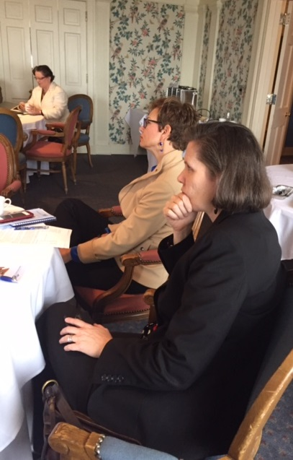
Diversity of the Program
Diversity of Needs Related to:
Clinicians & Traditional Academics
Experience
Distance
Meeting time
Department Characteristics
Missions
Notes:
Jean does this one. 5 Minutes
Chairs- clinicians, scholars, teachers, researchers, etc
Range from Interims to 20 years of experience.
56 Chairs
5 miles apart physically yet at times the culture seems more than that.
Complexity of Depts, Colleges- size, distance (athens, savannah), support staff
Mission of the University,College, Department

Slide 12
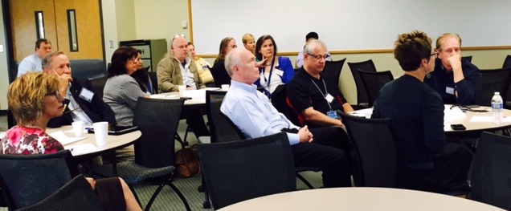
Exercise 2: Common Challenges
Disruptive faculty behavior/Bully
Poor performance/evaluation/promotion/raises
Change management
Assignments (teaching/committee/clinical/lab space….)
Notes:
Jean introduces this slide and has team hand out scenarios. Beth starts 1st scenario as moderator. 15 mins per scenario
Jean suggested the following dialogue: “Though we are a professionally diverse group, we likely share similar professional challenges in our chair roles. In our program, the chairs review common scenarios and role play how we might handle them. Today, we will do the same thing, and after each scenario, we will share together our ideas and feedback, with the idea that the exercise will help us grow together. For each scenario, we will spend 5-7 mins reviewing the scenario and role playing/discussing appropriate responses by table. Then, we will spend another 5-7 mins sharing our responses and feedback per table. Here is the first scenario (Beth reads)
Jean starts with second scenario
Rich starts third scenario
Deb does the last scenario

Slide 13
Disruptive Faculty Behavior/Bully
Dr. Roberts, a senior faculty member in your department, is a bully. She intimidates junior faculty by threatening that if they do not do what she wants, she will not support them for promotion. She has “asked” Dr. Young, a jr faculty member, to (join her research team; use her textbook; teach her course; adopt her pedagogy, etc). Dr. Y has come to you to seek guidance. She has no interest in Dr. R’s ______and she has her own productive program of research or teaching style that is just getting underway.
Notes:
Beth reads and moderates this scenario

Slide 14
Poor Performance, Evaluations, Promotion, Raises, etc.
You are doing annual evaluations. One of your faculty members has not met the goals from the prior year, has very poor evaluations from the learners and has failed to produce the curriculum for the new program for next year. In addition, they have not completed their time and attendance forms, learner evaluations or attended a faculty meeting since their last evaluation. Their first comment at the evaluation is “I have been here for 5 yrs and have not gotten a raise”. I deserve a 10% raise and I want more resources.
Notes:
Jean reads and moderates this scenario

Slide 15
Change Management
A new program is about to be launched in your dept. This will result in changes to every faculty member’s schedule, reallocation of faculty offices and changes in the assignments of admin assts. Two trusted advisors have counseled you how to present this to the faculty. One argues “blame the dean”..create culture of blame. The other says demonstrate your authority “ new sheriff in town”...create a culture of fear. The public announcement of these changes goes out on email tomorrow morning at 9AM from the Dean’s office.
Notes:
Rich reads and moderates this scenario

Slide 16
Assignments
Teaching, Committee, Clinical, Lab space, etc
Brad is a faculty member who has been given an assignment (teach a basic course, sit on a committee, supervise students in clinical, or relocate to a different lab). Although qualified to complete the assignment, he would prefer to (teach an upper level course, not sit on a committee, not go to clinical, not move his lab, etc). His failure to comply will have a ripple effect on other faculty assignments. Others have more seniority and tenure. Brad insists he is being abused by the chair and being assigned in an unfair manner. Two colleagues are defending Brad, b/c he recently taught at a prestigious institution.
Notes:
Deb reads and moderates this scenario

Slide 17
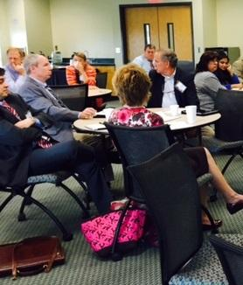
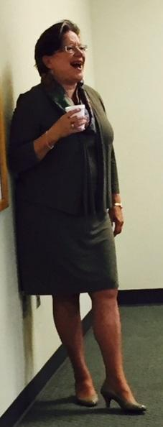
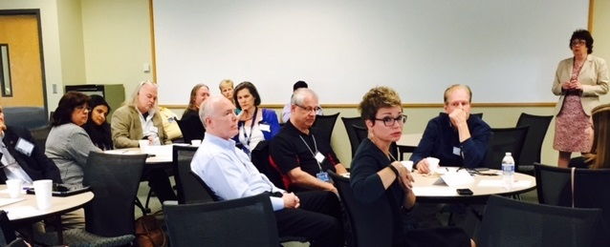

Outcomes
Relationships
Safe Space
Information Sharing
Skills Development
Resource Handbook
Lessons Learned
Notes:
Beth does this slide
Relationships -Met so many people I didn’t know before and my network of individuals to whom I can go for advice and support has grown exponentially. Especially across disciplines
2. Safe Space- Now that you are a chair, who is your colleague group? Not your supervisor; not your faculty; fellow chairs person understand exactly where I’m coming from without too much explanation. So wonderful to have that person
3. Information sharing -GREAT resource that I never had before - I can easily go ask any of my chair colleagues “How do you handle the new faculty evaluation form for your faculty?
4. Skills development
5. Chair resource handbook developed and distributed to new chairs by the Office of Faculty Development and updated every year.
6. Lessons learned - document created from veteran chairs to new chairs

Slide 18
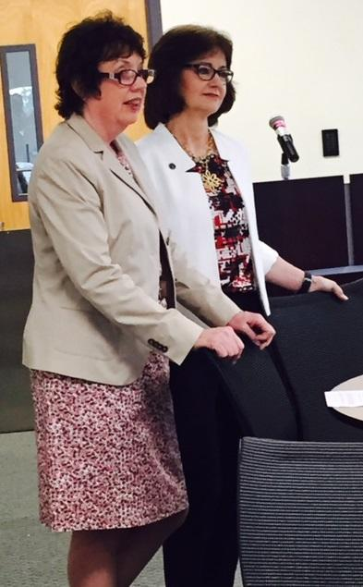
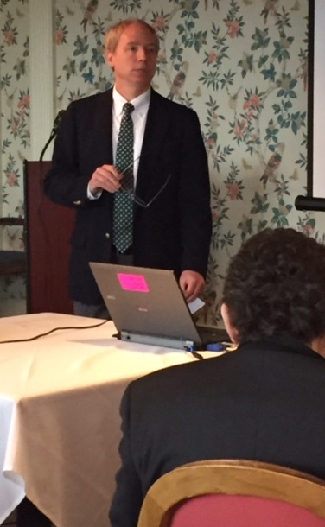
Would a program like this work at your university?

Slide 19


