Slide 1
Hedgehog Leadership in Academe
Dr. Thomas Duening
Chair, Management Dept.
University of Colorado Colorado Springs
tduening@uccs.edu

Slide 2
Introduction
Hedgehog-Style Leadership
Methodology
Pragmatism
Effectual Logic
Spontaneous Order
Identity Theory
Becoming a Hedgehog
Hedgehog Impact

Slide 3
Please Provide Feedback
Methodology
Clarity of conceptual articulation
Clarity of models
Additional literature
Publish?

Slide 4
My Background
Education
Professional
Entrepreneur
Current

Slide 5
Hedgehog-Style Leadership
“The fox knows many things, but the hedgehog knows one big thing.” (I. Berlin)
Problem statement:
  Academe is replete with fox-style leaders
    We are trained to be critical
    We advance from within
    We hire those who are like us
    We are generally risk averse
Hypothesis:
  Academe can benefit from balance of Hedgehog and Fox styles
Conclusion:
  Hedgehog style justified by converging independent areas of scholarship
  Hedgehog style can be learned and mastered through deliberate practice
  Balance creates superior results in faculty at all levels

Slide 6
Methodology
Hermeneutics? Edification? Sociology?
Based on convergence of independent scholarship
Example: Evolution
  Now broadly accepted in multiple independent disciplines
    Medicine
    Psychology
    Nothing in biology makes sense except in the light of evolution (Dobzhansky)
My goal is to make Hedgehog style leadership appealing enough to try

Slide 7
Pragmatism
James, Dewey, Rorty
Search for absolute (Platonic sense) is futile
  History of philosophy
  Bad questions that no longer are useful
  The safest general characterization of the European philosophical tradition is that it consists of a series of footnotes to Plato. (Whitehead)
Look to the future, rather than for foundations
Take care of freedom and truth will take care of itself
Inquiry is search for solidarity rather than Truth
Poetry and the novel replace epistemology

Slide 8
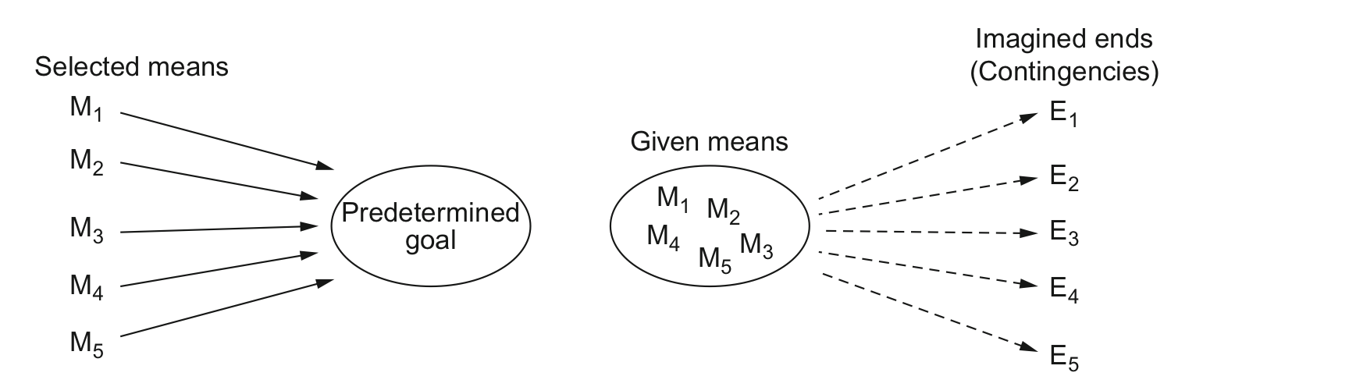
Effectual Logic
CAUSAL LOGIC
EFFECTUAL LOGIC

Slide 9
Spontaneous Order
Organization is result of human action, not human design
  Man never mounts higher than when he knows not where he is going (Oliver Cromwell)
  Civilization advances by extending the number of important operations we can perform without thinking about them (A.N. Whitehead)
Civilization is guided by abstract rules
  Traditions
  Language itself
  Moral principles
  Social conventions
Most are of unknown origin, they exist because they “work”
  Result of cultural evolution

Slide 10
Identity Theory
Examines how people develop personal sense of identity
Professional identity includes profession-specific-set of moral virtues
Virtue: Consistent action in the world
  Consistent (not something you do occasionally)
  Action (a choice to do “this” rather than “that”)
  In the world (something you do that affects others)
  The UCCS Entrepreneurial Identity Project
  Positive Organizational Behavior Research Group
How do you decide on which virtues to enact?
  Experience
  Reflection
How do we ascribe virtue?
  Familiarity
  Reputation

Slide 11
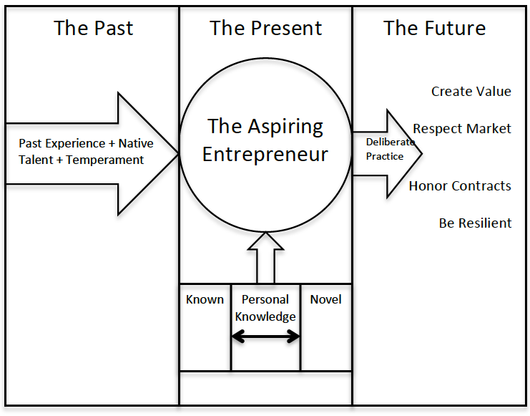
Entrepreneurial Identity

Slide 12
The Hedgehog Virtues
L
Listen
Look
O
Open
Opportunities
V
Invite
Everyone
E
Expect
Excellence

Slide 13
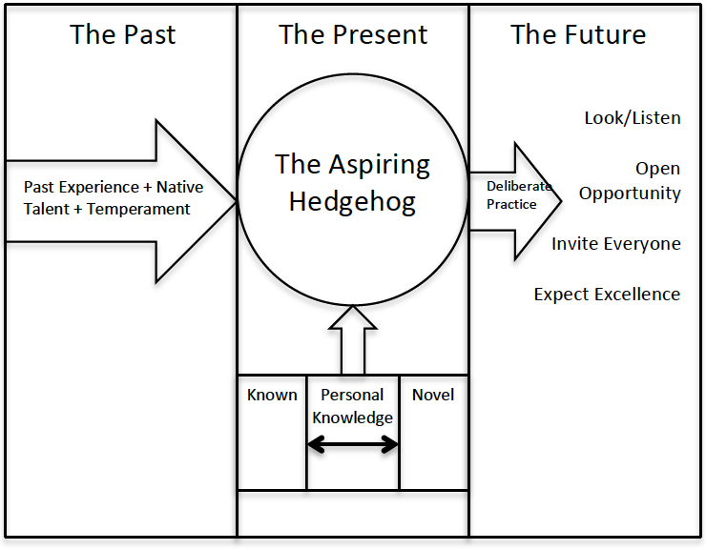
Becoming a Hedgehog

Slide 14
Hedgehog Impact
Long-time professor wins outstanding faculty award for first time in 26 years
  Rejuvenated and engaged
  Mentoring junior faculty again
Hiring stellar new junior faculty
Announced on 2.2 that team has three new Tier 1 pubs
Engaged, energized, active junior and senior faculty
No one seeks me out for policy advice

Slide 15
On Hedgehog Leadership
Differentiate between:
  Rule governed organization (Fox-style leadership), and
  Purpose governed organization (Hedgehog-style leadership)
Practice the virtues of Hedgehog-style leadership
  L.O.V.E.
Trust the spontaneous order
  Enact effectual logic
  Judge actions by the future
Expect excellence
  Be inclusive, but not without standards
  Establish a culture of professional virtues
Balance Fox and Hedgehog leadership
  Similar to Seligman’s balance between pessimists and optimists

Slide 16
Thank You
Dr. Thomas N. Duening
El Pomar Chair for Business & Entrepreneurship
Chair, Management Department
College of Business
University of Colorado Colorado Springs
tduening@uccs.edu

