Slide 1


Evaluating the Quality of Online Courses
Stephanie Boss, Dana Hilbert, Mary
Dzindolet and Jennifer Dennis
Academic Chairpersons Conference
February 2019

Slide 2
Who We Are
Dr. Stephanie Boss
  Chair, Sports & Exercise Science
Dr. Dana Hilbert
  Chair, Education
Dr. Mary Dzindolet
  Chair, Psychology
Dr. Jennifer Dennis
  Dean, Graduate & Professional Studies

Slide 3

Cameron University: Lawton, Oklahoma
Mid-Size Regional State University
  1 of 10 four-year state institutions
  Associates, Bachelors and Masters granting
  3,600 (enrollment)
Office of Distance Learning
  2 full-time professional staff
    Online Courses & Programs
    Blackboard Administrator/Helpdesk
  2 full-time administrative assistants
Approved for Online Delivery
  Associate Programs (3)
  Baccalaureate Programs (4)
  Masters Programs (3)
  Courses (350)

Slide 4
Table Discussion
Introduce yourself to others at your table
Discuss what online learning looks like at your institution

Slide 5
Objectives of the Presentation
Discuss significance of review process for maintaining quality of online courses
Discuss benefits and challenges of methods used to achieve quality assurance of online courses
Discuss strategies for improving quality assurance process

Slide 6
Rapid Growth of Online Delivery
Prompted Institutions to become:
  More efficient, effective, and uniform standards of practice across states;
  More effective in dealing with online quality and integrity issues; and
  Less costly for state and students
Development of Federal Regulations for State Authorization (SARA)
  Voluntary agreement among member states to establish comparable national standards for interstate offerings of online courses/programs
  Option for eligible state universities to participate in SARA
Notes:
So when you are faced with uncertainty think about this quote.

Slide 7
Online Quality Assurance System
Determined by the institution
Responsible for developing policies to identify:
  Review process
  Evaluation criteria
Accountable for the reporting of annual data to its home state portal

Slide 8
Hypothetical Scenarios
Institution A
Instructional Designer OR Instructional Development Faculty
Work with faculty in the creation of online courses
Institution B
Faculty Member
  Responsible for creating online courses
Assistance from the office of distance learning

Slide 9
Table Discussion
What Quality Assurance (course design and teaching effectiveness) system does your institution use?
Is your institution more like Institution A or B?
  What type of support for online learning exists at your institution?

Slide 10
Benefits for Online QA Model
Consistency, how students access information
Alignment between assessments and outcomes
Participation in SARA, $$$
Accountability, quality of courses offered
Recruitment, new majors/programs
Retention, flexible schedule for current students

Slide 11
Institutional Challenges
Lack of Resources
  Support quality assurance initiatives
Budget Restraints
  Approval of full-time faculty positions
  Potential shift in ratio of faculty vs. adjuncts
Academic Buy-In
  During the development and implementation of QA
  Lack of transparency in choosing QA model
  Lack of structure and accountability
  Student feedback

Slide 12
Faculty Challenges
Change of roles and responsibilities for Instructors
  Negative perceptions
  Qualifications needed
  Lack of faculty support/training with high expectations
  Technical expertise
  Evaluation and effectiveness
  Time management/course load
  Accessibility

Slide 13
The Chair’s Role
Academic Freedom
  QA has moved oversight from department to university
  Ownership of courses developed
Transparency
  Accuracy of information presented to faculty/adjuncts
  Professional demeanor
Demand (retention/recruitment)
  Scheduling
  Development
  Qualified faculty/adjuncts
Hiring Process (faculty and adjuncts)
  Online teaching experience
  Prior training
  Sample, online teaching

Slide 14
Table Discussion
How do you, as the chair, evaluate online courses at your institution?

Slide 15
Resources
Tutorials, Exemplary Online Courses
Sample, Design Templates
Sample, Evaluation Instruments

Slide 16
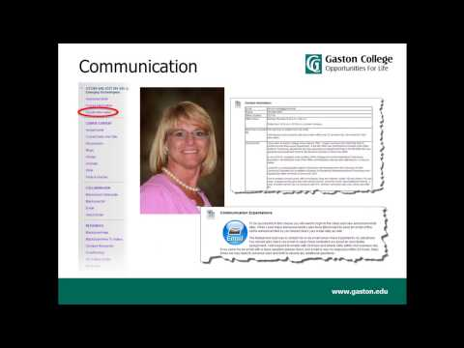

Sample, Exemplary Online Courses

Slide 17
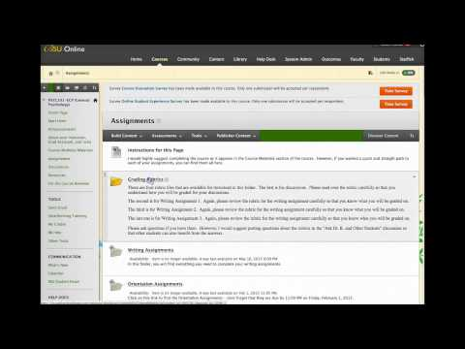
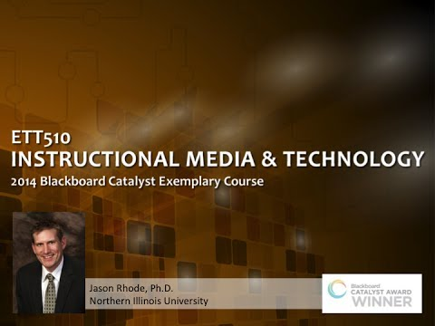
Sample, Exemplary Online Courses

Slide 18
Sample, Online Development Templates
PCC, Online Distance Education
https://canvas.pasadena.edu/courses/982220
Fresno State, Blackboard 9.1 Tool Guide
http://www.fresnostate.edu/academics/blackboard/documents/bb/Bb9.1ToolGuide612_000.pdf
USCA, Distance Learning
https://www.usca.edu/distance-learning/course-development/course-development-templates.dot
NIU, Faculty Development & Instructional Design Center
https://www.niu.edu/facdev/resources/onlineteaching/design/templates-and-starters.shtml

Slide 19
Sample, Evaluation Instruments
Institute Specific (four-year)
  Fayetteville State University Online Course Rubric
  Kansas State E-Learning Quality Checklist
  Pennsylvania State Quality Assurance e-Learning Design Standards
  Rochester Institute of Technology Online Course Design Checklist
  Southern Oregon University Best Practices in Online Course Design and Delivery
  University of New Mexico Online Course Standards Rubric
  University of Wisconsin-La Crosse Online Course Evaluation Guidelines
  Utah State Online Course Quality Rubric
Institute Specific (two-year)
  Bluegrass Community and Technical College Checklist for Online Course Design
  Lewis & Clark College Checklist for Instruct/Online and Hybrid Course Design
  Northeast Community College (NEEC) Rubric for Online Design Standards
  Palomar Online Course Best Practices Checklist

Slide 20
Sample, Evaluation Instruments
National/Statewide Influence
  Blackboard Exemplary Course Program Rubric
  California State University Quality Online Learning and Teaching (QOLT)
  Course Design Rubric for the Online Education California Community Colleges)
  Quality Matters (QM) Higher Education Rubric
  Illinois Online Network: Quality Online Course Initiative (QOCI)
  The Open SUNY COTE Quality Review (OSCQR)
  Southern Regional Education Board Checklist for Evaluating Online Courses
Online Professional Development
  Online Learning Consortium Quality Scorecard 2014
  EdTech Leaders Online Course Elements (Educational Development Center, Inc.)
  Learning Resource Network (LERN) Online Course Best Practices Checklist

