Slide 1
Successfully Navigating the Merger of Three Academic Departments into One
13_85 24_84 84_85
Drs. Mardell A. Wilson and Amy B. Harkins
Doisy College of Health Sciences
Saint Louis University
St. Louis, MO
February 7, 2019

Slide 2
Outline
Financial assessment and cost containment at the institutional level
Overview of the ”savings challenge” for the College
Overview of the changes proposed at the College level
Review of the Dean’s Lessons Learned
Review of the Chair’s Lesson’s Learned
Questions

Slide 3
Students = Revenue
Nearly all universities are tuition dependent
With fewer students we are all competing for the same dwindling pool
Privates (and to some degree publics) are being impacted by the ever increasing discount rate; those discounts do begin to blur the divide between private and public institutions

Slide 4

What Makes Allied Health Education Difficult?
Bimodal market awareness
Cost of instruction
Clinical Education – formal and informal requirements
Expanding degree requirements
Accreditation standards – friend or foe or both
Must still deliver quality education while facing the financial challenges!

Slide 5
Set Stage
Comprehensive evaluation facilitated by an 18 month engagement with an external consultant of all University functions
Every operation (Academic and Administrative) was evaluated
Two Foci with Corresponding Savings Target
  Organizational Re-Design
  Academic Reinvention

Slide 6
Set Stage
Decision was made not to share the target; but to explain the magnitude would affect positions and people – both faculty and staff
Every college could address the process in a way that worked best for them, although there were clear guidelines that needed to be followed if there were considerations for program disestablishment.
Can’t afford not to change!

Slide 7
Proposed Change: Merge three departments into one
Each Department was small, 7 faculty or less, but related programs
Loss of faculty lines with faculty retirements
Disestablished one small UG program, teach out in 1 year
Administrative savings from 3 Chairpersons to 1, reduced from 2.8 FTE administrative assistants to 1.8 administrative assistants
Improved financial oversight of a single department, with scaled operating and personnel budgets

Slide 8
Dean’s lessons learned during the process of the merger
Stay focused
Work intimately with faculty governance and leadership team
The dynamic changes significantly when people and jobs are involved; sometimes have to determine when group decisions will not yield the best outcome; or when it’s just not fair to the people who populate “the group”
Minimize disruption to the students
Minimize disruption to the faculty and staff – process and results
Consider bold decisions versus ones that demoralize everyone
Ask every question – Exhaust every angle

Slide 9
Dean’s Lessons Learned at the College level - continued
Communicate in a consistent dependable way
Provide several types of opportunities for how faculty/staff can provide feedback
Use any comprehensive review as an opportunity to address disparities
Understand affected faculty and staff need an appropriate amount of time to grieve
Take ownership of all decisions
Know when it is time to move ahead – Stay focused –
Stay appropriately positive

Slide 10
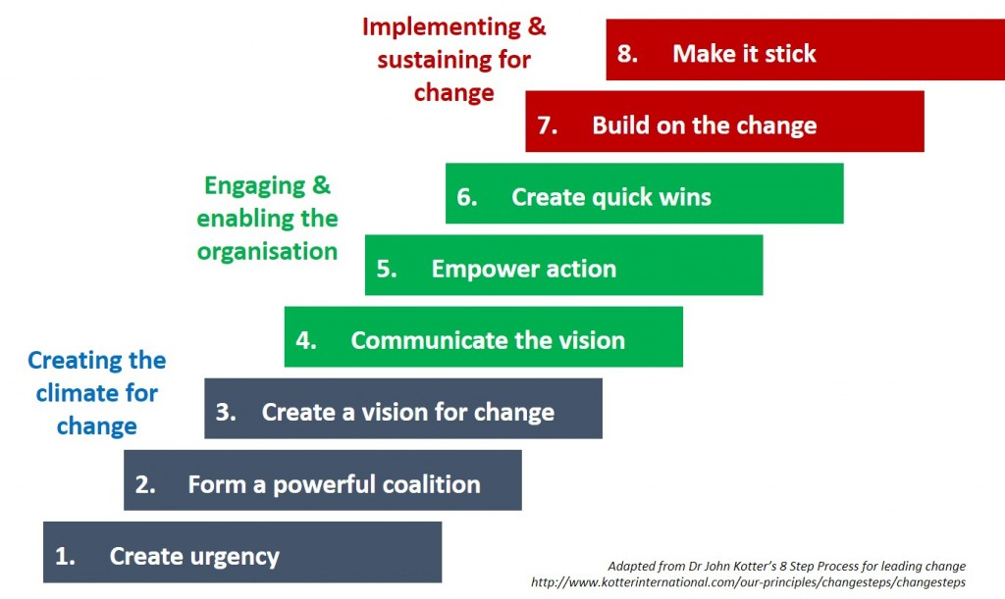
Chair’s lessons learned during the process of the merger
1a. Change-Management Strategy (Kotter’s 8 step model) - process

Slide 11
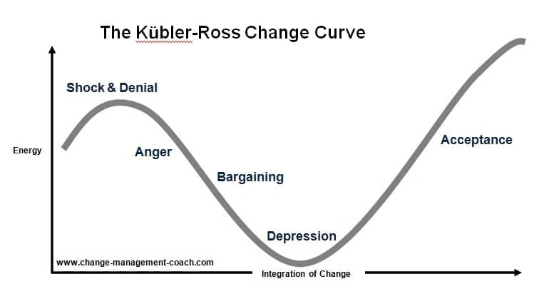
Chair’s lessons learned during the process of the merger
1b. Change-Management Strategy (Kubler-Ross) – grief model

Slide 12
Chair’s Lessons Learned at the College level - continued
Listen carefully; communicate in a consistent and clear manner
Dean and Chair work together; the integral piece to form a culture of trust, required for success of mergers
Accessibility and approachability, to provide support during the grief/emotional responses to the merger
Physical relocation, update/reorganization of office, teaching, and storage spaces
Retain and protect the individual Program’s identities
Remain positive and radiate calm, no matter what; Smile!

Slide 13
Summary
The Departmental merger saved money, reduced inflated faculty/staffing numbers; and also resulted in a better way of serving the students, the faculty, and the programs
Students have formed a new Departmental inter-professional student club with a focus on peer mentoring
New faculty friendships and professional/research collaborations are forming from proximity of faculty offices
Topics are discussed in appropriately comprised small groups; reduce wasted time
Revised curriculum, opportunities to see/talk about how things are done in other programs
Overall, the merger has elevated the visibility and collaboration of the new Department within the College

Slide 14
Dealing with Disruption in Higher Education
13_85 24_84 84_85
Questions

