Slide 1
ACC Houston 2019
Best Practices:
Administrative Chairs and Decision Making
Dino J. Laury, Ed.D
Feb 7-8, 2019

Slide 2
Fast Fact
2018-2019
RIT
Founded 1829, private – coeducational university
RIT student body
  15,946 undergraduates : 3,101 graduates
  Male 12,444 : Female 6,603 (Total: 19,047)
  1,200 students are deaf.
Faculty/staff body
  1,109 F/T, 22 P/T, 368 adjuncts
  2,515 staffs
  Total = 4.014

Slide 3
Introduction
Dino J. Laury, Ed.D.
Eleventh year as a department chairperson
Second presentation at ACC (first one, 2012)
Doctor of Education, Educational Leadership,
University of Rochester, May 2016
Interests: Decision making, program evaluation,
educational leadership, shared governance, curriculum
development, and faculty-student interaction.

Slide 4
Chairs and Decision Making
Chairs are scrutinized from day 1 on the job!
Decision making is difficult because issues are complicated and humans tend to take the path of least resistance.
Goal is to improve your process, not the end results.

Slide 5
Better Practice
Proposed framework
A chart of decision-making models and details
Discuss case studies

Slide 6
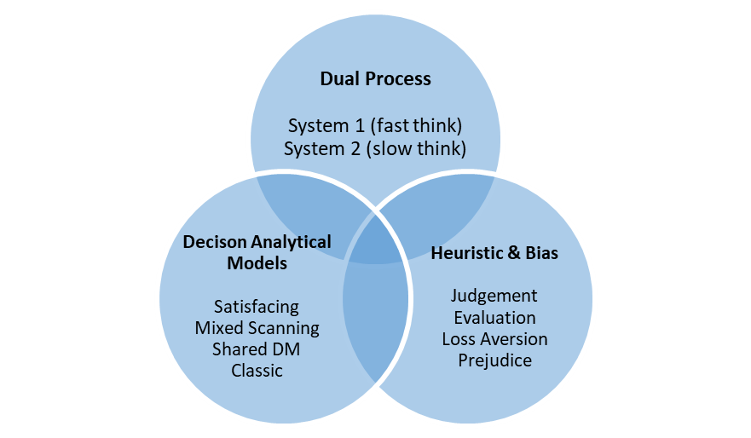

Figure 1. Laury’s Proposal of Deaf Lens' Decision Making Framework (Laury, 2019)
Deaf lens of an educational leader
Decision Model Selection
1. Can substitute with a different lens (CRT, Queer, Feminism, Positivism, etc.)
2. Different leadership and management styles.

Slide 7
DM Models
Hoy & Tarter (2008) illustrated common decision-making models.
Hoy & Tarter (2008) introduced shared decision-making model that includes consensus, consensus-majority, consensus-advisory, and leadership decision sub-models.
Goal is to improve your due process, not the end results.
See addendum docs

Slide 8
Case studies
Case 1: Curriculum developments-multiple departments
Case 2: Handling multiple complaints simultaneously
Case 3: Sequestration of department budget by 15%
Case 4: Promotion denied and recovery
Note: see addendum docs

Slide 9
Noppe Study
Noppe & et al. (2013) surveyed (n=) 281 educational leaders (79% male, 21% female) and their preferred approaches.

Slide 10
Suggested Resources
Hoy, W., & Tarter, C. (3rd Ed.) (2008). Administrators solving the problems of practice. Boston, MA: Pearson Education.
Hammond, J., Keeney, R., & Raiffa, H. (1999). Smart choices: A practical guide to making better life decisions. New York, NY: Broadway books.

Slide 11
References
Hoy, W., & Tarter, C. (3rd Ed.) (2008). Administrators solving the problems of practice. Boston, MA: Pearson Education.
Laury, D. (2019). A Perspective of a Deaf Academic Leader’s Framework for Decision Making in Higher ED for the Deaf. Submission paper for Review.
Noppe, R., Yager, S., Webb, C., & Sheng, B. (2013). Decision-making and problem-solving practices of Superintendents confronted by district dilemmas. NCPEA International Journal of Educational Leadership Preparation, 8(1), 1-18. ISSN: 2155-9635.

Slide 12
Questions
Please don’t forget the evaluation
Thank you!
Email: djlnet@rit.edu or Dino@mail.rit.edu

