Slide 1
Program assessment Implementing a cycle of continuous improvement
February 10, 2023
Dr. Terri Gaeddert, Associate Dean for Academics
Kansas State University Salina
College of Technology and Aviation

Slide 2
WHY
Continuous improvement in all programs
HOW
A systematic assessment process
  Successful data collection
  Thoughtful reflection on data
WHEN/WHAT
Annual assessment reports

Slide 3


Slide 4
Systematic Assessment Process
August Pre-Semester
Meeting
December
Data Reporting
(Review/Respond to ASL Feedback)
May Data Reporting
May Program Report (outcomes, methods, results, review)
A cycle of continuous improvement
May 2017
Notes:
NEW – May 20 (last contract day) report in Canvas
June 1-October 15: Submit Report and Data Form
October 15-December 1: ASL Reviews
December 1-March 1: Review/Respond to Feedback

Slide 5
August Pre-Semester Meeting
All Programs attend
Report Summary Information from May
December Data Collection Meeting
Program meetings
Enter any data from fall semester into program report for the year
May Data Collection Meeting
Program meetings
Program teams discuss needs for fall/new academic year
Enter data from spring semester into program report for the year
May Program Report/Reflection
All Programs attend
Share key data, summary reflections and ideas for future improvement
Submit annual data report (includes outcomes, data, and summary/reflection
Work within programs to finalize data report and summary report

Slide 6
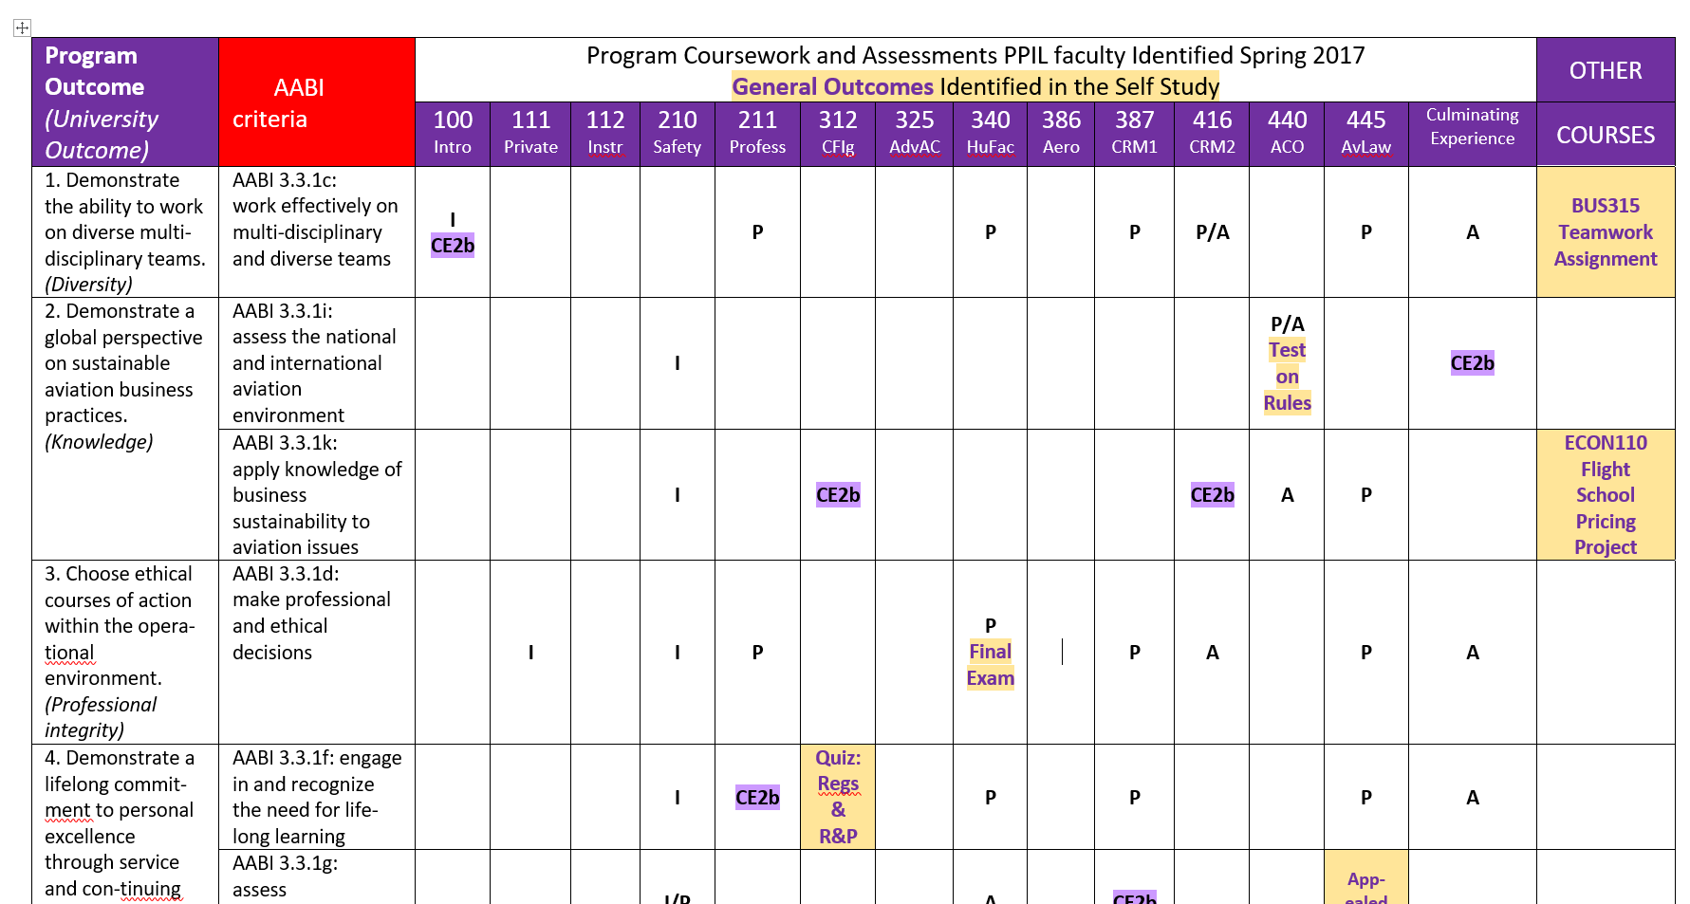

Slide 7
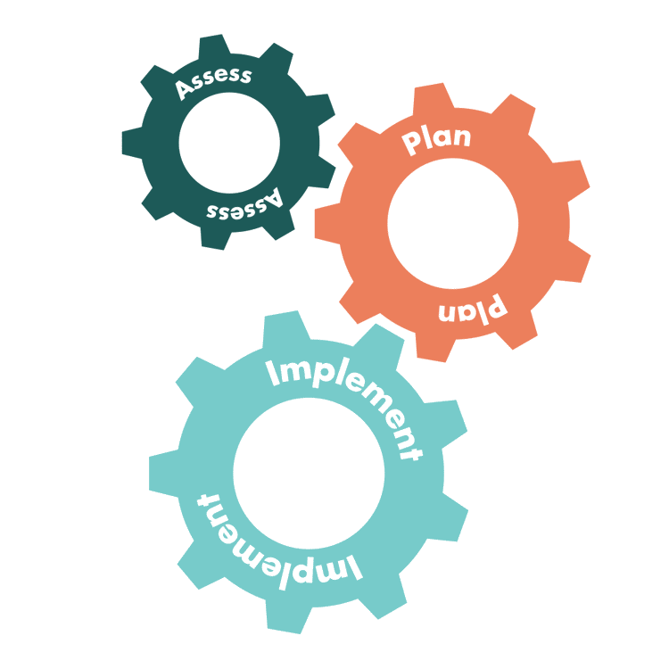
Annual Assessment Cycle
KSU Undergraduate Student Learning Outcomes (SLOs)
Knowledge
Communication (written and oral)
Diversity Awareness
Academic & Professional Integrity
Critical Thinking
Adopted by KSU Faculty Senate April 13, 2004
http://www.k-state.edu/assessment/slo/undergradobj

Slide 8
Added broader review of programs (APRR) to annual review process in Feb/Mar 2022.
August
Pre-Semester Meeting
(Review goals and assessments for the year)
October
Previous Year Assessment Report DUE to OoA
(Manhattan)
May
Data Reporting
(Submit Spring Data to
Option Coordinator)
May
Year End - Review Meetings
(outcomes, methods, results, review and set goals for next yr)
December
Data Reporting
(Submit Fall Data and
Review OoA Feedback)
December/January
Meeting w/OoA
(Respond to Feedback on prior year report; clarify questions)
May
Degree Option Reports Due
(To Department Head and AD)
A cycle of continuous improvement
Notes:
NEW – May 20 (last contract day) report in Canvas
June 1-October 15: Submit Report and Data Form
October 15-December 1: ASL Reviews
December 1-March 1: Review/Respond to Feedback

Slide 9
Spring 22 Year End
Review Meetings (May 18-19)
will include updates from meetings w/consultants!
August
Pre-Semester Meeting
(Review goals and assessments for the year)
October
Previous Year Assessment Report DUE to OoA
(Manhattan)
February/March
Review APRR Data w/Matrix Teams
Industry Advisory Day
May Data Reporting
(Spring Data to Option Coordinator)
Year End - Review Meetings
(review outcomes, methods, results; set goals for next yr)
December
Data Reporting
(Submit Fall Data and
Review OoA Feedback)
December/January
Meeting w/OoA
(Respond to Feedback on prior year report; clarify questions)
May/June
Degree Option Reports Due
(To Department Head and AD)
A cycle of continuous improvement
APRR - Use current system already in place for reviewing programs annually.

Slide 10
Assessment Report Summary - May 2022
Three BIG TAKE-AWAYS from this year’s work
APRR & Consultant Work
SLOs
Advisory Committee
Big TAKE-AWAYS

Slide 11
Assessment Report Summary - May 2022
Three BIG TAKE-AWAYS from MET
Industrial Advisory Board
  Business Acumen
  Technical Writing Skills
  Geometric Dimension and Tolerance
ABET Reaccreditation in Fall 2022
  Preparing for this visit
  F21 and S22 assessment data is collected, report to follow
Development work into Aerospace materials, processes, and courses.
  U.S. Space Command Fair
  Hypersonic Technology
  Composites

Slide 12
Assessment Report Summary - May 2022
Three BIG TAKE-AWAYS from Robotics & Automation ET
Industry Connections Strengthened 3rd RAET Graduate Alex Reichard job with Automatic Systems Inc., KC Advisory Board Expansion – Mars (Topeka) – Pfizer (McPherson) Fall Plant Tour Field Trip – 2021 Topeka/Sabetha – 2022 Hebron, NE | Expanding the Lab Experience New Equipment/Software Implementations: – Robot Conveyor Cell (hardware, software, HMI) – Collaborative Robot – Mini Conveyor Cells – New PLC/HMI stations New MET 240 Industrial Robotics course Integrating concepts between courses | Freshman Experience Support Field Trips Student Success Center Student community building Other support for students with misfocused expectations of college or the field of RAET

Slide 13
Program assessment Create a system for continuous improvement
Take one step.
1% better tomorrow than today!
Dr. Terri Gaeddert, Associate Dean
Kansas State University Salina

