Slide 1
Optimizing Course Offerings in a Science Department
Yu Kay Law
Department of Natural Science, Indiana University East

Slide 2
Scheduling
One of the most complicated parts of our lives … particularly when enrollments fluctuate.
What do we need to consider?

Slide 3
Issues …
Student A needs to graduate this year, but he can’t take required course Y!
Courses A and B are scheduled at the same time, and students need to take it at the same time!
Course D has 5 students in it … it won’t pay the bills. But we’ve not offered any electives in organismal biology for the last three years …
Dr. Bloggs doesn’t teach past 3pm … but students need it to be in the late afternoon!
Students want to take this face to face (or faculty believe it’s much better in person) … yet enrollments are much better online
Notes:
This is exasperated by (a) increasing # transfer students (less time to degree, but less intro classes and need to cram in sequences faster) and (b) decreasing enrollments.

Slide 4
Enrollment Picture
Notes:
Big Picture: even if the enrollment is fairly flat overall, course-by-course variation can be significant.

Slide 5
Context
Biology-focused science department; many courses online.
Regional campus – commuter campus in rural area, diverse student body.
BS in Biochemistry, Biology, Human Life Science; General Education; courses for nursing students.
Lots of athletes, non-traditional students. Most students have other commitments.
Professional (staff) advisors.
Several recent retirements/resignations of full time faculty.
RCM and upper administration – significant pressure to minimize low enrolled course sections.

Slide 6
Core Principles
Ensure students can graduate on time with regular course sections
Transparency:
  Faculty: know what is offered when and why
  Advisors/students: predictability
Maximize enrollment
Allow possibility for new/needed courses

Slide 7
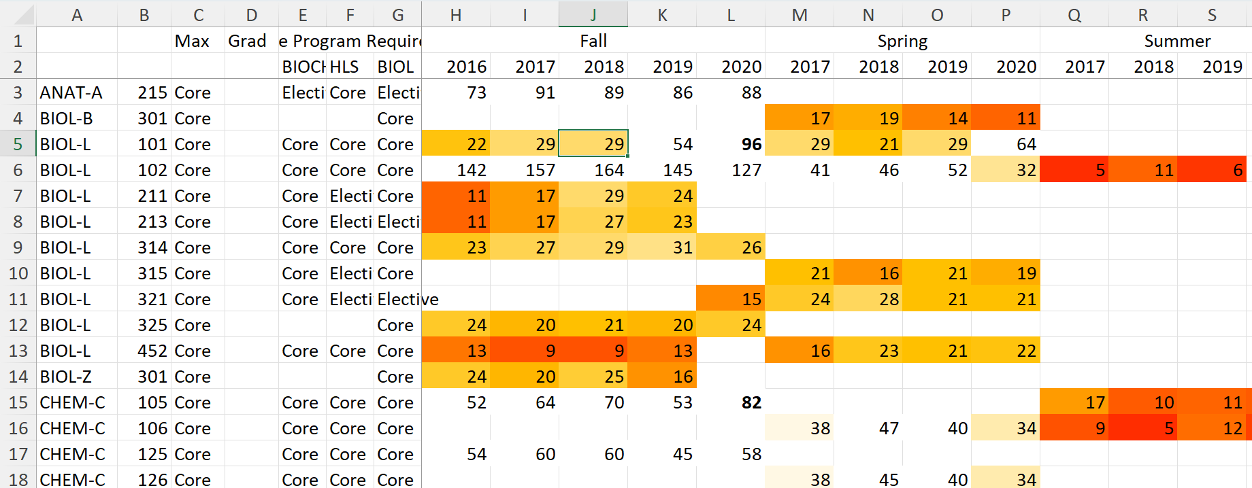
Reviewing Enrollments
Notes:
Previously – course offering frequency was ad-hoc; no structure – depends on faculty member making the call.
Fall 2020: Convened committee to review enrollments in courses to:
Figure out what offerings are really in demand – and how much.
Looked at historical enrollment #s, and aligned with program requirements/projected faculty availability.
What conclusions would you reach about these classes?
Faculty in committee – discussed with advisors before report sent to faculty (so input can be had e.g. about impact on time to degree

Slide 8
Committee Conclusions
Report of recommendations to faculty:
  Cut many summer core classes
  Some courses reduced to 1x per year, or once every other year (with similar courses to be offered in alternating pattern)
  Some courses offered online instead of/in addition to in person.
  Some electives/general education offerings canceled.
  Electives to be optimized to provide a range of courses.
Discussed with faculty; much of this adopted.
Notes:
Some of the conclusions were not adopted in full as staffing was available and enrollment was still positive.

Slide 9
Scheduling Process: Initial
Institution: two cycles: Sept → fall schedule; Feb → Spring/Summer
Start with last year’s schedule, known changes/adjustments added in.
Create grid schedule of F2F classes, work with Chair of Math/Dean to ensure initial structure doesn’t create significant conflicts.
Meet with faculty in subdiscipline (lab room) groups to work out schedule.
Discuss overall schedule with advisors and send to faculty members for corrections.
Send for implementation
Notes:
Known changes/adjustments:
Based on cycle, enrollments. For online classes (async): usually cancel all but one section (since we can add another relatively easily).
Big principle: conservative scheduling – rather have to add sections than ever have to cancel them.

Slide 10
Tweaks Along The Way
Throughout: adjust staffing/assignments as needed
Using experience, project what enrollments are like + potential for additional enrollment.
  Where possible, discuss with affected instructors
  If section is filling up + there is time for enrollment minimum to be met → add
  If section fills up + students need it to graduate – discuss with instructor or add section
If necessary – may need to cancel sections (work with advisors and discuss as needed)
Iterative Process – use this to influence future semesters’ schedule

Slide 11
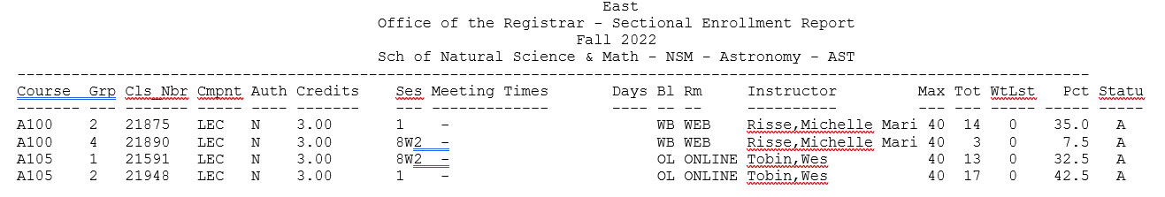
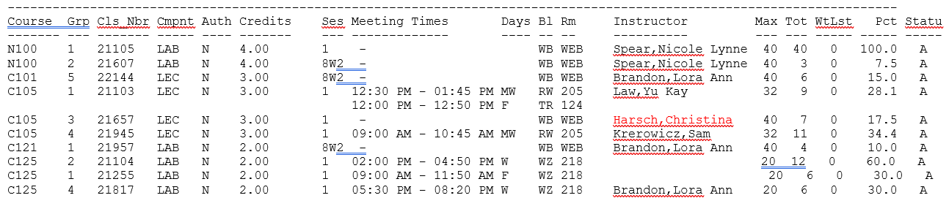
Example: June 22, 2022
Notes:
How would you interpret this? Interactive Discussion., Note importance of your own knowledge/sense of how fast enrollments change for X course, when course enrollment ends, collaboration with advisors.

Slide 12
Reflection After Classes Start
What were the major changes in enrollment this year vs last?
If there are significant changes in pattern, are these “one-off” or likely permanent?
  If permanent, what do we do about it, particularly if it affects our program?
Notes:
e.g. this year – planning for corequisite chemistry workshop next year to help more students get into gen chem their first year. May also reconvene strategic scheduling committee after degree map changes.

Slide 13
Key Principles
Affected faculty must be consulted/notified – no one should be surprised by changes
Do not overwork folks:
  If overloads needed – discuss with them how best to address
  Try avoiding adding to caps unless you must (and if so, discuss with relevant faculty)
    You will never avoid completely shutting students out
Avoid negatively affecting students – avoid canceling in person classes/synchronous classes

Slide 14
Acknowledgements
Dr. Parul Khurana (now at Central Connecticut State University)
Dr. Markus Pomper
Department of Natural Science, IU East

