Slide 1
Building Inclusion and Collaborative Skills through Interprofessional Simulation Design Challenges

Slide 2

Our Team
Presenters
Amelia Huelskamp, PhD, MA
Chase DuBois, BS
Co-Authors
Alicia Sellon, PhD, MSW
Andrea Smith, MSN-NE, RN
Laura Killam, MSN, RN
Colette Waddill, DNP, MSN, RN, IBCLC, CNE, CHSE
Jacqueline Vaughn, PhD, RN, CHSE
  Leadership Fellow for Innovation and Interprofessional Education
Justine Reel, PhD, LCMHC
  Interim Dean of the UNCW College of Health & Human Services

Slide 3
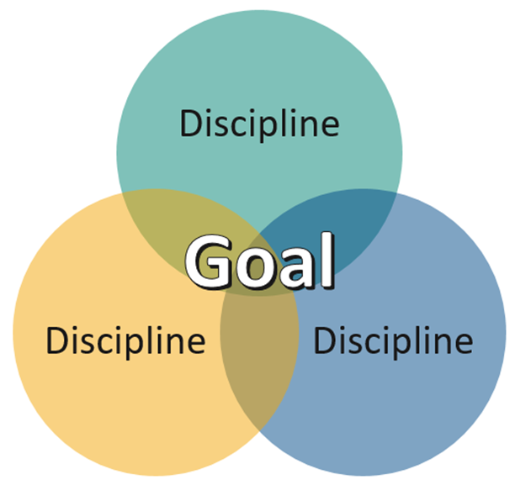
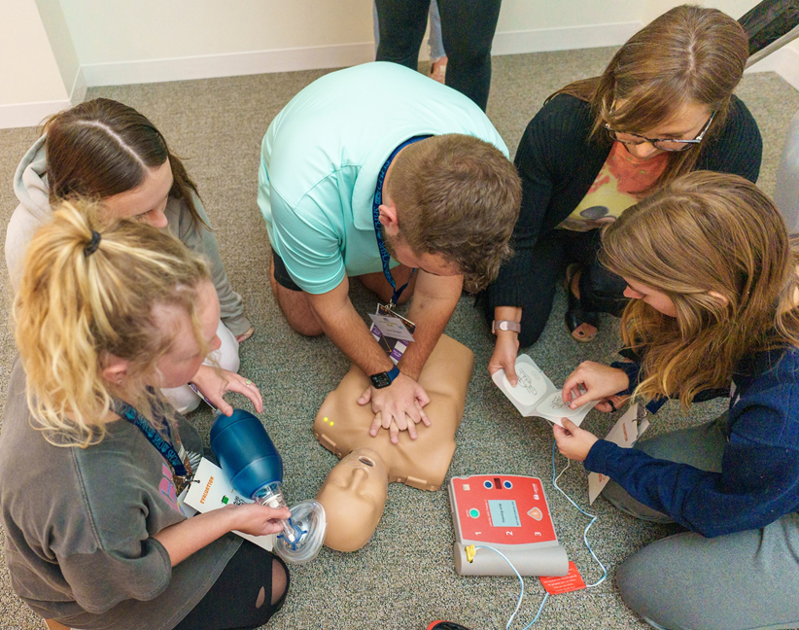
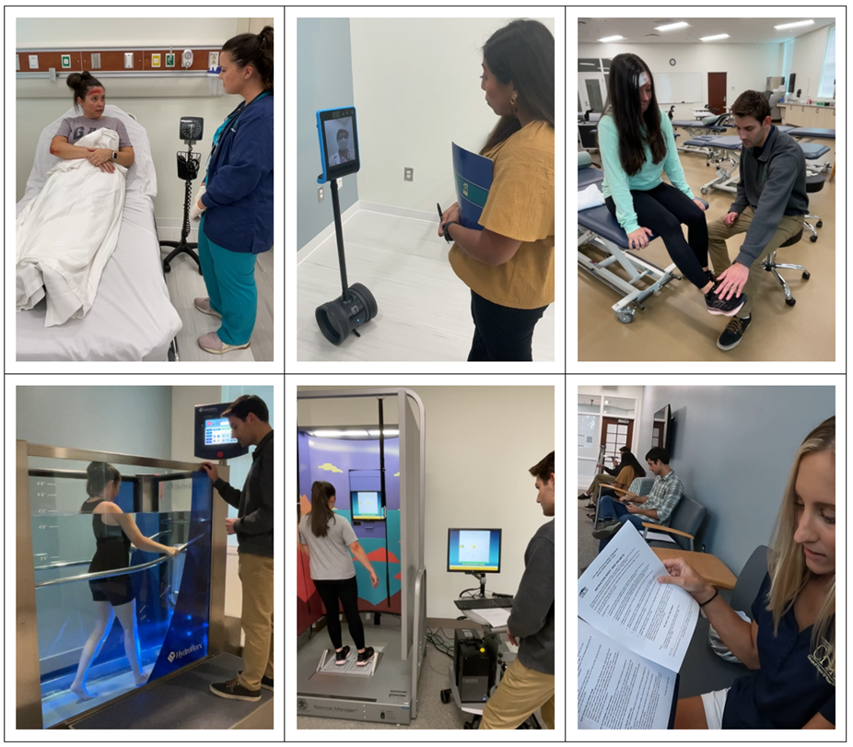
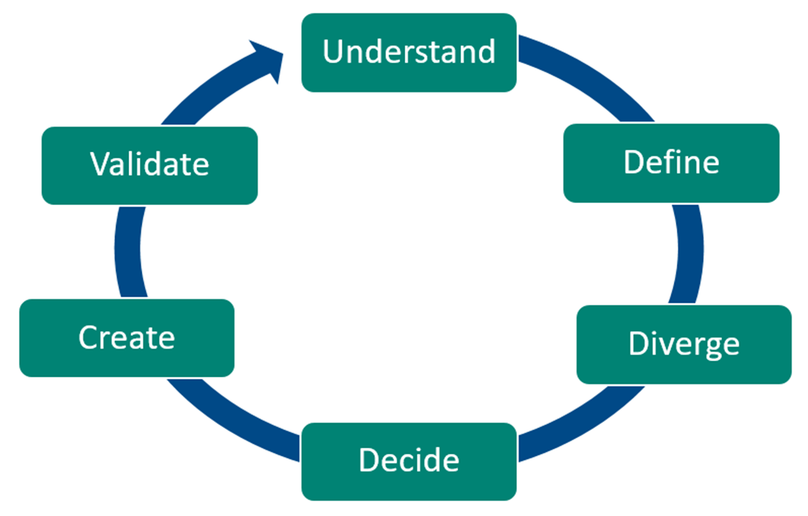
Presentation Outline
Interprofessional Education
Simulation-Based Education
Design Thinking
Our Project
Student Benefits
Encouraging IPE

Slide 4
Interactive
What is your definition of IPE?
What do you believe are the benefits and barriers of implementing IPE?

Slide 5

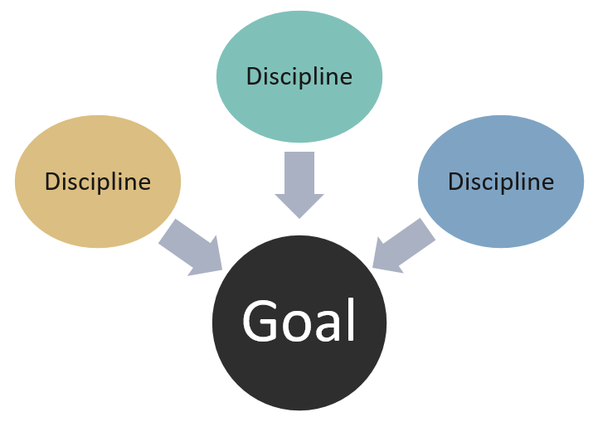
Interprofessional Collaboration
Interprofessional / Interdisciplinary
collaboration BETWEEN disciplines, shared responsibilities, more efficiency, better results [1]
Multidisciplinary
“Silos”, leading to hierarchies, communication barriers, and more need for project management [2]

Slide 6
An Important Transition
Away from multidisciplinary...
Economies naturally evolved to reward narrow disciplinary focuses, so academic careers also narrow in scope as they advance [3]
Towards interprofessional...
“... a complex technological society requires interdisciplinary solutions to its problems” [3]
Interprofessional education (IPE) is essential for an efficient and effective workforce
IPE encourages students to consider key differences between disciplines that could hinder collaboration, like terminology, methods, and the relative significance of problems/solutions. [3]
IPE deepens learning, increases respect for other disciplines, and strengthens communication skills [4]

Slide 7

Simulation-Based Education (SBE)
SBE is an immersive teaching method that exposes students to realistic interactive scenarios. [5]
It supports interprofessional collaboration, team-based decision-making, communication skills, and learning about other professions. [6]

Slide 8
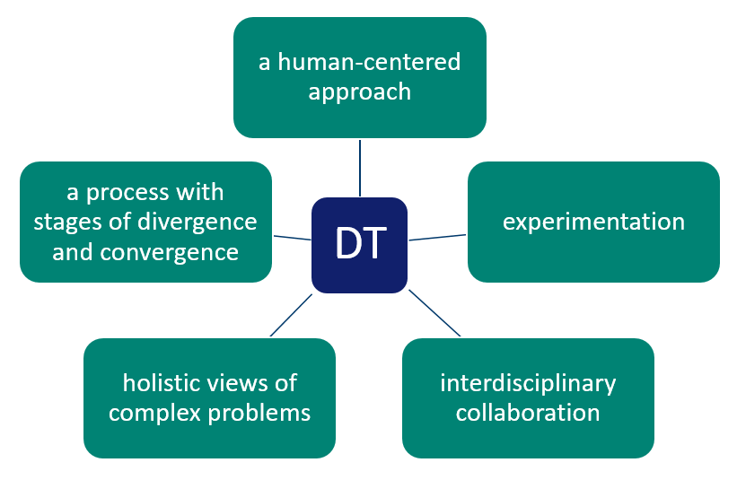
Design Thinking (DT)
DT is a method or cognitive style related to product development that enhances creativity and facilitates problem-solving. [7]
It has 5 general characteristics. [8]

Slide 9
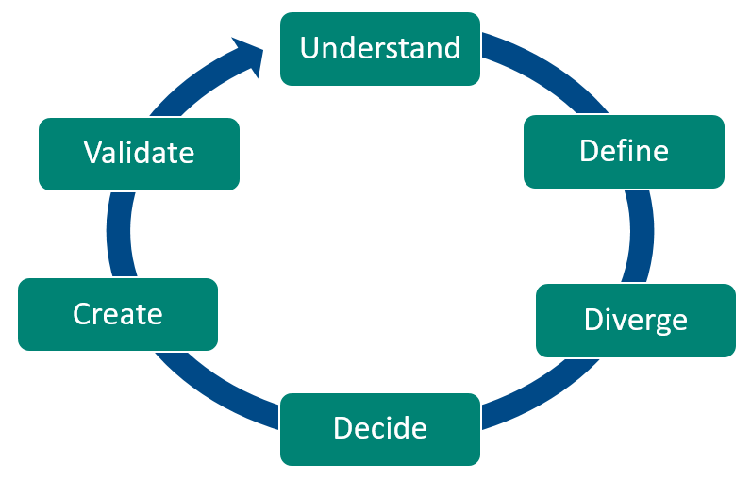
The Design Process

Slide 10
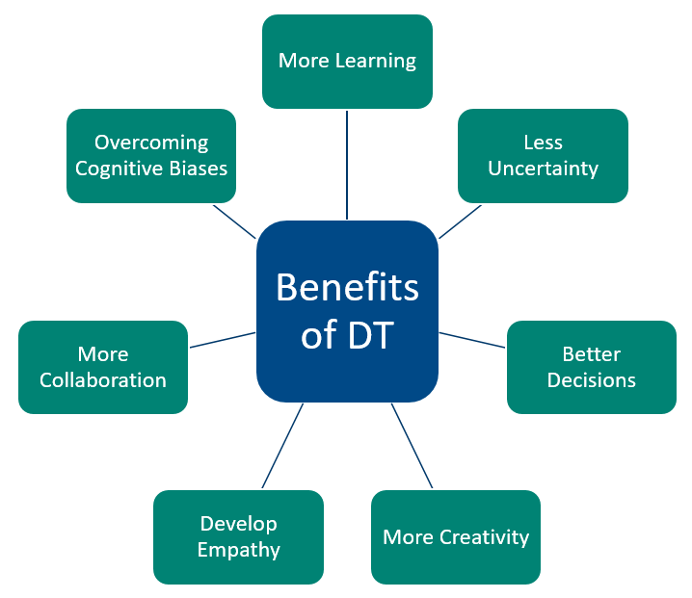
The Benefits of DT
Improves product quality and project efficiency. [9,10]
Helps develop teamworking skills and creativity. [10,11,12]

Slide 11
DT + IPE + SBE
Interprofessional student teams design the simulations they will perform.
They pick topics important to them, and practice performing future roles.
Each student pitches an idea before team discussions start.
Interprofessional facilitators ensure ideas are realistic and practical.

Slide 12
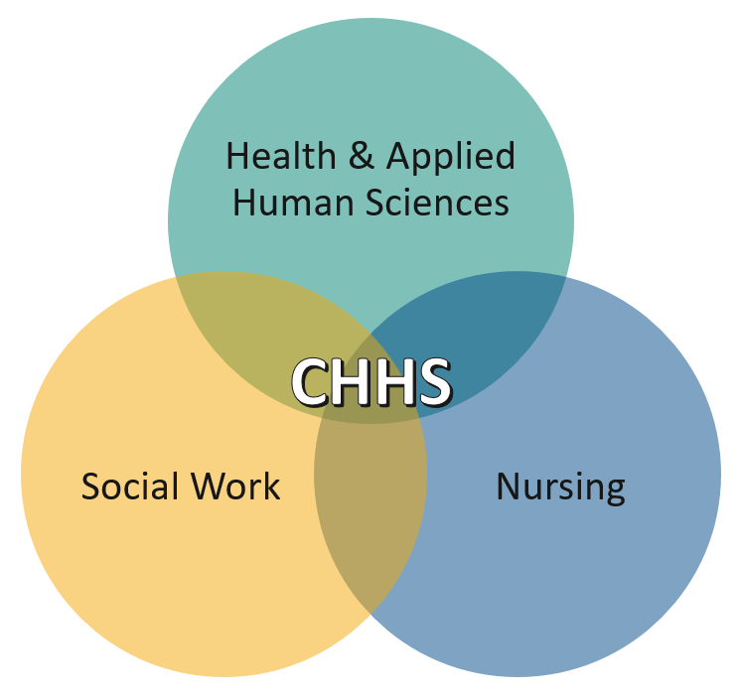
Our Pilot Project
Students and facilitators from each school in the UNCW College of Health & Human Services (CHHS) participated.
Students designed, performed, and presented healthcare simulations.
Facilitators ensured simulations were practical and realistic.

Slide 13
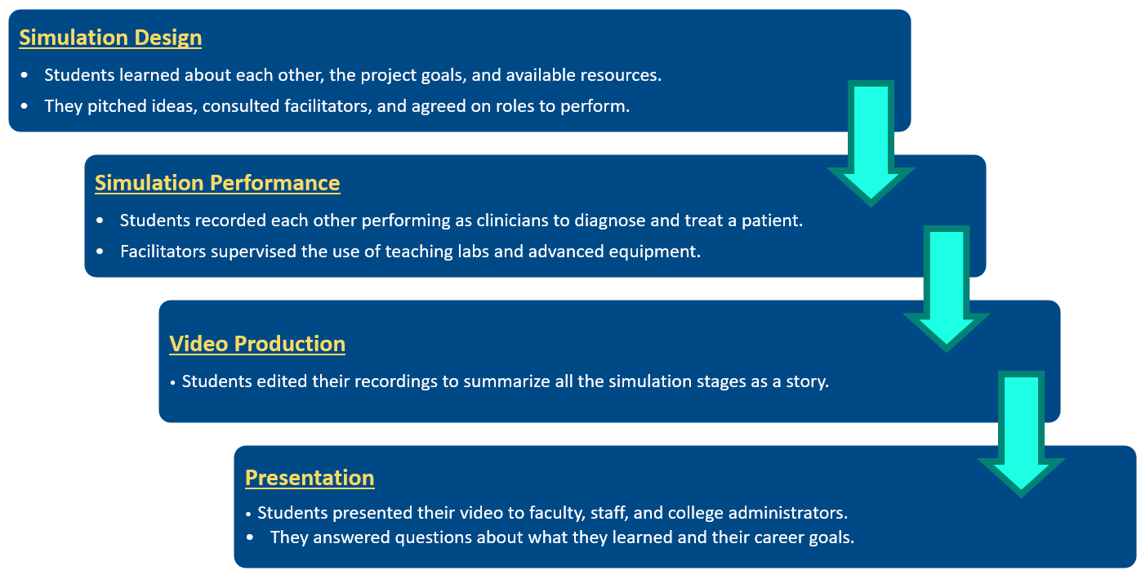
Project Format

Slide 14

Collaborating CHHS Schools
Nursing
An undergraduate Prelicensure Nursing student assessed the patient’s bike injuries and reported to other clinicians.
Social Work
A graduate student assessed the patient’s psychological condition and helped coordinate care.
Health & Applied Human Sciences
An undergraduate Exercise Science student performed physical therapy and tracked recovery.
An undergraduate Public Health student researched similar accidents and educated the patient about bike safety.

Slide 15
Assessing Results
Qualitative Data
Open-ended response questions about what they learned, how they think it will impact their future careers, and how they think the event could be better.
Quantitative Data
The “Interprofessional Collaborative Competencies Attainment Survey” (ICCAS) is a validated method of assessing the benefits of IPE. [13]

Slide 16
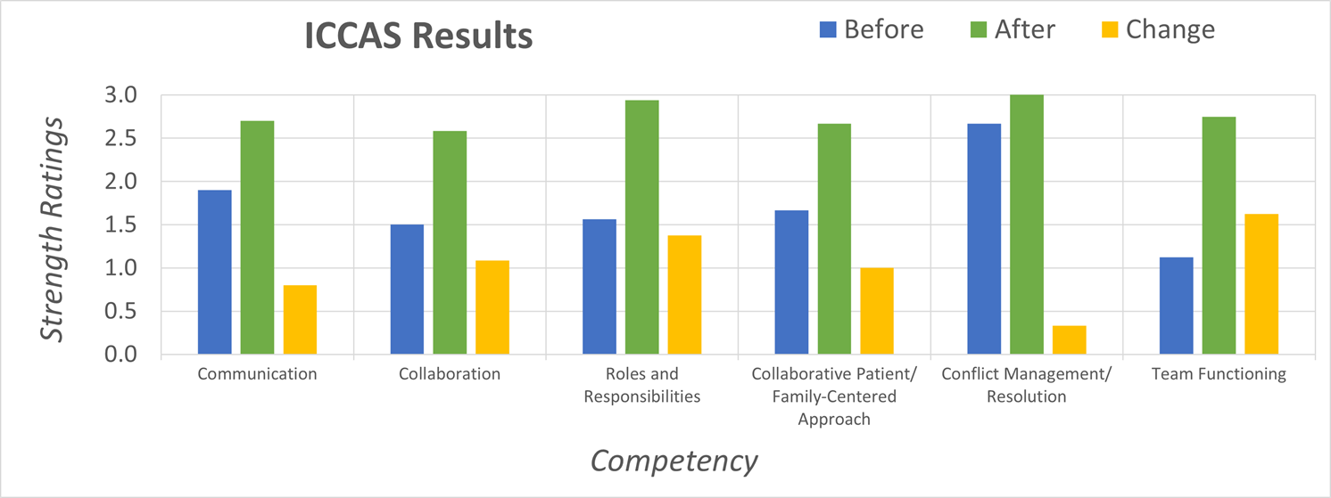
Quantitative Results
On average, students reported increases in all 6 collaborative competencies.

Slide 17
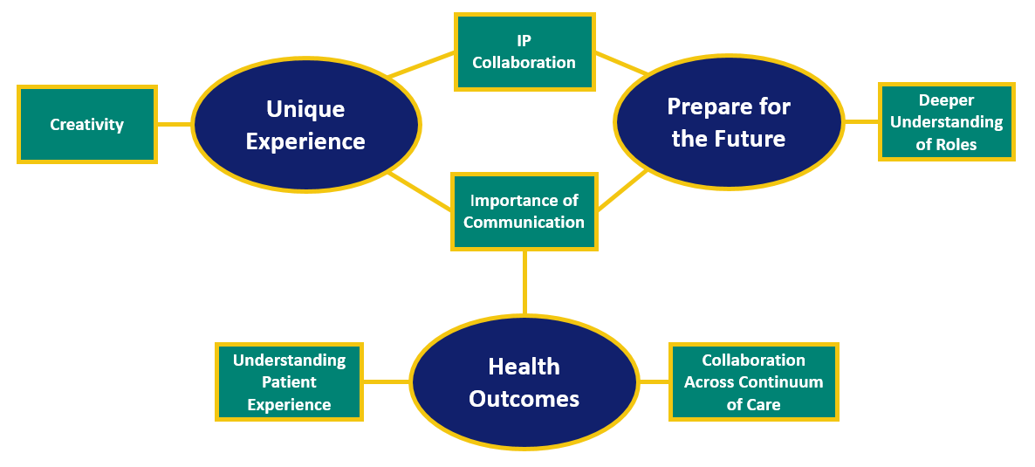
Qualitative Results
Thematic analysis was used to analyze the open-ended questions.
3 themes were identified:

Slide 18
Encouraging IPE
Incentivize Participation
Encourage students to reference their experience when applying for jobs and graduate programs.
Establish teaching awards to celebrate integrating IPE into academic programs.
Recognize Successful Projects
Feature events in school newsletters, marketing materials, and social media.
Build IPE Into Teaching Requirements
Recognize IPE as evidence of high-quality teaching for reappointment, promotion, and tenure.
Remove Barriers
Identify funding opportunities for educational innovation.
Promote the emphasis of IPE in strategic plans and grant development.
Increase awareness of the benefits of IPE and inter-departmental collaboration.

Slide 19
Potential Applications
Engineering, Clinical, and Business professionals collaborating to solve healthcare problems with marketable solutions.
Agricultural, Health, and Sociology professionals collaborating to promote sustainable food systems and dietary practices.
Ecological, Legal, and Marketing professionals collaborating to promote environmental conservation and pollution reduction.

Slide 20
References
Littlechild B, Smith R. A Handbook for Interprofessional Practice in the Human Services: Learning to Work Together. New York, NY: Routledge; 2013.
Hall P. "Interprofessional teamwork: Professional cultures as barriers". Journal of interprofessional care (1356-1820), 19, p. 188; 2005.
Petrie HG. Do You See What I See? The Epistemology of Interdisciplinary Inquiry. Journal of Aesthetic Education, 10(1), 29–43. https://doi.org/10.2307/3332007. 1976.
Burgess A, van Diggele C, Roberts C, Mellis C. Teaching clinical handover with ISBAR. BMC Med Educ. Dec 3 2020;20(Suppl 2):459. doi:10.1186/s12909-020-02285-0
INACSL Standards Committee., Watts P, Rossler K, Bowler F, Miller C. Onward and Upward: Introducing the Healthcare Simulation Standards of Best Practice. Clin Simul Nurs. 01/2021 2021;58:1-4.
Nichols A, Wiley, S., Morrell, B., Emlich Jochum, J., Moore, E., Carmack, J., Hetzler, K., Toon, J., Hess, J., Meer, M., Moor, S. Interprofessional Healthcare Students' Perceptions of a Simulation-Based Learning Experience. J Allied Health. 01/2019 2019;48(3):159-166.
Johansson-Sköldberg U, Woodilla J, Cetinkaya M. Design Thinking: Past, Present and Possible Futures. Creativity and innovation management. 2013 2013;22(2):121-146. doi:10.1111/caim.12023
Baraças Figueiredo Correio L, Leme Fleury A. Design Sprint versus Design Thinking: A comparative analysis. GEPROS : Gestão da Produção, Operações e Sistemas. 2019;14:23-47.
Owen, C. 2007. Design thinking: Notes on its nature and use. Research Quarterly 2 (1): 16–27.
Liedtka, J. Perspective: Linking Design Thinking with Innovation Outcomes through Cognitive Bias Reduction. Journal of Product Innovation Management, v. 32, n. 6, p. 925–938, 2015.
Melles, G., Howard, Z. and Thompson-Whiteside, S. (2012) Teaching Design Thinking: Expanding Horizons in Design Education. Procedia – Social and Behavioral Sciences, 31, 162–6.
Brown T. Design Thinking. Harvard Business Review. 2008; 86: 84-92.
Archibald D, Trumpower D, MacDonald CJ. Validation of the interprofessional collaborative competency attainment survey (ICCAS). J Interprof Care. Nov 2014;28(6):553-8. doi:10.3109/13561820.2014.917407

