Slide 1

Course Sharing:
An Interprofessional Education (IPE) Perspective

Slide 2

Summit on Higher Education
Fall Festival
Anita C. Hazelwood, EdD, RHIA, FAHIMA, is a Professor and Health Sciences Department Head in the College of Nursing and Health Sciences at the University of Louisiana at Lafayette. Anita is the recipient of the Lafayette General Medical Center/BORSF Professorship in Health Sciences.
Anita is an AHIMA ICD-10-CM and ICD-10-PCS trainer and has conducted numerous coding workshops throughout the state and nation; she has written numerous articles, co-authored several textbooks and authored chapters in several HIM textbooks. Anita was the recipient of AHIMA’s Legacy Award in 2003.
On a professional level, Anita is a member of the American Health Information Management Association (AHIMA) and has served on various committees and boards.
Anita is currently serving as the Chair of CAHIIM’s Health Information Management Accreditation Council.
Anita Hazelwood, EdD, RHIA, FAHIMA

Slide 3

Jennifer B. Lemoine, Ph.D., DNP, APRN is a Professor, and the Interim Dean for the University of Louisiana at Lafayette College of Nursing and Health Sciences and is the recipient of the Sheila Ardoin Walsh Memorial BORSF Professorship in Nursing.
Dr. Lemoine teaches across graduate nursing programs, including masters and doctoral level students and is the recipient of the university’s 2018 Ray P. Authement Excellence in Teaching award. She is a 2020 Elevating Leaders in Nursing Education Fellow. Dr. Lemoine has secured over $113,000 in grant funding and holds one U.S. patient. Additionally, she has authored over 25 publications and presented as numerous local, state, and national nursing conferences.
Jennifer is actively engaged in legislative initiatives at the state and federal levels, serving as the Chair of the Health Policy Committee for the Louisiana Association of Nurse Practitioners. Her efforts have focused on increasing access to care for citizens of Louisiana and advancing the profession of nursing.

Slide 4
Objectives
Discuss need for and benefits of IPE in the health professions
Examine role of accreditors in IPE
Review steps in developing IPE courses
Address challenges of IPE courses

Slide 5
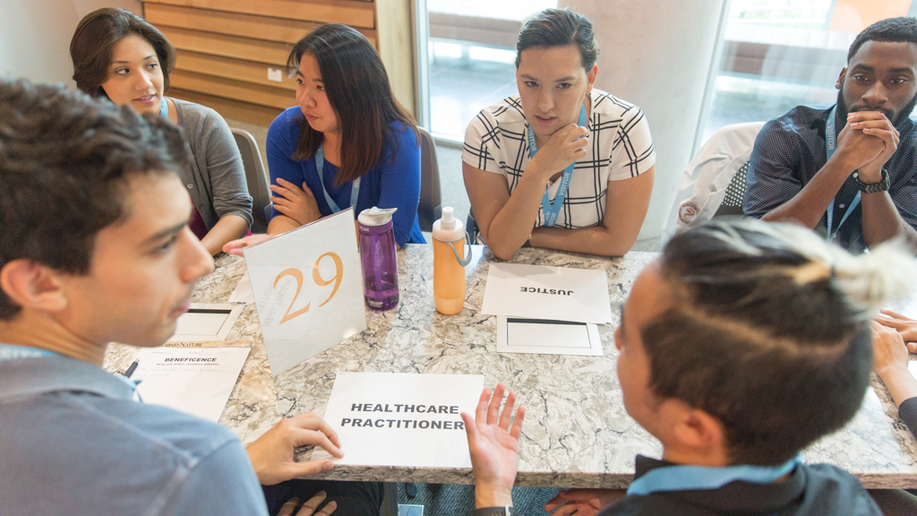
What is Interprofessional Education (IPE)
Interprofessional education involves educators and learners from 2 or more disciplines who jointly create and foster a collaborative learning environment (Buring et al)
Notes:
The need for interprofessional education (IPE) in the health professions has been recognized for many years. In the early 1900s, the idea of IPE was introduced to mission hospitals in India (O’Hara et al, 2018). According to Pecukonis, Doyle and Bliss (2012) “The notion of collaborative, interprofessional education and service provision is far from novel. Interprofessional teams were utilized as early as the 1960s where collaboration at the level of the community health center provided comprehensive care to underserved populations” (p. 417). In 1998, the Pew Health Professions Commission identified the need for interdisciplinary teams as an endeavor to strive for in the 21st century (O’Neil, 1998). This commitment to IPE in academia was further demonstrated by the formation of the Interprofessonal Education Collaborative (IPEC) in 2009 (Zorek & Raehl, 2012) with the mission “to promote, encourage and support efforts to prepare future health professionals so that they enter the workforce ready for interprofessional collaborative practice that helps to ensure the health of individuals and populations” (IPEC, Vision and Mission, 2019).
According to Buring et al. (2009). “Interprofessional education involves educators and learners from 2 or more disciplines who jointly create and foster a collaborative learning environment (p. 59). Mcpherson, Headrick and Moss (2001) consider IPE as “when healthcare professionals learn together, learn from each other, and/or learn about each other’s roles in order to facilitate collaboration”(p. 47ii). Gilbert (2005) differentiates between multidisciplinary and interdisciplinary education; he defined multidisciplinary as “when students from many disciplines learn the same subject at the same time” (p. 89). He indicated that transdisciplinary implied interaction “between, among or across disciplines” (p. 89). According to the World Health Organization (2010), IPE occurs “when students from two or more professions learn about, from, and with each other to enable effective collaboration and improve health outcomes” (p.8 ). Anderson, et al (2019) states that “The premise of interprofessional education (IPE) is that students from different health science backgrounds actively engage together early in their training to develop skills necessary to collaborate successfully” (p. 2). This collaboration among students/professionals may occur in a variety of settings, both clinical and non-clinical.

Slide 6
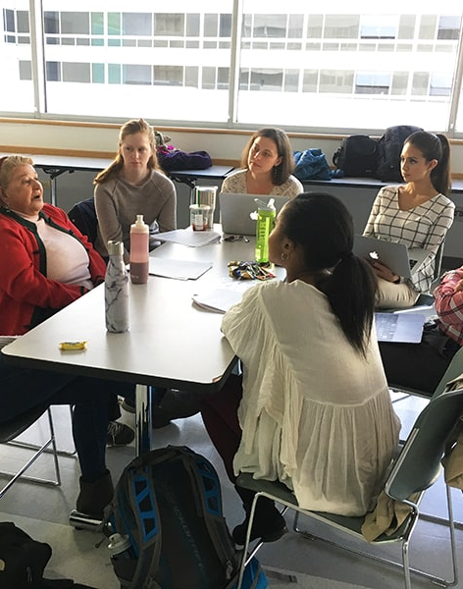
What is Interprofessional Education (IPE)?
When healthcare professionals learn together, learn from each other, and/or learn about each other’s role in order to facilitate collaboration (Mcpherson, Headrick and Moss)

Slide 7
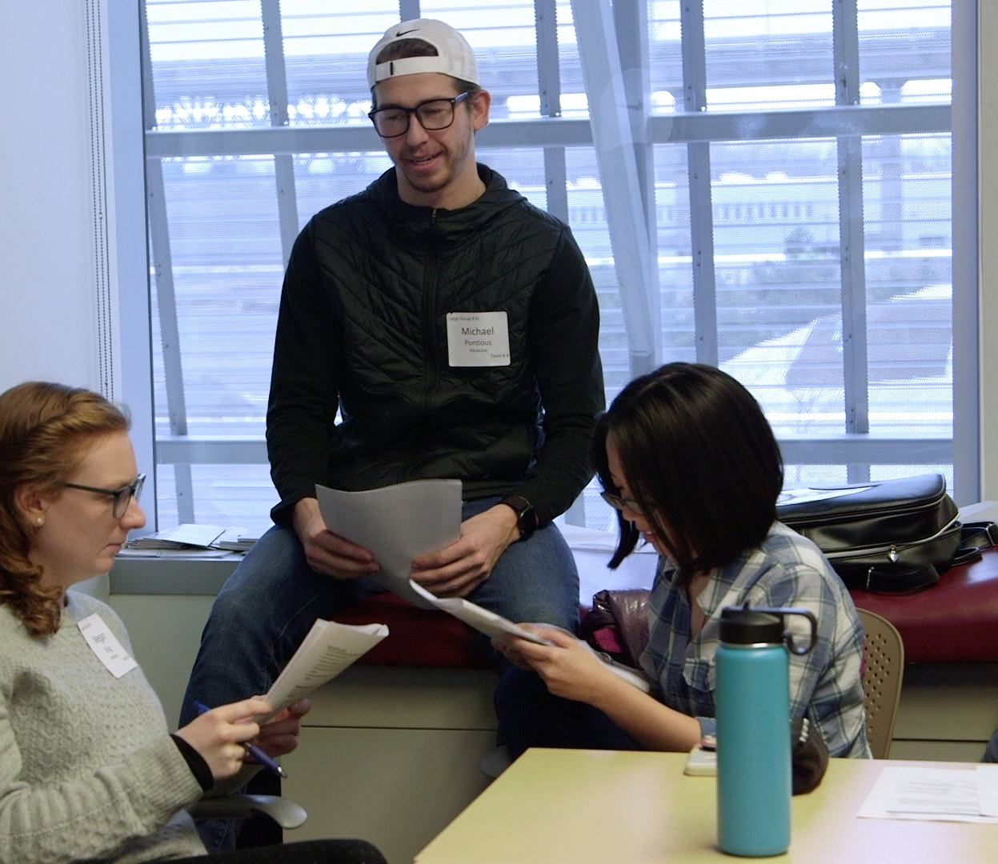
What is Interprofessional Education (IPE)?
When students from two or more professions learn about, from, and with each other to enable effective collaboration and improve health outcomes (WHO)

Slide 8
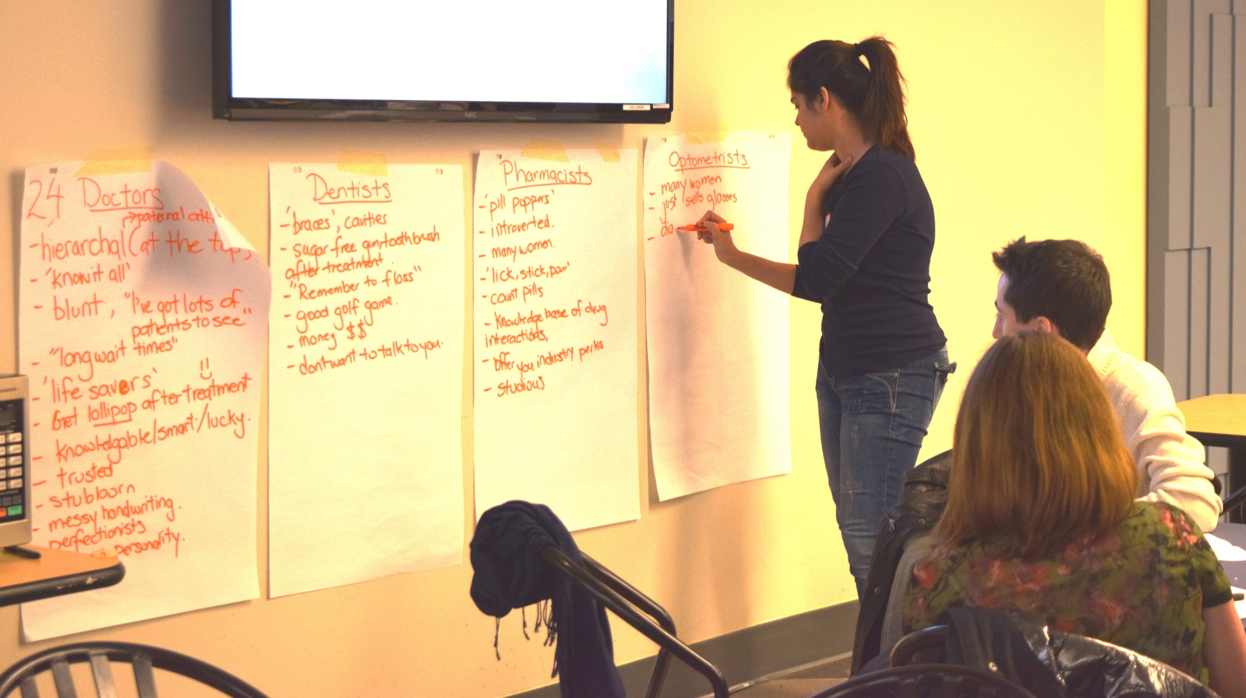
What is Interprofessional Education (IPE)?
The premise of IPE is that students from different health science backgrounds actively engage together early in their training to develop skills necessary to collaborate successfully (Anderson et al)

Slide 9
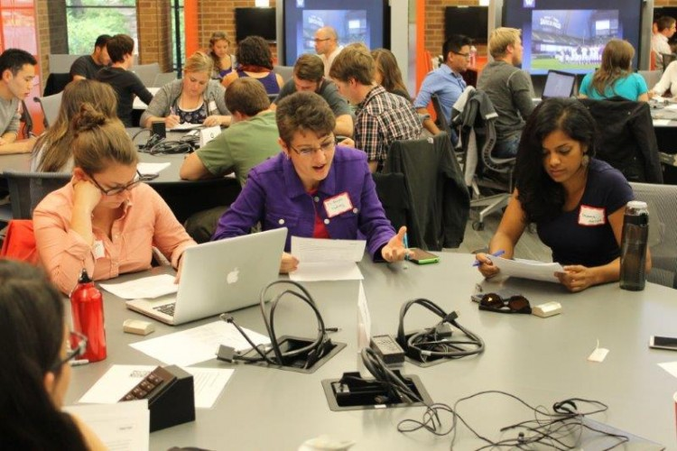
Interchangeable terms used to describe IPE
Shared learning
Multiprofessional education
Interprofessional training
Multidisciplinary education
Notes:
A variety of terms have been used to describe this pedagogic practice (Sittig & Hazelwood, 2018). Some of these include shared learning, interprofessional training, multidisciplinary education, and multiprofessional education (Angelini, 2011; Illingworth & Chelvanayagam, 2007). Pecukonis, Doyle and Bliss (2012) state “Terms such as shared learning, collaborative, interprofessional, and multiprofessional are used interchangeably and without general agreement to meanings” (p. 419).

Slide 10
Benefits of IPE
Raising awareness of the roles and responsibilities of all healthcare professionals
Creating a better understanding of the contributions of all healthcare team members to patient care and outcomes
Facilitating interprofessional communication
Preparing students for dealing with the complexities of teamwork
Increasing cultural sensitivity
Improving perceptions and attitudes of all healthcare professionals
Allowing health professionals to strengthen their identities

Slide 11
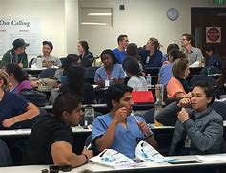
Benefits of IPE
Providing support and treatment for patients
Increasing patient satisfaction
Decreasing recovery time for patients
Decreasing morbidity
Providing patient-centered care

Slide 12

Barriers to IPE
Logistical barriers
Time constraints
Lack of shared values
Accreditation issues (benefits and challenges)
Funding
Preconceived stereotypes and prejudices among health professionals
Notes:
Although studies have shown the benefits of IPE, there are still barriers to implementation. There are logistical barriers including scheduling of courses, available space, and large numbers of health professions’ students, as well as problems with faculty buy-in, turf issues, workload additions, and administrative support. Time constraints is identified by Stanley and Stanley (2019) as one of the major factors that prevents collaboration among disciplines. They also discuss lack of shared values and respect as a determining factor. O’Hara et al (2018) cite different accreditation standards and professional requirements as other obstacles to IPE support. Standards dictate what should or should not be included in a program’s curricula and there may not be additional time to include interprofessional courses (Gilbert, 2005).
Gilbert (2005) also states “Developing IPE courses is an extremely complex and complicated process involving many people in committee work in which fundamental structural barriers have to be addressed… These barriers include funding of courses and recognition of faculty members who teach them” (p. 100). He adds “A major barrier to effecting these changes is that there are not established models for funding. A model is needed that might pay release time to the home department of a faculty member participating in teaching an interprofessional team-taught course” (p. 100). Bond, Dehan, and Horacek (2018) suggest “Preconceived negative stereotypes and prejudices within health professions may act as barriers to interprofessional collaboration, thus creating a detrimental clinical outcome for patients and practitioners” (p 144). Pecukonis, Doyle and Bliss (2008) believe that the very culture of the various professions are barriers to IPE and state
It is not surprising that most health disciplines do not acquire interprofessional cultural
competence and avoid cooperative training opportunities with the classroom or clinical
setting. Thus, an important educational goal should be to train healthcare providers to
transcend their professional biases that limit integrated and comprehensive patient care
(p. 421).
Stanley and Stanley (2005) agree and state “The values, beliefs, attitudes and behaviours of individuals within an organization or community defines their culture” (p. 68).
Gilbert (2005) indicates that many interprofessional programs may not be sustainable after the initial offering but adds “every health and human service program must recognize ultimately that IPE forms a small but permanent part of its curriculum – that IPE is not an add-on, but an integral and necessary component in the education of health and human service professionals, regardless of discipline” (p. 101). As accrediting agencies become more invested in IPE, these obstacles become more easily surmountable.
Accrediting Agencies Role in IPE
Many organizations that accredit health professionals’ educational programs have included requirements for IPE in their published expectations for curricular content (Sittig & Hazelwood, 2018). Zorek and Raehl (2012) conducted an analysis of the IPCP (Interprofessional Collaborative Practice) and IPE-related accreditation standards for colleges and schools of dentistry, medicine, nursing, occupational therapy, pharmacy, physical therapy, physician assistant, psychology, public health and social work. Twenty-three accreditation documents were identified for these professions and twenty-one were analyzed. In those documents, 205 statements were found that could be relevant to IPE. They categorized these statements as accountable statements and non-accountable statements. An accountable statement was defined by Zorek and Raehl (2012) as “A directive or requirements aimed at ensuring a specific IPE or IPCP leaner outcome that the accrediting body could reasonably hold the college or school accountable to” (p. 3). Non-accountable statements were those that were found in titles or explanatory information but not within statements that required accountability by the school or college. Sixty statements were found to be accountable. Of these, forty-six or 77% were found in the requirements of the Commission on Collegiate Nursing Education (CCNE) and the Accreditation Council for Pharmacy Education (Zorek & Raehl, 2012). Zorek and Raehl (2012) recommend “The accrediting bodies representing the US health professions collaborate to create a common IPE standard” (p. 6). Another step forward is the Commission on Accreditation for Health Informatics and Information Management’s decision, in 2017, to become a member of the Health Professions Accreditors Collaborative (HPAC). Lalani and Gibb (2018) believe that this demonstrates “a commitment to advance interprofessional education” (p. 19).

Slide 13

Many Flavors of IPE Implementation
Single event with two disciplines
Assignments with groups comprised of all disciplines
Extracurricular activities
Dedicated IPE class shared across programs
Study Abroad opportunities

Slide 14

University of Louisiana at Lafayette
The University of Louisiana at Lafayette’s more than 19,000 students attend a world-renowned research (R1) institution spread across a 1,500-acre campus of handsome red brick buildings and natural beauty.

Slide 15

University of Louisiana at Lafayette
The University is an international leader in computer science, engineering and nursing. But that only counts a few of the more than 240 stellar undergraduate, graduate, and doctoral programs. Or, to put the last century or so in perspective, enough degree options to outnumber the entire original student body.

Slide 16

University of Louisiana at Lafayette
The University of Louisiana of Lafayette proudly preserves and celebrates the Cajun and Creole cultures. Our rich heritage is interwoven in our traditions and is a part of everyday life on campus.
UL Lafayette embodies the cultures and spirit that are the heart of Louisiana.

Slide 17
IPE in the College of Nursing and Health Sciences
LHC Group – Myers School of Nursing
4 year baccalaureate program
Accelerated RN-to-BSN program
Masters’ programs
DNP program
Health Sciences
Health Services Administration
Health Information Management
Certificate programs
Graduate certificate in Population Health
Notes:
There are 8 colleges at the University – we are in the College of Nursing and Health Sciences

Slide 18
Steps in Developing IPE Courses/Activities
Identify possible course offerings
Explore academic programs interested in course sharing
Soliciting administrative support
Recruiting faculty
Balancing workloads

Slide 19
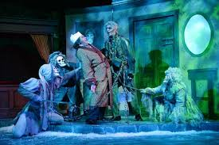
Ghosts of IPE Past, Present and Future in the CONHS
Past IPE Activities
Current IPE Opportunities
Future IPE Opportunities
Notes:
Let’s start with the ghost of IPE past - One of the largest Lafayette hospitals, Our Lady of Lourdes, physically moved into a new facility several years ago. Our seniors worked very hard in the HIM department getting them ready for the move across town. Before the actual move, the facility did a run-through of transferring the patients from the old to the new hospital. Our students volunteered for that. Some of the students acted as patients at the new hospital and tested out the meal ordering system, lab system etc. We didn’t even know we were doing a IPE experience but we were!

Slide 20
Current IPE Opportunities
IPHE 310: Professional Values, Ethical and Legal Tenets of Healthcare
  Required in both the nursing and HIM undergraduate programs
  Taught jointly by a nursing and health information management faculty member
  Currently a hybrid course
  30-120 students per semester
  Sample activities
Wellness Wednesday – Nursing school clinic for students, faculty and staff
NURS 806: Healthcare Informatics
  Doctoral level nursing course (100% online)
  Taught jointly by a nursing and health information management faculty member
  Benefits to the students
Notes:
IPHE 310: Professional Values, Ethical and Legal Tenets of Healthcare
Required course in both the nursing and HIM undergraduate programs
Taught by both a nursing and a HIM instructor
Currently a hybrid course – some face to face classes and some online activities
Anywhere from 30-120 students per semester
Sample Activities
Discussion Boards – students are placed into groups to discuss an ethical dilemma through discussion boards. There is always a mixture of nursing students and HIM students in each group. The students are required to make a post about their assigned “Dilemma” answering the following questions:
Is your dilemma a moral, legal or ethical dilemma?
Based off of the required readings, what is your position on this dilemma
Do any of the ethical principles of autonomy, beneficence, nonmaleficence, and justice apply?
Students must have a minimum of 100 words in their original post and must answer at least one peer post indicating whether or not they agree with the peer and provide support of your view
Sample “dilemmas”: Should an alcoholic patient, who may die of liver disease, receive an organ transplant?; Is assisting with suicide ever ethically justified?; When, if ever, should you disclose a patient’s medical condition to the family?; Should parents be allowed to refuse medical treatment such as chemotherapy to their infant?
Worth 150 points
Group Poster Presentation – this is a group project; again, groups are comprised of nursing and HIM students. They are presenting a case study on an ethical or legal topic and preparing a PP with at least four sources of information. Some examples of case studies include Removing a Feeding Tube, Sterilizing the Mentally Retarded Patient, Consent from a Sedated Patient, Anencephalic baby, frozen embryos, homeless repeat patients, bone marrow transplants. Worth 100 points.
Guest speakers – HIM faculty talk to all of the students about the field, collaboration with other healthcare professionals, opportunities, salaries, outlook for jobs, etc.
Positives – students give good reviews. Nursing students are taking their clinicals at the same time and think it is too much work with clinicals.
Negatives – working with the nursing faculty. One HIM instructor has taught this course over the last 3 years but there have been 3 different nursing instructors. They have changed the format of the course every year and the book – has created a lot of work for the HIM faculty member
Started on a new project earlier this month (September). The nursing school has a “Wellness Wednesday” clinic for students faculty and staff. It is run by nursing students at the second semester junior level. They use a paper record and are running out of space. Faculty met with the College administrators and faculty director of Wellness Wednesday to see what we can do to help them out. Projects will include:
Purging of records and looking into a shredding service for health records
Reviewing forms used (only ID info gathered was name of patient)
Privacy issues
Finding an inexpensive or free EHR or developing an Access database for information to eliminate the paper records

Slide 21
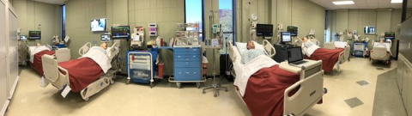
Future IPE Activities
Working with nursing students during simulation activities
IPE Day for nursing and health information management students
IPE Day for nursing, HIM, health services administration, athletic training, and health, wellness and promotion students

Slide 22
References
Anderson, O., August, E., Goldberg, P., Youatt, E., & Beck, A. (2019). Developing a framework for population health in interprofessional training: An interprofessional education module. Frontiers in Public Health, 7, 1-8. doi:10.3389/fpubh.2019.00058
Buring, S., Bhushan, A., Broeseker, A., & et al. (2009). Interprofessional education: definitions, student competencies, and guidelines for implementation. American Journal of Pharmaceutical Education, 73(4), 59.
Lee CT, Doran DM. The Role of Interpersonal Relations in Healthcare Team Communication
and Patient Safety: A Proposed Model of Interpersonal Process in Teamwork. Can J Nurs
Res. 2017 Jun;49(2):75-93. doi: 10.1177/0844562117699349. Epub 2017 Mar 28. PMID:
28841059.
McPherson, K., Headrick, L., & Moss, F. (2001). Working and learning together: Good quality care depends on it, but how can we achieve it? Quality and Safety in Health Care, 10, 46ii-53.
World Health Organization (WHO). (2010). 2010 Framework for action on interprofessional education and collaborative practice. Geneva: WHO Press.

Slide 23

Contact Information
Dr. Anita Hazelwood
anita.hazelwood@louisiana.edu
Dr. Jennifer Lemoine
jennifer.lemoine@louisiana.edu
Notes:
Getting ready for Mardi Gras!!

