Slide 1
Potential of Pathway Partnerships with High Schools
ACC Presentation
February 10, 2023
Dr. Terri Gaeddert, Associate Dean for Academics
Kansas State University Salina
College of Technology and Aviation

Slide 2
WHY?
Changing landscape of higher education
Enrollment
Pathways/Pipelines
Marketing/Visibility
Cost of higher education
Workforce needs
Economic development (regional/state)
Other?

Slide 3
Data for Transfer Courses
Notes:
Old concurrent credit – change around 2015-2016 with HLC guidance updates.

Slide 4

Transfer Courses
Total transfer courses in
fall 2021 = 506 courses.
Over $443,000 in tuition.

Slide 5
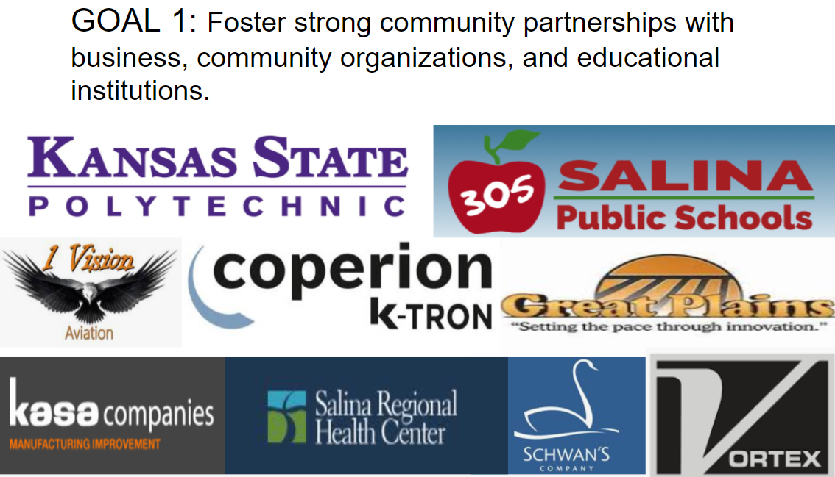
RELATIONSHIPS, RELEVANCE, RIGOR
Policy Brief from Education Commission of the States encourages greater collaboration between K-12 and postsecondary education.

Slide 6
A JOURNEY
Fall 2018 – conversations around loss of headcount (changes in concurrent credit)
Fall 2019 – continued conversations regarding local industry needs
Spring 2020 – discussions with local school district personnel
Fall 2020 – planning in earnest
*district approval of courses
*create enrollment guides
*subject level meetings with faculty
*meetings with school counselors
Spring 2021 – marketing
*meetings with parents
*other marketing opportunities
Fall 2021 – first class of students

Slide 7
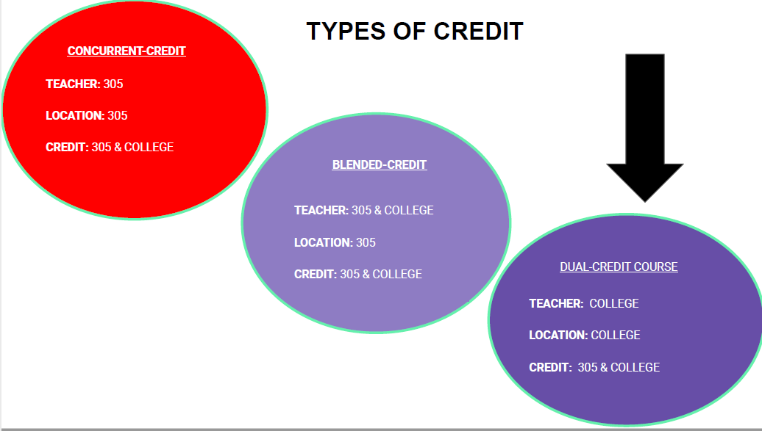

Slide 8
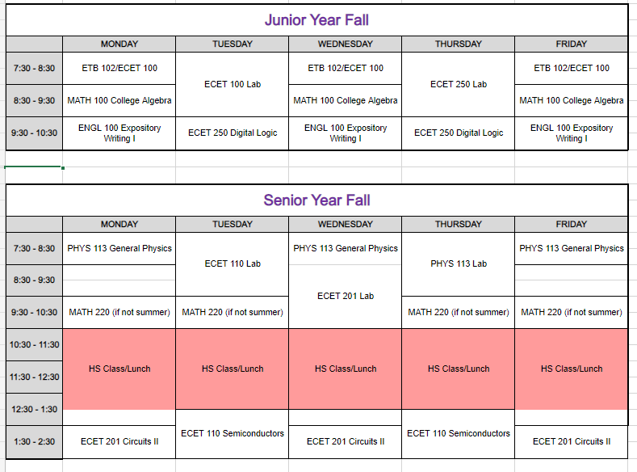

Slide 9
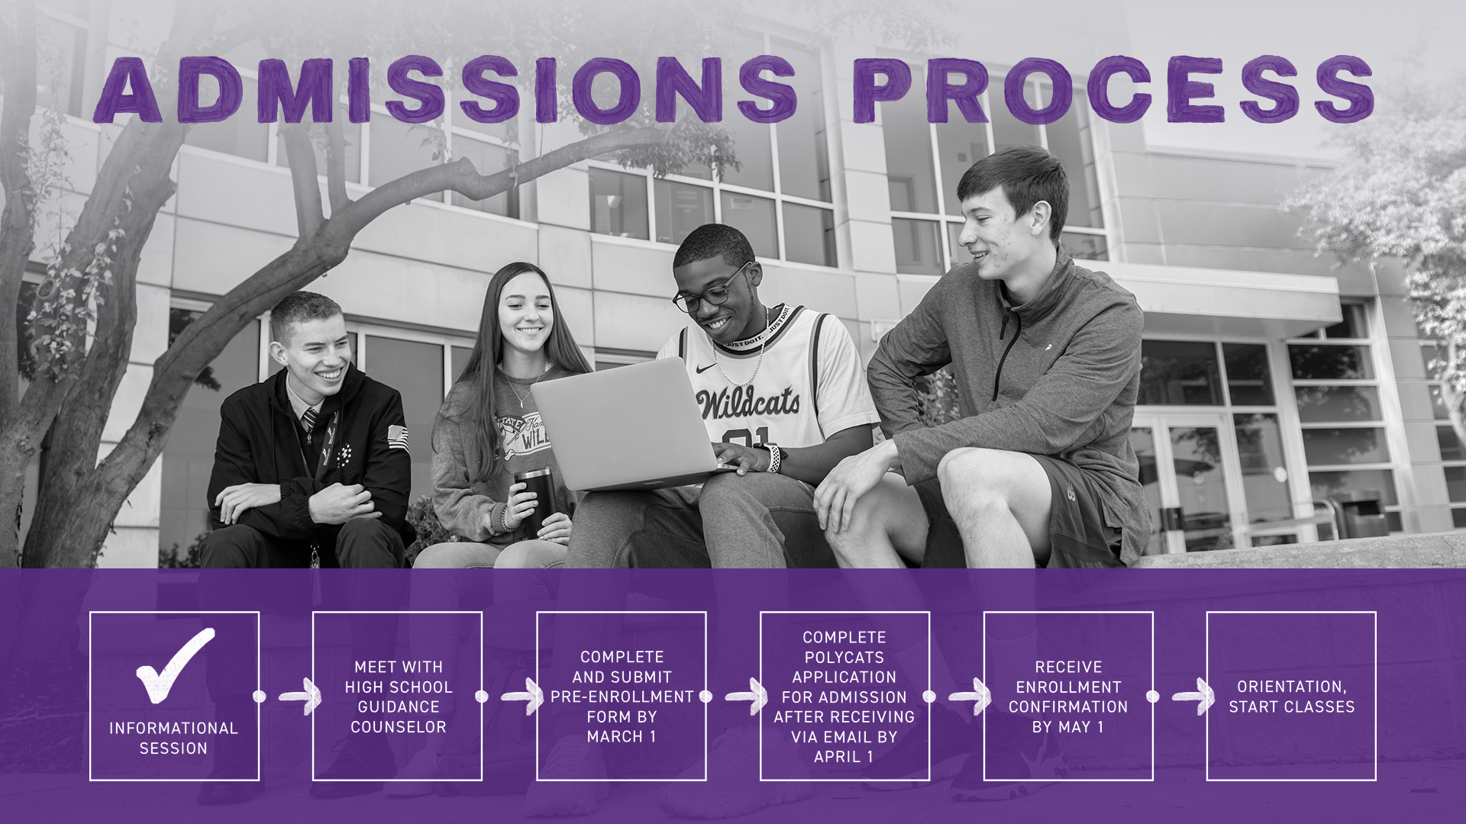

Slide 10
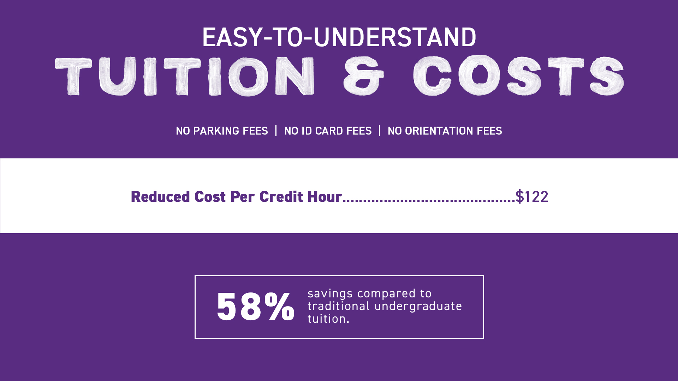

Slide 11

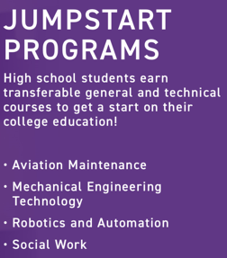
High School Initiative: PolyCATS

Slide 12
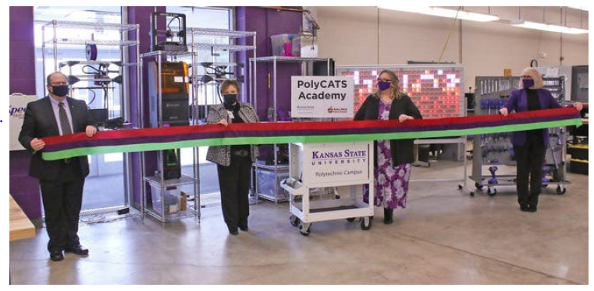

Slide 13

Numbers At-a-Glance
High School Initiative

Slide 14
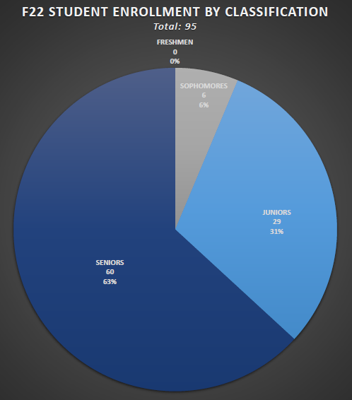
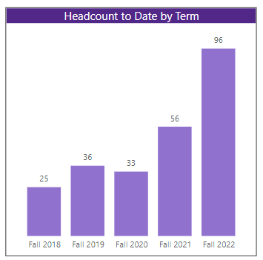
PolyCATS Headcount – Fall 2022 – By Classification

Slide 15
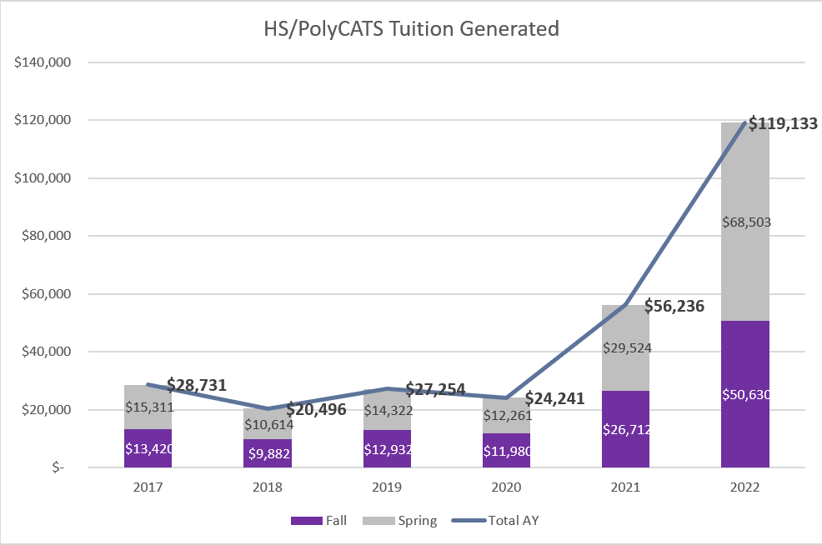
High School Initiative: PolyCATS 2022-2023
239 (95+144) students enrolled
918 credit hours generated
Goal: Reduce average student debt by 50%
$156,060 Savings in Tuition for fall and spring
Notes:
Goal: Reduce average student debt
918 SCHs = about 30 FTE fall/spring students

Slide 16
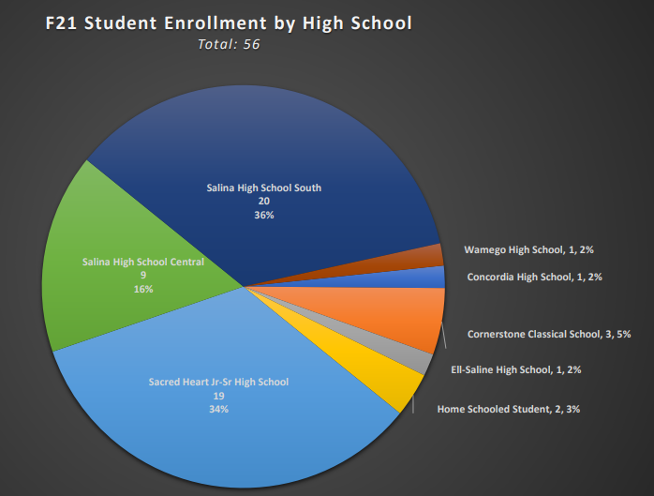
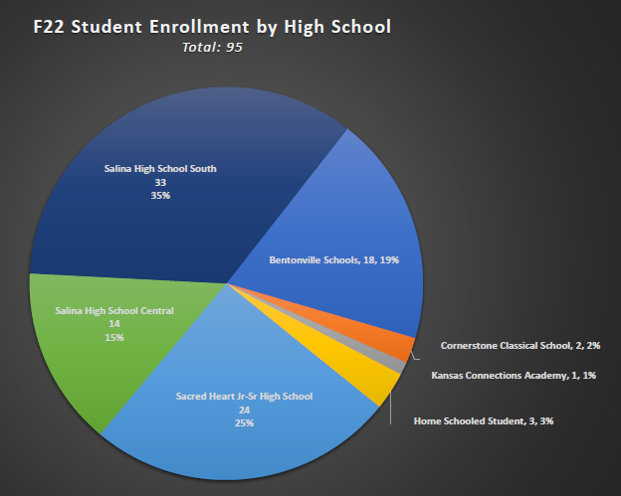
Headcounts by High School
Fall 21 & Fall 22

Slide 17
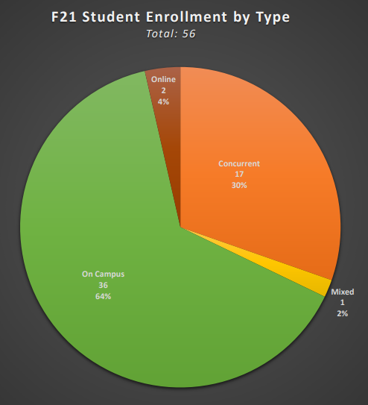
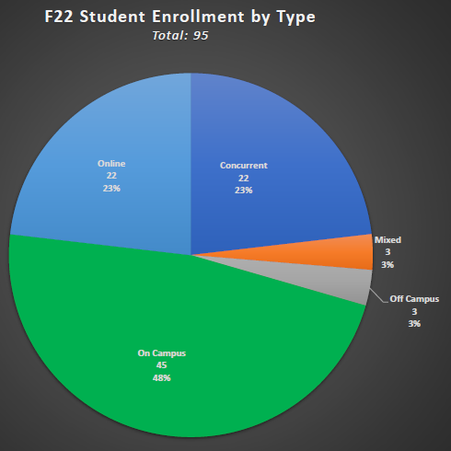
Headcounts by Enrollment Type Fall 21 & Fall 22

Slide 18


Slide 19
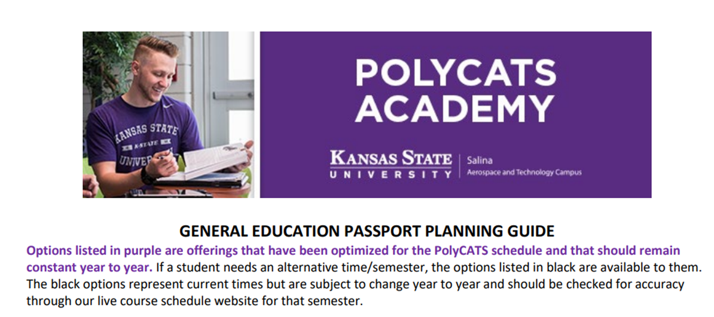
What’s Next?
Data Analysis
Equity/Access
General Education “Passport”

Slide 20
References for further review
Williams, A. and Perry, A. (2020). Prioritizing Equity in Dual Enrollment. Policy brief. Education Commission of the States.
An, B. P. (2013). The Influence of Dual Enrollment on Academic Performance and College Readiness: Differences by Socioeconomic Status. Research in Higher Education, 54(4), 407-432. https://doi.org/10.1007/s11162-012-9278-z
Statement on Dual Enrollment. (2019). Bulletin of the American Association of University Professors (2010), 105, 59–60. https://www.jstor.org/stable/26891811
Harrington, C., & Rogalski, D. M. (2020). Increasing College-Readiness: Accelerated Learning Programs for High-School Students. Journal of Developmental Education, 43(3), 2-4,6-11.
https://er.lib.k-state.edu/login?url=https://www.proquest.com/scholarly-journals/increasing-college-readiness-accelerated-learning/docview/2444987942/se-2?accountid=11789
Clayton, G. (2021). Advanced Placement and Concurrent Enrollment Substitution Effects. Journal of Advanced Academics, 32(3), 380–396. https://doi-org.er.lib.k-state.edu/10.1177/1932202X211004901
Lee, J., Fernandez, F., Ro, H. K., & Suh, H. (2022). Does Dual Enrollment Influence High School Graduation, College Enrollment, Choice, and Persistence? Research in Higher Education, 63(5), 825–848. https://doi-org.er.lib.k-state.edu/10.1007/s11162-021-09667-3

Slide 21
Questions?
Dr. Terri Gaeddert, Associate Dean for Academics
Kansas State University Salina
College of Technology and Aviation
tgaeddert@ksu.edu

