Slide 1

Developing Certificate Programs to Increase Student Enrollment

Slide 2
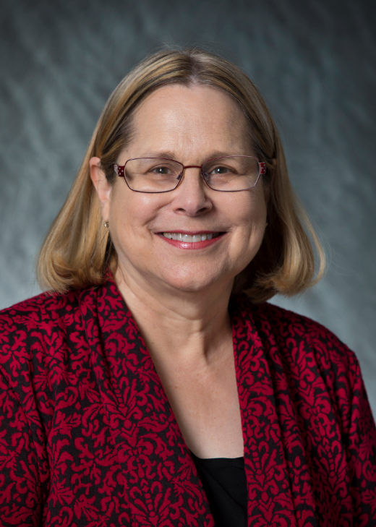
Summit on Higher Education
Fall Festival
Anita C. Hazelwood, EdD, RHIA, FAHIMA, is a Professor and Health Sciences Department Head in the College of Nursing and Health Sciences at the University of Louisiana at Lafayette. Anita is the recipient of the Lafayette General Medical Center/BORSF Professorship in Health Sciences.
Anita is an AHIMA ICD-10-CM and ICD-10-PCS trainer and has conducted numerous coding workshops throughout the state and nation; she has written numerous articles, co-authored several textbooks and authored chapters in several HIM textbooks. Anita was the recipient of AHIMA’s Legacy Award in 2003.
On a professional level, Anita is a member of the American Health Information Management Association (AHIMA) and has served on various committees and boards.
Anita is currently serving as the Chair of CAHIIM’s Health Information Management Accreditation Council.
Anita Hazelwood, EdD, RHIA, FAHIMA

Slide 3

Jennifer B. Lemoine, Ph.D., DNP, APRN is a Professor, and the Interim Dean for the University of Louisiana at Lafayette College of Nursing and Health Sciences and is the recipient of the Sheila Ardoin Walsh Memorial BORSF Professorship in Nursing.
Dr. Lemoine teaches across graduate nursing programs, including masters and doctoral level students and is the recipient of the university’s 2018 Ray P. Authement Excellence in Teaching award. She is a 2020 Elevating Leaders in Nursing Education Fellow. Dr. Lemoine has secured over $113,000 in grant funding and holds one U.S. patient. Additionally, she has authored over 25 publications and presented at numerous local, state, and national nursing conferences.
Jennifer is actively engaged in legislative initiatives at the state and federal levels, serving as the Chair of the Health Policy Committee for the Louisiana Association of Nurse Practitioners. Her efforts have focused on increasing access to care for citizens of Louisiana and advancing the profession of nursing.
Jennifer B. Lemoine, Ph.D., DNP, APRN, MN, RN

Slide 4
Objectives
Address decisions to offer certificate programs
Examine disadvantages and advantages of certificate programs
Review step-by-step process of implementing certificate programs

Slide 5
Driving Certificate Decisions
American public has lost confidence in the economic benefits of a 4 year-college degree
  Not addressing inadequate financial aid and rising student debt
  Too time-consuming
  Growing awareness of other career training options
Most Americans do believe in some education after high school but look more favorably on community college or certificates
Many employees are dropping a degree as a hiring requirement
  State of Maryland
  Silicon valley
  Google

Slide 6
Responses by Universities and Colleges
Academic portfolios focus on skills, reshape offerings, learning outcomes, and tuition structure
Preparing for a career may not necessarily entail a traditional four-year degree
Interest in non-degree and certificate credentials that support in-demand fields
Enrollment strategies meet students where they are
Universities must deliver a robust digital classroom experience; real-time admission and registration communications
Universities must embrace a new sense of flexibility and transparency.
Colleges and universities will look to creatively streamline existing costs and identify new revenue sources
Certificate programs
Notes:
The World Economic Forum, for examples, estimates that 50% of employees worldwide will need reskilling by 2025.

Slide 7
Value of Certificate Programs
They help create lifelong learners
Beyond degrees
They help higher ed better align with workforce needs
Higher education is criticized for failing to produce graduates with tangible, workforce-ready skill sets
Especially important for non-STEM disciplines
Many graduates are in jobs that they didn’t need a degree to obtain
They help institutions stand out as leaders in the industry and increase enrollment
Stackable certificates often build towards masters’ degrees

Slide 8
Critics of Certificate Programs
Some schools offer programs where graduates earn very low wages even with a certificate
According to a Hechinger Report, some certificate graduates don’t earn as much as high school graduates
Quality of programs is often very low

Slide 9
Examples of Progressive Certificate and Credentialing Programs
Virginia’s FastForward Credentialing Program
  A short-term workforce credential program that trains Virginians for top, in-demand jobs across the Commonwealth
  Managed by Virginia’s Community Colleges
  Responsive to employer needs
  Benefits to Virginia Community College system
Harvard Extension
  Provides graduate certificate to deepen expertise and advance students in their current career
  Comparison of graduate certificates vs. Master’s degrees
  Two most common fields for post-master’s certificates are education and healthcare
Notes:
Difference between certificate and credentialling

Slide 10
Examples of Progressive Certificate and Credentialing Programs
Coursera
  Research shows that 89% of individuals earning a certificate believe that they will stand out to employers and secure a job upon graduation if they concurrently get a microcredential certificate
  74% of the students surveyed felt that a college offering microcredentials would make them feel favorable about choosing that university
Purdue Global
  Offers a variety of professional certificate programs at both the undergraduate and graduate level
    Examples include graduate certificate in accounting, graduate certificate in human resources, crime scene technician certificate, autism spectrum disorder postbaccalaureate certificate, medical assistant certificate
Notes:
Difference between certificate and credentialling

Slide 11
Examples of Progressive Certificate and Credentialing Programs
Cornell Certificate Programs
  Offers over 170 online programs for professional development through eCornell
  Examples include marketing certificate programs, data science and analytics certificate programs, environmental, social, governance certificate programs, leadership certificate programs, diversity and inclusion certificate programs, project leadership certificate programs, human resources certificate programs, business and finance certificate programs, hospitality certificate programs, healthcare certificate programs, engineering certificate programs, law certificate programs, and beekeeping master certificate program
Notes:
Difference between certificate and credentialling

Slide 12

UL Lafayette’s Certificate Programs
The University of Louisiana at Lafayette’s more than 19,000 students attend a world-renowned research (R1) institution spread across a 1,500-acre campus of handsome red brick buildings and natural beauty.

Slide 13

UL Lafayette’s Certificate Programs
The University is an international leader in computer science, engineering and nursing. But that only counts a few of the more than 240 stellar undergraduate, graduate, and doctoral programs. Or, to put the last century or so in perspective, enough degree options to outnumber the entire original student body.

Slide 14

UL Lafayette’s Certificate Programs
The University of Louisiana of Lafayette proudly preserves and celebrates the Cajun and Creole cultures. Our rich heritage is interwoven in our traditions and is a part of everyday life on campus.
UL Lafayette embodies the cultures and spirit that are the heart of Louisiana.

Slide 15
UL Lafayette’s Certificate Programs
Graduate Certificate in Cardiovascular Nursing
Graduate Certificate in Population Health
Notes:
Things to discuss for the certificate programs:
a. approval process through Louisiana System Board and Board of Regents
b. funding for students –cardiovascular offers scholarships and population health is eligible for federal financial aid
c. recruiting

Slide 16
Graduate Certificate in Cardiovascular Nursing
UL Lafayette offers one of only three Graduate Certificate in Cardiovascular Nursing
The program is designed for nurse practitioners and APRNs who want advanced training in cardiovascular health and disease management
The six-month program is 12 credit hours of online learning and 120 hours of direct patient care clinical experiences

Slide 17
12 Steps: Developing a Graduate Certificate Program in Cardiovascular Nursing
1. Needs assessment
2. Funding & Resources
3. Garnering departmental buy-in
4. Working with the Dean of the Graduate School
5. Writing the proposal
6. University level approval
7. Regulatory bodies (as appropriate)
8. Course development
9. Community partnerships
10. Recruitment and retention
11. Program implementation
12. Program evaluation

Slide 18
Lessons Learned
Expect smaller cohorts the first few times offered
Programs that include clinical or practice hours may have fewer completers
Marketing the program(s) to the target audience in a creative way is essential
  Who is the target audience?
  Is there a way to “sell” these programs to our current students?
Funding opportunities can make or break a program
Importance of developing community partnerships for recruitment, retention, and program sustainability
Importance of tracking program outcomes
  Educational system level
  Employer level (particularly if $ involved)

Slide 19
Graduate Certificate in Population Health
The Department of Health Sciences is home to the state’s first Graduate Certificate in Population Health
The graduate certificate program is open to professionals with a bachelor’s degree who recognize disparities in the health system and want to make health care and treatment more equitable.
This certificate is designed for healthcare professionals in direct patient care, as well as those who work in healthcare administration, informatics, health information management, and risk managers.
The six-month program includes 12 graduate credit hours of online learning.

Slide 20
Lessons Learned
Marketing of the program
  External marketing
  Internal marketing
    Partnering with other departments
Tie-in to Masters’ program

Slide 21

Future Plans
Notes:
Possible cancer registry certificate

Slide 22
Contact Information
Anita Hazelwood, EdD, RHIA, FAHIMA
  Anita.hazelwood@louisiana.edu
  337-482-6633
Jennifer B. Lemoine, PhD, DNP, APRN, MN, RN
jennifer.lemoine@louisiana.edu
337-482-1029

