Slide 1
TEAMING UP TO REDUCE "SLUDGE"
PRACTICAL GUIDANCE FOR PROCESS IMPROVEMENT
KEVIN VAN WINKLE &
TIMOTHY MOTTET
COLORADO STATE UNIVERSITY PUEBLO

Slide 2
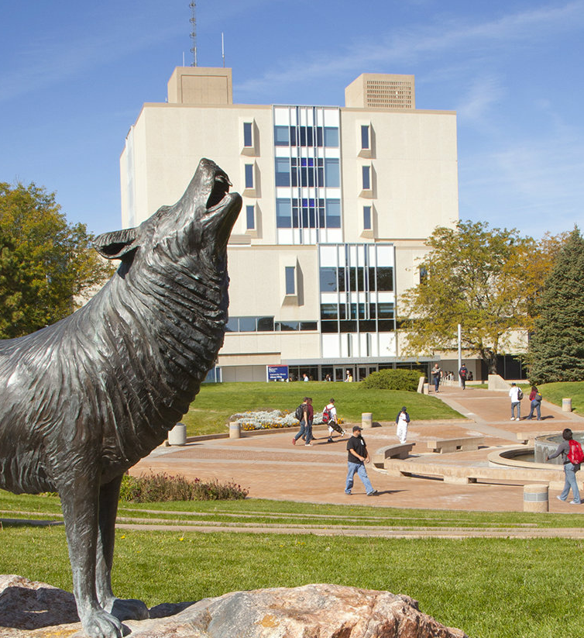


The Presidential Fellow will serve as an advisor to the President on issues that impact the morale, working conditions, assignments, budgets and communication strategies for faculty at CSU Pueblo.
"PRESIDENTIAL FELLOW ANNOUNCEMENT"
PRESIDENT TIMOTHY MOTTET

Slide 3
sludge - all the little things that delay, undermine, and otherwise prevent us from doing what we want to do

Slide 4

  Difficult to locate information
  Badly designed documents
  Duplicative processes
  Meetings for meetings' sake
  Writing unread reports
  Troublesome technology

Slide 5

SLUDGE
EXEMPLIFIED

Slide 6
WHERE DO YOU ENCOUNTER SLUDGE?

Slide 7

  Increases frustration
  Increases irritability
  Increases incivility
  Reduces morale
  Reduces cognitive capacity
  Reduces sense of value

Slide 8

THE SLUDGE
AUDIT
  Announce
  Identify
  Prioritize
  Focus
  Reduce

Slide 9

  Automate
  Eliminate
  Reconsider
  Digitize
REDUCE

Slide 10
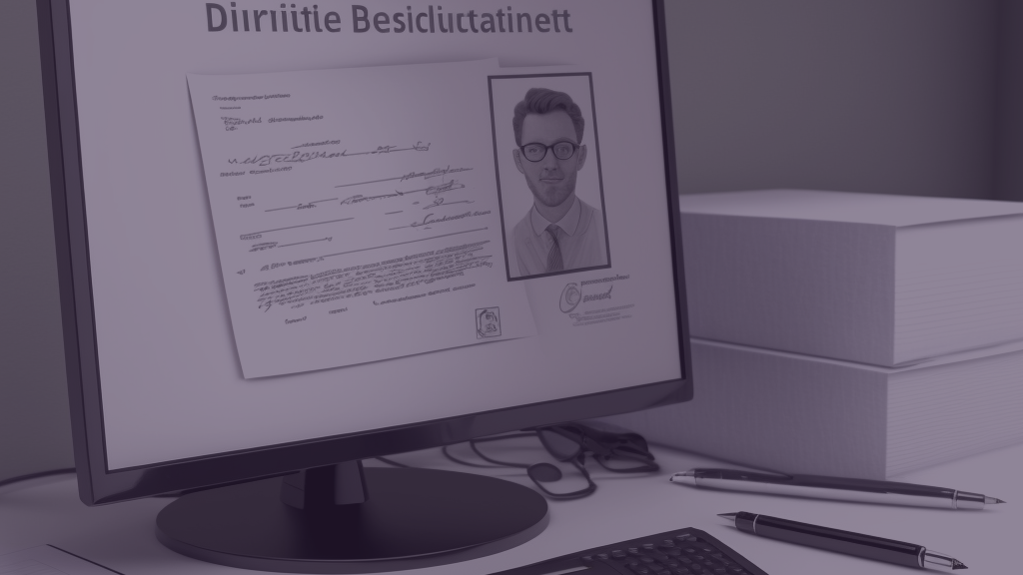
SLUDGE REDUCED

Slide 11
HOW CAN YOU REDUCE SLUDGE?

Slide 12

As part of an ongoing strategy, sludge reduction can improve the processes underpinning modern institutions of higher education at the same time that it strikes at the root cause of our current malaise: not feeling valued.
"COULD REDUCING 'SLUDGE' INCREASE FACULTY MORALE?"
KEVIN VAN WINKLE
INSIDE HIGHER ED

Slide 13

QUESTIONS?

Slide 14

THANK YOU
KEVIN VAN WINKLE &
TIMOTHY MOTTET
COLORADO STATE UNIVERSITY PUEBLO

