Slide 1

Title IX, the Clery Act and VAWA: What the Department Chair
Needs to Know
35th Academic Chairpersons Conference
Orlando, Florida, February 15, 2018

Slide 2
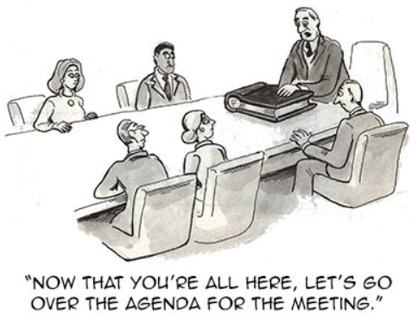
Title IX, the Clery Act and VAWA: What the Department Chair
Needs to Know
Interactive Workshop
Highlight best practices
Review research findings
Notes:
Consider arranging participants at this point.

Slide 3
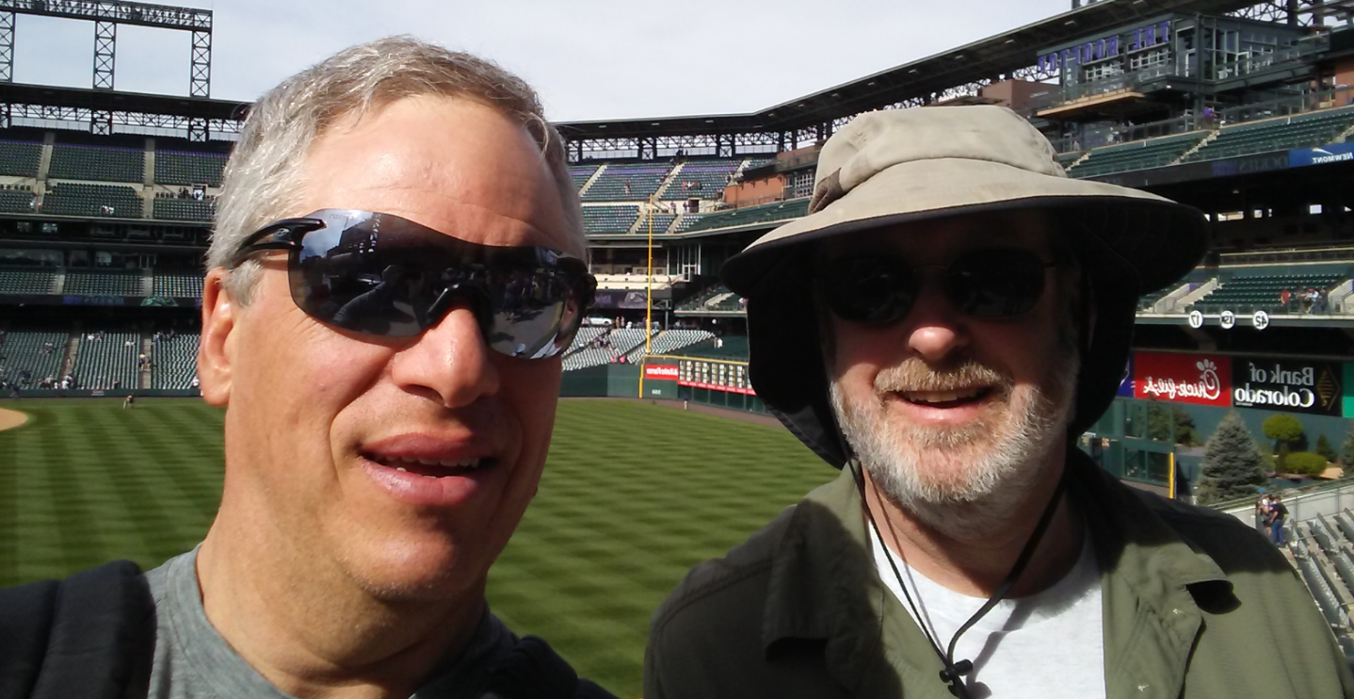
Presenters
Stephen Pyle, MS, CHE
  Associate Professor, College of Hospitality Management
  Johnson & Wales University – Denver
David Line,
PhD, MPH, LMSW
  Associate Professor,
  Public Health
  A.T. Still University
Notes:
Stephen – Has been a non-compliance liaison for 15 years at Johnson & Wales and a department chair for 20 years.
Dave –

Slide 4
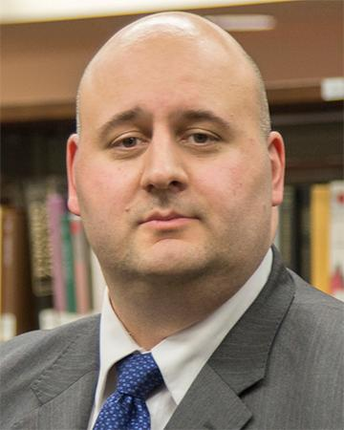
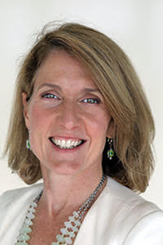
Thanks to:
Matthias Rubekeil
Title IX, Non-discrimination Coordinator, Johnson & Wales University
Elizabeth Canning, Director-Institutional Equity/Title IX Coordinator, Community College of Rhode Island

Slide 5


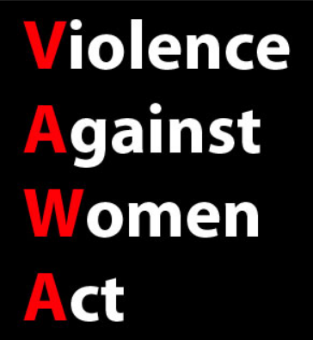
What are:

Slide 6

Who are you:
Your:
Name
Institution
Department
Years as a Chair
Experience with Compliance

Slide 7

Workshop Design
4 Scenarios
  15 minutes each
Work together
  Answer questions
  Discuss with group
Collectively Reflect
  Refer to handout for details and questions

Slide 8
Mixed Methods Research
Research Questions:
  What is the Department Chair’s role in the compliance effort?
  What impact does distance education have on the Title IX and Clery Act Compliance?

Slide 9
Mixed Methods Research
Interview of Subject Matter Expert
  Compliance Officers
  Title IX Lawyers
Online Survey of Compliance Officers
  Focus on role of Chairs in their Compliance efforts
  Focus on the implications of Distance Education on Compliance efforts

Slide 10
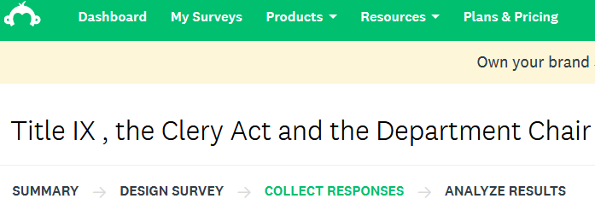
Study Details
Subject Matter Experts
Responses (ongoing)
  n = 25

Slide 11

Workshop Caveats

Slide 12
Workshop Caveats
Justice System and Title IX
State Laws, Title IX, Clery Act, and VAWA
  Differences by State
  Institutional discretion
    Review with your institution

Slide 13
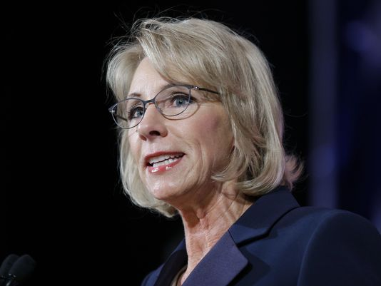

Workshop Caveats
Administration Discretion
  Bush Administration
    Clear and Convincing
  Obama Administration
    Preponderance of Proof
  Trump Administration
    Preponderance of Proof OR Clear and Convincing

Slide 14
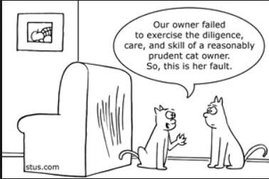
Workshop Caveats
Prudent Professional
  Current
  Informed
  Knowledgeable

Slide 15
Title IX Compliance Experience
Who has been trained in Title IX/Clery Compliance as a member of academia?
Who has been trained in Compliance, specifically in their role as an Academic Chair?
Notes:
Record response rates.

Slide 16
Title IX Compliance Experience
Our research found:
  90% of institutions include Department Chairs as part of the compliance efforts.
  70% of institutions do not have trainings or materials specifically for Department Chairs.
  44% of Department Chairs will be involved at some point in their tenure.

Slide 17
Foundational Thoughts
Chairs have obligation to protect learning environment.
Chairs have to take action (when directed).
Chairs are often in the middle.
Chairs are responsible for department.

Slide 18

Scenario 1 – The Report
Scenario #1 – student comes to you and complains their faculty member is using sexualized language
all the time in class.

Slide 19

Scenario 1 – The Report
Questions
  Is this a Compliance Issue?
    Do you need to respond to this situation?
  What do you do next?
  When do you do it?
  How do you do it?

Slide 20
Scenario 1 – The Report
Answers
  Is this a Compliance Issue?
    Yes, we get federal funding so we must respond.
  What do you do next?
    We report this to our Title IX Compliance Officer.
  When do you do it?
    As soon as possible.
  How do you do it?
    Phone call, email, or direct conversation.

Slide 21
Scenario 1 – The Report
Our Research Found:
  100% of the time Chairs are considered Mandatory Reporters/Responsible Employees.
  95% of the time for Faculty.
  90% of the for Department Staff.

Slide 22

Scenario 1 – The Report
Talking Points
  How does an investigation work?
    Incident reported
    Investigative
    Write investigation report
    Decision made
    Issue sanction
    Finish and close file

Slide 23
Scenario 1 – The Report
Talking Points
  Investigation Outcome Goals
    Determine what happened.
    Address and stop activity which is leading to report.
    Provide support to all parties and address effect of behavior.
    Ensure issue is not systematic.
    Manage potential for retaliation.

Slide 24
Foundational Thoughts
Chairs have obligation to protect learning environment.
Chairs have to take action (when directed).
Chairs are often in the middle.
Chairs are responsible for department.

Slide 25
Scenario 2 – The Call
Scenario #2 – You have just been notified that a faculty member within your department is under investigation by your Title IX Office.
Asked to arrange a meeting between:
  Yourself,
  The Title IX Office investigator and
  The faculty member.

Slide 26
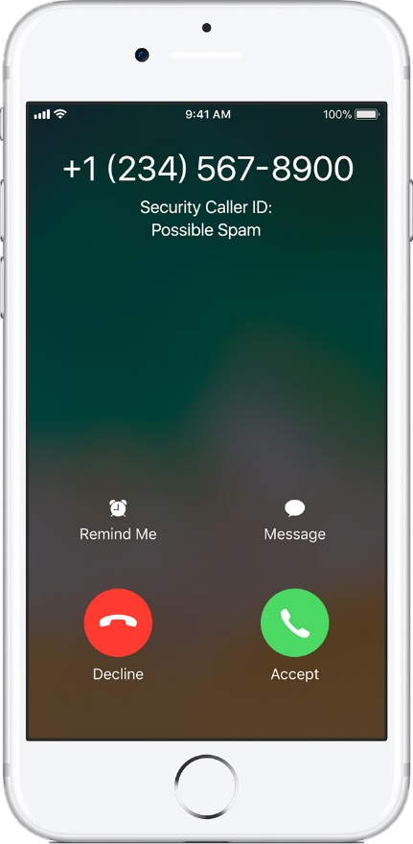
Scenario 2 – The Call
Questions
  What do you do next?
  When do you do it?
  How do you do it?

Slide 27
Scenario 2 – The Call
Considerations
  What do you do next?
    This is likely a big deal to others. Support, not protect.
  When do you do it?
    What is the harm in delay?
    What is the benefit of delay?
  How do you do it?
    In writing, personally, timely?

Slide 28

Scenario 2 – The Call
Talking Points
  Support, not protect
  Community member
  Not in trouble
  Big deal to others
  Be respectful
  Support and protect those not responsible
Notes:
a. Chair is often the one who the faculty member turns to so knowing how to convey the compliance process is critical. Your role is to support faculty.
b. You cannot protect someone under investigation, but you can help them
c. Everyone is a member of the community until they are not
d. “Am I in trouble?” – not until we find out
e. “Every case gets looked at, not just you”
f. This might not be a big deal to you as a Chair, but it is a BIG deal to your faculty member
g. Be respectful to keep the process as human as possible
h. Don’t forget that we need to reintroduce the person who is found not responsible (we don’t do guilt in this process)

Slide 29
Scenario 2 – The Call
Our Research Found:
  45% of the time Department Chairs are included in Compliance Investigations involving their Faculty and Staff.
  70% of institutions notify Department Chairs when their Faculty or Staff are under investigation.

Slide 30
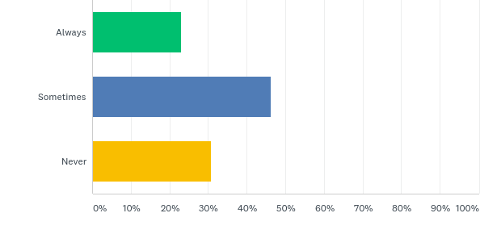
Scenario 2 – The Call
Our Research Found:
  Department Chairs are representatives in the investigation of Faculty and Staff:

Slide 31
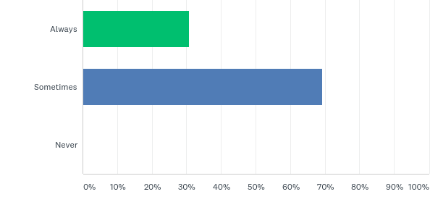
Scenario 2 – The Call
Our Research Found:
  Department Chairs implement outcomes with Faculty and Staff:

Slide 32
Foundational Thoughts
Chairs have obligation to protect learning environment.
Chairs have to take action (when directed).
Chairs are often in the middle.
Chairs are responsible for department.

Slide 33

Scenario 3 - Accommodations
Scenario #3 – The Compliance Office calls one of your faculty members and asks that they allow a student who missed their final to retake it and update the grade.

Slide 34

Scenario 3 - Accommodations
Questions
  What do you do next?
  When do you do it?
  How do you do it?

Slide 35
Scenario 3 - Accommodations
Considerations
  Title IX Office is in charge.
    If request is reasonable, there is no choice.
  Reasons may be confidential.
    It is not about faculty or class.
    It is about the situation or student.

Slide 36

Scenario 3 - Accommodations
Talking Points
  Do not “overhelp.”
  Be part of the solution.
  Be respectful.
  Manage potential for
  retaliation.
Notes:
a. Chair is often the one who the faculty member turns to so knowing how to convey the compliance process is critical. Your role is to support faculty.
b. You cannot protect someone under investigation, but you can help them
c. Everyone is a member of the community until they are not
d. “Am I in trouble?” – not until we find out
e. “Every case gets looked at, not just you”
f. This might not be a big deal to you as a Chair, but it is a BIG deal to your faculty member
g. Be respectful to keep the process as human as possible
h. Don’t forget that we need to reintroduce the person who is found not responsible (we don’t do guilt in this process)

Slide 37
Foundational Thoughts
Chairs have obligation to protect learning environment.
Chairs have to take action (when directed).
Chairs are often in the middle.
Chairs are responsible for department.

Slide 38

Scenario 4 – Distance Ed
Scenario #4 – An online student who lives in another state (1000 miles away) reports they need an extension due to a domestic violence situation.

Slide 39

Scenario 4 – Distance Ed
Questions
  What do you do next?
  When do you do it?
  How do you do it?

Slide 40
Scenario 4 – Distance Ed
Considerations
  What do you do next?
    What is your policy for on campus student?
    What are the interstate “counseling” laws?
  When do you do it?
    Are your instructors aware of the policy?
    Have you contacted the Compliance Office?
  How do you do it?
    In person, remote video conference, contact local experts?

Slide 41
Scenario 4 – Distance Ed
Our Research Found:
  85% of institutions do not have training Specific for Distance Education.
  60% of institutions have not had an issue yet.
  60% of institutions believe online compliance issues will increase.

Slide 42
Scenario 4 – Distance Ed
Talking Points
  Distance education students should get the same services provided to campus students.
  Some states have employment obligations which might apply to students.
  A policy should be in place to address this issue.
  This policy should be part of instructor training.
  Educate Compliance Officers on pedagogy.
Notes:
a. Chair is often the one who the faculty member turns to so knowing how to convey the compliance process is critical. Your role is to support faculty.
b. You cannot protect someone under investigation, but you can help them
c. Everyone is a member of the community until they are not
d. “Am I in trouble?” – not until we find out
e. “Every case gets looked at, not just you”
f. This might not be a big deal to you as a Chair, but it is a BIG deal to your faculty member
g. Be respectful to keep the process as human as possible
h. Don’t forget that we need to reintroduce the person who is found not responsible (we don’t do guilt in this process)

Slide 43
Foundational Thoughts
Chairs have obligation to protect learning environment.
Chairs have to take action (when directed).
Chairs are often in the middle.
Chairs are responsible for department.

Slide 44

Chair Training Exercise
You have been asked by Human Resources for input on a new training specifically for Department Chairs in Title IX Compliance.
What should be included?
Notes:
Where do we need more training?

Slide 45

Chair Training Exercise
Our Research Shows:
  Title IX Compliance Officers biggest concerns regarding Department Chairs.
Notes:
Where do we need more training?

Slide 46
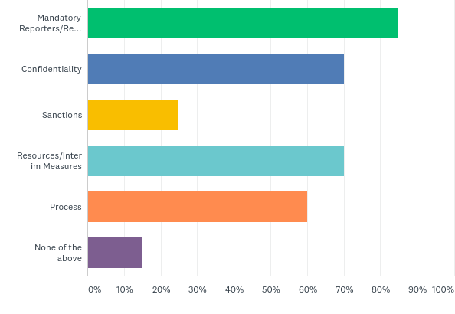
Chair Training Exercise
Our Research Shows:
  Title IX Compliance Officers think these should be included in Department Chair trainings.

Slide 47

Workshop Takeaways

