Slide 1
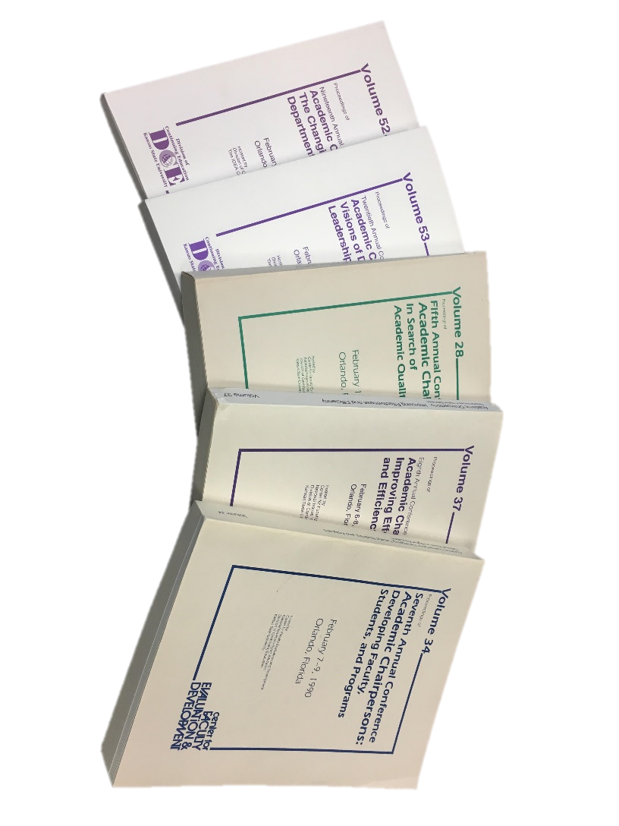
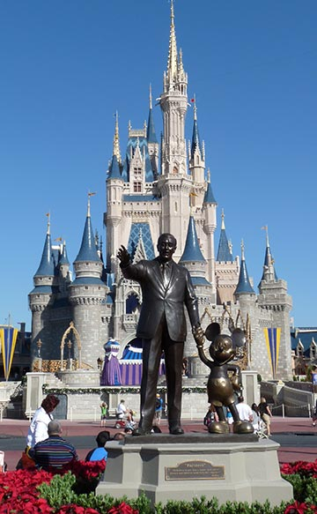

History of the Academic Chairs Conference
35th Academic Chairpersons Conference
Orlando, Florida, February 16, 2018

Slide 2

Presenters
David Line, PhD, MPH, LMSW, COI
  Associate Professor, Public Health
  A.T. Still University
Stephen Pyle, MS, CHE
  Associate Professor, College of Hospitality Management
  Johnson & Wales University – Denver
Notes:
Stephen – Has been a non-compliance liaison for 15 years at Johnson & Wales and a department chair for 20 years.
Dave –
Thank you to our research assistants

Slide 3

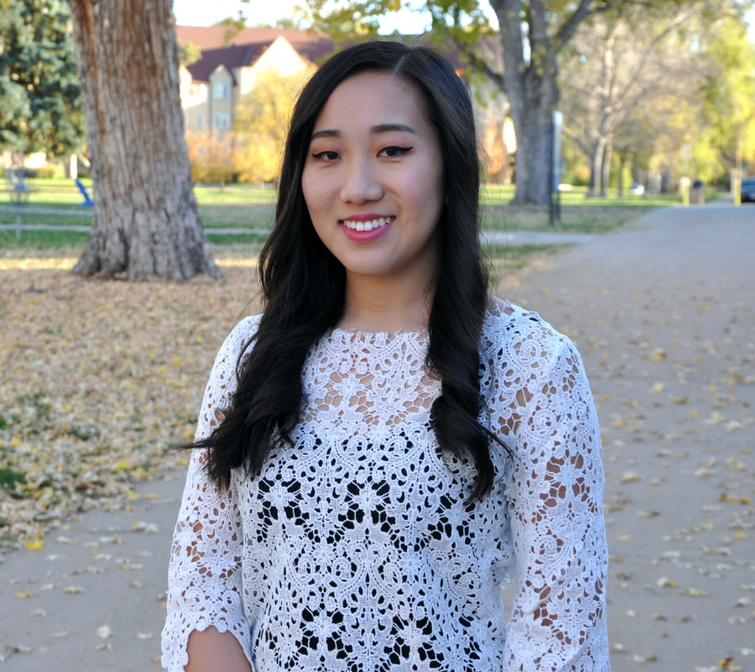
Thanks to:
Yesenia Servin, BS in BKP-Food Service Management, May 2021
Sophia Kim, BS in Business Administration, May 2018

Slide 4

IDEA Behind the Research

Slide 5


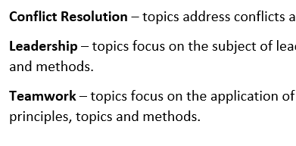
Methodology
Developed topics areas from sample years.
Developed definitions for each topic areas.

Slide 6
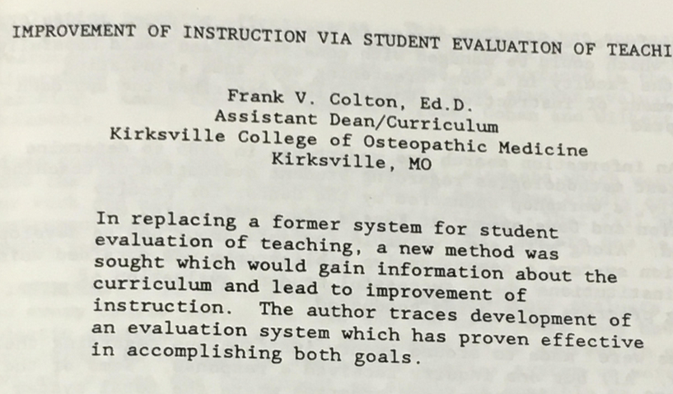

Coded
  Presentations prior to 2002
  Conference proceedings from 2003 – 2018

Slide 7
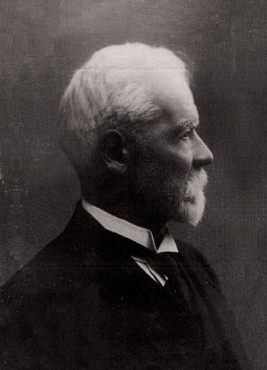
Five Functions of Management
Planning
Organizing
Staffing
Directing
Controlling
Henri Fayol 1841 -1925

Slide 8
Presentation Selection Focus
Special Focus in some years
Continual Focus
  Issues and Trends in Higher Education
  Working with Faculty & Administration
  Operating the Department
  Leadership & Management

Slide 9
Limitations
Attendance for each session not incorporated.
Dependent on what people submit.
Based on what the Selection Committee feels is pertinent and of interest to Chairs.

Slide 10
By the Numbers
1984 to 2018 = 34 Years
  2000 missing
Number of Sessions = 1756
Number of Topics = 24
Average Sessions per Topic = 162.25
Notable
  Average from 1995 to 2002 = 26.9 Sessions
  Average for other years = 60.3 Sessions

Slide 11
Evolution of Topics
Resolved Issues
Sleepers
Emerging Trends
Continual Themes

Slide 12

Evolution of Topics
Resolved Issues

Slide 13
Evolution of Topics
Emerging Trends

Slide 14
Evolution of Topics
Sleepers

Slide 15
Evolution of Topics
Continual Themes

Slide 16
Top 5 & Bottom 3
Topic | Number of Presentations | Trending
Conflict Resolution | 408
Leadership | 358
Program Development | 333
Chair Effectiveness | 330
Faculty Development | 320
Working w/External Stakeholders | 22
Adjunct Faculty | 19
Distance Education | 16
Notes:
Provide 35 year heat map of topics to participants

Slide 17
Principles of Management
Overall
By Topic
Notes:
Topics association with Principles of Management

Slide 18
Difficult Times?

Slide 19

Alternative & Creative

Slide 20

Future uses of the Data

