Slide 1

Evaluating
Online
Programs
Challenges & strategies

Slide 2
Who we are
Dr. Katherine Adler, DHA, FACHE, TOC
Associate Professor & Associate Dean, Academics & Assessment
HLC Peer Reviewer, QM Certification in Online Teaching

Slide 3
Who we are
Dr. Katherine Adler, DHA, FACHE, TOC
Associate Professor & Associate Dean, Academics & Assessment
HLC Peer Reviewer, QM Certification in Online Teaching
Dr. Mary-Katherine McNatt, DrPH, MPH, MCHES, CPH, COI
Chair & Associate Professor, Public Health
(oh wait … she’s not here …)

Slide 4
Who we are
Dr. Katherine Adler, DHA, FACHE, TOC
Associate Professor & Associate Dean, Academics & Assessment
HLC Peer Reviewer, QM Certification in Online Teaching
Sue McDaniel, MS
Instructional Designer
Notes:
Sue is filling in for the very pregnant and absent MKM

Slide 5
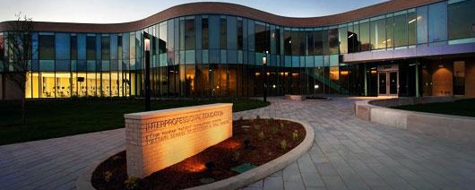

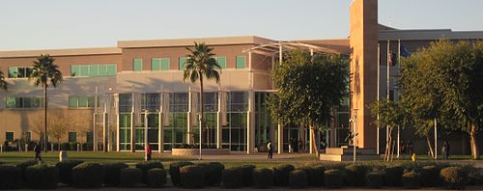
A.T. Still University
Notes:
Kathy: Foundational school of osteopathic medicine – 1892 in Kirksville, Mo – second campus in Mesa, Arizona – 6 schools: Kirksville College of Osteopathic Medicine, Missouri School of Dental and Oral Health, the Arizona School of Dental and Oral Health, School of Osteopathic Medicine in Arizona, the Arizona School of Health Sciences, and Us – College of Graduate Health Studies is fully online with on-campus office space in MO and AZ

Slide 6
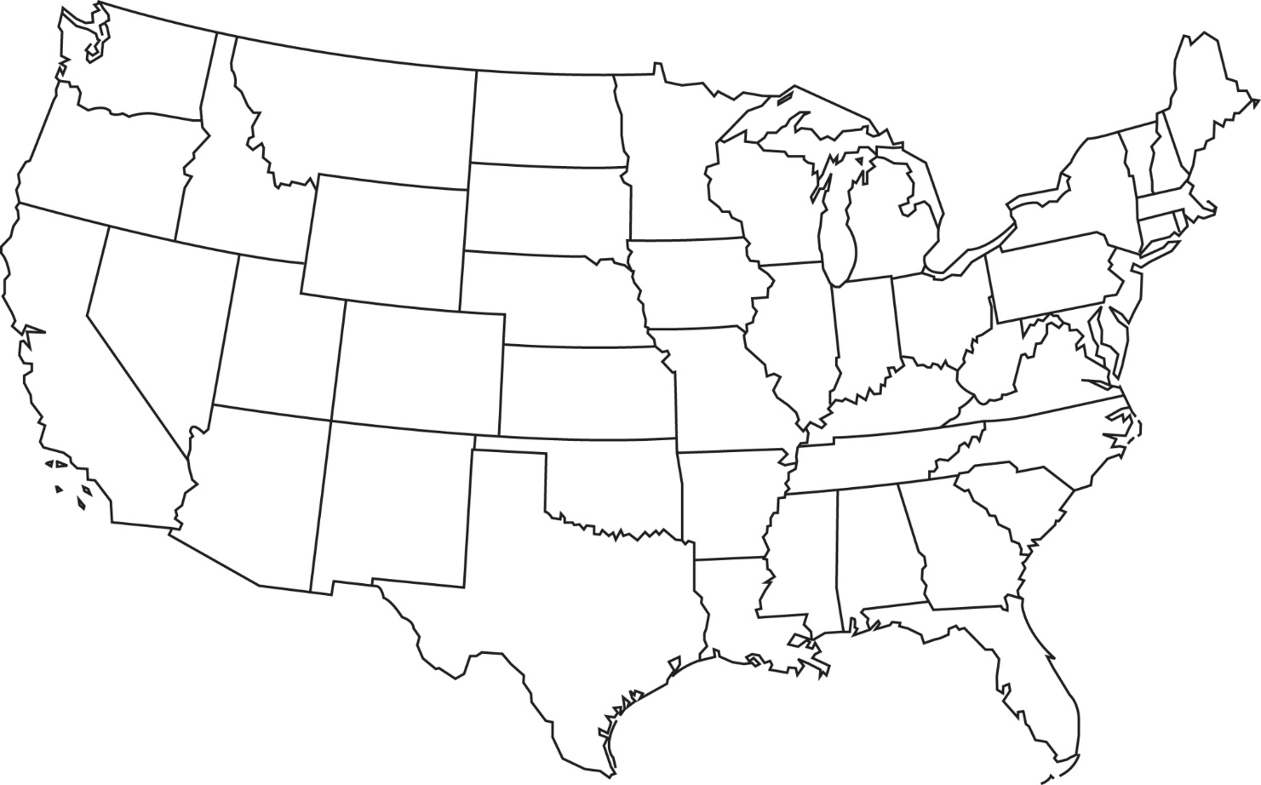
A.T. Still University
Notes:
Sue
CGHS is a online school – but we have physical offices in Kirksville and Missouri
The Dean is in Mesa, the Associate Dean is in Kirksville

Slide 7
A.T. Still University
Notes:
Sue
Program Chairs – Arizona, Michigan, New York and 2 in Texas

Slide 8
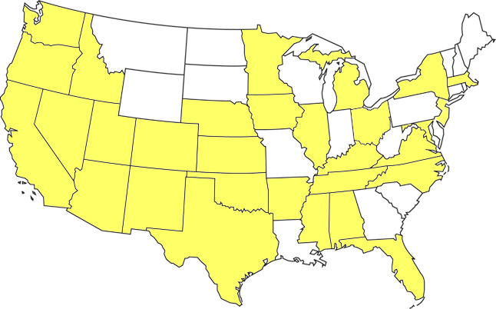
A.T. Still University
Notes:
Sue
We have faculty all across the country – 30 states – all the states highlighted + Hawaii
CGHS is the “largest” school of the university (1/3 of the total student body) – approximately 1,100 students in almost all states + Puerto Rico + 9 foreign countries + military installations

Slide 9

Today’s agenda
Quantitative Data Collection
  Student
  Faculty
  Course
  Program
  Curriculum
Qualitative Data Collection
  Curriculum
  Program
  Course
  Faculty
  Student
Using the data
Notes:
Sue
Today we’re going to discuss all the types of data we collect – individual up to curriculum, then curriculum down to student

Slide 10

Notes:
Kathy
Audience Engagement –
Course competency achievement? How do you assess / measure that competencies are being met?
How do you assess that your program competencies are being met?
What other assessment measures are you doing?

Slide 11

Notes:
Kathy
Right now, how do you know your program competencies are in alignment with your course and module/unit objectives?
What tools do you use?
Where does the data come from?

Slide 12

Notes:
Kathy
Data is like potato chips, you can’t stop at just one data point. Pretty soon you are trying to capture ALL of the data points, the first ones being quantitative because, theoretically, they’re the easiest: student retention, program persistence/completion, GPA, etc.
This is the science of evaluation

Slide 13
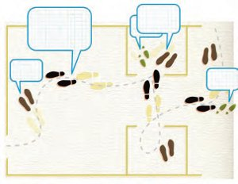
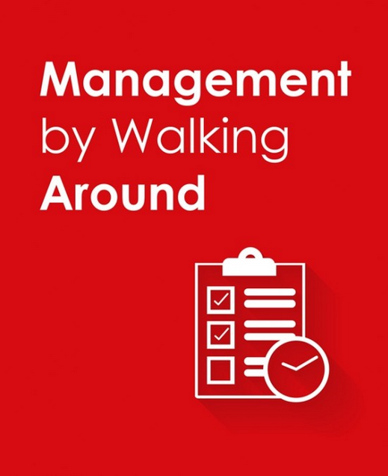
It’s a bit different online …
Notes:
Sue
Because we are 100% online, we have to do things differently.
we have to find new ways to conduct assessment.
We can’t sit in on lectures.
We can’t catch students or instructors in the hallway to ask “how are things going”?
This makes producing evidence of quality for HLC (our accrediting body) challenging.
We have no on-campus equivalent courses – we can’t easily compare the online course to anything – had to create our own calculation of seat time / credit hours awarded (Carnegie hours)

Slide 14

Quantitative data
  Student
  Faculty
  Course
  Program
  Curriculum
Notes:
Sue
We collect quantitative data on all levels …

Slide 15
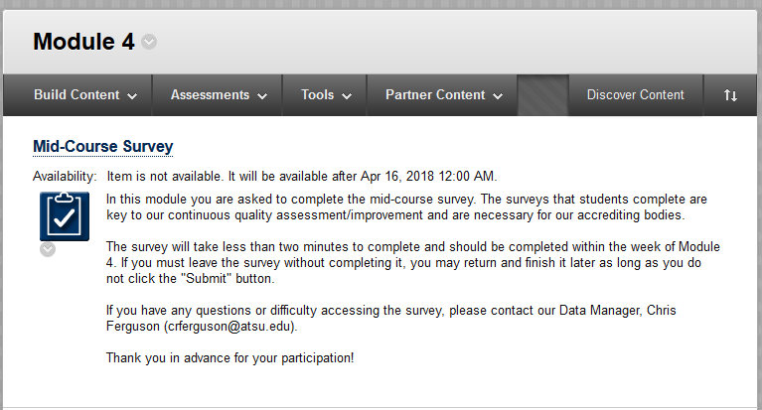
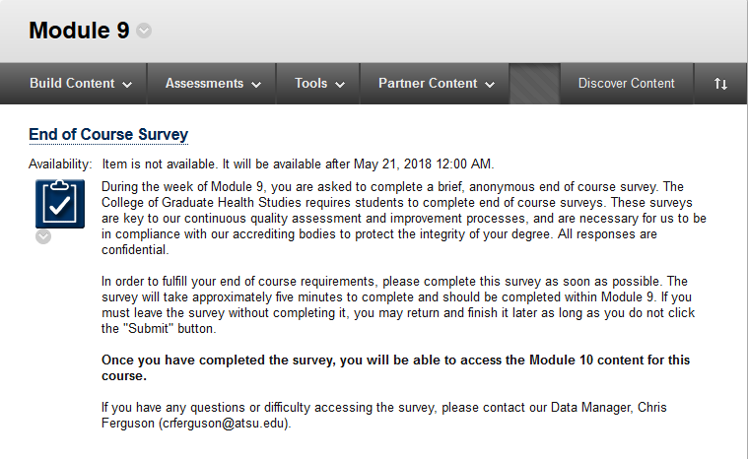
Student
Surveys in Blackboard
Notes:
Sue
We use surveys in Blackboard at weeks 4 and 9 – which allows us to gather both quantitative and qualitative data. These are anonymous and the Grade Center columns are hidden from instructors so faculty can’t see who completed the survey. When our data manager downloads the results, the order is scrambled from Grade Book order so the results can’t be tied back to an individual student.
The only way data can be tied back to the student is if the student provides information that self-identifies – or there’s only one student in the class

Slide 16
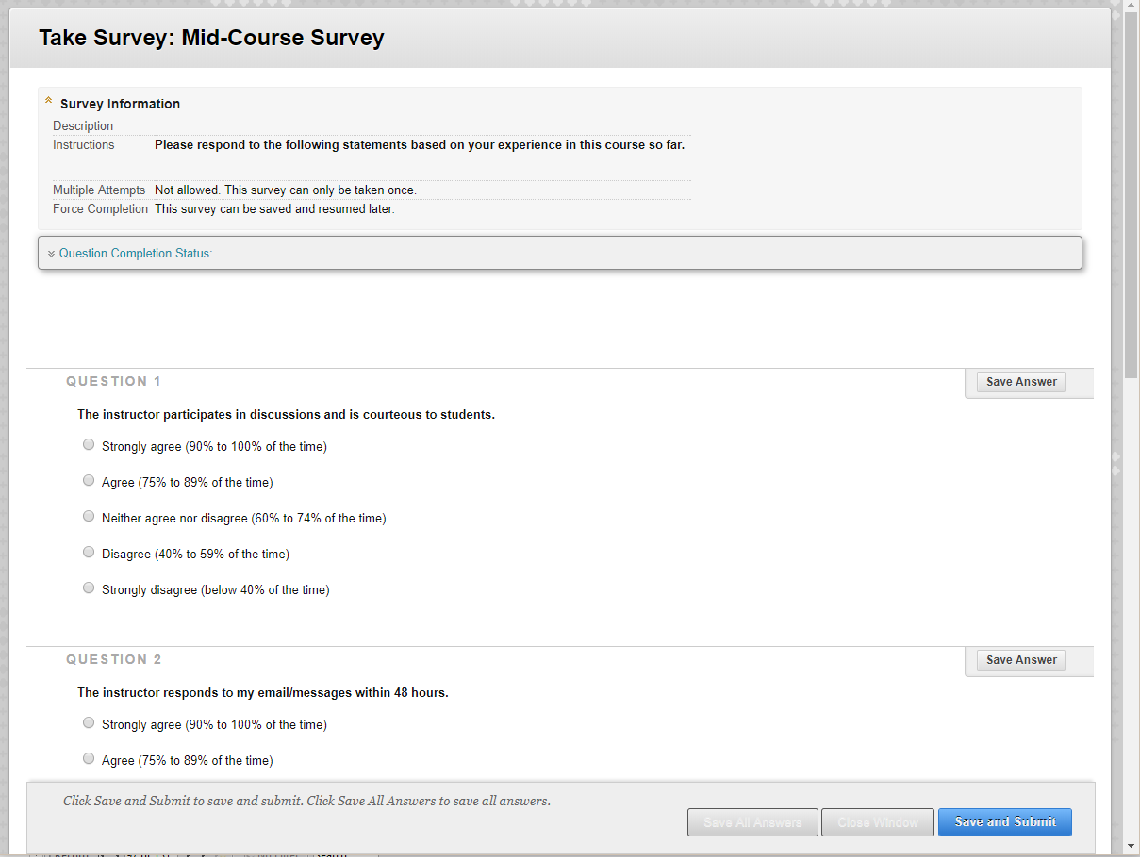
Student
Mid-Course Survey
Notes:
Sue
The instructor participates in discussions and is courteous to students.
The instructor responds to my email/messages within 48 hours.
My weekly assignments have been returned to me and grades posted by no later than Thursday evening after assignments were due (within 7 days for ARP project submissions)
The instructor provided feedback that allows me to make necessary corrections and improve my work.
Please use this section to share any further comments
This is used to primarily assess instructor engagement early on in the course to see if anything needs to be improved.
We do use a likert scale, but it’s important to note that anything below 40% is an extreme that we do not want to hit. Actually anything below 70% is of concern to us.
We get about a 78% response rate

Slide 17
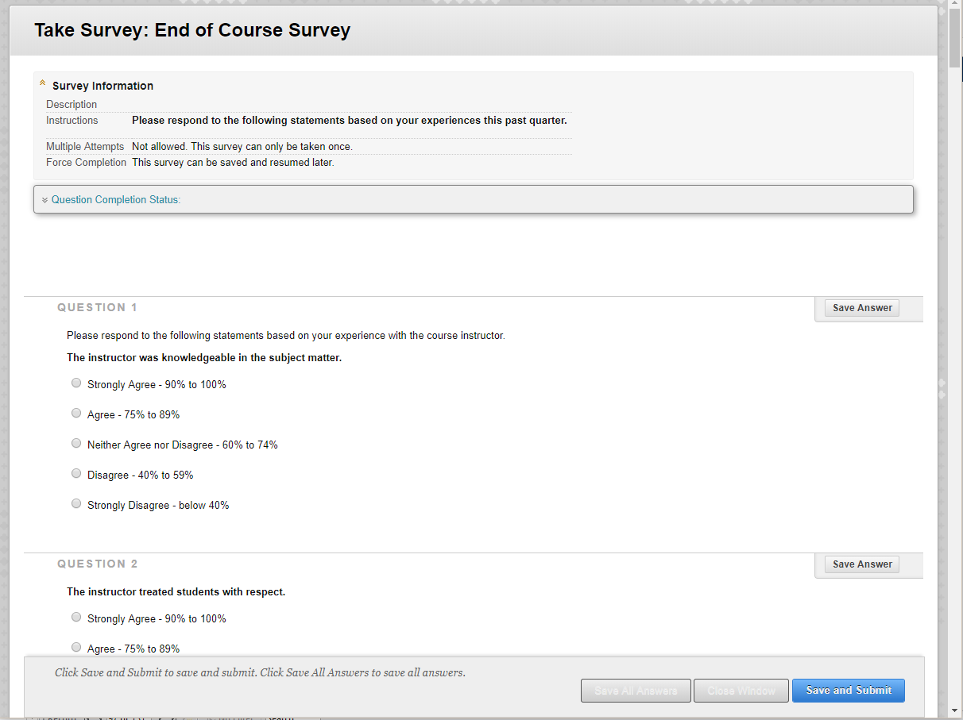
Student
End of course survey
Notes:
Sue
96% response rate – you heard that right – 96% for EOC
The reason that we get such a high response rate is due to an adaptive release of the students’ final course module.
This section of the survey addresses things about the course.
This helps us get a gauge of how much time a student self reports in terms of time spent, the pace of the course, and how the workload compares to other courses they’ve taken.
This is also collected using the same Likert scale as the mid course survey.

Slide 18
Student
questions re: course
How many hours did you spend per week, on average, in this course?
Course competencies were clear
Course activities were effective in reinforcing or solidifying learning
I was able to monitor or track my progress in this course
I have gained a great deal of practical knowledge
Which concepts/modules did you find particularly difficult?
Which activities did you like/find not helpful?
Do you have any suggestions?
Notes:
Sue
The pace of this course was: much too fast – too fast – about right – too slow – much too slow
How many hours did you spend per week, on average, in this course?
Compared to other courses that I have taken, the amount of effort required to succeed in this course was: much higher – higher- about the same – lower – much lower
The course syllabus clearly describe course content, competencies, objective, activities, assessments and point distribution, and was easy to follow
The textbook selection was appropriate and current for this course.
Course content was organized in a manner that facilitated learning.
Course competencies were clear.
Course activities were effective in reinforcing or solidifying learning
Course assessments demonstrated transfer of knowledge.
Discussions enhanced my learning in this course.
I was able to monitor or track my progress in this course.
I was satisfied with the amount of interaction with other students in this course.
I have gained a great deal of practical knowledge from this course.
If your shared a concern about the course with your instructor, was the concern addressed?
Which concepts or modules did you find particularly difficult in this course?
Which concepts or modules were particularly well delivered?
Which activities did you like in the course?
Which activities did you find to be not helpful?
Do you have any suggestions for what we could do differently?

Slide 19
Student questions re: instructor
The instructor treated students with respect.
Course grades were an accurate reflection of my performance.
The instructor established an active presence within the course.
Compared to other courses that I have taken, the amount of effort required to succeed in this course was …
Which concepts or modules did you find particularly difficult in this course?
Which activities did you like in the course? Which activities did you find to be not helpful?
Notes:
These are some of the questions the students complete on the instructor. Here is where we collect some of the instructor engagement data.
34 questions covering instructor knowledge and treatment of students, grading expectations, interactions with the instructor and other students, instructor presence, pace of the course, effort required, textbook selection, etc.
The instructor was knowledgeable in the subject matter.
The instructor treated students with respect.
Course grades were an accurate reflection of my performance.
The instructor’s grading expectations were clear and applied consistently.
I am very satisfied with the amount and quality of instructor interactions (including feedback) in this course.
The instructor was timely in response to emails and requests for formative feedback (48 hours).
The instructor was timely in providing grades with summative feedback (96 hours, 7 days for ARP project submissions)
The instructor established an active presence within the course.
The instructor added value to the course discussions by sharing relevant knowledge.
The instructor added value to the course discussions by building on contributions of students.
The instructor added value to the course discussions by providing useful insights.
The instructor added value to the course discussions by connecting student responses to the course material.
The instructor added value to the course discussions by highlighting the practical relevance of course materials.
The instructor added value to the course discussions by keeping the discussion focused.
The instructor added value to the course discussions by prompting additional discussion as needed.
96% response rate – you heard that right – 96% for EOC
The reason that we get such a high response rate is due to an adaptive release of the students’ final course module.
This section of the survey addresses things about the course.
This helps us get a gauge of how much time a student self reports in terms of time spent, the pace of the course, and how the workload compares to other courses they’ve taken.
This is also collected using the same Likert scale as the mid course survey.

Slide 20
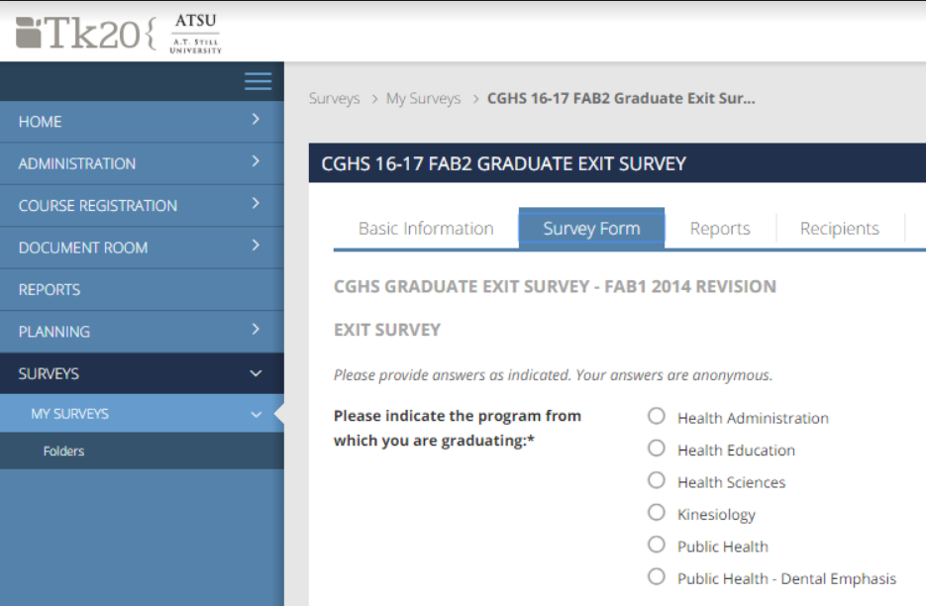
Student graduate exit survey
Notes:
Kathy
Continuing on with the student satisfaction theme, we also conduct out graduate exit survey in TK20, sent to their ATSU email addresses. The students are asked to reflect on their program and how well it prepared them for the workforce among other things. We also use this to collect specific data for accrediting agencies, such as what field they are working in.
We collect information on the ATSU CPAs

Slide 21
Student graduate exit survey
What was the most memorable moment during your matriculation?
Are you proud to be a part of the ATSU family? Yes/No
Would you recommend ATSU/CGHS to your friends, family, and colleagues? Yes/No
Do you wish to be active in ATSU alumni programs? Yes/No
Do you plan to return to ATSU for a subsequent degree or certificate? Yes/No
Notes:
Kathy
In addition to asking questions on satisfaction levels in various ATSU services, we ask questions on overall satisfaction. Here are some examples.

Slide 22
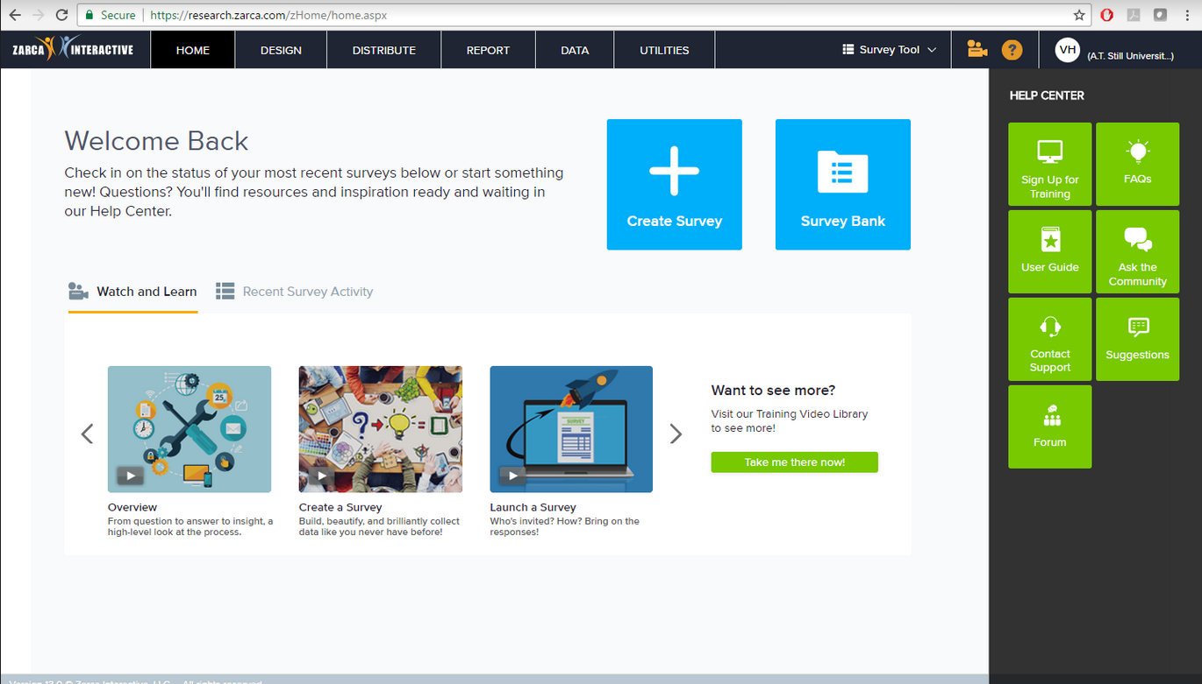
Student alumni survey
Notes:
Kathy
We do an alumni survey using the software Zarca. This is similar to the graduate exit survey, but for individuals that have been graduated for more than a year.

Slide 23
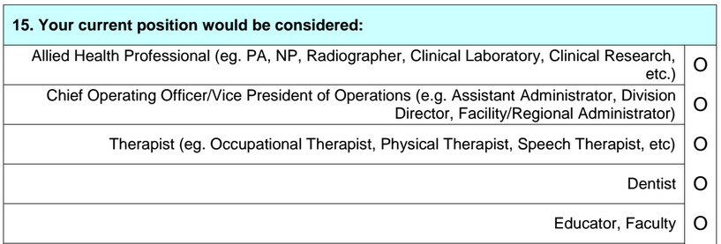

Student alumni survey
Notes:
Kathy
Most of our students come to us already working in their field of choice, so we need to concentrate on other items that help us judge if the program is helping students excel.
Did your degree result in a promotion?
How long did it take you to find employment after graduating? (If you were not working in your chosen field)
we also ask questions on employment and willingness to serve ATSU – this is used for things like filling appointments to curriculum committees and practicum sites

Slide 24
Student alumni survey
What do
you do?
Notes:
Sue
Are there data points that you collect on your students/graduates that we’ve not covered here?

Slide 25
faculty instructor course evals
The course competencies describe outcomes that are measurable.
The module learning objectives are appropriately designed for the level of the course.
The assessment instruments selected are appropriate to the student work being assessed.
The course provides activities that correlate to real-world expectations.
Course content flows in a logical progression.
Course tools and media support student engagement.
What is the most/least effective assignment in the course?
Notes:
Sue
And, we don’t let the instructors off the hook either. They are asked to complete an end of course survey responding to questions on the courses, whether or not they feel it covered the course competencies and to what degree, as well as their thoughts on the text, learning objectives, course outcomes, assessments and overall course content.
In the past, our faculty may not have taken this very seriously – Letha example – this doesn’t help us pull together evidence to support course changes and evidence for HLC

Slide 26
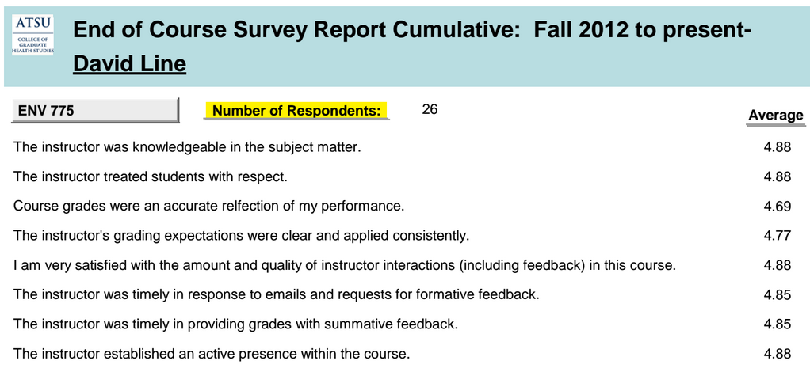
faculty
Survey info shared
Notes:
Kathy
We store the various data points we were collecting into an Access data base so that we could slice and dice the data.
All of the survey responses are then entered into the database and the information provided to individual faculty and the overall aggregate data to the program chairs.
Transparency – all the data collected is returned to the faculty – quantitative data, grade distribution, and student comments (qualitative data)

Slide 27

faculty faculty tracking
Notes:
Kathy
And now, back to instructor engagement!
In addition to data from our students and on our courses,
We also collect data on how our instructors do, and how engaged they are in their courses.
We collect this data to collect evidence to meet HLC rules on instructor engagement – ensures this is NOT a correspondence course – we don’t have an on-campus equivalent of any of our courses, so this makes it challenging … we’ve had to create a few measurements that are a little “outside of the box” to demonstrate the effectiveness of our courses and generate evidence for our coming HLC visit in November
This is not really one of the favorites of our instructors – but we need to provide evidence to support our courses are online and not correspondence.

Slide 28
Faculty faculty expectations
Weekly announcements with supplemental material (minimum of 1 / week)
Discussion engagement – 15% of total postings
Grading – using established rubrics in the course, within 96 hours of deadlines, with comments/substantive feedback
Respond to student emails & requests within 48 hours
Notes:
Kathy
We’ve established some benchmarks we can measure against (based on QM and other best practices)

Slide 29
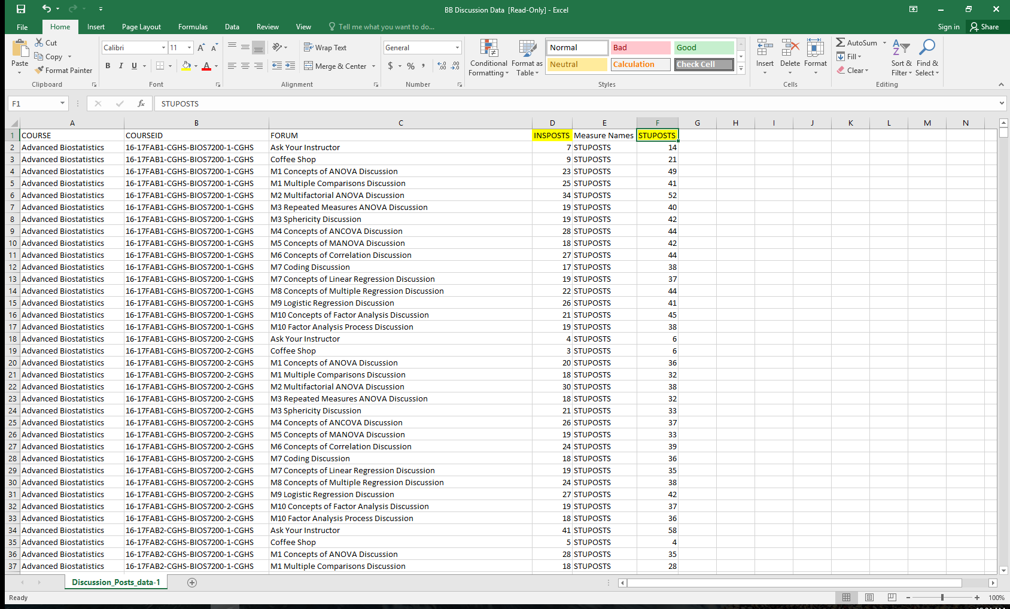
Faculty data from blackboard
Notes:
Sue
Every week we receive a data export from Blackboard and extrapolate the data we need. Here is the raw discussion posting data.

Slide 30
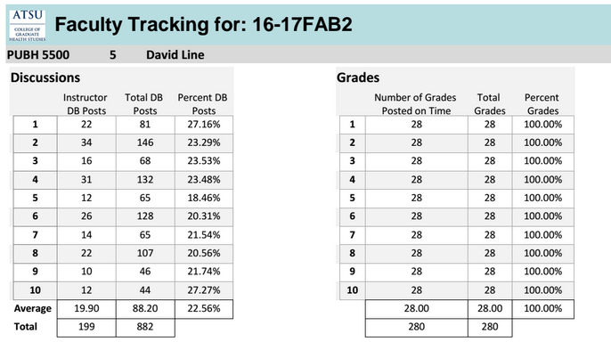
Faculty
Tracking report
Notes:
Sue

Slide 31
Faculty grading
Sunday | Monday | Tuesday | Wednesday | Thursday | Friday | Saturday
Assignment Due for Students |  |  |  |  |  | Assignment Graded by Instructor
Assignment Due for Students |  |  |  | Assignment Graded by Instructor
Assignment Due for Students |  |  | Assignment Graded by Instructor
Assignment Due for Students |  | Assignment Graded by Instructor
Normal
Required
Expected
Best Practice?
Notes:
Kathy
Normally a one week turnaround time for grading assignments is acceptable in an on-campus course
The shorter nature of online courses requires a quicker turnaround time.
Faculty need to focus on discussion forums in the second half of a week. (first post by students is required by Wednesday 11:59pm)
Faculty who do not finish grading in 96 hours have been shown to fall behind in their courses.
Feedback given to students in 48 hours has the most impact.
However, this turnaround time did not allow enough time for instructors.
Thus, a 96-hour turnaround time for assignments is ideal because it gives faculty enough time to make meaningful comments while still getting students rapid feedback.

Slide 32
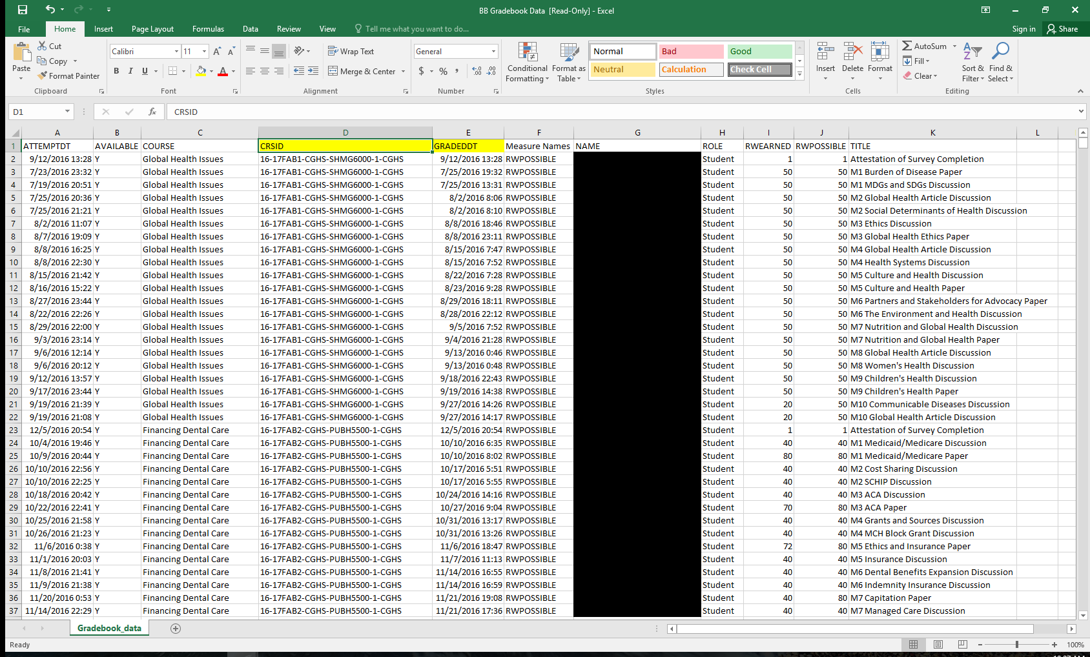
Faculty grading
Notes:
Sue
Again raw data is pulled from Blackboard

Slide 33
Faculty tracking report
Notes:
Sue
This is extrapolated to create the second part of the Faculty Tracking report for the Program Chairs and the individual faculty members

Slide 34
faculty
alumni survey
What do
you do?
Notes:
Sue
Are there data points that you collect on your students/graduates that we’ve not covered here?

Slide 35

Program / course
Carnegie units
Notes:
Kathy
We have shown you some of the ways to assess students and faculty which has resulted in very rich longitudinal data that we use for instructor quality improvement and course improvement.
Then, we learned that the HLC was focusing on online courses to make sure they were meeting the engagement requirements per credit hour. Institutions had to establish the number of hours per credit hour – ATSU set 45 hours as the standard.
This is where Carnegie Units come in.
For those individuals who have the misconception that online education is not as rigorous or as much work for the student as the traditional setting, they are certainly mistaken. Here’s why……

Slide 36
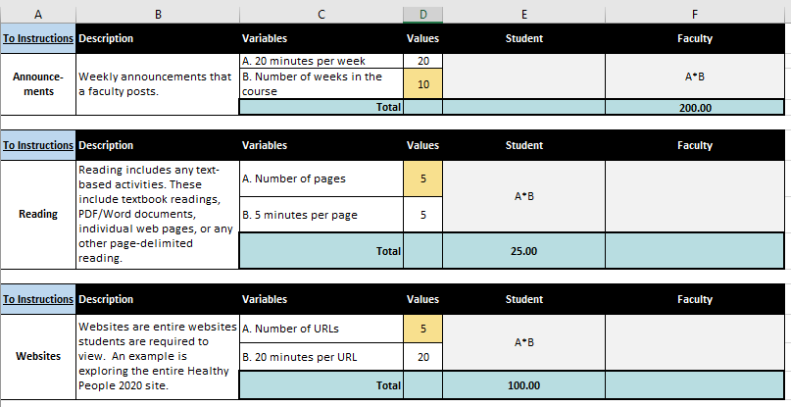
Program / course calculations
Notes:
Kathy
We looked at every activity that engaged a student in learning. And BTW, we are still identifying things!
Some of these are straight forward like reading or watching a video. Papers and discussions posed a challenge.
Discussion
word requirement
words per minute
posting requirement
number of students
Based upon what you see on the screen, if students are supposed to look at 3 websites, how much “time” does that take? (3 x 20 = 60 minutes = 1 hour)
What about a textbook chapter of 23 pages? (23 x 5 = 115 minutes = 1 hour, 55 minutes)

Slide 37
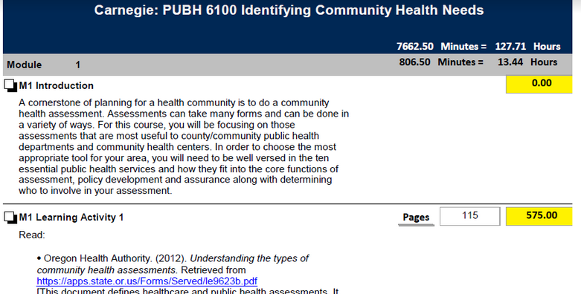
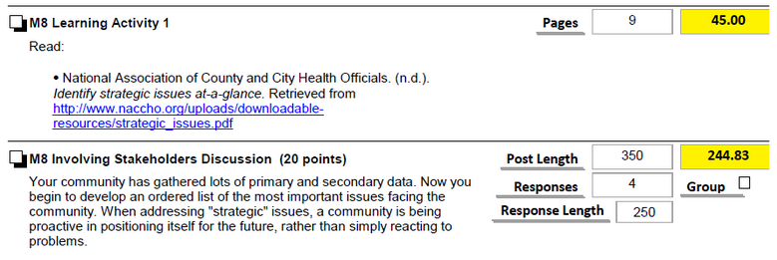
Program / course
Carnegie unit reports
Notes:
Kathy
Here is an example of what our syllabus that’s been Carnegied looks like. This is an example of how we evaluate courses.
Because we don’t have an on-campus equivalent to apply the 1+2 normal calculation, this is the way we have demonstrated that equivalency for an online course without an on-campus equivalent.
Mention the HLC training – they liked this! HLC main concerns are consistent, documented, and measurable. Applied across all our courses the same way.

Slide 38
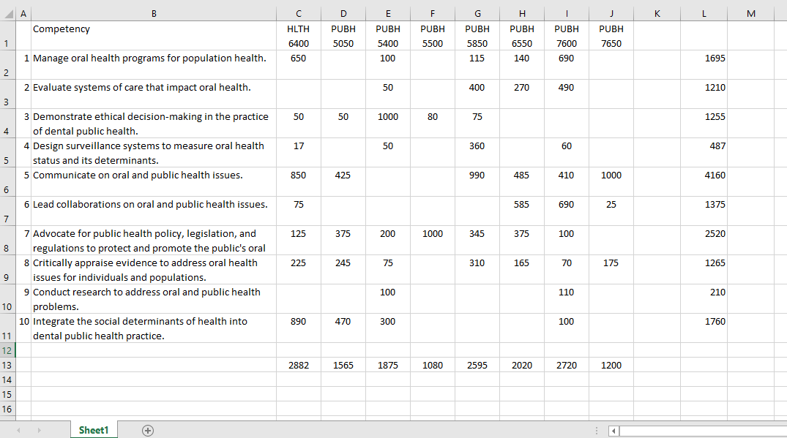
Curriculum / program / course competency mapping
Notes:
Sue
Map assessments in a course to the competencies and then use the points assigned to each assessment to generate a quantitative data map. This shows us where we are strong and where we need to do some work with the competencies of our program.
If you want to know more about this specific piece, we’ll be presenting about this on Friday.

Slide 39

Curriculum / Program
Who else should we ask?
Notes:
Kathy
Who else should we ask to find out if we are doing a good job - employers

Slide 40
Curriculum / program / course
alumni survey
What do
you do?
Notes:
Sue
Are there data points that you collect on your students/graduates that we’ve not covered here?

Slide 41

Notes:
Kathy
That’s how we gather and review quantitative data for our online program. We do similar things regarding qualitative data. For the rest of our presentation we will review the art of evaluation, these are the main areas we look at.

Slide 42

Qualitative data
  Curriculum
  Program
  Course
  Faculty
  Student
Notes:
Sue
Now we’re going to funnel back down to the student

Slide 43




Curriculum / program
Curriculum evaluation
Notes:
Kathy
When it comes to the curriculum we have a variety of qualitative evaluation points including Alumni Relationships, Faculty Connections, and Curriculum Committees.
About the “why” behind the numbers
Professional Competencies
Accreditation Standards and
Institutional Expectations
In addition to meeting these, we are on various committees where we look at innovation, pedagogy and testing questions. This allows us to look at the standards and competencies from a qualitative perspective.
At the program level we contrast the quantitative expectations and outcomes with our delivery options and online best practices. Specifically we focus on how to develop skills and concepts using the learning management system and the remote locations of our students. Matching assignments which focus on the student and their location with the professional competencies/standards we can increase the experiential nature of the program.

Slide 44

Curriculum / program course
Curriculum committee
Notes:
Sue
Discussions with students and faculty in Curriculum Committee meetings has led to the reduction of posts and announcements.
We have also recognized what we need to include in the course introductions to increase instructor engagement without increasing work load, as well as in faculty training techniques and student orientation program development
Involving students on the curriculum committee allows us to get feedback on what to include in courses and the academic degree plan.

Slide 45
Curriculum / program / course alignment
Program Competencies & ATSU CPAs
Course Competencies
Learning Objectives
Graded assessments
Notes:
Sue
Learning objectives, course competencies, program competencies

Slide 46
Curriculum / program / course alignment
Program Competencies & ATSU CPAs
Course Competencies
Learning Objectives
Graded assessments
Notes:
Sue
Program = overarching (at the end of a program) Apply biostatistics concepts in a community evaluation. And the ATSU CPAs of Critical Thinking and Social Responsibility
Course = specific (at the end of a specific course) Solve biostatistics calculations.
Learning objective = Calculate the relative ratio of risk.

Slide 47
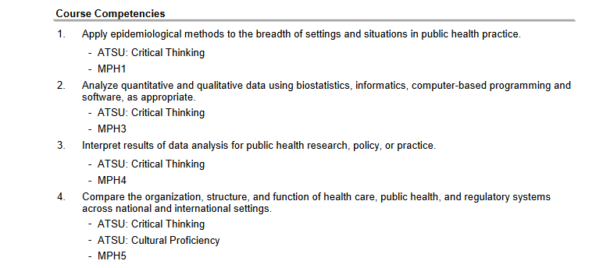
Course syllabus
Notes:
Sue
All competencies need to be measurable – here is how we show in our syllabus how the course competencies align with the program competencies (e.g., MPH1, MPH3, MPH4, MPH5) as well as the ATSU Core Professional Attributes

Slide 48
Course learning activities
Create activities
Practice
Determine
Engage
Analyze
Synthesize
Provide resources
Build skills
Learn from others
Model
Succeed in the activity
Broader outcomes
Increase interest
Make evaluation more interesting
Increase critical thinking
Notes:
Sue
(Quality Matters)
Learning activities provide course content, develop skills, and support other elements. – do more than just read the textbook
Create Activities which allow students to practice, engage, and move around the taxonomy.

Slide 49

Faculty evaluating faculty
Notes:
Kathy
Evaluating faculty, oh where do I start? Here’s where we focus on the “warm and fuzzy” qualitative aspects of the faculty. We could focus on a qualitative evaluation of their scholarly activities and service. We could also look at how well they utilize the Learning Management System and their working relationships with staff and peers. Now we’ll talk about how we look at their performance. We look at their course content knowledge, communication, management, engagement, and class climate.

Slide 50
Faculty evaluating faculty
Instructor Presence
Equivalent of being in “class”
Review & reflection of key points
Interactions
Build Connections
Student to student
Faculty with student
To students
To course content
To the program
Welcome message
Course introductions
Module introductions
Notes:
Kathy
Communication
Course management
Engagement
Content knowledge
Class climate
Continuing with the review of the faculty we will look at Communication, Course Management, Engagement, Content Knowledge, and Class Climate in the use of learning activities.
How faculty member interacts with students (using student’s name, signing posts/announcements) are they welcoming?

Slide 51


Student
Course interaction
Notes:
Kathy
The qualitative aspects of evaluating students involves assessing their satisfaction levels with phone calls. In the phone call I ask them
how well the program meets their scheduling needs
when they post
which course they value the most
what types of assessments were valuable to them
how meaningful are the discussions
did they feel engaged by the faculty?
In addition to phone calls, I look at course messages between faculty and students and view the second-hand comments made by everyone.

Slide 52

Student professional lives
Notes:
Kathy
The qualitative aspects of evaluating students looks at the types of alumni survey to understand what types of jobs they are getting.

Slide 53
OK now it’s your turn

Slide 54
Using the data
Quantitative Data
Qualitative Data
Curriculum Development
Notes:
Sue
We generate better more solid product because we know what works and why.
Looking at student feedback helps us set best practices in terms of faculty engagement. Improved overall learning experience.
Or
Looking at quantitative feedback from various sources helps us to decide where to look for qualitative improvements to develop new best practices. This leads to improved overall learning experiences.
This is not an overnight process. This has taken 4 years to get to. Continued data collection. Team of individuals. The more data we collect, the more we need. That is what has prompted the home grown data base, but you can start small and grow.

Slide 55
QUESTIONS?
Notes:
Do you have any suggestions for us to improve our process or data points?

Slide 56
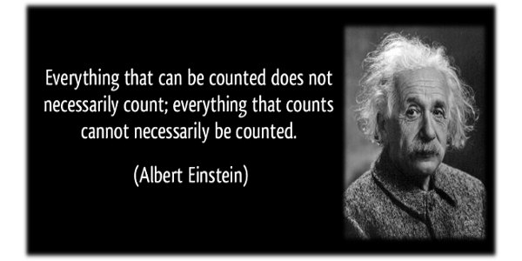
Notes:
Leave you with this parting thought … thank you!

