Slide 1
Using Audit Data in Program Assessment
Dr. Jackie Kress, Georgian Court University jkress101@gmail.com
35th Academic Chairpersons Conference
February 16, 2018

Slide 2
Goals
Consider fidelity & program audits
Identify trackable program elements
Use audit data for continuous improvement
Why?
Program audits identify gaps in program processes, track improvement, and reduce problems for students, faculty, and staff.

Slide 3

Program Quality: Major Perspective
Required courses in major
Elective courses in major
Practica/Internships
Grades (GPA, P/F Comps)
Assessments
What students know
What students can do

Slide 4





Expectations, requirements & decisions of many
External Entities
College/University
Program/Department
Faculty Members
Students
= complex system
Notes:
.

Slide 5
Systems Thinking requires you to:
Acknowledge all the parts
Understand their purposes & interconnections, and
Integrate them into a view of the whole.

Slide 6
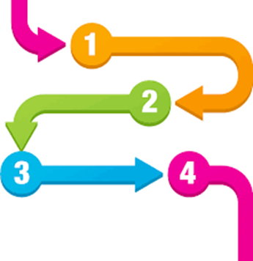



Pair systems thinking with auditing to take the kinks out of your programs.

Slide 7
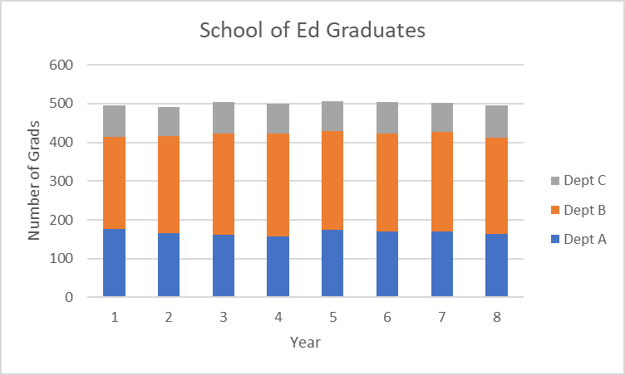
How many students graduated Y1-8?

Slide 8

Is the graduation approval process working?
Were grad applicants ready to graduate?

Slide 9
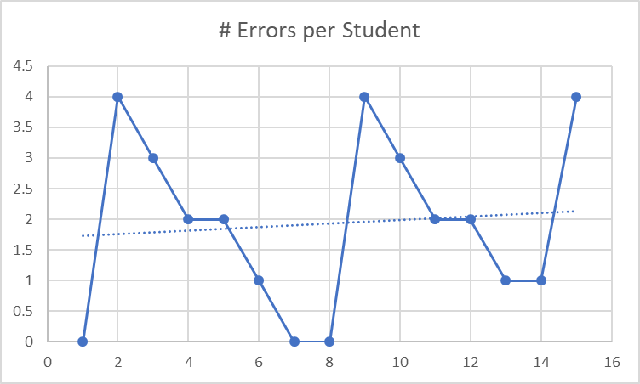
Were grad applicants ready to graduate? Some.

Slide 10
What problems needed to be addressed?

Slide 11

PONC
821*15 = 12,315 minutes = 205 hours or ≈ 6 weeks
$20*205 = $4,100 per year!

Slide 12
Policies, Processes, & Paperwork
Grades Incomplete or F for a required course
No grade was recorded for a required course
GPA too low for graduate degree
Credits Lacks credits for degree - general
Lacks credits for specific requirements in program
Dissertation Has not had/passed oral defense
Final doc not submitted and approved
Matriculation Not matriculated in appropriate program
Gaps in matriculation
Not permanently matriculated in program
Comps Exam Not taken and passed comps/qualifying exams
Not submitted/passed portfolio review

Slide 13
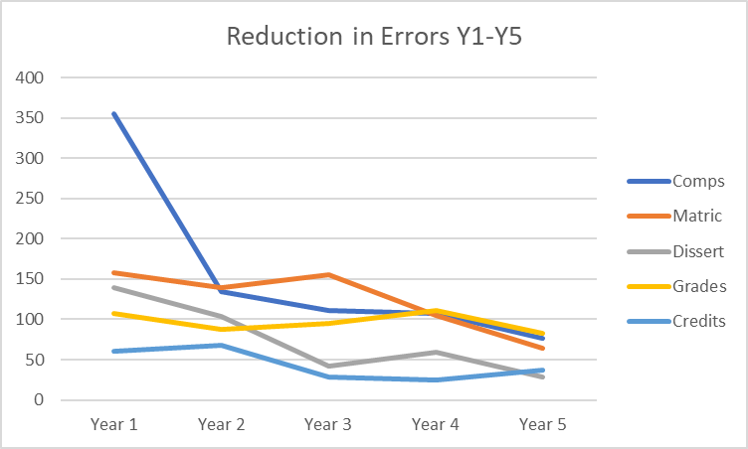
From Out-of-Control to a Controlled Process

Slide 14

Improvements based on audit data should be:
Clear and visually mapped
Communicated
Easy to check
Standardized
Poka-yoked where possible
Streamlined
Automated/proactive advice
= Simply system

Slide 15
How did the process improvements impact graduation approvals Y2-8?

Slide 16
3 Types of Audits: 1 Question
How well is the system working?
Graduation Audit
Will students have met all degree requirements by the time they finish their last course?
Policy, process, and paperwork issues?
Completers Audit
Did all program completers have essentially the same academic opportunities and experiences?
Quality and equity issues across locations and formats?
Cohort Audit
Are current students making expected, problem-free,
high touch progress?
Course selection, advising, program info, and enrichment issues?

Slide 17

Critical Concepts
Fidelity is necessary
Policy ≠ Practice or a process
Catalogs = Repositories, ≠ communications
Means mask problems
Questions guide data collection and info value
Public means/Private ranges
Fix problems, not blame

Slide 18

New Prairie Press – Presentation Docs
Color PPT slides
Background information
How to conduct a graduation audit
List of some key improvements made based on grad audit data
References

Slide 19
Thanks!
Any questions?
Credits: Slide design by SlidesCarnival.com

