Slide 1


Breaking Through the Sexed Glass Ceiling: Women in Academic Leadership Positions
KEISHA LOVE, University of Cincinnati
SUSAN KIRKPATRICK SMITH, Kennesaw State University
DAWN M BAUNACH, Kennesaw State University
SHEILA SMITH MCKOY, Kennesaw State University

Slide 2
Women in Executive Positions in Higher Education
Keisha Love, Ph.D.

Slide 3
2005-2006: A Historic Year for Women in Higher Education
National Center for Education Statistics (2015)

Slide 4
Faculty Statistics
In 2015, across public institutions, for profit institutions (e.g. DeVry), and not-for-profit (private) institutions, women represented 42.4% of full-time faculty at institutions with a tenure system, despite earning more degrees.
Men
Women
National Center for Education Statistics (2015)

Slide 5
Disparities for Women in Faculty Positions
Fewer women represented at the rank of full professor
Lower salaries
Less compensation (e.g. start-up funds, administrative stipends)
Less positive teaching evaluations
More service work
American Association of University Women (2016)
https://www.insidehighered.com/news/2008/06/12/women
Biggs, J., Hawley, P., Biernat, M. (2017). The academic conference as a chilly climate for women: Effects of gender representation on experiences of sexism, coping responses, and career intentions. Sex Roles. DOI: 10.1007/s11199-017-0800-9

Slide 6
Disparities for Women in Executive Positions in Higher Education
American Council on Education (2017)
  Men outnumber women 2:1 on governing boards (e.g., board of trustees)
  As of 2016, women only held 30% of presidencies across all institutions of higher education
  From 2008 to 2013, the percentage of women serving as provost at doctoral granting institutions declined from 33.3% to 26.1%. Conversely, during the same time, more women became provosts at masters, bachelors, & associate granting institutions
American Association of Colleges and Universities (2013)
  In 2013, roughly 39% of deans across all institutions were women, with 20% being represented at doctoral or research institutions

Slide 7
Why Does the Disparity Exist?
Individual Reasons
*More family responsibilities
* Less assertive
*More likely to sacrifice career for partner or spouse
Systemic Reasons
* Institutionalized sexism, racism, and/or elitism
*Gender stereotypes
*Lack of effective mentors and advocates
USA Today College, Thompson & Parry (2017), UC Focus Groups

Slide 8
How Can Women Advance?
Practical Tips
Create a vision & conduct a self-assessment of professional strengths & weaknesses
  What is the end goal? Develop a plan.
Complete objective assessments of your personal fit for the position(s) you wish to obtain
  Myers Briggs Type Indicator or Gallup StrengthsFinder Assessment
  Seek feedback from a colleague or mentor

Slide 9
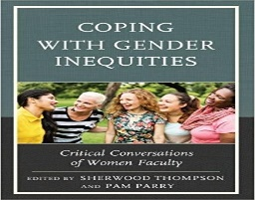
How Can Women Advance?
Practical Tips
Find mentors who can:
  Provide career guidance
  Assist you with negotiating barriers
  Provide emotional support
  Help develop your administrative savviness
Hill, L., & Wheat, C. (2017). The influence of mentorship and role models on university women leaders’ career paths to the university presidency. The Qualitative Report 22(8), 2090-2111.
McCrary, D. (2017). Establishing effective mentoring relationships, part I and II. In Coping with Gender Inequities: Critical Conversations of Women Faculty, Ed. Thompson, S. & Parry, P. Rowman & Littlefield, Lanham, Maryland.

Slide 10


How Can Women Advance?
Practical Tips
Create mental associations and build a reputation for yourself
  Cultivate a reputation as an independent thinker who is not afraid to lead
    *Be mindful of the double standard regarding assertiveness
  Seize opportunities to collaborate with executive leaders

Slide 11
How Can Women Advance?
Practical Tips
Negotiate funding to support professional development (e.g., conference travel, webinars, continuing education courses)
Sample development opportunities
  Academic Chairpersons Conference
  Higher Education Resource Services (HERS) Leadership Institute - https://hersnet.org/institutes/what-are-the-institutes/
  American Council on Education (ACE) Academy for Department Chairs - http://www.acenet.edu/leadership/programs/Pages/Leadership-Academy-for-Dept-Chairs.aspx
  National Conference on Race and Ethnicity in Higher Education (NCORE) - https://www.ncore.ou.edu/en/
  POD Network - https://podnetwork.org/event/2017-pod-network-conference/

Slide 12
How Can Women Advance?
Practical Tips for Institutional Leaders
Awareness is key
Be Intentional about Developing & Supporting Women
  Provide funding to support attendance at professional development conferences and seminars
  Create programs that position women in leadership roles
  Develop men as allies

Slide 13
Purposefulness
Susan Kirkpatrick Smith, PH.D.

Slide 14


Stereotypical Leadership Styles by Gender
Intelligence
Innovation
Ambition
Honesty
Decisiveness
Compassionate
Organized
Task-oriented
Problem solver
Reflective
Relational
Competitive
Hierarchical
Rational
Unemotional
Analytic
Controlling
http://www.pewsocialtrends.org/2015/01/14/chapter-2-what-makes-a-good-leader-and-does-gender-matter/
Kruse and Prettyman 2008 Women, Leadership, and Power: Revisiting the Wicked Witch of the West https://doi.org/10.1080/09540250701805797

Slide 15
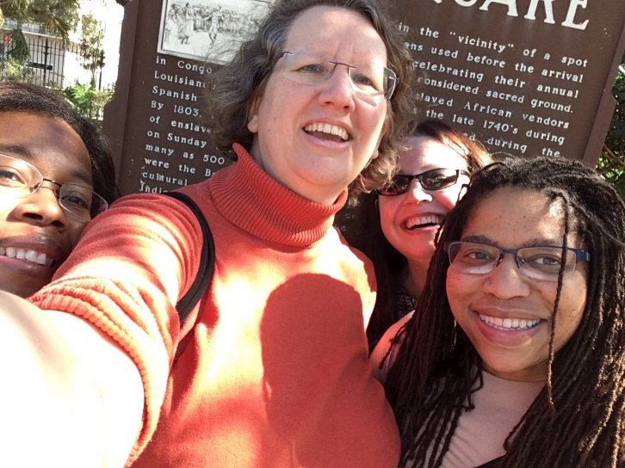

Stereotypical Leadership Styles by Gender: Examples from Kennesaw State University
What matters in getting work done?
  Purposefulness
  Gender
Take Away Message:
Cultivate personal relationships with your chair colleagues to foster more cooperative working relationships
Emergent themes from the conversations with chairs:
Female deans were more likely to cultivate cooperation among chairs, and a cooperative atmosphere in general
Male deans did not seem to be against cooperation, collegiality, but they did not seem to be as effective in generating it
Female chairs could work to foster cooperation among chairs even with a male dean who was not purposeful about cultivating cooperation

Slide 16
Discussion
You are a chair in a department that has not always considered collegiality or cooperation when considering who to hire into tenure track lines.
  As the chair who must charge the committee, what are ways that you can suggest that the search committee now take this into consideration?
  What pushback would you anticipate, if any?
  How would you handle the pushback?
A new dean has been hired with some chair input, but he was not the top choice. He is excellent at fundraising, but is not good at listening to others when setting priorities in the college.
  You and your fellow chairs need support for your programs at the upper administration.
  How might you purposefully work together to create a plan to get the support you need?

Slide 17
Sexual Harassment in Academia
Dawn Michelle Baunach, Ph.D.

Slide 18
Sexual Harassment, #MeToo, and Time’s Up
2017 Becomes a Watershed Year for Sexual Harassment
Entertainment (Harvey Weinstein and Kevin Spacey)
Politics (Al Franken and Roy Moore)
Business (Travis Kalanick and Wayne Pacelle)
Food (Mario Batali and John Besh)
Music and Arts (James Levine and Russell Simmons)
Television News (Matt Lauer and Charlie Rose)
Print Media (Ross Levinsohn and Glenn Thrush)
Radio (Garrison Keillor and Michael Oreskes)
Comedy (Louis C.K. and T.J. Miller)

Slide 19
Sexual Harassment in Academia
Academia Has Not Escaped Scrutiny
Michigan State University and Dr. Larry Nassar
Baylor University’s Athletics Program
Stanford University and Brock Turner
Penn State University and Jerry Sandusky
These scandals focus on university’s cover-ups of sexual assault allegations. What about sexual harassment in academia?
Has the “Harvey effect” reached academia?

Slide 20
Sexual Harassment in Academia
Sexual Harassment, KSU Sexual Misconduct Policy
“Unwelcome verbal, nonverbal, or physical conduct, based on sex or on gender stereotypes, that is implicitly or explicitly a term or condition of employment or status in a course, program, or activity; is a basis for employment or educational decisions; or is sufficiently severe, persistent, or pervasive to interfere with one’s work or educational performance creating an intimidating, hostile, or offensive work or learning environment, or interfering with or limiting one’s ability to participate in or to benefit from an institutional program or activity.”
Sexual harassment in academia is covered by Title VII of the Civil Rights Act of 1964 and Title IX of the Educational Amendments of 1972. Other covered behaviors include: dating violence, domestic violence, nonconsensual sexual contact, sexual exploitation, sexual misconduct and stalking.

Slide 21
Sexual Harassment Statistics
Prevalence
Nearly 50% of women students experience some kind of sexual harassment during their college years – although these are 1990s data (Thakur & Paul, 2017)
38% of women and 23.4% of men graduate students self-report experiencing sexual harassment from faculty or staff; 57.7% of women and 38.8% of men graduate students self-report experiencing sexual harassment from other students (Rosenthal et al., 2016)
Roughly one in ten women graduate students report being sexually harassed by a faculty member (Cantor et al., 2015)
Anonymous crowdsourced survey (of students and faculty) of sexual harassment and assault grows to over 2,300 entries in two months (Kelsky, 2017)
Cantor, D., Fisher, B., Chibnall, S., Townsend, R., Lee, H., Bruce, C. & Thomas, G. (2015). Report on the AAU campus climate survey on sexual assault and sexual misconduct. https://www.aau.edu.
Kelsky, K. (2017) Sexual harassment in the Academy: A crowdsource survey. http://www.theprofessorisin.com
Rosenthal, M.N., Smidt, A.M., & Freyd, J.J. (2016). Still second class: Sexual harassment of graduate students. Psychology of Women Quarterly, 40(3), 364-377.
Thakur, M.B., & Paul, P. (2017). Sexual harassment in academic institutions: A conceptual review. Journal of Psychosocial Research, 12(1), 33-40.

Slide 22
Sexual Harassment Research
Effects
Well-being: Increased feelings of anger, fear, guilt, alienation, loneliness, and helplessness; lowered life satisfaction and self-esteem; and increased psychological distress, job stress, and PTSD symptoms
Physical Health: Increased nausea, headaches, fatigue, insomnia, respiratory infections, weight loss, and gastrointestinal problems
Academic: Poorer quality of school work; worsened relationships with peers and authority figures; unfavorable perceptions of the university; increased absenteeism and likelihood of leaving school; difficulty paying attention in class; and problems studying
Thakur, M.B., & Paul, P. (2017). Sexual harassment in academic institutions: A conceptual review. Journal of Psychosocial Research, 12(1), 33-40.

Slide 23
Recommendations and Best Practices
Immediately report any allegation to the Title IX Coordinator for the university, regardless of type of reporting party (student, staff, faculty, visitor)
Inform complainant and/or respondent of campus resources
Do not manage or investigate allegations on your own – let the office equipped to manage and investigate sexual misconduct handle the matter
Do not assume anything – allegations are allegations until they are resolved by the Title IX office
As a department chair, you may have a role in implementing interim measures for alleged complainants and respondents, such as allowing student to make up missed work and exams or changing work assignments until the Title IX office resolves it
If appropriate, there may be alternative ways to resolve allegations other than a formal investigation, including informal agreements between parties and mediation

Slide 24
Intersectional Proprioception
Sheila Smith McKoy, Ph.D.

Slide 25
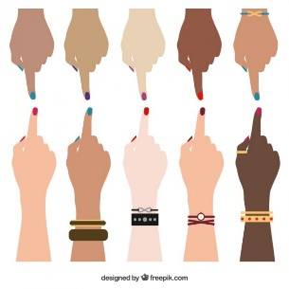

Towards a Shared Definition
Intersectionality: A term coined by Critical Race Theorist, Kimberlé Crenshaw, intersectionality focuses on aspects of defining “others,” in reference to race, sexual orientation, class, ability, etc, as well as the ways in which these identities are interwoven.
Proprioception: The unconscious perception of movement and spatial orientation of the body in reference to its surroundings.
Intersectional Proprioception: The practice of knowing how your body is situated in the space in which you sit; an awareness of how you are perceived in reference to race, sexual orientation, class, ability as an academic leader.
Crenshaw, Kimberlé, "Demarginalizing the Intersection of Race and Sex: a Black Feminist Critique of Antidiscrimination Doctrine, Feminist Theory and Antiracist Politics” (1989)

Slide 26

Sustaining IP
  Mentorship
  Ally Relationships
    See Smith McKoy, Sheila. “Surviving Sisterhood in the Academy.” College Language Association Journal. 60.1 (2016):62-77.
  Meeting Oneself
  Personal Syllabus

Slide 27
Discussion
You are the first person of your gender and race to chair the department. You follow a white male chair whose annual review process was unpopular, but never challenged. When you ask a director to provide feedback on the teaching evaluations and syllabi of lecturers in the director’s program, member of the department receive an email from an anonymous source declaring that you are setting up a dual system of review.
What is the appropriate response?
How do you address the issue with faculty?
How does having IP help?
You are an unmarried chair, who does not live with your partner. A faculty member worked to curry favor with you by dropping by the office without appointments and sending numerous text messages. When a faculty vote creates a class that competes with “her” class, she blames you and retaliates by accusing you of desiring her sexually.
What is the appropriate response?
How do you protect yourself and your career in this instance?
How does having IP help?

Slide 28
Questions?

