Slide 1
Move Over or Move Out:
Working Collaboratively with Former Chairs
Christy Crutsinger
Vice Provost for Academic Affairs
Michael McPherson
Associate Vice Provost for Faculty

Slide 2
One hard story from the road…
Notes:
Read Rick’s story

Slide 3
Former department chairpersons are some of the happiest people on campus.

Slide 4
Former department chairpersons are some of the happiest most miserable people on campus

Slide 5
Who will benefit from this session?
Incoming Chairs
Current Chairs
Outgoing Chairs
YOUR DEPARMTENT

Slide 6


Incoming Chair Perspective
Outgoing Chair Perspective

Slide 7
Setting the Stage
Conducted a focus group with former and incoming chairs.
Semi-structured questions were used to facilitate discussion.
Notes:
How long were you chair?
Recall when you first became chair ---- did you experience any challenges from former chairs who were still on faculty? If so, what were these challenges?
What strategies did you use to overcome these challenges?
What factors impacted your decision to step down as chair?
What was the most difficult aspect of your transition?
What legacy did you leave to ensure that the new department chair will experience success and the department would continue to thrive?
Were there any adjustments to workloads that made your transition easier?
Are there any institutional initiatives that would have helped with your transition?
Have your views of leadership changed since your role as chair? If so, how? Are you a better or worse faculty member after serving as chair? If so, explain.

Slide 8
Incoming Chair Perspective
What problems have you experienced as an incoming chair (or have you observed) with a former chair who has returned to faculty?
Discuss and identify the top two most egregious problems/challenges.

Slide 9
“unwelcomed”
“The former chair is ‘always’ there.”
“I’m there for you (kind of).”
“Good luck with that.”
“On my own.”

Slide 10
Outgoing Chair Perspective
Imagine that you have just stepped down as chair. What do you think is the most difficult aspect of this transition?
At the your table discuss and identify the top two challenges.

Slide 11
“Discounted”
“Bitter”
“Feel unappreciated”
“I have no confidence in new chair.”
“The undoing of all my good work really hurts.”
“Frustrating not being able to make decisions.”
“Vindicated”
“Teaching again is tough.”

Slide 12
Susan & Linda

Slide 13
Report Out.
What is important to Susan? What are her problems, pains, and challenges?
What is important to Linda, the former chair? What are her problems, pains, and challenges?
What specific actions would you recommend for Susan?
How can Linda help with the transition?

Slide 14
Jason & Harold

Slide 15
Report Out.
What is important to Jason, the new incoming chair? What are his problems, pains, and challenges?
What might be behind Harold’s behavior?
What specific actions would you advise Jason to take?

Slide 16
Seema & John

Slide 17
Report Out.
What are the major issues raised by this case?
What can Seema do to move the unit forward at this point?
What options does Seema have for her bid for promotion to full?
What can the institution do to help Seema?
What proactive measures should have been taken?

Slide 18
Institutional Initiatives
Faculty development leaves, course buy-outs, or research start-up funds for outgoing chairs returning to faculty.
Benefits:
Outgoing chair can reboot research/teaching agenda (and detox)
Provides incoming chair the opportunity to launch new initiatives, set new direction.

Slide 19
Institutional Initiatives
Leadership Development. Intentional support and resources to help chairs navigate in their complex roles as academic leaders and unit managers.
Benefits:
Allows chairs to explore contemporary issues and practices through engagement and collaborative dialogue.
Provide basic set of procedures to accelerate the development of UNT’s Leadership team.

Slide 20

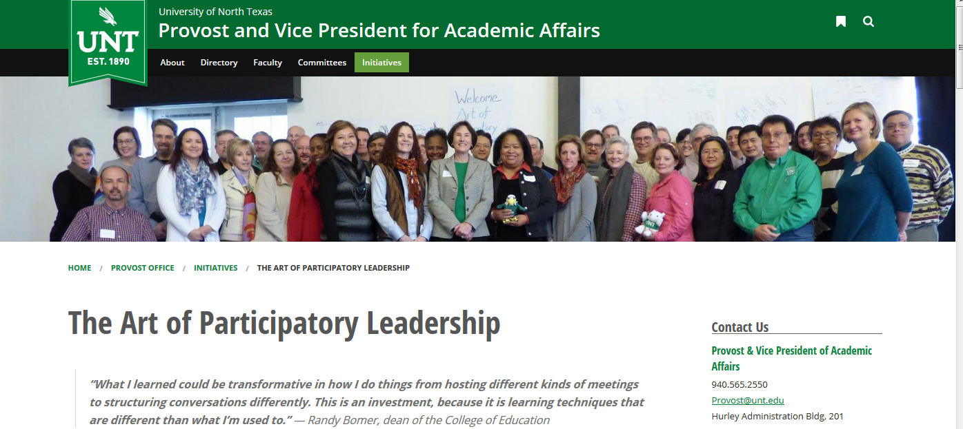
Institutional Initiatives

Slide 21

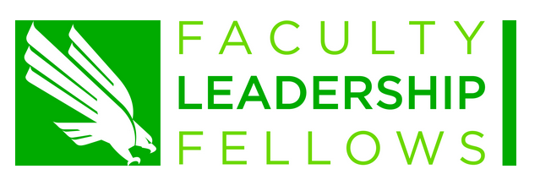

Institutional Initiatives

Slide 22
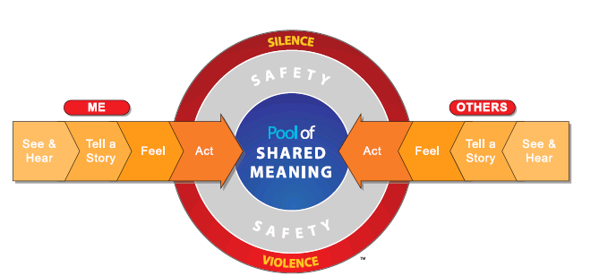
Crucial Conversations

Slide 23
Departmental Initiatives
Develop an apprenticeship for promising faculty.
Build a repository of resources that can be easily shared; make these documents transparent and build it into your Standard Operating Practices (SOP)
Create a ‘hall of fame’ that lists former department chairs.

Slide 24
What are some ideas about how an incoming chair could avoid these problems while leveraging the experience of the outgoing chair?

Slide 25
What can YOU do as an incoming chair?
Honor and respect former department chair’s work.
Ask for their advice.
Honor their contributions in meaningful ways.
Avoid negative talk about past decisions.

Slide 26
How could an outgoing chair be the most helpful to his or her department?

Slide 27
What can YOU do as an outgoing chair?
Know when it is time to step down.
Create a welcoming environment (e.g., clean the office).
Volunteer to handle a difficult task (scheduling) for a specific period of time.
Develop your leadership pipeline.
Support new leadership.
Leave an honorable legacy.

Slide 28
Questions?
Michael.mcpherson@unt.edu
Christy.crutsinger@unt.edu

