Slide 1
Succeeding with Problem Faculty:
a 6-Step Guide
35th Annual Chairpersons Conference
Orlando, FL
February 14, 2018
R. Kent Crookston
Professor & Dean Emeritus
Brigham Young University
kent_crookston@byu.edu

Slide 2
Who are the “Problem Faculty?”
Underperformer
Procrastinator
Prima donna
Complainer
Lone wolf
Bully
Passive-aggressive
Already retired
Poor teacher
End runner
Know-it-all
Uncivil
The 10:90 rule

Slide 3
Which Describes Your Department?
“We’re okay; he’s not.”
“We’re dysfunctional; he’s symptomatic.”

Slide 4
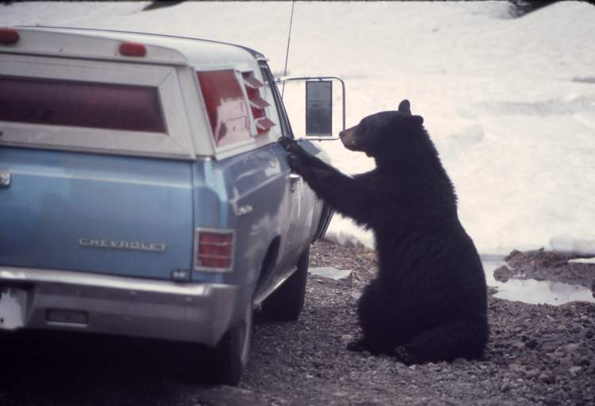
Solving the Bear Problem:
What Did They Do?

Slide 5
Six Steps
Clarify Values & Expectations
Follow Policy
Build Trust with Colleagues
Evaluate Yourself & Your Perceptions
Listen
Take Appropriate Action

Slide 6
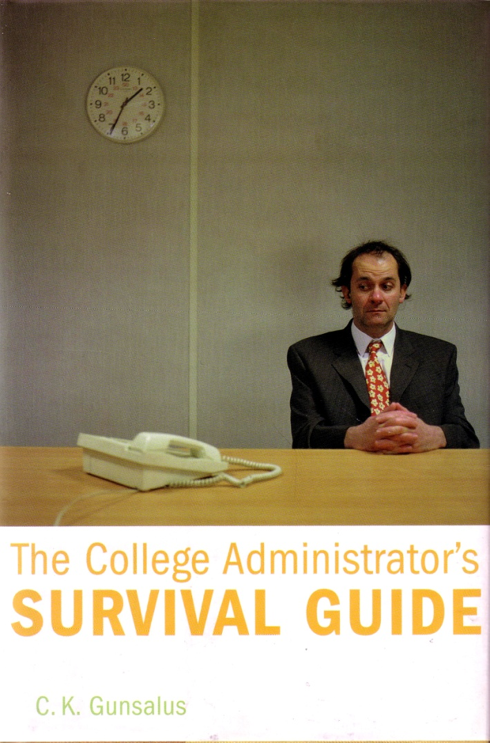
Step 1
Clarify Values & Expectations
Someone frustrate or
disappoint you?
Ever let them know,
in a positive way,
what you expect?
- Gunsalus, (2006)

Slide 7
Clarify
Values & Expectations
Why do we exist?
Whom do we serve?
What do we strive for?
What do we prioritize - value?
What is ideal behavior?
What is unacceptable?
The deviant will stand out.
Very
important

Slide 8
“We start every meeting with a
reminder…”
“We renew our commitment annually”
“I constantly remind faculty…”
“It’s a focus of our celebrations”
- Survey comments

Slide 9
Great Department Climate
Organize socials
Walk the halls, interact
Write personal notes
Bring chocolates
Attend seminars, events
Catch people doing good
Nothing more foundational
  Knowing what is Valued & Expected
  Values and expectations are Upheld

Slide 10
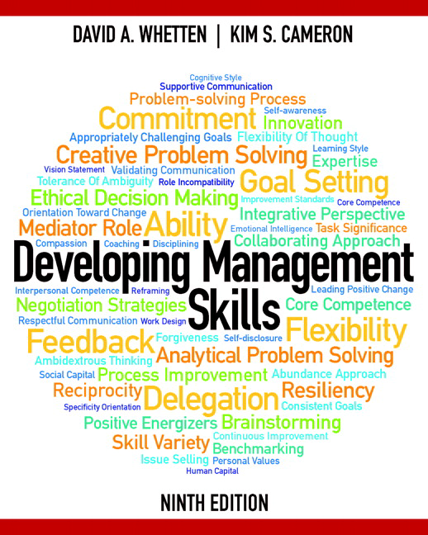
Performance = Expectations
x Ability x Motivation
P = ExAM
Mathematical
- Whetten & Cameron (2016)

Slide 11
Performance = Expectations
x Ability x Motivation
Consequences
“Motivation isn’t something you do to someone. People are motivated by the consequences they anticipate.”
Patterson et al, (2013)

Slide 12
Dog training
ALWAYS reward
good behavior
NEVER reward
bad behavior
“What part of never…?”
- Gunsalus, (2006)

Slide 13
Step 2 Follow Policy
Policy is your friend
Policy check
Be aware of “apparent authority”
Don’t let policy exception be yours
Jots & tittles – for good reason
“You didn’t follow policy; were you
sloppy or discriminatory?”
Never paraphrase or summarize
How about exceptions?

Slide 14
Civility policy: a two-edged sword
“Civility & tolerance are hallmarks of educated men and women... serious breaches of civility should be condemned” - AAUP
But, drafting of standards can encourage incivility.
- Crookston (2017)

Slide 15
Civility policy expectations
1.
2.
3.
4.
“Target” and “Unacceptable” behaviors
Chair discuss the “gap”
Focus on patterns
Persistence and patience
Don’t dismiss the odd ball,
the provocative, the outspoken

Slide 16
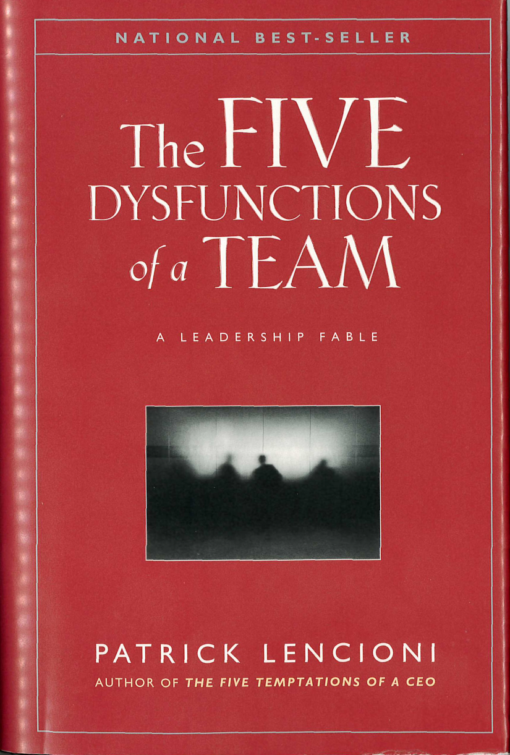
Step 3 Build Trust
with Colleagues
Dysfunction #1:
Absence of Trust
- Lencioni (2002)

Slide 17
Uphold
Values & Expectations
= TRUST
More
important
Caution
Don't confuse YOUR expectations with agreed-upon expectations.
Your own expectations can be resentments waiting to happen.

Slide 18
David Bednar – President BYU Idaho
Earn Personal Trust:
Be vulnerable and transparent
Give and accept apologies
No put downs
No end runs
Keep confidences
Make humble decisions
Extend trust to others

Slide 19

Who are the key colleagues
with whom to build trust?
Extend trust first

Slide 20
Evaluate yourself
and your perceptions
Step 4
“The other guy’s a jerk!
“But… I actually need him to keep being a jerk – so that I’ll remain justified in blaming him for being a jerk.”
- Arbinger Group (2000)

Slide 21

“Anytime we think
the problem is
‘out there,’
that thought
is the problem.”
- Covey, (1989)

Slide 22
Evaluate yourself and your perceptions
“The other guy’s a jerk!
What changes can we make
within ourselves
to improve our interactions?

Slide 23
What are their…
Hopes
Goals
Needs
Trials
Burdens
Pains
Neglect or mistreatment?
What am I feeling I should do?

Slide 24
Be Quick to Observe
1. to see or notice
2. to act upon or obey
Be watching for signs of problems or troubles.
Act on what you feel you should do.
55
Chair: ideal position

Slide 25
David Bednar – President BYU Idaho
Be Quick to Observe
  Example:
  A faculty member seems to be disengaging and isolating herself.
  What are the consequences of your ignoring her?

Slide 26

“Porcupines
with
hearts
of gold”
- Sutton, (2007)

Slide 27
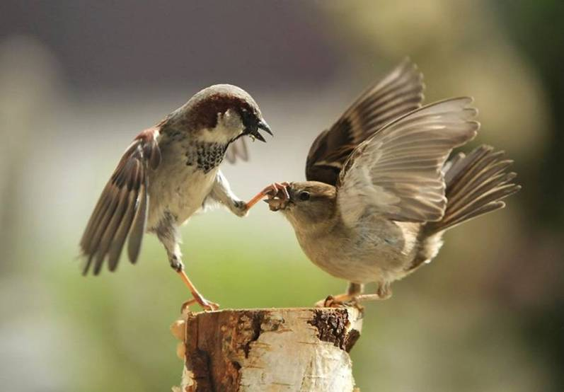
Step 5: Listen
Have you earned the right to ask someone if you can listen to them?
Hypocrisy detectors
Notes:
Male & female English sparrow. Ignoring gender - which is the chair?

Slide 28

“When we listen to complaints, we are tempted to engage in conversation.”
- Leaming, (2007)

Slide 29

Verbal Persuasion
They need you to
be wrong
Final judge in
their own head
You lose every time
- Patterson et al, (2008)

Slide 30
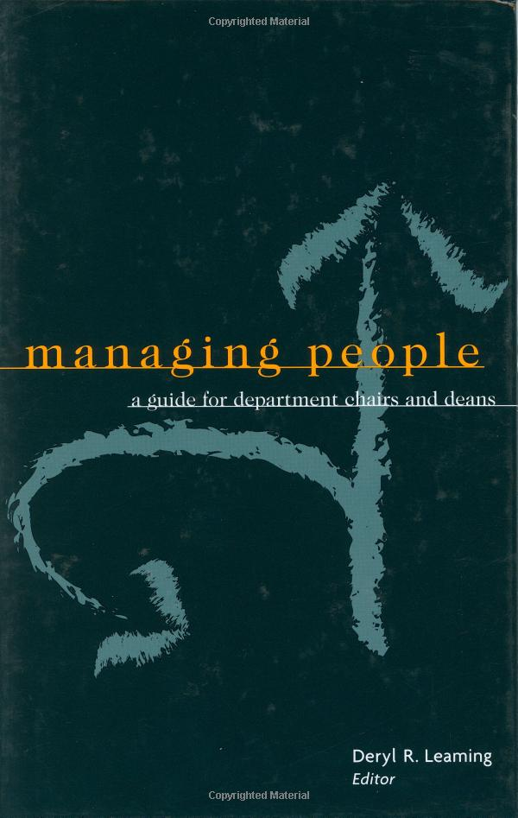
Handling conflict
with difficult faculty
“They’d rather be
heard and understood
than agreed with”
- Bissell, (2003)

Slide 31
How do I know
when I am listening?

Slide 32

Lucas interviewed 100 chairs and 25 difficult colleagues
Very willing to talk
Felt isolated
- Lucas, (1994)

Slide 33

Empathic
listening
“Empathy is the kindling
that fires compassion,
impelling us
to help others”
Bhattacharjee
National Geographic
January 2018

Slide 34
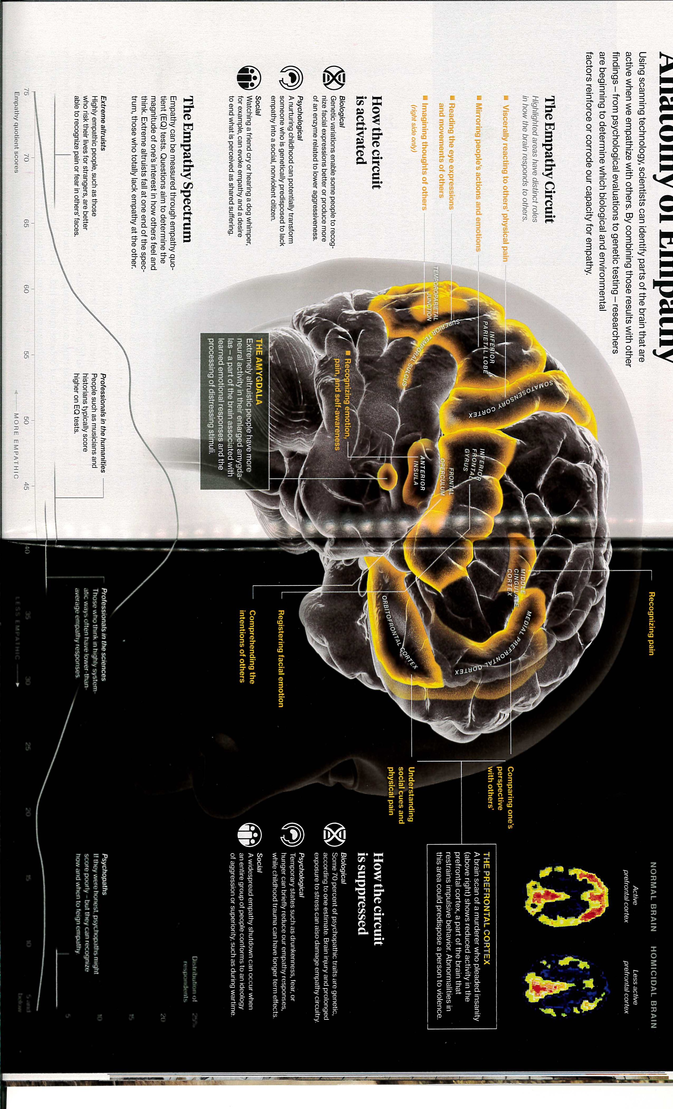
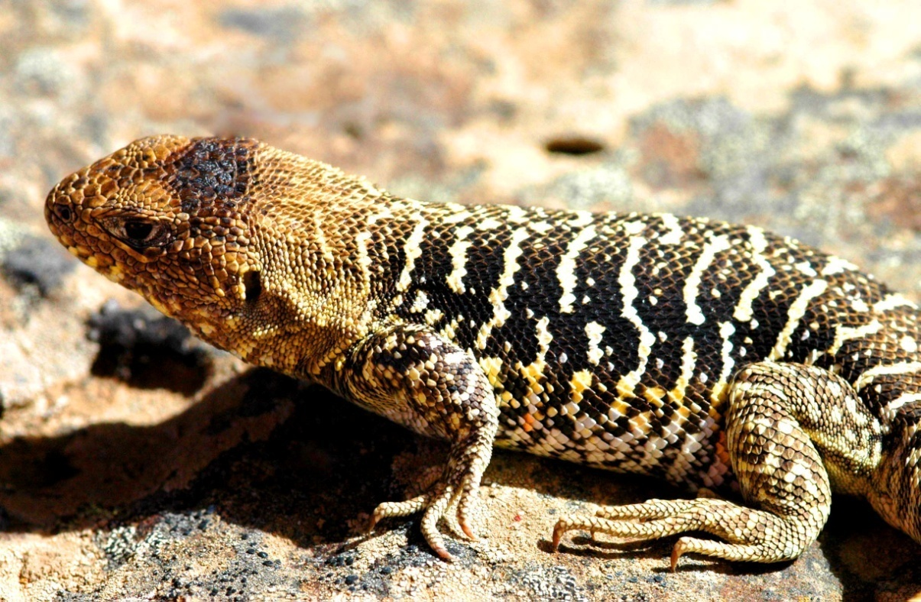
“Our social brain
is plastic, even in adulthood, and we can
be trained to be more kind and generous”
Lizard Brain

Slide 35
Take Appropriate Action
Act quickly (dog training)
Follow policy
Confront with confidence
- in private
- show respect
- describe the gap
Assemble a solid case
Be patient
Apologize
effective
time

Slide 36
Assemble a Solid Case
Don’t wait until the last straw
Keep your dean informed
Hold annual performance appraisals
Take fair and accurate notes
Document everything – especially your good-faith efforts!
Policy jots & tittles – for good reason
No surprises

Slide 37


Coach
Judge
Anson, “This place owes me”
Clarence

Slide 38
Practice
Olympic hopefuls
Club Skaters
Amateurs
- Patterson et al. (2008)

Slide 39
Bullies
Clarify values and expectations
      .
Follow policy
Build trust with colleagues
Evaluate yourself and your perceptions
Listen
Take appropriate action
Reconsider
everything
  Uphold them

Slide 40
Toxic culture remains
- Twale & De Luca, (2008)

Slide 41
B. Passive-Aggressive
Never ignore [shine a light]
Be persistent [regular, over time]
No power struggles
Avoid diversions
No excuses [“Let’s make a plan”]
Secure professional help
Good news – bad news
gaps & patterns

Slide 42
C. Psychologically Impaired
Withdrawal, Cynicism
Lowered productivity,
Anger, Arrogance
20 - 25% of us affected
Impacts Functioning 5 -10%
Higher Ed. 2X
- Oxenford & Kuhlenschmidt, (2012)

Slide 43
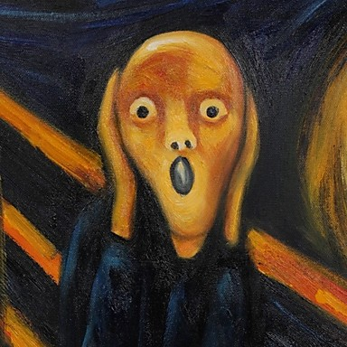
C. Psychologically Impaired
Recognize what you’re seeing
Follow the 6 steps
Change
- Oxenford & Kuhlenschmidt, (2012)

Slide 44
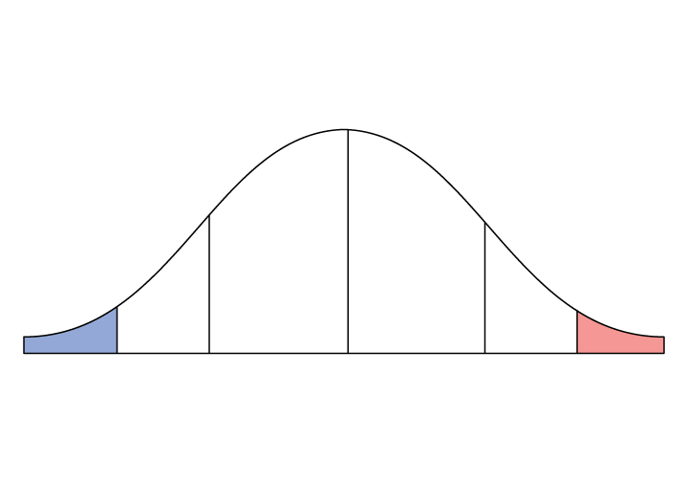
Change Characters
Settlers
Early
Settlers
Late
Settlers
Stay at
Homes
Pioneers
(
(
Trail
Blazers
Trail
Saboteurs
$
$
< 2%
I------ ~16% ------I
- Schlechty, Rogers & Crookston

Slide 45
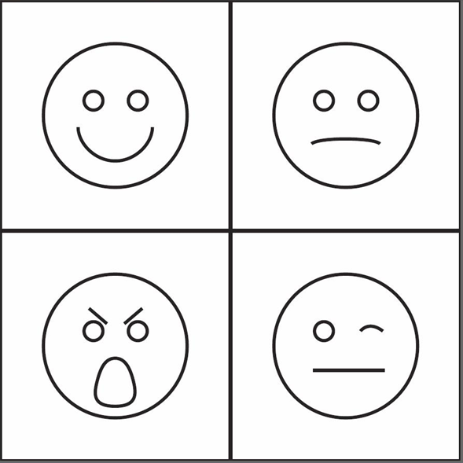
D. Conflicts
True False
Peace
Conflict

