Slide 1
Assessment of Student Learning as a Driver to Departmental Development
Andi Lassiter
Department of Psychology

Slide 2
Overview/agenda
Our institution and department
Student learning goals → culture shift → growth
Linking to individual and departmental growth
Suggestions, recommendations, possibilities

Slide 3
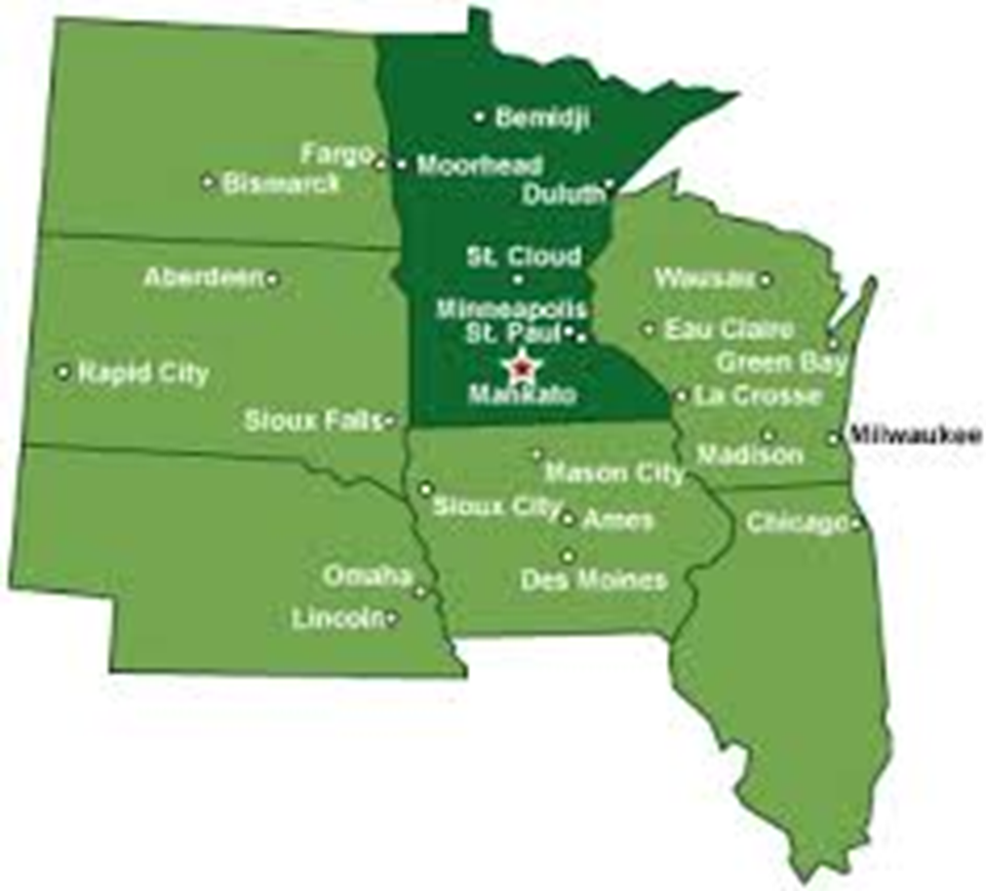
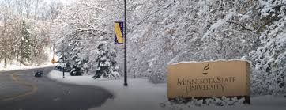

Slide 4
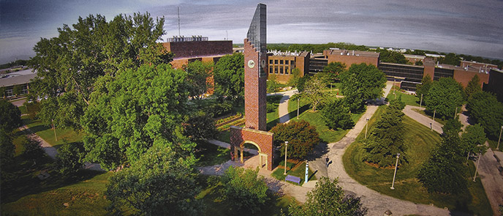

Slide 5
Our department
19 faculty
~500 undergraduate majors
2 Master’s programs
1 Applied Doctoral program

Slide 6
Scientific Literacy | Communication | Knowledge/ Application | Critical Thinking
Appreciate psychology broadly as a science by understanding breadth of scientific methods, developing skills to competently consume and apply those methods, and conducting research. | Demonstrate competence in professional oral, written, and interpersonal communication skills. | Demonstrate a broad base of knowledge of psychological science with the ability to apply within a wide variety of contexts. Furthermore, students should apply knowledge in a manner that is ethically appropriate, socially responsible, and sensitive to populations from diverse backgrounds. | Apply scientific thinking to evaluating evidence and multiple sources of information about behavior, including being an effective consumer of information, thinking critically and analyzing the behavior and emotions of self and others, and being able to identify and interpret journal articles
Notes:
Student learning goals

Slide 7
Outcomes
Individual-level
  Teaching effectiveness
  Scholarship
  Service
Department-level
  Student learning
  Program quality
  Awards/graduation
  Credit hour production

Slide 8
Development
Individual-level
  Conference participation
  Preparation
  New faculty orientation
  Peer reviews
Department-level
  Fall retreat
  Workshops, colloquia
  Faculty mentoring
  Cross-disciplinary research groups
Notes:
What can we do at the department level to encourage growth for the department as a whole?

Slide 9
Planning and Reporting cycles
Program review
Assessment of student learning

Slide 10
Planning for Development
Departmental goals and motivation
Strengths and talents
Development opportunities
Development objectives and action steps

Slide 11
Development initiatives as evidence of resource management

Slide 12
Linking assessment and growth
Shared expectations on faculty evaluation
Targeted faculty development activities
Shared, whole-department, developmental activities

Slide 13
Easy, cheap or free
New-faculty orientation programs
Teaching GA workshops
Fall departmental retreats
Collaborative faculty scholarship workgroups
Textbook publisher luncheons
  Lunch-n-learns

Slide 14
Discussion Questions
Can development initiatives be evidence of resource management?
What have you observed about how assessment of student learning can be used to drive departmental development/growth?
Are there other development initiatives that a department might use to be more intentional?

Slide 15
Case study activity
Present example case including student learning goal, and accompanying departmental goal.
Facilitate participants as they work through the development planning process considerations (slide 10)
Brainstorm potential ways to implement broad development initiatives to support student learning goals presented in the case

