Slide 1
Three Essentials for Making Effective Decisions
33rd Annual Chairpersons Conference
Charleston, SC – April 5, 2016
R. Kent Crookston
Brigham Young University
Provo, Utah 84602
kent_crookston@byu.edu

Slide 2
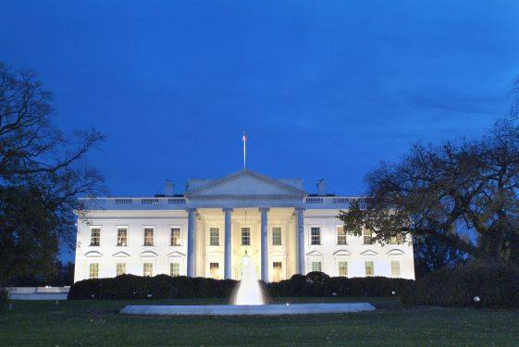
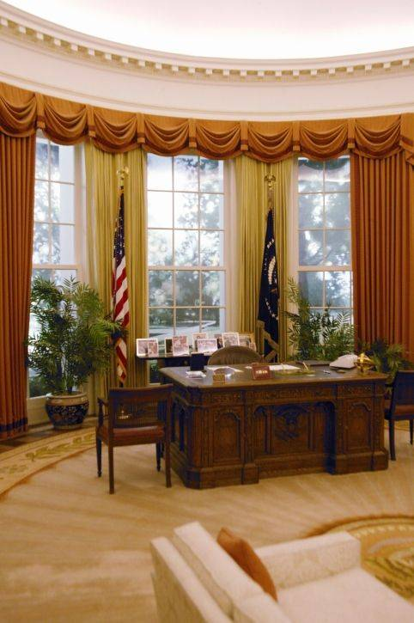
Roger Porter (2005)
American Presidency
Confidence

Slide 3
Porter’s 9 - Classical
Identify decision maker
Clarify decision
Stakeholders
Data
Options
Objectives
Best option
Mourn
Implement

Slide 4
If one did specify
only three…
What would they be?

Slide 5
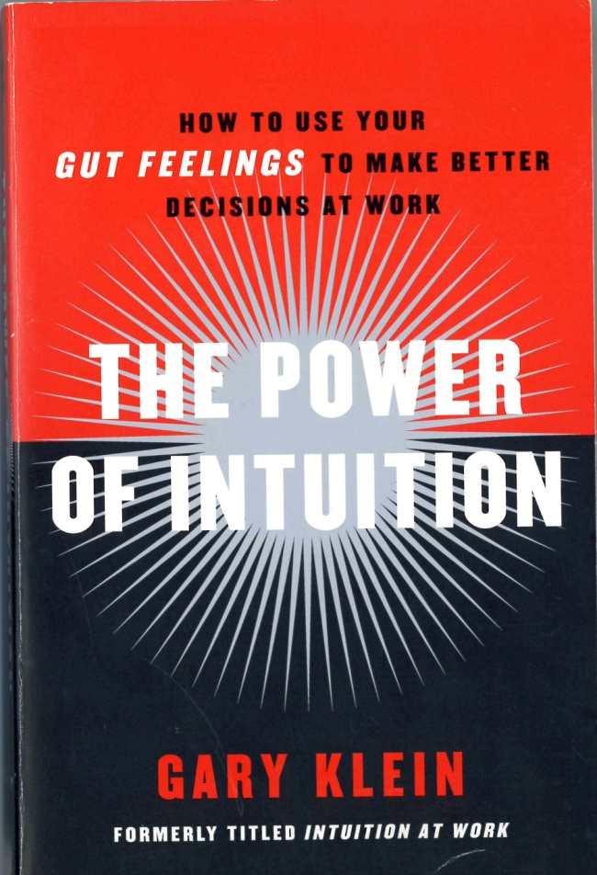
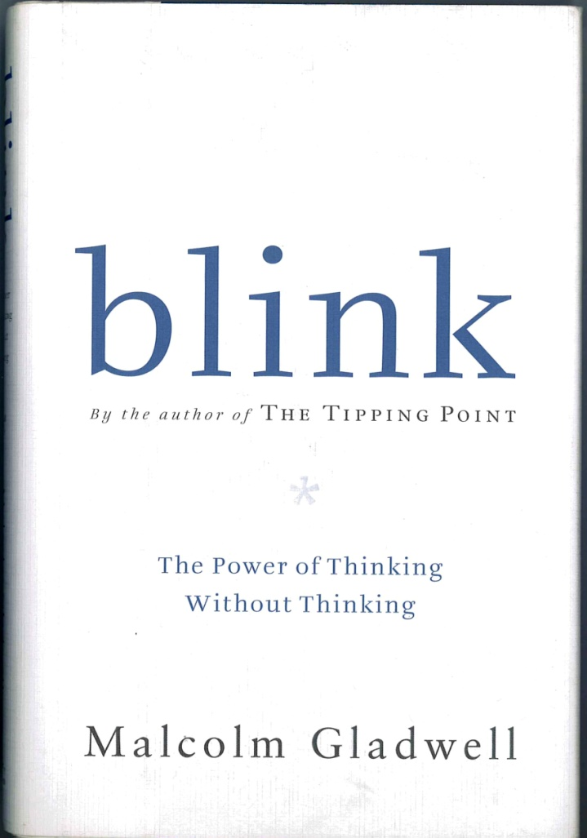
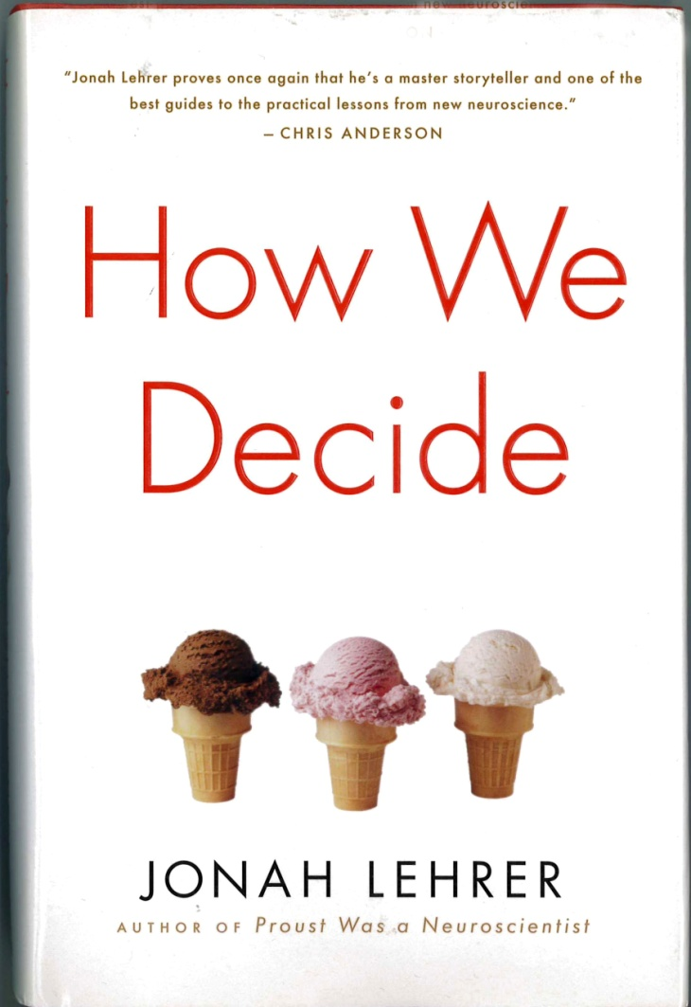
Classical
Gut
Identify decision maker
Clarify decision
Stakeholders
Data
Options
Objectives
Best option
Mourn
Implement
“Classical model a myth”
- Klein (2003)
Crookston’s 3
Be Proactive
Be Humble
Be Composed
“Thinking too much”
- Lehrer (2009)

Slide 6
Be Proactive

Slide 7
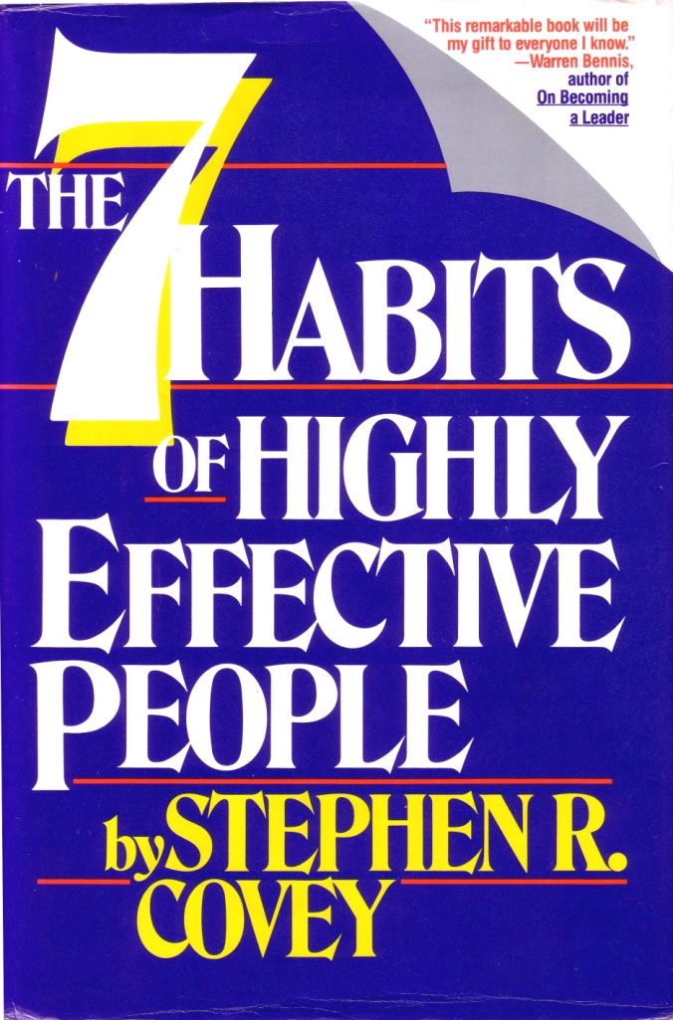
Be Proactive
I control one thing: myself
Response-ability =
able to choose response
Behavior a function of
decisions, not conditions
- Covey (1989)

Slide 8
Language
There’s nothing I can do
That’s just the way I am
He makes me so mad
I have to
I can’t
Alternatives?
I’ll change
I control my feelings
I choose to
I choose not to
“In choosing our response,
we powerfully affect circumstance”
- Covey (1989)

Slide 9
A story
I am a loving caring daughter
--------------
I am excellent at
remembering names
“That’s a Lie!”
It was a decision

Slide 10

“Your life is the creation of what you focus on – and what you don’t.”
- Gallagher (2009)

Slide 11
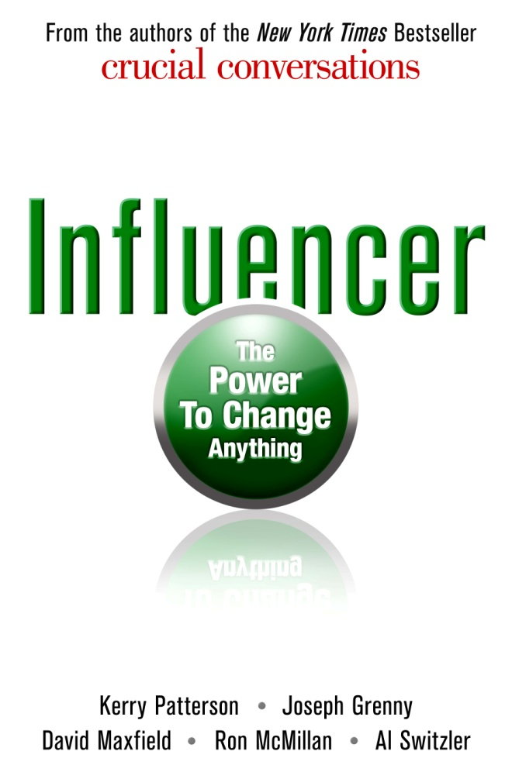
Practice
Olympic hopefuls
Club Skaters
Amateurs
- Patterson et al. (2008)

Slide 12
Porter’s 9 - Classical
Identify decision maker
Clarify decision
Stakeholders
Data
Options
Objectives
Best option
Mourn
Implement
Make sure everyone understands the ‘decision rules’ in advance
- Sanaghan (2015)

Slide 13
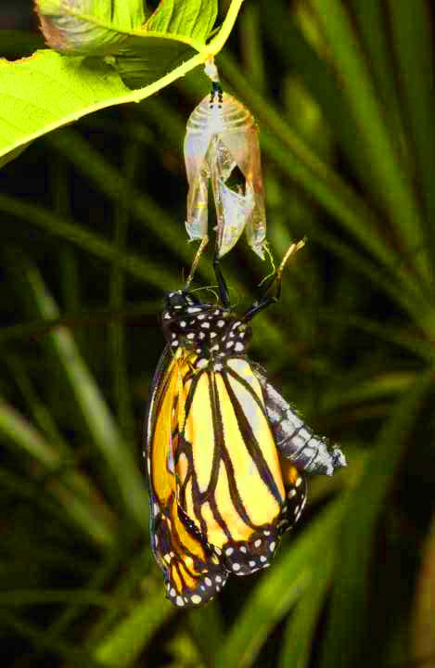
Porter’s 9 - Classical
Identify decision maker
Clarify decision
Stakeholders
Data
Options
Objectives
Best option
Mourn
Implement
“Inside every butterfly there's a caterpillar that succeeded in letting go.”
Lynch & Kordis
(1988)

Slide 14
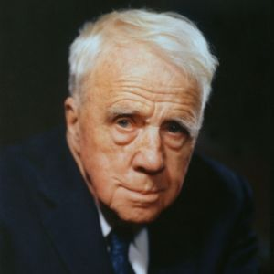
The Road Not Taken
The other road would also have made all the difference, because he would have “taken” it.
Robert Frost
1874-1963

Slide 15
Be Humble

Slide 16
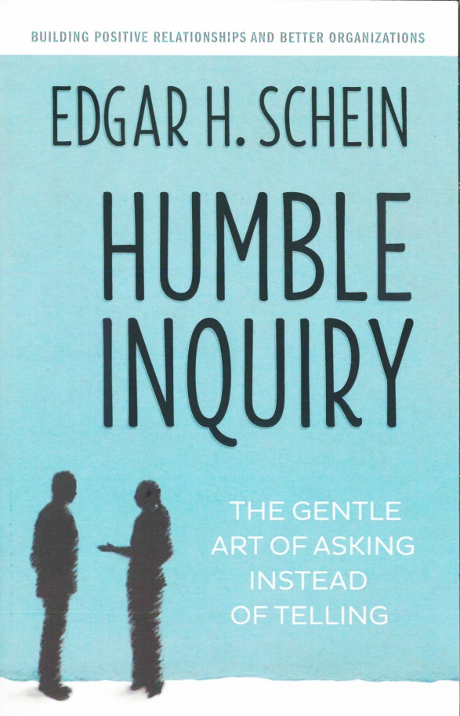
HUMILITY: Positive mid-point between arrogance and lack of self-esteem
Minimize your preconceptions;
maximize your listening
- Schein (2013)

Slide 17
How do you know
when you are listening?
Undergraduate student:
“Willing to be influenced”
“Willing to change my mind”
- See also Schwartz (2015)

Slide 18
Truth About Smart Decisions
“Don’t be afraid to not be the expert.”
“One good mistake can teach us more than all the successful decisions combined.”
- Gunther (2008)

Slide 19
Level 5 Leadership
Looked for:
Companies that:
    Outperformed Fortune 500
    3X (15 years)
    Previously unremarkable
- Collins (2005)

Slide 20
Level 5 Leadership
Found:
    11 Companies
    Outperformed Fortune 500
    7X (15 years)
    Previously unremarkable
    All had Level 5 Leader
- Collins (2005)

Slide 21
Level 5 Leaders
5. Personal Humility & Professional Will
4. Clear & Compelling Vision
3. Effective Pursuit of Objectives
2. Contributing Team Member
1. Highly Capable; Good Work Habits
- Collins (2005)

Slide 22
Level 5 Leaders
Personal Humility
Compelling modesty
Company first, self last
Poor results looked in mirror
Success looked out window
Gargantuan ego of CEO
led to mediocrity or demise
of comparison companies
- Collins (2005)

Slide 23
Level 5 Leaders
Personal Humility
Compelling modesty
Company first, self last
Poor results looked in mirror
Success looked out window
  Impact of Level 5 decisions:
    on your unit’s success?
    on your own legacy?

Slide 24
Be Composed

Slide 25
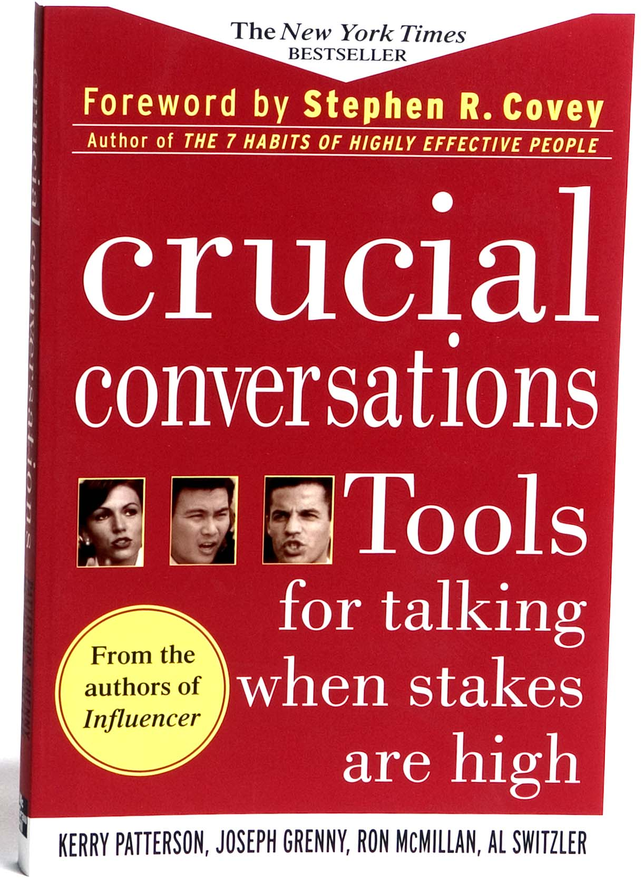
When things matter
most – we’re at our
worst behavior
We start to go blind
Hard time seeing
beyond the point
we’re trying to make
- Patterson et al. (2002)

Slide 26
  Mind-reading failure
  Autism
- Gladwell (2005)

Slide 27
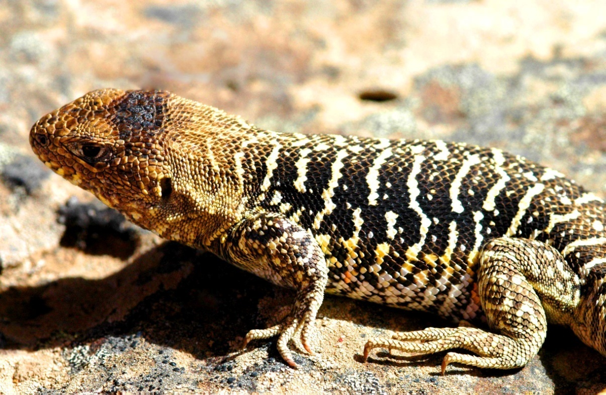
Lizard Brain

Slide 28
Could she have written?:
I am excellent at
controlling my anger
“That’s not like me”

Slide 29

Mauboussin
“Stress clips the ability
to think long-term
and compels poor
decisions.”
- Mauboussin (2009)

Slide 30
Be Proactive
Be Humble
Be composed
Confidence

