Slide 1
Everyone COUNTS or nobody COUNTS*
Paul Craig, Michael Kotlarchyk, Sophia Maggelakis
Rochester Institute of Technology
Rochester, New York
*Quote from Michael Connelly’s fictional LAPD detective Hieronymus "Harry" Bosch
Notes:
Paul

Slide 2
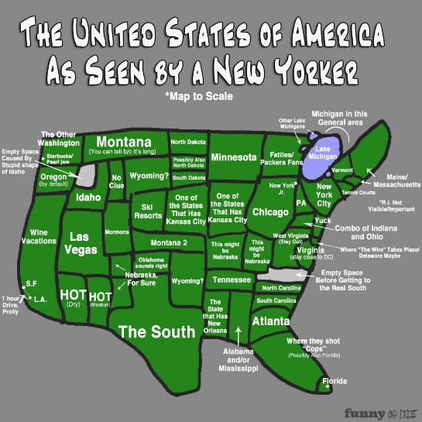
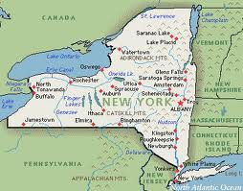
RIT is here
Notes:
Paul

Slide 3
Agenda
12:45 Presentation about our current efforts at RIT
1:05 Breakout groups to identify common challenges
1:25 Top four challenges are selected from all groups
1:45 Four groups reform around interest in challenges
2:05 Groups report possible solutions
2:20 Summary by the facilitators
Notes:
Paul

Slide 4
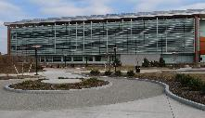


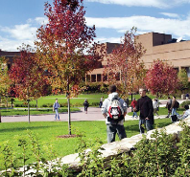
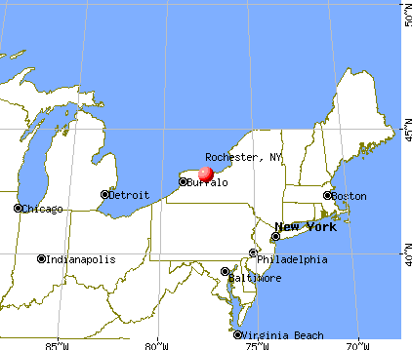
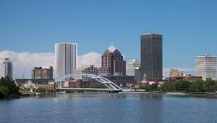
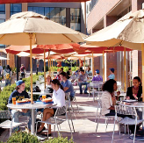
About RIT
1,300-sq-acre campus in suburban Rochester
Enrollment: 15,400 UG; 3,200 grad
9th largest enrollment of US private universities
Nine colleges, large enrollment in STEM disciplines
Known for cooperative education
Quarter-based academic calendar converts to semester
calendar in Fall 2013
Notes:
Paul

Slide 5
About the College of Science
Academic Units
  Gosnell School of Life Sciences
  School of Mathematical Sciences
  School of Physics & Astronomy
  School of Chemistry & Materials Science
  Chester F. Carlson Center for Imaging Science
Faculty
  132 tenured and tenure-track
  48 lecturers
  10 Research Faculty and 7 Visiting Faculty
Staff
  Advisors
  Facilities Management
  Administration
  Research Scientists
  Postdoctoral Fellows
Notes:
Paul

Slide 6
The Goal
Make all faculty, staff, and administrators feel like they count
Find solutions that
  Meet the needs of individuals
  Respect the concerns of all groups
  Address the expectations of our students, their parents, and all our constituents
Communicate and implement these solutions
Help faculty and staff understand the challenges that administrators face
Help administrators understand the challenges that faculty and staff face
Notes:
Paul

Slide 7
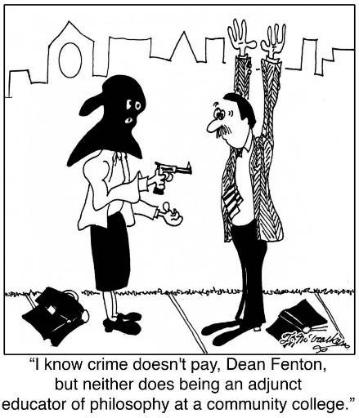
http://www.jantoo.com/cartoons/keywords/adjunct-educator
Notes:
Paul

Slide 8
Competing Goals in the College of Science
Maintain Quality Teaching in Light of
  Rising Research Expectations
    More Ph.D. Programs
    Pressure to win funding
    Higher publication requirements for tenure and promotion
  Increasing Enrollment
  Improving Retention
Autonomy vs. Sense of Belonging
Culture shift
  Technology
  Social media
  Societal attitudes about education and college loans
Notes:
Sophia

Slide 9
Our Approach to Meeting These Challenges
Monthly College wide meetings
Meetings with specific groups
  The Dean meets monthly with all the pre-tenure faculty
  The Dean holds separate meetings each semester with NTT faculty, associate professors and full professors over lunch
  Weekly meeting with the department heads and the dean
  Each department head meets 1:1 with the dean each month
  Monthly reading sessions with the heads and the dean on topics related to leadership in higher education
Notes:
Sophia

Slide 10
Our Approach to Meeting These Challenges
Advisory Boards meet regularly with the Dean
  COSSAB (College of Science Student Advisory Board)
  COSSAC (College of Science Staff Advisory Council)
  COSLAC (College of Science Lecturers Advisory Council)
Notes:
Sophia

Slide 11
Our Approach to Meeting These Challenges
Centralized Academic Advising
Workload Portfolios
  Scholar, Blended and Teaching
Research Symposia
  COS faculty returning from sabbatical or with COS funding
  RIT Undergraduate Research Symposium
Funding
  Competitive funding for NTT faculty
  Dean Research Initiation Grants to help tenured and tenure-track faculty
  Competitive funding for Staff Professional Development
Notes:
Sophia

Slide 12
Ground Rules
Everyone participates
  Each of you writes out your answers to the questions
  Everyone shares in your small group
Look for common challenges
Seek common solutions
Goal – each of you leaves with something concrete that you can implement on your own campus
Notes:
Paul

Slide 13
Breakout Groups
What are the top two challenges that you face in providing for the needs and concerns of your faculty and staff?
Record your findings on a large 2’ x 3’ post-it notes
Notes:
Paul

Slide 14
Top Two Concerns for Each Group
Strained or stagnant budgets 4X
Faculty and staff won’t speak their minds out of respect for chairs
Implementing differential workload
Equality vs. parity
Maintaining faculty numbers to fulfill positions
Role of the dean and lack of communication/transparency
Collegial governance
Silos of multiple campuses
Online classes
Questions of research productivity and scarcity of funds
How to celebrate the good actors
Notes:
Note: These were the results for the first set of breakout groups

Slide 15
Selection of 4 Top Challenges
Review the findings of each group
Look for commonalities
Select the top 4 challenges by vote
Form new breakout groups that focus on each of the 4 challenges
Notes:
Sophia

Slide 16
Top Challenge Breakout Groups
Is this a universal solution or specific to your own campus?
If you solve a problem for one group, will it create problems for others?
What type of support will you need from your Dean to implement this solution?
Can you project a timeline for implementing our solution?
Share best practices – what has worked for you?
Notes:
Sophia

Slide 17
Presenting Group Findings
Identify your challenge
Suggest solutions
  General vs. local
  Best practices to report (are you doing this already?)
  Support you would need
  Timeline
  Unintended consequences
Notes:
Paul

Slide 18
Strained or stagnant budgets
There should be transparency in terms of educating the faculty and staff about how the budget works, including an explanation.
If the campus culture is administratively top-down, that needs to be explained to the faculty or corrected.
Alternative sources of income should be explored (pot money in Colorado or lottery money, appealing to the president for capital funds from fundraising).
Vote in the right legislators to get state funding and support.
Notes:
Note: These were the suggestions from the second breakout group on this topic.

Slide 19
Workload policies
Campuses must provide a workload policy to clarify expectations for all faculty: non-tenure track as well as tenured/tenure-track.
Minimum expectations must be clear.
The workload model document must emphasize the benefits as well as the expectations of the workload.
With clarified workload models, peer pressure should should be a motivator as well.
Associate the workload and plan of work with the contract.
Tie that into incentives and rewards.
This will also help with motivating tenured faculty.
Notes:
Note: These were the suggestions from the second breakout group on this topic.

Slide 20
Silos
Identify the silos on your campus:
  Different campuses
  Grad vs. undergrad faculty
  Adjuncts and full time
  Effect of unions
Communication is the solution between groups
Reconnect with the institutional mission to find common issues
Consistent communication
Shared governance body in decision processes, e.g., have faculty from different areas contribute to salary discussions.
Support each other
Find the common thread (goals) that is consistently communicated. This comes back to core values
Collaborative projects
Notes:
Note: These were the suggestions from the second breakout group on this topic.

Slide 21
Limited funding vs. increased research expectations
Educate upper administration to have a realistic transition of expectations. Emphasize efforts rather than demanding the funding.
Explain that some disciplines cost more than others.
Educate the faculty about the funding needs of different disciplines
Deans and chairs must enforce the deliverables of the faculty
Mentorship for writing grant proposals
Bring in outside people from NSF to help with grant funding mentoring, CUR
Notes:
Note: These were the suggestions from the second breakout group on this topic.

