Slide 1
Desperate Times?
Recruiting students for your department

Slide 2
Finding students
Number of Illinois high school graduates continues to decrease
University enrollment down 11% over five years
State funding down-tuition increasing
Department numbers over five years: 178 students increased to 196 students

Slide 3
Recruiting Practices
Building the Fundamentals
  Face-to-Face Interaction
    Personal Tours

Slide 4
Recruiting Practices
Building the Fundamentals
  Face-to-Face Interaction
    Personal Tours
    Be part of a university day

Slide 5


Slide 6
Recruiting Practices
Building the Fundamentals
  Face-to-Face Interaction
    Personal Tours
    Be part of a university day
    Create special sessions

Slide 7
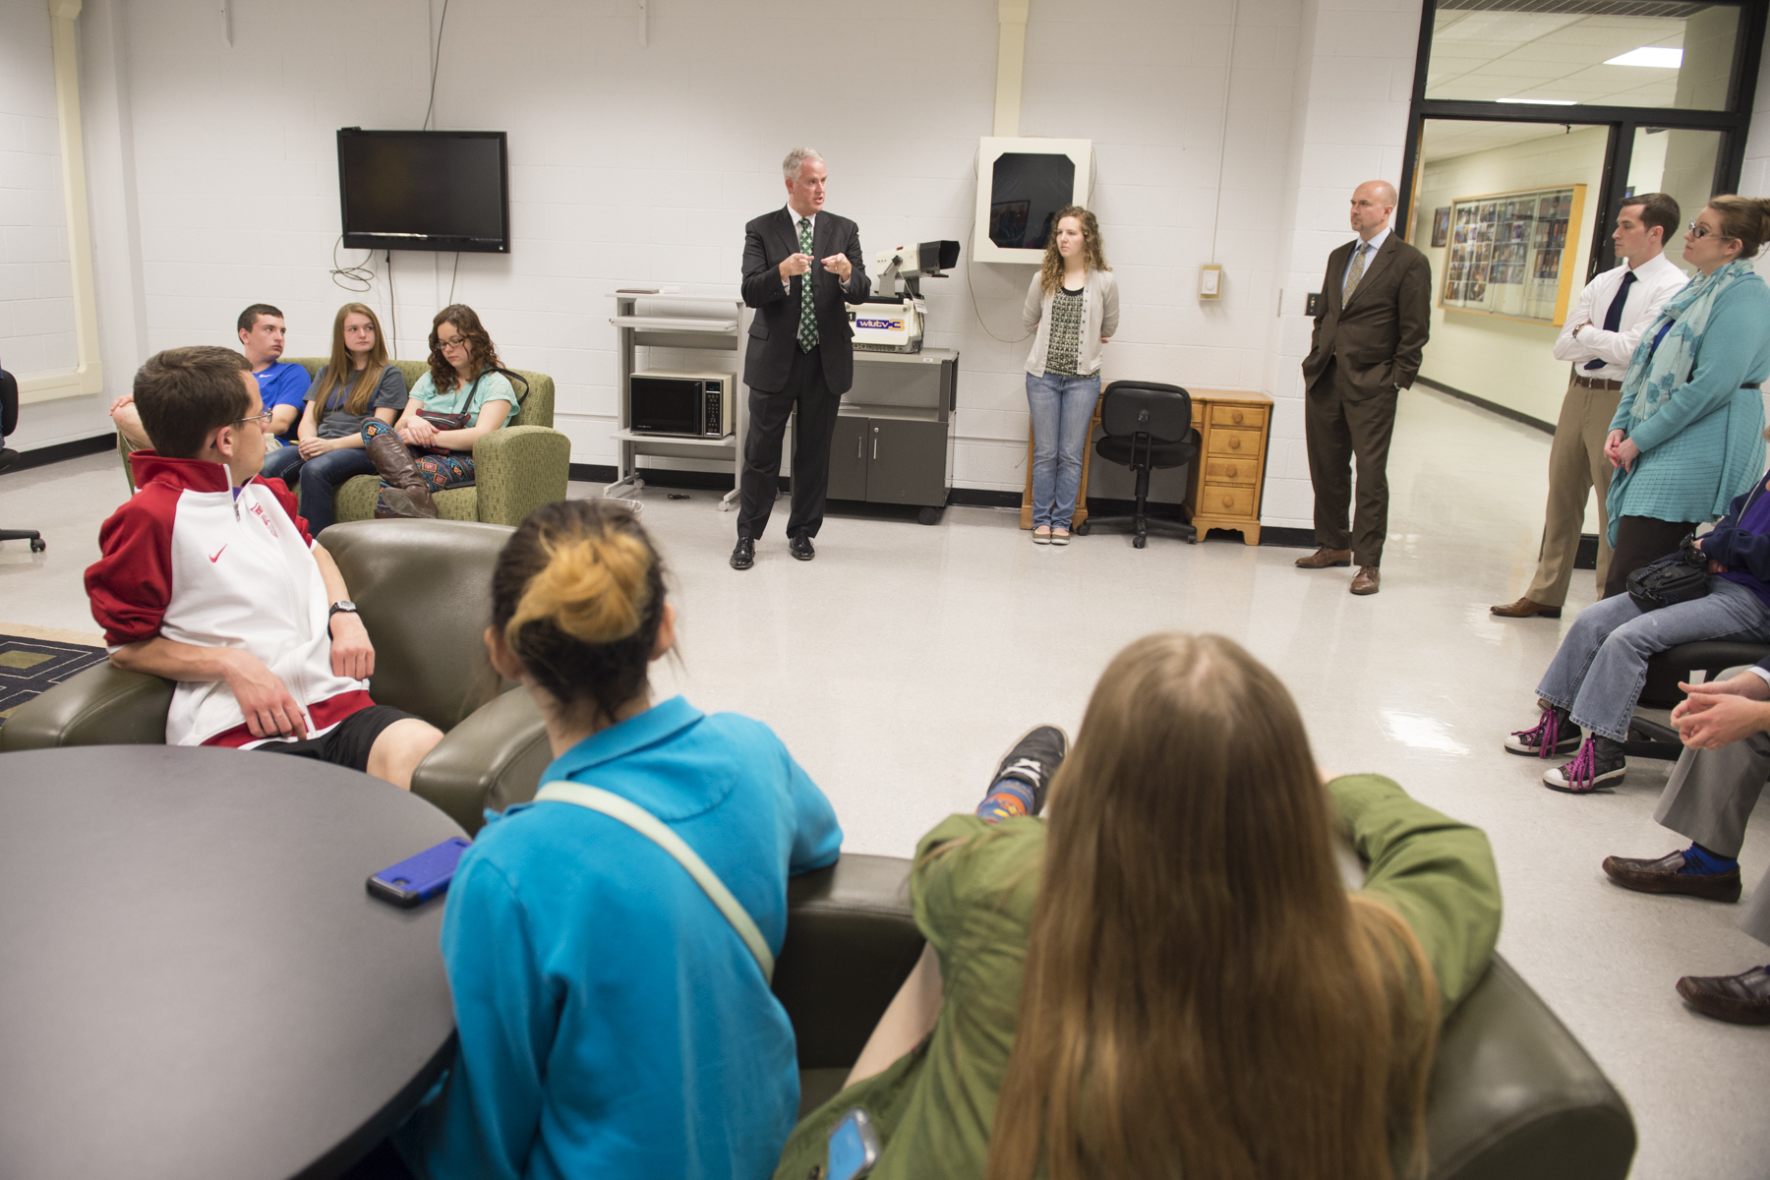

Slide 8
Recruiting Practices
Building the Fundamentals
  Face-to-Face Interaction
    Personal Tours
    Be part of a university day
    Create special sessions
    Online presence

Slide 9
Going to the Sources
High Schools
Community Colleges

Slide 10
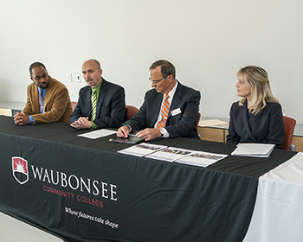

Slide 11
Incentives (carrots)
Scholarships and Tuition Waivers
T-shirts
Other Giveaway Items

Slide 12
Promoting Yourself
Our “Success Stories”

Slide 13


Slide 14
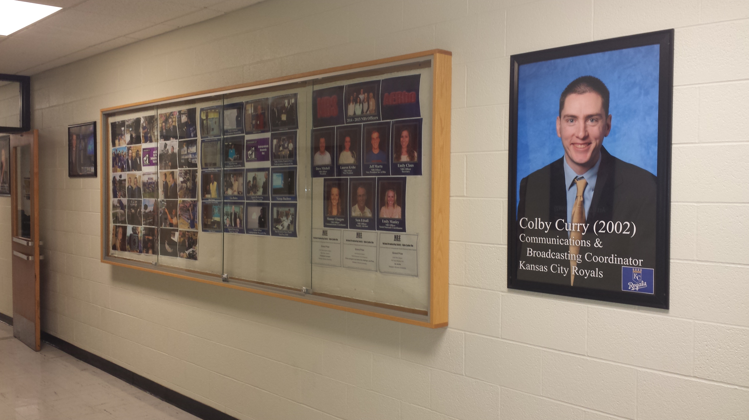

Slide 15
Promoting Yourself
Our “Success Stories”
Our Alumni Board

Slide 16
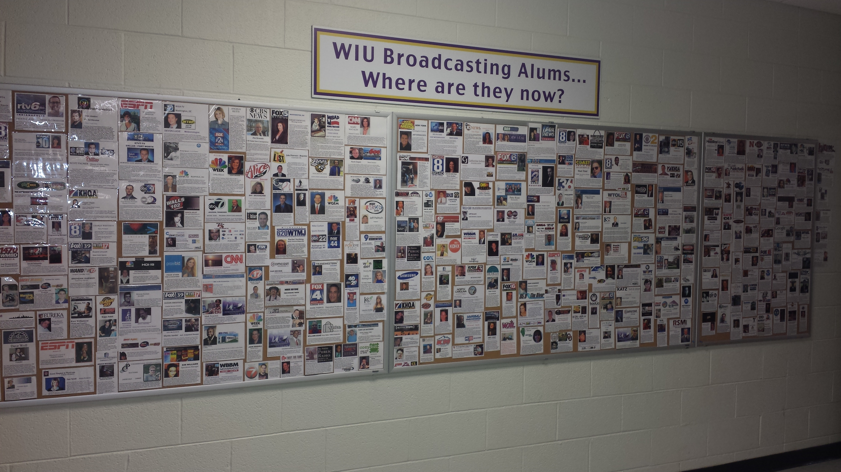

Slide 17
Promoting Yourself
Our “Success Stories”
Our Alumni Board
Social Media

Slide 18
Contacts
Postcards

Slide 19


Slide 20
Contacts
Postcards
Personalized Videos

Slide 21


Slide 22
Show your Diversity
Represent all that you do
Show who is doing it
Long-term commitment

Slide 23
Contacts
Postcards
Personalized Videos
Phone Calls

Slide 24
Last Thoughts
Watch for anything that you can “borrow” for your own situation.
Be prepared to adapt. Change will happen.
Create a distinctive niche.

Slide 25


