Slide 1
Creating and supporting BEST PrACTIcES IN STUDENT RETENTION
N. Douglas Lees
Associate Dean for Planning & Finance, Professor of Biology, Former Chair of Biology
Founding Faculty of University College (UC)
Simon Atkinson
Chancellor’s Professor and Chair of Biology

Slide 2
Institutional Context
Urban, public, research university with > 30,000 students
Founded in 1969 from two, 2-year campuses
Dominated by professional schools
Indiana; low educational attainment
No community college until ~2002, IUPUI was open admissions
Plagued by low retention and graduation rates

Slide 3
WHAT BRINGS YOU TO THIS SESSION?

Slide 4
Session objectives
Defining “retention” in both specific and general terms
Remind everyone why chairs should care
Provide examples of campus-level programs (general and targeted) that work
Provide examples of local (department-level) programs that work in year one and beyond

Slide 5
retention
“THE retention rate” is defined as the persistence of fall, full-time, first-time freshmen to the next fall.
(excludes transfers, part-timers, spring beginners)
Also used generally to measure persistence to graduation.
Is closely linked to academic success

Slide 6
Why does retention matter?
1. It is the right thing to do!
2. Fiscal: lost income/reduced resources replacement costs; unused capacity, impact on performance-based funding
3. Negative recruitment impact; students and parents know!
4. Damages the graduation rate
5. Reputation damaged; national rankings
6. Political; public investment, state support

Slide 7
Chair leadership challenges
Establishing credibility for the venture
Gaining faculty buy-in
reducing criticism
promoting active participation
Balancing resources
faculty and staff time & energy, fiscal
Working with higher administration
sharing the rewards of success

Slide 8
Campus-level Programs through University College (uc)
General audience:
Themed Learning Communities; TLC
Summer Bridge; SB
e-Personal Development Portfolio; ePDP
Targeted audiences:
21st Century Scholars Support Program; 21CSSP
Diversity Enrichment & Achievement Program; DEAP

Slide 9
Local-level programs
Freshmen Work Program (FWP; Biology)
Peer-Led Team Learning (PLTL; Chemistry & Chemical Biology)
Life & Health Sciences Internships (LHSI; Biology and the School of Medicine) (sophomore-junior program)

Slide 10
Themed Learning Community (TLC)
3-5 freshmen level classes linked by a common theme; includes a 1st year Seminar*
*team taught– faculty member, advisor, librarian, student mentor
Instructors work together: active & collaborative learning, service learning, co-curricular activities, and shared assignments

Slide 11
TLC examples – fall, 2013
“Molecules to Medicines”
Concepts of Biology I
Principles of Chemistry I
1st Year Seminar
“Baby, I Was Born This Way!”
Human Anatomy
Intro. Psychology
1st Year Seminar

Slide 12
TLC efficacy
Compare to cohort in unlinked 1st Year Seminar
Av. GPA gain over 11 years – 0.16 (0.01-0.26)
Av. retention change over 10 years – 3.2%
N for TLC = 138-768*; N for non-TLC = 1211-2017
*877 in fall, 2014
Data controlled for demographics, enrollment, student preparation

Slide 13
Summer bridge (sb)
2-Week Program (4 days/week) before fall term
Helps student make a smooth transition, get a head start on Fall, and make connections
Can be combined with a TLC
Experiences: team-building, technology, writing, campus resources, ethics, time, fiscal & stress management, PULs, project/presentation, RISE

Slide 14
Summer bridge efficacy
Fall 2011: GPA +SB/-SB; 2.90/2.71
(2.64/2.15 for AA and 2.90/2.65 for HISP)
Fall 2010: GPA +SB/-SB; 2.98/2.77
(2.66/2.24 for AA)
Fall to Fall (2010-11) retention 81%/73%, 77%/63% for AA, (2012-13) 72%/65%
5-year average gain of >6%

Slide 15
Electronic personal development portfolio (ePDP)
Relatively new on-line (or paper) journal
Starts with “About me.” and “Why am I here?”
Builds a meaningful plan for college
Promotes self-assessment, exploration, goal setting, planning and evaluation
Lists skills as acquired
Self-reflection a major component
Serves as a showcase for learning & experiences
LHSI (years 2-3) picks up on this

Slide 16
epdp efficacy
First year showed gains in GPA (~0.1 for both first semester and first year) and retention for those using the ePDP
Years 2 and 3 were flat. Traced to reduced instructor training and technology problems.

Slide 17
21st century scholars support program (21cssp)
Targeted to 21st Century Scholars, a state (1990) supported program that makes college attainable for the economically disadvantaged. (many 1st generation/under-represented students)
students identified in 7th & 8th grades
provides 15 c.h. of tuition/sem. (public univ.)
University provides an additional $2K (Pledge Grant, Jaguar Journey) at start if they enroll in a TLC or SB, participate in mentoring and maintain a 2.5 GPA

Slide 18
21cssp: characteristics and efficacy
Early cohorts performed poorly
Support program developed in 2006
Provides: academic and tutor support, peer mentoring, personal enrichment workshops, career advice, social & cultural events
Mandates 8 on-campus study hours/week
Efficacy: retention went from 57% to 72% (2006-2011) (all students 67%-74%)

Slide 19
Diversity enrichment and achievement program (DEAP)
Relatively new, open to all but targets AA and HISP students
Recruitment begins at the time of admission
$500 scholarship to attend SB
Students attend 4 developmental workshops/year, monthly group meetings, weekly mentor contacts, accountability via 2, 2-hour study tables per week.

Slide 20
Deap efficacy
Also - provides holistic support – academic, personal, social
Efficacy: over two years retention is up 7% and 4%, over three years GPA is up 0.15 over a comparable group.

Slide 21
Freshmen Work Program (FWP)
Biology
Working students at urban institutions; more so at IUPUI
Off-campus vs. on-campus work
Enrollment Services pilot support (2000-03)
Base support - Commitment to Excellence (CTE)
Parameters: $9/hr., 10-12 hrs./wk., $2 from department, work study where eligible, grant the rest

Slide 22
FWP
Identify students at summer orientation
Placement in teaching prep, research labs, special facilities, in large classes
Retention over 10% above campus average
Other benefits: know why many don’t return, several were 3 year grads!, many never leave the research lab, scholarly products

Slide 23
Peer-led team learning (PLTL)
Chemistry but adaptable to others
Started at CUNY in 1994, adopted at IUPUI in
1997
75 min. sessions (replaced a recitation) of ~10 students run by a peer mentor (recent, successful UG student) who facilitates group problem solving.
Mentors attend a 1 c. h. course in pedagogy/content; paid $600/section (course fee, CTE covers)

Slide 24
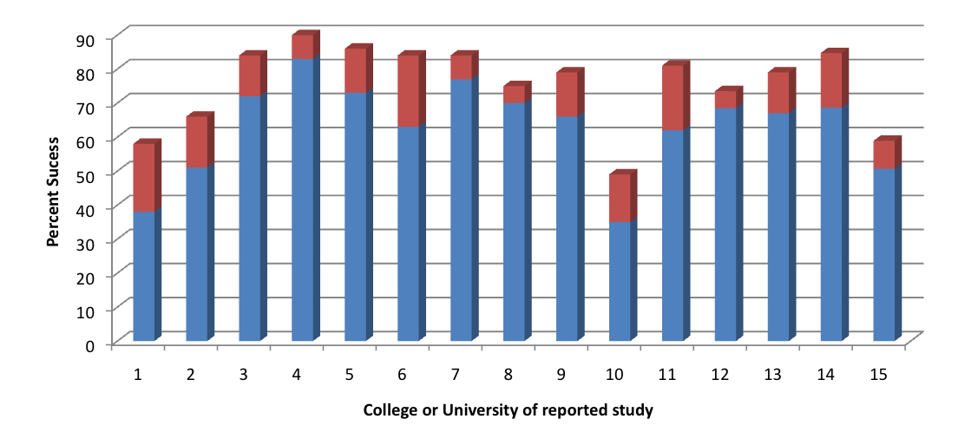
PLTL efficacy
City College of New York, (1-2), St. Xavier Chicago, (3), U. of Pittsburgh (4), Penn State Schuykill, (5), U. of Kentucky (6), U. of Ohio Athens (7), U. of Miami Ohio (8), U. of Rochester, Org (9), U. of West Georgia (10), and NYC Technical (11).
Blue = Non PLTL Red = PLTL

Slide 25
Life health sciences internships (LHSI)
Targets 2nd & 3rd year students, is selective
Leverages campus strengths and foci
Collaboration: Biology and IUSM
Funded by CTE ($250K in base)
$10/hr. for 10 hr./wk. in a professional school setting: med, dent, pharm, optom, PT, OT
Supported ~50 students per year, additional $ now allow 70/year

Slide 26
lhsi
Participants must have at least 3.0 in their major and plan to attend a professional school.
LHSI is seen as a prestigious CV builder
EFFICACY:
1. From 2007-2013 98% have graduated or continued (retained) beyond their internship.
2. 6 (2%) have left/dropped out
3. 92/179 grads are in IU Grad/Prof programs

Slide 27
Unexpected BeneFits
Both LHSI and FWP now promoted in campus recruitment efforts for high ability students.
Increased credibility for undergraduates applying to our professional schools.

Slide 28
Recommendations for chairs
Establish credibility and support regarding retention with faculty by citing its fiscal, reputational and political impact
Participate in campus initiatives that make sense for the department
Create in-house programs where appropriate
Support and highlight the work of faculty who participate

Slide 29
Recommendations for chairs
Make arrangements to share the rewards of programs and efforts that work
Keep the issue “alive”; regularly report on campus and department progress

Slide 30
Contacts for those who get the credit
TLC: Lauren Chism, lchism@iupui.edu
SB: Heather Bowman, hebowman@iupui.edu
ePDP: Cathy Buyarski, cbuyarsk@iupui.edu
21CSSP: Phyllis Washington, phwashin@iupui.edu
DEAP: Eric Williams, @iupui.edu
FWP: Doug Lees, nlees@iupui.edu
PLTL: Lin Zhu, zhu2@iupiui.edu
LHSI: Brandi Gilbert, brgilber@iupui.edu

Slide 31
Additional information
For TLC, SB, ePDP, 21CSSP and DEAP:
https://uc.iupui.edu/
(Tabs: Undergraduate Education and Student Services
For LHSI: http://www.iupui.edu/
(enter LHSI in Search box)

