Slide 1
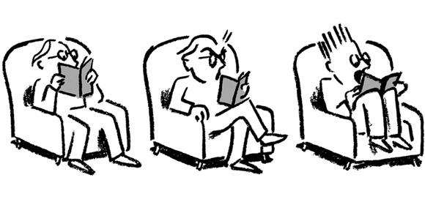
Trigger Warnings: Useful Pedagogical Tool or Threat to Academic Freedom?
Susan H. Gere, Ph.D., Professor, Director,
Division of Counseling and Psychology
Lesley University, Cambridge, MA
Subtitle

Slide 2
What are trigger warnings?
“Trigger warnings” are explicit alerts that material (students) are about to read or see in a classroom might upset them, or as some students assert, cause symptoms of post-traumatic stress disorder in victims of rape or in war veterans.
They usually take the form of a sentence or a few words to caution readers/viewers about the content that follows. They were used first on feminist websites to flag graphic accounts of or extensive discussion of abuse, torture, self-harming behavior, disordered eating, depiction or discussion of violence, particular kinds of consensual sexual activity, and discriminatory attitudes or actions such as sexism or racism.

Slide 3
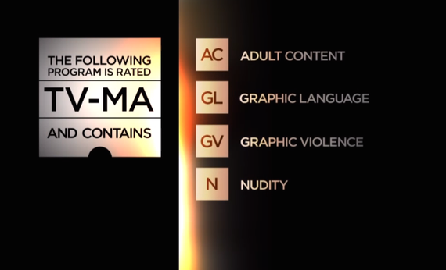
Television has Content Warnings
Pay television has "trigger warnings" of a sort.
A similar rating could work on course syllabi.

Slide 4
Common Trigger Warnings on Internet
Swearing
Rape
Abuse (physical, mental, emotional, verbal, sexual)
Child abuse/pedophilia
Self-injurious behavior (self-harm, eating disorders, etc.)
Talk of drug use (legal, illegal or psychiatric)
Suicide

Slide 5
Trigger Warnings In Course Syllabi
“trigger warning”
“content warning”
“activation warning”
“stress warning”
“objectional material warning”
With some broad indication as to the nature of the content e.g.
“Warning for a graphic depiction of sexual violence”
“Content Warning: disordered eating”

Slide 6
General Statement
Another approach could be a more general statement of alert such as that suggested by Angus Johnston who teaches history at Hostos Community College, City University of New York (Inside Higher Ed, May 29, 2014).
Course Content Note
At times this semester we will be discussing historical events that may be disturbing, even traumatizing, to some students. If you ever feel the need to step outside during one of these discussions, either for a short time or for the rest of the class session, you may always do so without academic penalty. (You will, however, be responsible for any material you miss. If you do leave the room for a significant time, please make arrangements to get notes from another student or see me individually.)
If you ever wish to discuss your personal reactions to this material, either with the class or with me afterwards, I welcome such discussion as an appropriate part of our coursework.

Slide 7
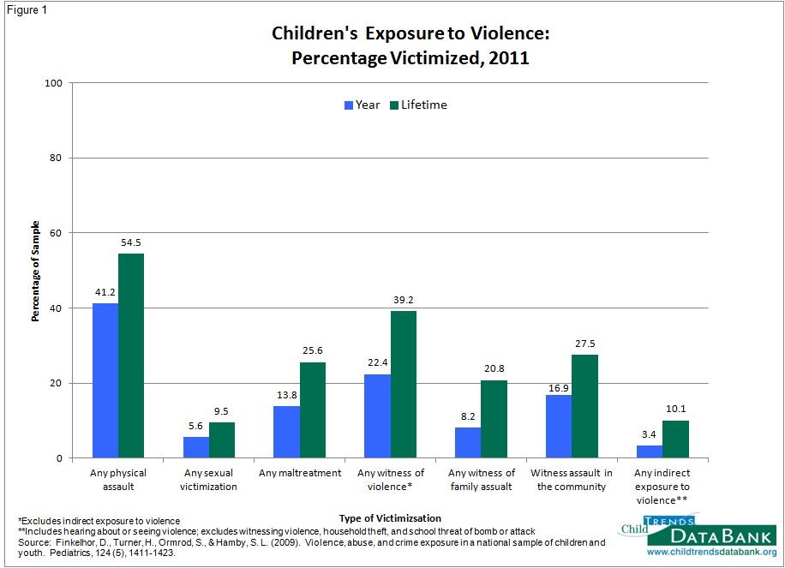
Experience of Violence Prior to College
Over 60% of students have had exposure to violence
Children’s Exposure to Violence: A Comprehensive National Survey (Finkelhor, Turner, Ormrod, Hamby & Kracke, 2009)

Slide 8
The Ethics of Teaching
Columbia University Graduate School of Arts & Sciences Teaching Center (http://gsas.columbia.edu/teachingcenter).
ETHICAL ISSUES IN COLLEGE TEACHING
• ACADEMIC FREEDOM
Does the principle of academic freedom allow you (or your students) to:
• use language in class that some might find offensive?
• discuss unrelated topics in the classroom?
• INTELLECTUAL FREEDOM
Is it appropriate to express ideas or viewpoints that offend some of your students?
Must you remain neutral when teaching controversial issues?
Do you have an obligation to present opposing perspectives on a particular topic (for example, evolution)?
CLASSROOM MANAGEMENT
How can one best handle problematic behavior without embarrassing a student?
• CONFIDENTIALITY
What should you do if a student tells you something in confidence that raises concerns about the student’s mental health
When, if ever, can you breach a student’s confidentiality?
• A HOSTILE LEARNING ENVIRONMENT
Is an instructor justified in making students’ feel uncomfortable in the interest of promoting critical inquiry and reflection?

Slide 9
Mental Health Knowledge for Teachers
Eileen Zurbriggen, a professor of psychology at the University of California at Santa Cruz has studied vicarious trauma in the undergraduate classroom (In Press: Psychological Trauma: Theory, Research, Practice, and Policy). "As many as 50 percent of students have some trauma history, and even small doses of representations of trauma can affect people." She suggests that mental health experts contribute knowledge to faculty about avoiding the potential negative experiences students can have. Her ideas include:
Vary the intensity of material presented: limit graphic material and intersperse first person accounts with more abstract (emotionally distant) material
Incorporate positive, uplifting material, use humor
Advise students when material may be challenging
Help students feel safer by:
  Allowing students to leave the room or skip films if they are being triggered by the material
  Give students the choice of watching films in a media lab or at the library giving them more control over material and taking breaks as needed
  Assure students of psychological safety and confidentiality if they disclose a personal history of trauma – perhaps asking students to agree to confidentiality
  Provide information on self-care and referrals to professional counseling
  Maintain and attitude of respect toward the student
  Normalize the experience of vicarious traumatization – in the first class describe and normalize the experience talking in a very general way without too many specifics
  Provide information on self-care as a protective factor – give information on coping strategies e.g. balance of work and leisure, taking breaks, getting enough sleep, physical activity or exercise and healthy food, meditation, journal writing, do this throughout the course
  Empower students via a social action project and being proactive in problem solving any negative reactions they may have
Social support – providing some individual support as needed, referring students to campus counseling/advisors, structure exercises to share reactions in pairs and freewriting, small discussion sections, peer support face to face

Slide 10
The Debate: Rants and Raves
Trigger warnings have gained the most traction at the University of California, Santa Barbara, where the student government formally called for them. But there have been similar requests from students at Oberlin College, Rutgers University, the University of Michigan, George Washington University and other schools.
The debate has left many academics fuming, saying that professors should be trusted to use common sense and that being provocative is part of their mandate. Trigger warnings, they say, suggest a certain fragility of mind that higher learning is meant to challenge, not embrace. In addition, trauma triggers are diverse and pretty non-specific. Anything can serve as a trauma trigger. (New York Times, May 18, 2014)

Slide 11
In Defense of being Offensive
There is a real and serious value to being offended…Part of that is talking about deadly serious and uncomfortable subjects. Greg Lukianoff, president of the Foundation for Individual Rights in Education.
A trigger warning could… set the tone for reading and understanding the book, … skew students’ perceptions,…highlight particular issues as necessarily more upsetting than others, and direct students to focus on particular themes that have been singled out and potentially ruin the reading for some students (Jill Filiposvic, The Guardian, 2014).
I’m a prof at an elite liberal arts college who teaches courses on gender and sexuality, as well as American lit…I don’t have any problem with profs doing their own thing, but make an institutional policy on trigger warnings and you’ll see a lot of homophobia, transphobia, and the like rain down, with institutional sanction. People will be demanding trigger warnings for representations of homosexuality, of women who choose to have abortions, etc (majortominor July 7, 2014)

Slide 12
AAUP Position Paper
The presumption that students need to be protected rather than challenged
in a classroom is at once infantilizing and anti-intellectual.
It makes comfort a higher priority than intellectual engagement and –
as the Oberlin list demonstrates –
it singles out politically controversial topics like sex, race, class, capitalism,
and colonialism for attention.
Indeed, if such topics are associated with triggers, correctly or not, they are likely
to be marginalized if not avoided altogether by faculty who fear complaints
for offending or discomforting some of their students.
Although all faculty are affected by potential charges of this kind, non-tenured
and contingent faculty are particularly at risk.
In this way the demand for trigger warnings creates a repressive,
“chilly climate” for critical thinking in the classroom.

Slide 13
AAUP August 2014
The classroom is not the appropriate venue to treat PTSD, which is a medical condition that requires serious medical treatment. Trigger warnings are an inadequate and diversionary response. Medical research suggests that triggers for individuals can be unpredictable, dependent on networks of association. So color, taste, smell, and sound may lead to flashbacks and panic attacks as often as the mention of actual forms of violence such as rape and war. The range of any student’s sensitivity is thus impossible to anticipate. But if trigger warnings are required or expected, anything in a classroom that elicits a traumatic response could potentially expose teachers to all manner of discipline and punishment.

Slide 14
AAUP August 2014
Instead of putting the onus for avoiding such responses on the teacher, cases of serious trauma should be referred to student health services. Faculty should, of course, be sensitive that such reactions may occur in their classrooms, but they should not be held responsible for them. Instead, as with other disabilities, a student diagnosed with PTSD should, in advance, agree on a plan for treatment with the relevant health advisors who, in some cases, may want to alert teachers to the presence of a trauma victim in their classroom. The Americans with Disabilities Act contains recommendations for reasonable accommodation to be made on an individual basis. This should be done without affecting other students’ exposure to material that has educational value.

Slide 15
It Gets Personal and Political
Kevin Williamson (National Review, May 19, 2014,”You’re All Worthless and Weak”) complains about new demands to put trigger warnings on some literature and certain circumstances. He goes so far as to say
Millennials are “soft”
In response to Williamson, jasdye in the Forward Progressive blog (May 22, 20140) counters:
“We Should Put Trigger Warnings on Conservatives” who do not understand that … “ people can have …trauma related to certain memories, and that these events can be triggered by images and evocations…These triggers are real – as real as depression. Kevin Williamson may not have triggers. He may not have had traumatic experiences…He hates the idea of trigger warnings not because it will hurt his appreciation of Moby Dick …He thinks if something doesn’t affect or hurt him, it shouldn’t hurt anybody else either. And if other people complain about it but it doesn’t affect him, it means it’s not real, right? This is a crux of American conservatism. It’s how they can talk about the poor so callously, because ultimately US conservatism is centered on the White Rich Hetero Male and his self-sustaining myths.”

Slide 16
Two Professors Weigh In
I quite object to the argument that ‘Kids today need to toughen up’…that absolutely misses the reality that we’re dealing with. We have students coming to us with serious issues and we need to deal with that respectfully and seriously. (Meredith Raimondo, Professor, Oberlin College)
Whether or not the warnings are required, I still think that it is ethically responsible to share with students your course content so that they can be prepared, given the high rates of sexual assault among college students (Elana Newman, University of Tulsa psychology professor; Research director of the Dart Center for Journalism and Trauma, Columbia University Graduate School of Journalism)

Slide 17
“You are Triggering me! The Neo-Liberal Rhetoric of Harm, Danger and Trauma” July 7, 2014
Responding to the posting alejo July 6 ,2014, asserts
That is not censorship and it’s not necessarily pandering to a neoliberal trauma-centering subject…It’s being kind to the humans around you, and trying to create a culture of thoughtfulness about the reality of oppression in people’s lives and the fact that such oppression can be especially upsetting or traumatizing.
Silver H agrees
A trigger warning functions along the lines of “spoiler alert”…and serves to allow a person to make the decision to engage or not with specific content…Trigger warnings do the same thing; they allow someone to decide when the appropriate time is to engage with certain content. This has a natural extension into academia where students are expected to employ critical thought to various material and maintain a certain grade point average while doing so. Allowing a student to decide what time is best to engage with potentially triggering material doesn’t create a culture of victimhood; it simply empowers a person.”

Slide 18
My Turn
When does our refusal to take our student’s reactions in account lead to a hostile learning environment?
  Emotional well-being supports intellectual challenge
Are we justified in making students’ feel uncomfortable in the interest of promoting critical inquiry?
  Feeling uncomfortable is not the same as feeling unsafe
Are trigger warnings necessary or can we do better?
  We are all part of the human social condition

Slide 19
Moral Solidarity
“Moral solidarity” means that we neither avoid nor judge the reactions of our students but take into account that there are many possible reactions that content and delivery might evoke and we make space for the processing of these reactions.
My faculty research:
Faculty members’ spiritual and political commitments fueled their moral commitment to witnessing students’ trauma histories and solidarity with students’ learning challenges
They also had a socially constructed view of mental health problems that was related to structural injustice and were invested in creating caring and collaborative teaching environments, reframing education as a more socially and emotionally connected process

Slide 20
Overall Recommendations
My overall recommendation is that establishing commonality among all students in the recognition that we live in a violent world, helps create an atmosphere that is fair to all students, where student trauma survivors are not singled out for special attention of either a positive or negative nature.
In addition, moral solidarity with our students communicates safety, stability and general acceptance of who they are, wherever they are on life’s path. Although, this imperative may sometimes put us in ethical conflict with our evaluative responsibilities, it is probably the only way to go with our diverse learners.
Creating opportunities for students to reflect on their responses to the professor, the material and the learning environment decreases emotional reactivity and helps students integrate their learning.

Slide 21

Final Thoughts
Let’s avoid dichotomizing:
  Intellectual freedom and Moral solidarity
  Faculty rights and the Ethics of teaching
  Medical mental health model and Social justice model

