Slide 1

Preparing and using classroom observations in faulty teaching
Peggy Thelen, Ph. D.
Associate Professor of Education
Department Chair
Alma College

Slide 2
PREPARING AND USING CLASSROOM OBSERVATIONS IN FACULTY TEACHING
In this session, we will:
Look at an evaluation model which:
  helps the evaluator and faculty member to prepare for the observation
  provides the evaluator with a list of items to be observed
  provides a look at what feedback and reflection is important after the observation
Discuss the importance of context specific observation and assessment, and the need for flexible assessment and evaluation
Have a chance to share assessment and evaluation needs, any models currently used, as well as difficulties and successes in the process.

Slide 3
PREPARING FOR CLASSROOM OBSERVATIONS
Step 1
Pre-observation discussion with faculty member
Step 2
Classroom Observations
Step 3
Post-observation meeting

Slide 4
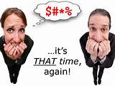
Step 1: Pre-observation discussion with faculty member
1. What to observe specifically
Faculty wishes
Observer requirements/wishes
a) Foundational items that must be observed or standards that must be met
b)What else?
2. When
3. What does observer need to have from faculty to prepare for observation: syllabus, other materials, etc.
4. Length of observation
5. How many observations

Slide 5

Step 2: Classroom Observations
A. Knowledge of the subject matter
B. Effective presentation of the subject matter
1. Well organized course materials
a) All materials needed are present
b) Distribution of materials is planned
2. A structured approach to the presentation of the subject matter
3. Clear explanations of course concepts and expectations; explains in different ways if necessary
4. Appropriate pedagogy, including active learning experiences; tries to reach many learning styles
5. Passion when presenting the subject matter
6. Monitors student engagement throughout the class period

Slide 6
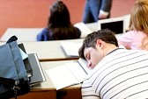
Classroom Observations
C. Assessment of student learning
1. On-going informal assessment
a) Questions
b) Small or large group discussions
c) In-class activities
2. Assessments match objectives of the lesson
a) Remediation takes place if students do not understand or learn subject matter

Slide 7

Classroom Observations
D. Positive relationships with students
1. Mutual respect
2. Ethical behavior
3. Classroom environment is safe and open; students feel free to voice opinions, answer questions, and engage in discussions
4. Appropriate classroom management techniques; students respond positively
5. Sense of humor!

Slide 8


Post-Observation Meeting
A. Positive feedback
B. Constructive feedback
C. Questions
D. Faculty goals and improvement plan
CONGRATULATIONS…..
…OR NOT…..

Slide 9
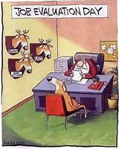
Post-Observation Meeting
Positive Feedback
  ALWAYS start with positive feedback
    a) Find something to confirm
  Don’t say anything you don’t meant
  3. Save a little positivity for later

Slide 10
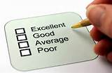
Post-Observation Meeting
B. Constructive feedback
1. Feedback on the standards or “musts” the assessor observed
2. Feedback on the other items

Slide 11

Post-Observation Meeting
Questions
1. Assessor
a) clarifications
2. Faculty

Slide 12
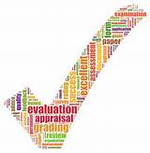
Post-Observation Meeting
D. Faculty goals and improvement plan
1. Written goals
2. How to get there
3. Is everybody satisfied?

Slide 13
The importance of:
-context specific observation and assessment
The need for:
-flexible assessment and evaluation

Slide 14
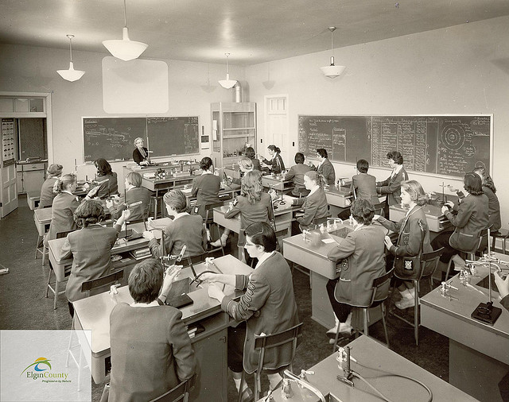
YOUR:
1. Assessment and evaluation needs
2. What current model(s) do you use that are successful?
3. Difficulties and successes in the process
Alma College Science class 1956

Slide 15
Questions…
…Answers

Slide 16
Thank you…
Dr. Peggy Thelen
Associate Professor of Education
Education Department Chair
Alma College
thelen@alma.edu

